Slide 1
Providing a purpose: Factorising double brackets
Silent
Teacher
Intelligent Practice
Narration
Your Turn
$$x^{2}−8x+15$$
$$x^{2}−11x+24$$
$$x^{2}−5x−24$$
Practice

Slide 2
Worked Example
Your Turn
What values of $x$ makes this expression equal to zero?
$$x^{2}−6x−8$$
What values of $x$ makes this expression equal to zero?
$$x^{2}−7x−12$$
@mrbartonmaths

Slide 3

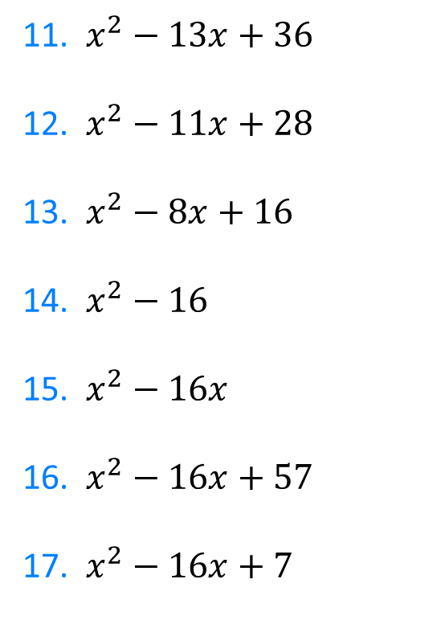
1. $x^{2}−4x+3$
2. $x^{2}−5x+4$
3. $x^{2}−6x+5$
4. $x^{2}−7x+10$
5. $x^{2}−8x+15$
6. $x^{2}−11x+24$
7. $x^{2}−5x−24$
8. $x^{2}+5x−24$
9. $x^{2}+5x−14$
10. $x^{2}+5x−36$
11. $x^{2}−13x+36$
12. $x^{2}−11x+28$
13. $x^{2}−8x+16$
14. $x^{2}−16$
15. $x^{2}−16x$
16. $x^{2}−16x+57$
17. $x^{2}−16x+7$
@mrbartonmaths

Slide 4
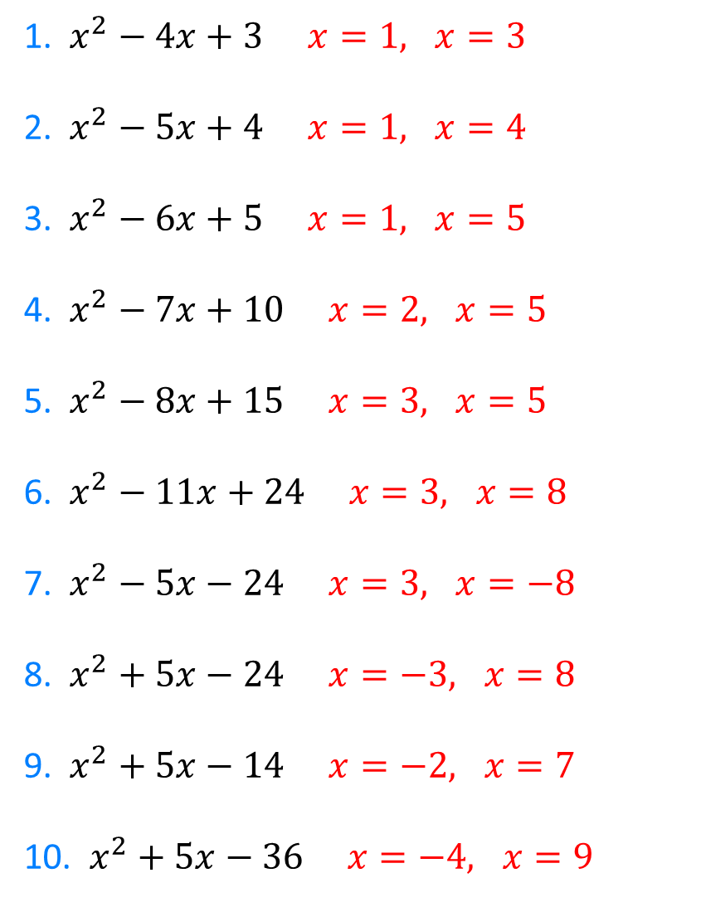
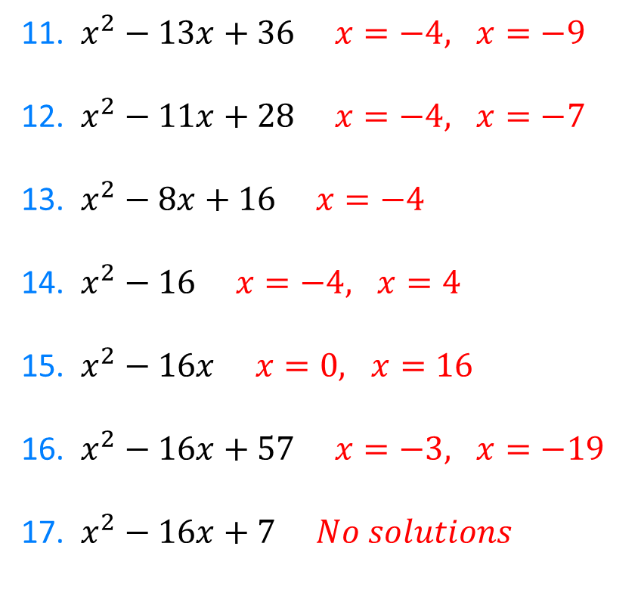
1. $x^{2}−4x+3$ $x=1, x=3$
2. $x^{2}−5x+4$ $x=1, x=4$
3. $x^{2}−6x+5$ $x=1, x=5$
4. $x^{2}−7x+10$ $x=2, x=5$
5. $x^{2}−8x+15$ $x=3, x=5$
6. $x^{2}−11x+24$ $x=3, x=8$
7. $x^{2}−5x−24$ $x=3, x=−8$
8. $x^{2}+5x−24$ $x=−3, x=8$
9. $x^{2}+5x−14$ $x=−2, x=7$
10. $x^{2}+5x−36$ $x=−4, x=9$
11. $x^{2}−13x+36$ $x=−4, x=−9$
12. $x^{2}−11x+28$ $x=−4, x=−7$
13. $x^{2}−8x+16$ $x=−4$
14. $x^{2}−16$ $x=−4, x=4$
15. $x^{2}−16x$ $x=0, x=16$
16. $x^{2}−16x+57$ $x=−3, x=−19$
17. $x^{2}−16x+7$ $No solutions$
@mrbartonmaths

