Slide 1
Inverse Proportion: equations
Silent
Teacher
Intelligent Practice
Narration
Your Turn
$$y varies inversely with 2x$$
$$y varies inversely with x^{2}$$
$$y varies inversely with x+3$$
Practice

Slide 2
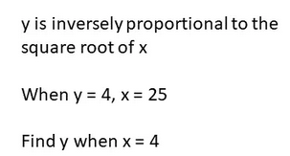
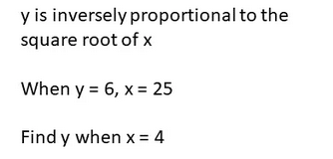
Worked Example
Your Turn
y varies inversely with x + 3
When y = 52, x = 3.
Find y when x = 5.
y varies inversely with 2x + 1
When y = 30, x = 4.
Find y when x = 7.

Slide 3
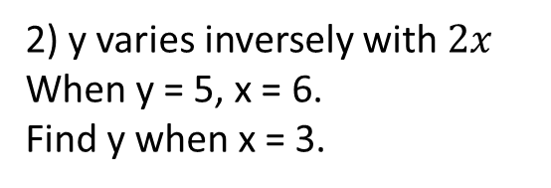
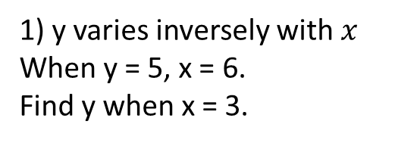
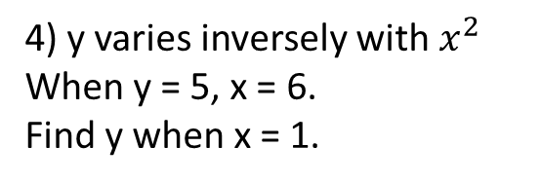
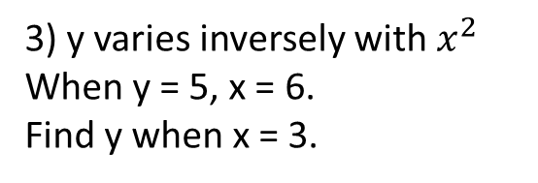
Practice
1) y varies inversely with $x$
When y = 5, x = 6.
Find y when x = 3.
6) y varies inversely with $x+3$
When y = 5, x = 6.
Find y when x = 1.
2) y varies inversely with $2x$
When y = 5, x = 6.
Find y when x = 3.
7) y varies inversely with ${\left(x+3\right)}^{2}$
When y = 5, x = 6.
Find y when x = 3.
3) y varies inversely with $x^{2}$
When y = 5, x = 6.
Find y when x = 3.
8) y varies inversely with ${\left(x+3\right)}^{2}$
When y = 5, x = 3.
Find y when x = 0.
4) y varies inversely with $x^{2}$
When y = 5, x = 6.
Find y when x = 1.
9) y varies inversely with ${\left(2x\right)}^{2}$
When y = 5, x = 6.
Find y when x = 3.
5) y varies inversely with $x+3$
When y = 5, x = 6.
Find y when x = 3.

Slide 4
Practice
1) y varies inversely with $x$
When y = 5, x = 6.
Find y when x = 3.
6) y varies inversely with $x+3$
When y = 5, x = 6.
Find y when x = 1.
2) y varies inversely with $2x$
When y = 5, x = 6.
Find y when x = 3.
7) y varies inversely with ${\left(x+3\right)}^{2}$
When y = 5, x = 6.
Find y when x = 3.
3) y varies inversely with $x^{2}$
When y = 5, x = 6.
Find y when x = 3.
8) y varies inversely with ${\left(x+3\right)}^{2}$
When y = 5, x = 3.
Find y when x = 0.
4) y varies inversely with $x^{2}$
When y = 5, x = 6.
Find y when x = 1.
9) y varies inversely with ${\left(2x\right)}^{2}$
When y = 5, x = 6.
Find y when x = 3.
5) y varies inversely with $x+3$
When y = 5, x = 6.
Find y when x = 3.

