Slide 1
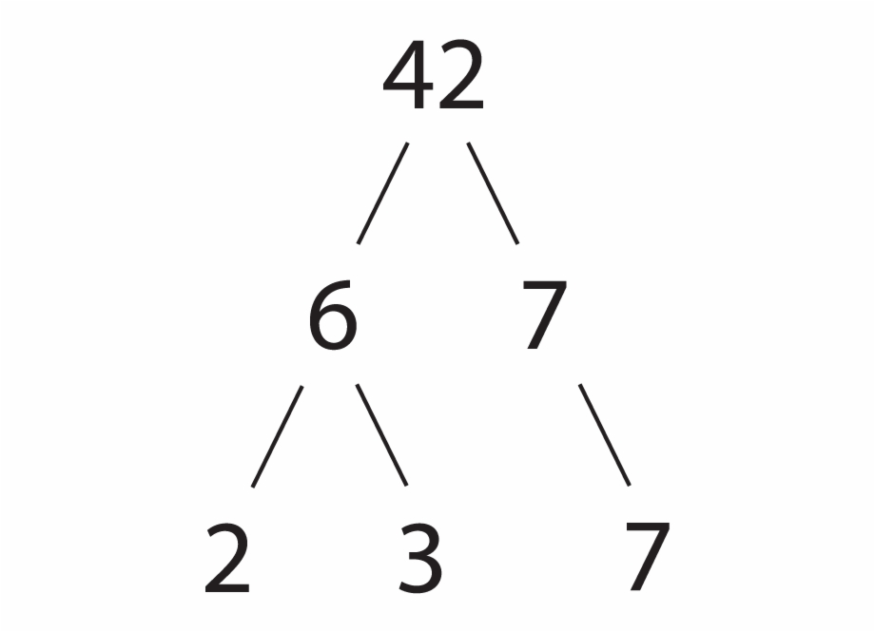
Prime factor decomposition: Fill in the gaps
Silent
Teacher
Intelligent Practice
Narration
Your Turn
Practice

Slide 2
Worked Example
Your Turn
$$\text{Express}\text{ 30 }\text{as} \text{a} \text{product} \text{of} \text{prime} \text{factors}$$
$$\text{Express}\text{ 60 }\text{as} \text{a} \text{product} \text{of} \text{prime} \text{factors}$$
@mrbartonmaths

Slide 3
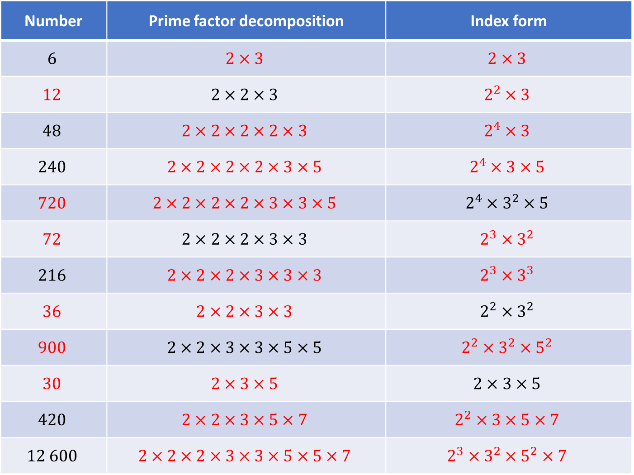
Number | Prime factor decomposition | Index form
$$6$$ | $$2×3$$ | $$2×3$$
$$12$$ | $$2×2×3$$ | $$2^{2}×3$$
$$48$$ | $$2×2×2×2×3$$ | $$2^{4}×3$$
$$240$$ | $$2×2×2×2×3×5$$ | $$2^{4}×3×5$$
$$720$$ | $$2×2×2×2×3×3×5$$ | $$2^{4}×3^{2}×5$$
$$72$$ | $$2×2×2×3×3$$ | $$2^{3}×3^{2}$$
$$216$$ | $$2×2×2×3×3×3$$ | $$2^{3}×3^{3}$$
$$36$$ | $$2×2×3×3$$ | $$2^{2}×3^{2}$$
$$900$$ | $$2×2×3×3×5×5$$ | $$2^{2}×3^{2}×5^{2}$$
$$30$$ | $$2×3×5$$ | $$2×3×5$$
$$420$$ | $$2×2×3×5×7$$ | $$2^{2}×3×5×7$$
$$12 600$$ | $$2×2×2×3×3×5×5×7$$ | $$2^{3}×3^{2}×5^{2}×7$$
$$1.$$
$$2.$$
$$3.$$
$$4.$$
$$5.$$
$$6.$$
$$7.$$
$$8.$$
$$9.$$
$$10.$$
$$11.$$
$$12.$$

Slide 4
Number | Prime factor decomposition | Index form
$$6$$ | $$2×3$$ | $$2×3$$
$$12$$ | $$2×2×3$$ | $$2^{2}×3$$
$$48$$ | $$2×2×2×2×3$$ | $$2^{4}×3$$
$$240$$ | $$2×2×2×2×3×5$$ | $$2^{4}×3×5$$
$$720$$ | $$2×2×2×2×3×3×5$$ | $$2^{4}×3^{2}×5$$
$$72$$ | $$2×2×2×3×3$$ | $$2^{3}×3^{2}$$
$$216$$ | $$2×2×2×3×3×3$$ | $$2^{3}×3^{3}$$
$$36$$ | $$2×2×3×3$$ | $$2^{2}×3^{2}$$
$$900$$ | $$2×2×3×3×5×5$$ | $$2^{2}×3^{2}×5^{2}$$
$$30$$ | $$2×3×5$$ | $$2×3×5$$
$$420$$ | $$2×2×3×5×7$$ | $$2^{2}×3×5×7$$
$$12 600$$ | $$2×2×2×3×3×5×5×7$$ | $$2^{3}×3^{2}×5^{2}×7$$
$$1.$$
$$2.$$
$$3.$$
$$4.$$
$$5.$$
$$6.$$
$$7.$$
$$8.$$
$$9.$$
$$10.$$
$$11.$$
$$12.$$

