Slide 1
Converting from denary to different bases
Silent
Teacher
Intelligent Practice
Narration
Your Turn
$4$(base 2)
$54$ (base 5)
$14$(base 16)
Practice

Slide 2
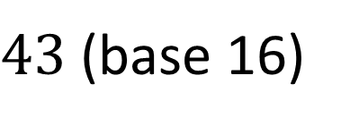
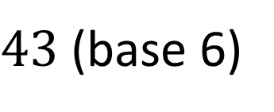
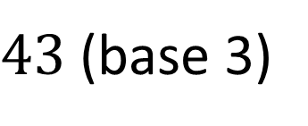
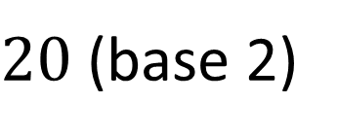
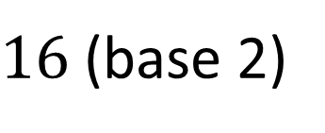
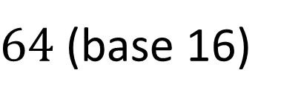
Worked Example
Your Turn
$16$(base 2)
$20$(base 2)
$43$(base 3)
$43$(base 6)
$43$(base 16)
$64$(base 16)
@DrChris_Baker
Notes:
16 (base 2) = 10000 20 (base 2) = 10100
43 (base 3) = 1121 43 (base 6) = 111
43 (base 16) = 2B 64 (base 16) = 40

Slide 3
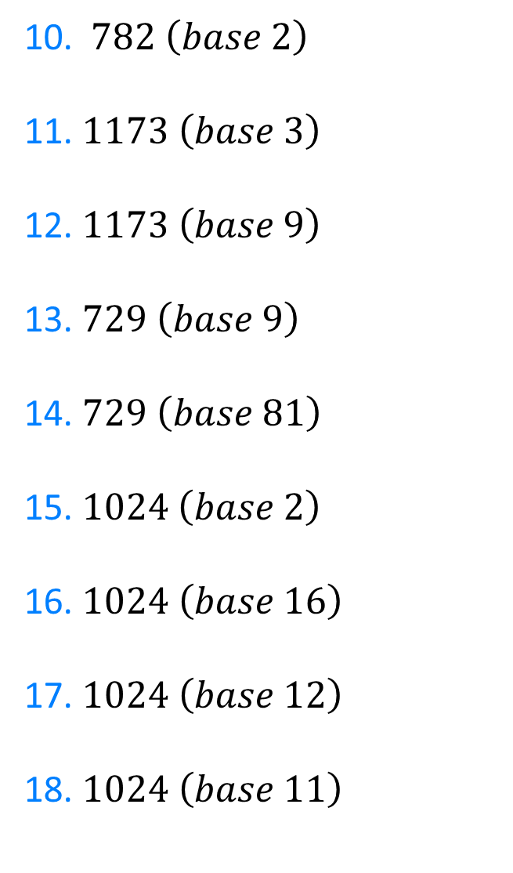
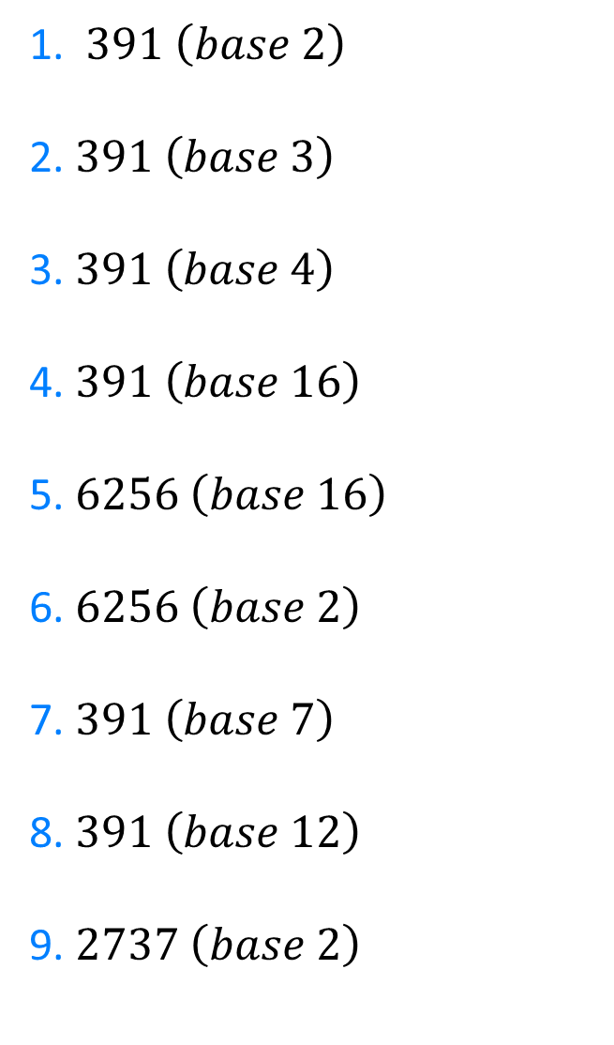
1. $391 \left(base 2\right)$
2. $391 \left(base 3\right)$
3. $391 \left(base 4\right)$
4. $391 \left(base 16\right)$
5. $6256 \left(base 16\right)$
6.$6256 \left(base 2\right)$
7. $391 \left(base 7\right)$
8. $391 \left(base 12\right)$
9. $2737 \left(base 2\right)$
10. $782 \left(base 2\right)$
11. $1173 \left(base 3\right)$
12. $1173 \left(base 9\right)$
13. $729 \left(base 9\right)$
14. $729 \left(base 81\right)$
15.$1024 \left(base 2\right)$
16. $1024 \left(base 16\right)$
17. $1024 \left(base 12\right)$
18. $1024 \left(base 11\right)$
@DrChris_Baker

Slide 4

110000111
112111
12013
187
1870
1100001110000
1066
287
101010110001
10. $782 \left(base 2\right)$
11. $1173 \left(base 3\right)$
12. $1173 \left(base 9\right)$
13. $729 \left(base 9\right)$
14. $729 \left(base 81\right)$
15.$1024 \left(base 2\right)$
16. $1024 \left(base 16\right)$
17. $1024 \left(base 12\right)$
18. $1024 \left(base 11\right)$
1. $391 \left(base 2\right)$
2. $391 \left(base 3\right)$
3. $391 \left(base 4\right)$
4. $391 \left(base 16\right)$
5. $6256 \left(base 16\right)$
6.$6256 \left(base 2\right)$
7. $391 \left(base 7\right)$
8. $391 \left(base 12\right)$
9. $2737 \left(base 2\right)$
1100001110
1121110
1543
1000
10
10000000000
400
714
851
@DrChris_Baker

