Slide 1
Generating quadratics sequences from the nth term
Silent
Teacher
Intelligent Practice
Narration
Your Turn
$$n^{2}$$
${ n}^{2}$+1
${ n}^{2}−$1
Practice

Slide 2
Worked Example
Your Turn
Generate the first 5 terms of the sequence $n^{2}$ -2
Generate the first 5 terms of the sequence $n^{2}$+2

Slide 3
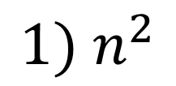
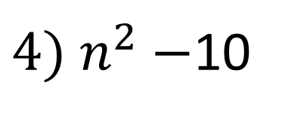
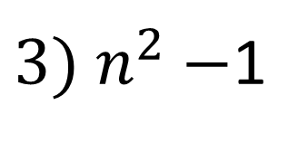
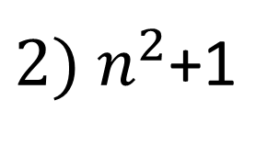
$$Generate the first 5 terms of the following sequences$$
$${1) n}^{2}$$
$${7) 1− n}^{2}$$
${2) n}^{2}$+1
$${8) −n}^{2}$$
${3) n}^{2}−$1
$${9) n}^{2}−n$$
${4) n}^{2}−$10
${10) n}^{2}−n$ +1
$${5) 10− n}^{2}$$
${11)1+ n}^{2}−n$
$${6) 100− n}^{2}$$
${12)10+ n}^{2}−n$

Slide 4
$$Generate the first 5 terms of the following sequences$$
$${1) n}^{2}$$
$${7) 1− n}^{2}$$
1,4,9,16,25
1,-3,-8,-15,-24
${2) n}^{2}$+1
$${8) −n}^{2}$$
2,5,10,17,26
-1,-4,-9,-16,-25
${3) n}^{2}−$1
$${9) n}^{2}−n$$
0,3,8,15,24
0,2,6,12,20
${4) n}^{2}−$10
${10) n}^{2}−n$ +1
-9,-6,-1,6,15
1,3,7,13,21
$${5) 10− n}^{2}$$
${11)1+ n}^{2}−n$
9,6,1,-6,-15
$${6) 100− n}^{2}$$
1,3,7,13,21
${12)10+ n}^{2}−n$
99,96,91,84,75
10,12,16,22,35

