Slide 1
Product Rule Non polynomial
Silent
Teacher
Intelligent Practice
Narration
Your Turn
$$\frac{d}{dx}x^{2}\sin{x}$$
$$\frac{d}{dx}e^{x}\sin{x}$$
Practice

Slide 2
Worked Example
Your Turn
Find $\frac{dy}{dx}$ of $\left(3x+5\right)e^{x}$
Find $\frac{dy}{dx}$ of $\left(7x−2\right)e^{x}$
Differentiate
$$\left(3x+5\right)\sin{x}$$
Differentiate
$$\left(7x−2\right)\cos{x}$$
@DrChris_Baker

Slide 3
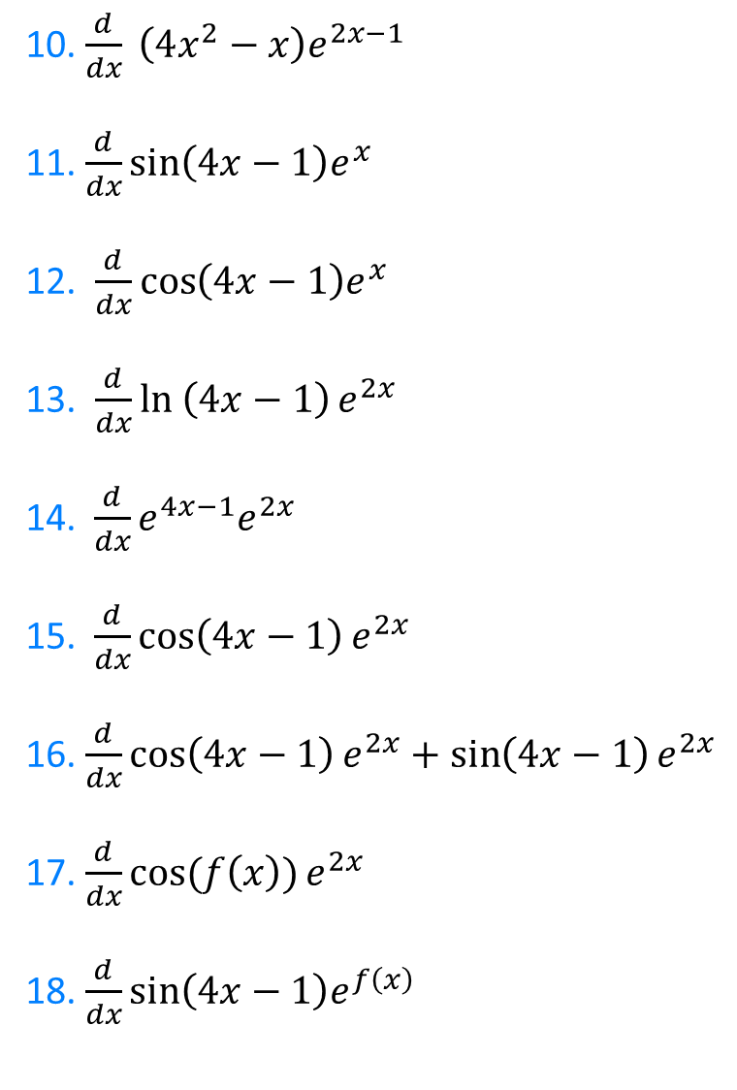

1. $\frac{d}{dx} \left(4x−1\right)e^{x}$
2. $\frac{d}{dx} \left(4x−1\right)\sin{x}$
3. $\frac{d}{dx} \left(4x−1\right)\cos{x}$
4. $\frac{d}{dx}\left(4x−1\right)\ln{x}$
5. $\frac{d}{dx}\left(4x−2\right)e^{x}$
6.$\frac{d}{dx}\left(4x−1\right)\cot{(2x)}$
7. $\frac{d}{dx} \left(4x−1\right)e^{2x}$
8. $\frac{d}{dt} e^{2x}\sin{3x}$
9. $\frac{d}{dx}e^{2x}\cos{3x}$
10. $\frac{d}{dx} \left(4x^{2}−x\right)e^{2x−1}$
11. $\frac{d}{dx}\sin\left(4x−1\right)e^{x}$
12. $\frac{d}{dx}\cos\left(4x−1\right)e^{x}$
13. $\frac{d}{dx}\ln\left(4x−1\right)e^{2x}$
14. $\frac{d}{dx}e^{4x−1}e^{2x}$
15.$\frac{d}{dx}\cos\left(4x−1\right)e^{2x}$
16. $\frac{d}{dx}\cos\left(4x−1\right)e^{2x}+\sin\left(4x−1\right)e^{2x}$
17. $\frac{d}{dx}\cos{(f\left(x\right))}e^{2x}$
18. $\frac{d}{dx}\sin\left(4x−1\right)e^{f\left(x\right)}$
@DrChris_Baker
Notes:
Hopefully, the students will notice that you do not have to use the product rule on Q14, just the rules of indices!

Slide 4
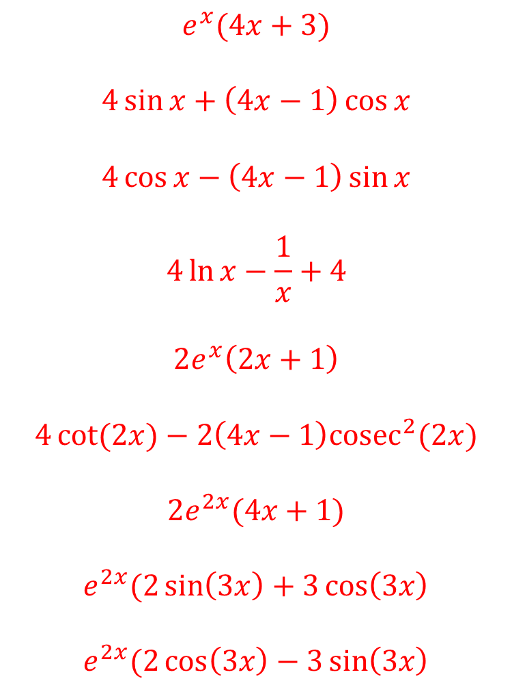
1. $\frac{d}{dx} \left(4x−1\right)e^{x}$
2. $\frac{d}{dx} \left(4x−1\right)\sin{x}$
3. $\frac{d}{dx} \left(4x−1\right)\cos{x}$
4. $\frac{d}{dx}\left(4x−1\right)\ln{x}$
5. $\frac{d}{dx}\left(4x−2\right)e^{x}$
6.$\frac{d}{dx}\left(4x−1\right)\cot{(2x)}$
7. $\frac{d}{dx} \left(4x−1\right)e^{2x}$
8. $\frac{d}{dt} e^{2x}\sin{3x}$
9. $\frac{d}{dx}e^{2x}\cos{3x}$
$$e^{x}(4x+3)$$
$$4\sin{x}+\left(4x−1\right)\cos{x}$$
$$4\cos{x}−\left(4x−1\right)\sin{x}$$
$$4\ln{x}−\frac{1}{x}+4$$
$$2e^{x}\left(2x+1\right)$$
$$4\cot{(2x)}−2\left(4x−1\right)cosec^{2}(2x)$$
$$2e^{2x}(4x+1)$$
$$e^{2x}(2\sin\left(3x\right)+3\cos\left(3x\right)$$
$$e^{2x}(2\cos\left(3x\right)−3\sin\left(3x\right)$$
@DrChris_Baker

Slide 5
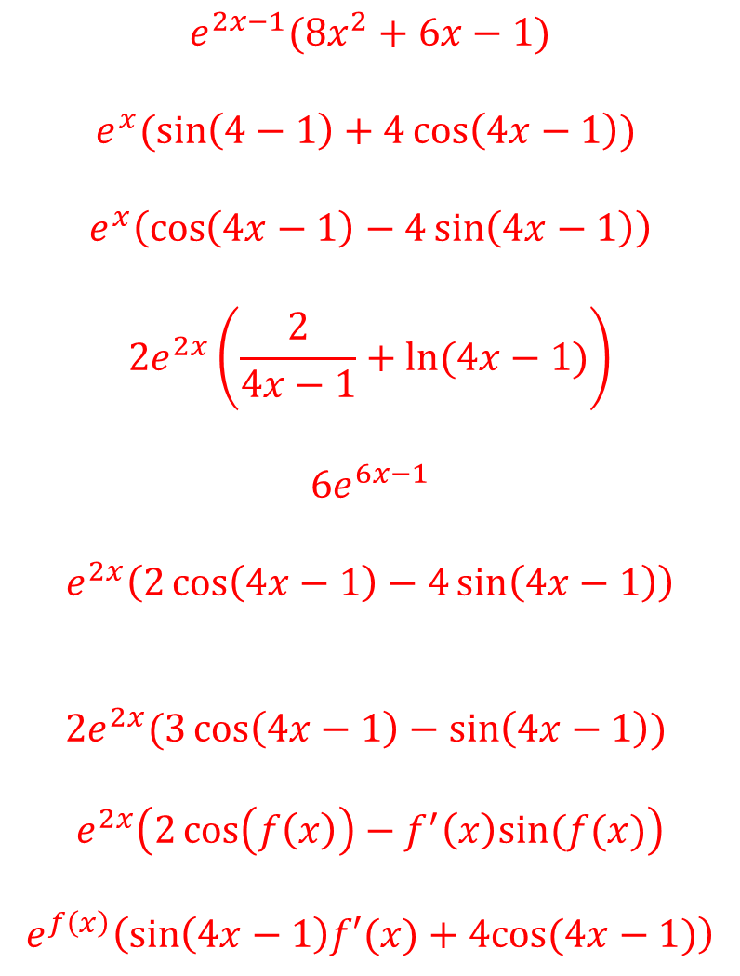
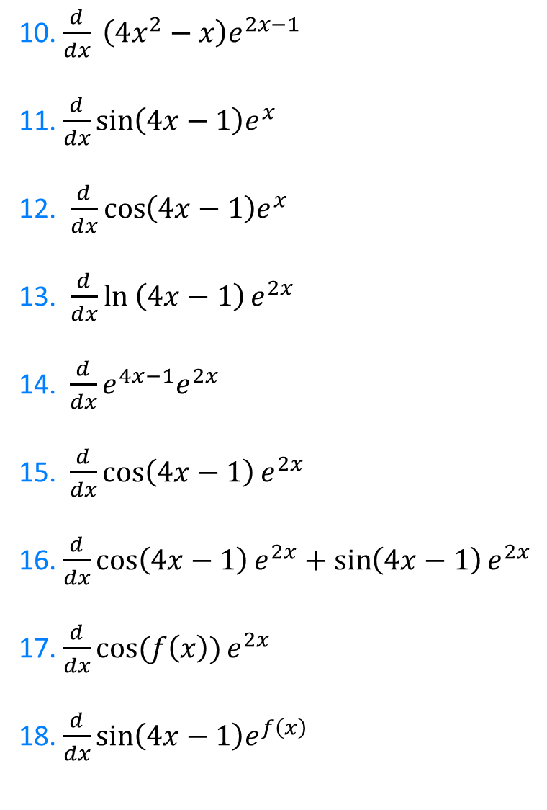
10. $\frac{d}{dx} \left(4x^{2}−x\right)e^{2x−1}$
11. $\frac{d}{dx}\sin\left(4x−1\right)e^{x}$
12. $\frac{d}{dx}\cos\left(4x−1\right)e^{x}$
13. $\frac{d}{dx}\ln\left(4x−1\right)e^{2x}$
14. $\frac{d}{dx}e^{4x−1}e^{2x}$
15.$\frac{d}{dx}\cos\left(4x−1\right)e^{2x}$
16. $\frac{d}{dx}\cos\left(4x−1\right)e^{2x}+\sin\left(4x−1\right)e^{2x}$
17. $\frac{d}{dx}\cos{(f\left(x\right))}e^{2x}$
18. $\frac{d}{dx}\sin\left(4x−1\right)e^{f\left(x\right)}$
$$e^{2x−1}(8x^{2}+6x−1)$$
$$e^{x}(\sin\left(4−1\right)+4\cos\left(4x−1\right))$$
$$e^{x}\left(\cos\left(4x−1\right)−4\sin\left(4x−1\right)\right)$$
$$2e^{2x}\left(\frac{2}{4x−1}+ln⁡(4x−1)\right)$$
$$6e^{6x−1}$$
$$e^{2x}\left(2\cos\left(4x−1\right)−4\sin\left(4x−1\right)\right)$$
$${2e}^{2x}(3\cos\left(4x−1\right)−\sin\left(4x−1\right))$$
$$e^{2x}\left(2\cos\left(f\left(x\right)\right)−f^{′}\left(x\right)sin⁡(f(x)\right)$$
$$e^{f\left(x\right)}\left(\sin\left(4x−1\right)f′(x)+4cos⁡(4x−1)\right)$$
@DrChris_Baker

