Slide 1
Product Rule Polynomial
Silent
Teacher
Intelligent Practice
Narration
Your Turn
$$\frac{d}{dx}(2x+1)(3x^{2}−x+1)$$
$$\frac{d}{dx}\left(3x^{3}−2x\right)\left(x^{5}+\sqrt{x}\right)$$
Practice

Slide 2
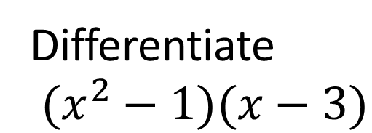
Worked Example
Your Turn
Find $\frac{dy}{dx}$ of $(x−1)(x−2)$
Find $\frac{dy}{dx}$ of $(x−2)(x−3)$
$$\frac{ⅆy}{ⅆx}=\left(x−2\right)\left(1\right)+(x−1)(1)$$
$$\frac{ⅆy}{ⅆx}=\left(x−3\right)\left(1\right)+(x−2)(1)$$
$$\frac{ⅆy}{ⅆx}=2x−3$$
$$\frac{ⅆy}{ⅆx}=2x−5$$
Differentiate
$(x^{2}−1)(x−3)$
Differentiate
$(x^{4}−2x)(x^{2}−1)$
$$\frac{ⅆy}{ⅆx}=\left(x−3\right)\left(2x\right)+(x^{2}+1)(1)$$
$$\frac{ⅆy}{ⅆx}=\left(x^{2}−1\right)\left(4x^{3}−2\right)+(x^{4}−3x)(2x)$$
$$\frac{ⅆy}{ⅆx}=3x^{2}−6x+1$$
$$\frac{ⅆy}{ⅆx}=6x^{5}−4x^{3}−6x^{2}+2$$
@DrChris_Baker

Slide 3
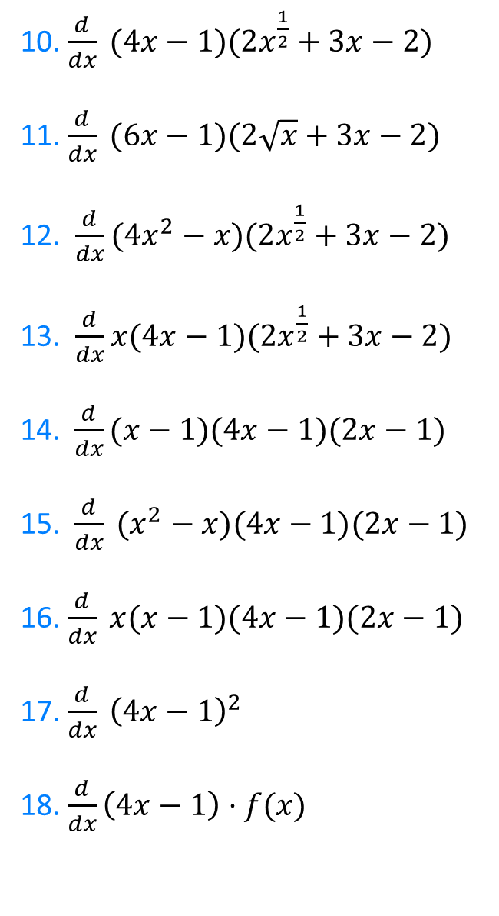
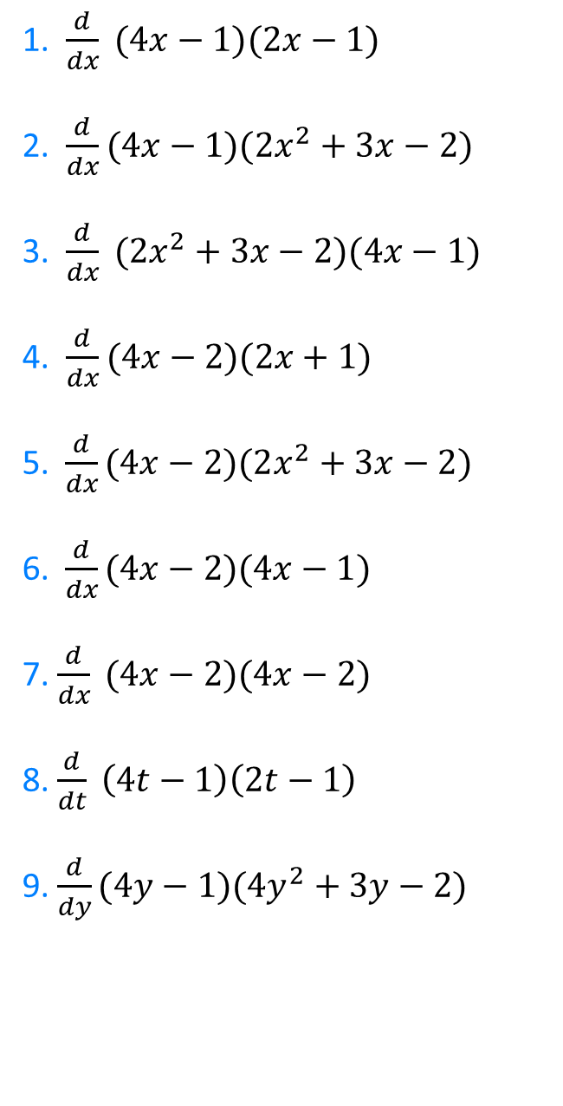
1. $\frac{d}{dx} (4x−1)(2x−1)$
2. $\frac{d}{dx}(4x−1)(2x^{2}+3x−2)$
3. $\frac{d}{dx} (2x^{2}+3x−2)(4x−1)$
4. $\frac{d}{dx}(4x−2)(2x+1)$
5. $\frac{d}{dx}(4x−2)(2x^{2}+3x−2)$
6.$\frac{d}{dx}(4x−2)(4x−1)$
7. $\frac{d}{dx} (4x−2)(4x−2)$
8. $\frac{d}{dt} \left(4t−1\right)\left(2t−1\right)$
9. $\frac{d}{dy}(4y−1)(4y^{2}+3y−2)$
10. $\frac{d}{dx} (4x−1)(2x^{\frac{1}{2}}+3x−2)$
11. $\frac{d}{dx} (6x−1)(2\sqrt{x}+3x−2)$
12. $\frac{d}{dx}(4x^{2}−x)(2x^{\frac{1}{2}}+3x−2)$
13. $\frac{d}{dx}x(4x−1)(2x^{\frac{1}{2}}+3x−2)$
14. $\frac{d}{dx}(x−1)(4x−1)(2x−1)$
15.$\frac{d}{dx} (x^{2}−x)(4x−1)(2x−1)$
16. $\frac{d}{dx} x(x−1)(4x−1)(2x−1)$
17. $\frac{d}{dx} {\left(4x−1\right)}^{2}$
18. $\frac{d}{dx}\left(4x−1\right)⋅f(x)$
@DrChris_Baker

Slide 4
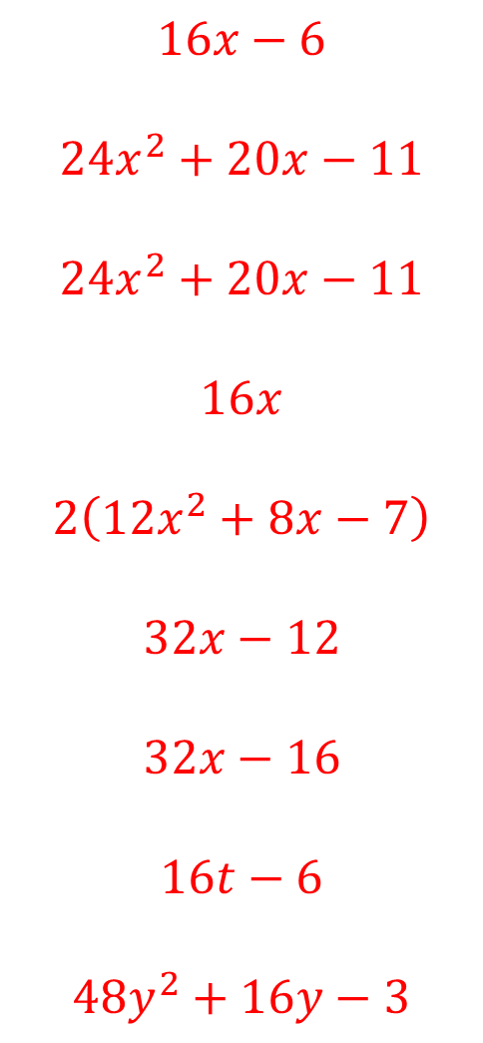
1. $\frac{d}{dx} (4x−1)(2x−1)$
2. $\frac{d}{dx}(4x−1)(2x^{2}+3x−2)$
3. $\frac{d}{dx} (2x^{2}+3x−2)(4x−1)$
4. $\frac{d}{dx}(4x−2)(2x+1)$
5. $\frac{d}{dx}(4x−2)(2x^{2}+3x−2)$
6.$\frac{d}{dx}(4x−2)(4x−1)$
7. $\frac{d}{dx} (4x−2)(4x−2)$
8. $\frac{d}{dt} \left(4t−1\right)\left(2t−1\right)$
9. $\frac{d}{dy}(4y−1)(4y^{2}+3y−2)$
$$16x−6$$
$$24x^{2}+20x−11$$
$$24x^{2}+20x−11$$
$$16x$$
$$2\left(12x^{2}+8x−7\right)$$
$$32x−12$$
$$32x−16$$
$$16t−6$$
$$48y^{2}+16y−3$$
@DrChris_Baker

Slide 5
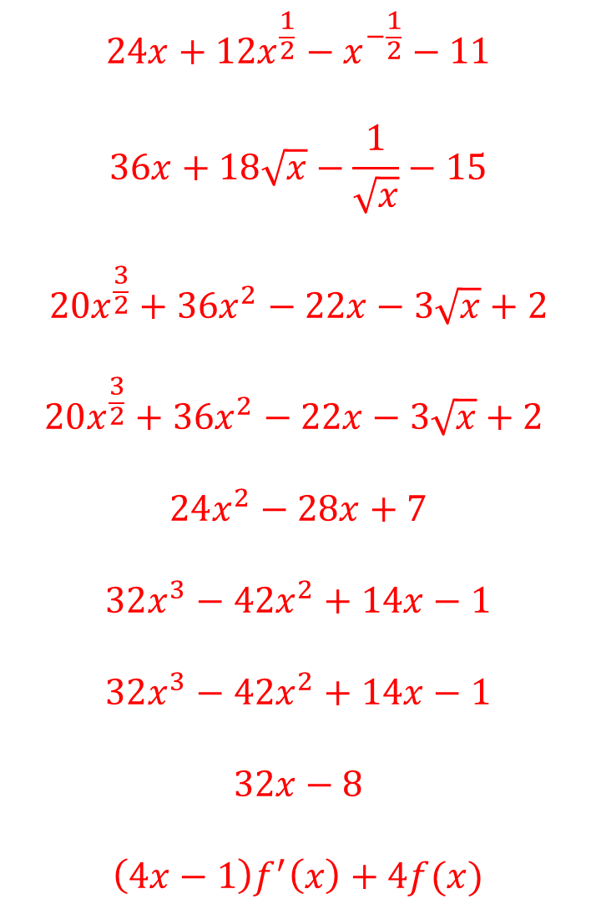
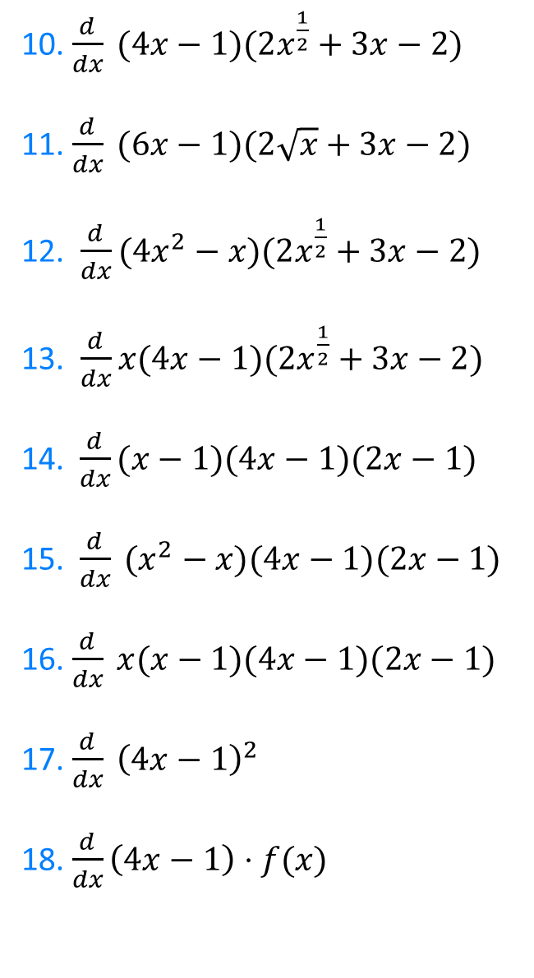
10. $\frac{d}{dx} (4x−1)(2x^{\frac{1}{2}}+3x−2)$
11. $\frac{d}{dx} (6x−1)(2\sqrt{x}+3x−2)$
12. $\frac{d}{dx}(4x^{2}−x)(2x^{\frac{1}{2}}+3x−2)$
13. $\frac{d}{dx}x(4x−1)(2x^{\frac{1}{2}}+3x−2)$
14. $\frac{d}{dx}(x−1)(4x−1)(2x−1)$
15.$\frac{d}{dx} (x^{2}−x)(4x−1)(2x−1)$
16. $\frac{d}{dx} x(x−1)(4x−1)(2x−1)$
17. $\frac{d}{dx} {\left(4x−1\right)}^{2}$
18. $\frac{d}{dx}\left(4x−1\right)⋅f(x)$
$$24x+12x^{\frac{1}{2}}−x^{−\frac{1}{2}}−11$$
$$36x+18\sqrt{x}−\frac{1}{\sqrt{x}}−15$$
$$20x^{\frac{3}{2}}+36x^{2}−22x−3\sqrt{x}+2$$
$$20x^{\frac{3}{2}}+36x^{2}−22x−3\sqrt{x}+2$$
$$24x^{2}−28x+7$$
$$32x^{3}−42x^{2}+14x−1$$
$$32x^{3}−42x^{2}+14x−1$$
$$32x−8$$
$$\left(4x−1\right)f^{′}\left(x\right)+4f(x)$$
@DrChris_Baker

Slide 6
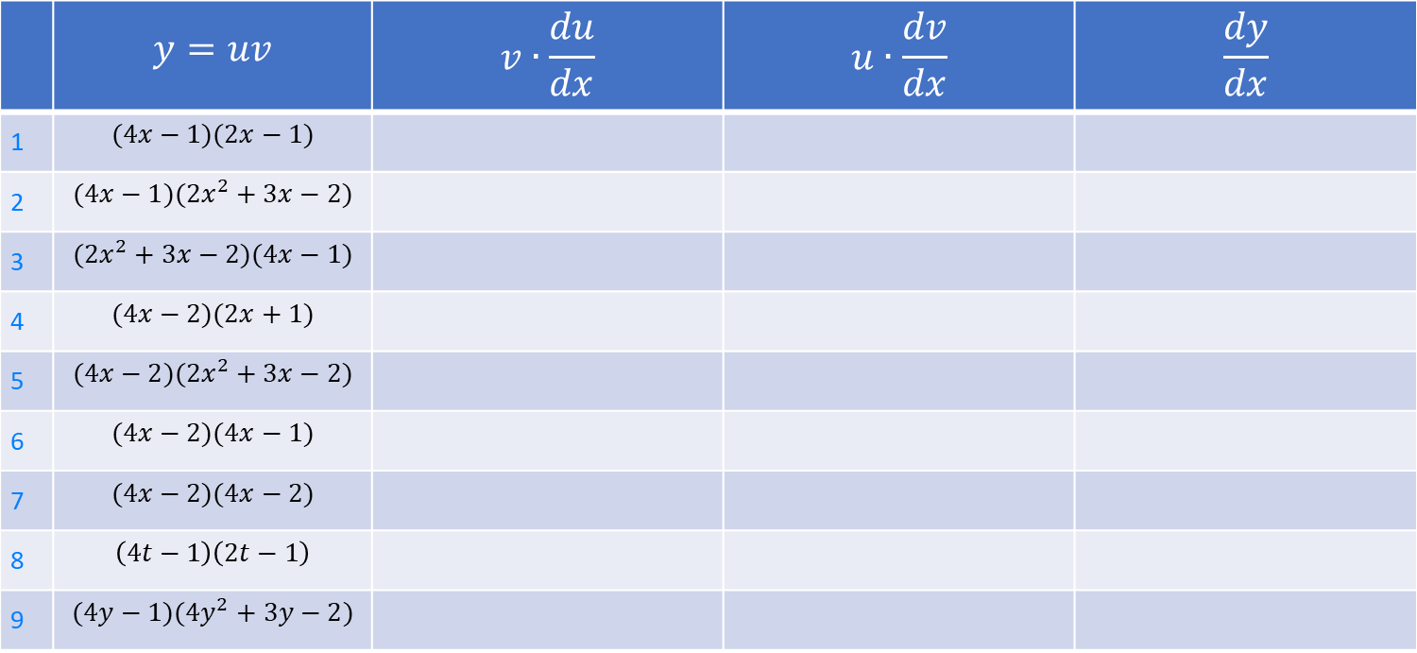
 | $$y=uv$$ | $$v∙\frac{du}{dx}$$ | $$u∙\frac{dv}{dx}$$ | $$\frac{dy}{dx}$$
1 | $$(4x−1)(2x−1)$$
2 | $$(4x−1)(2x^{2}+3x−2)$$
3 | $$(2x^{2}+3x−2)(4x−1)$$
4 | $$(4x−2)(2x+1)$$
5 | $$(4x−2)(2x^{2}+3x−2)$$
6 | $$(4x−2)(4x−1)$$
7 | $$(4x−2)(4x−2)$$
8 | $$\left(4t−1\right)\left(2t−1\right)$$
9 | $$(4y−1)(4y^{2}+3y−2)$$

Slide 7
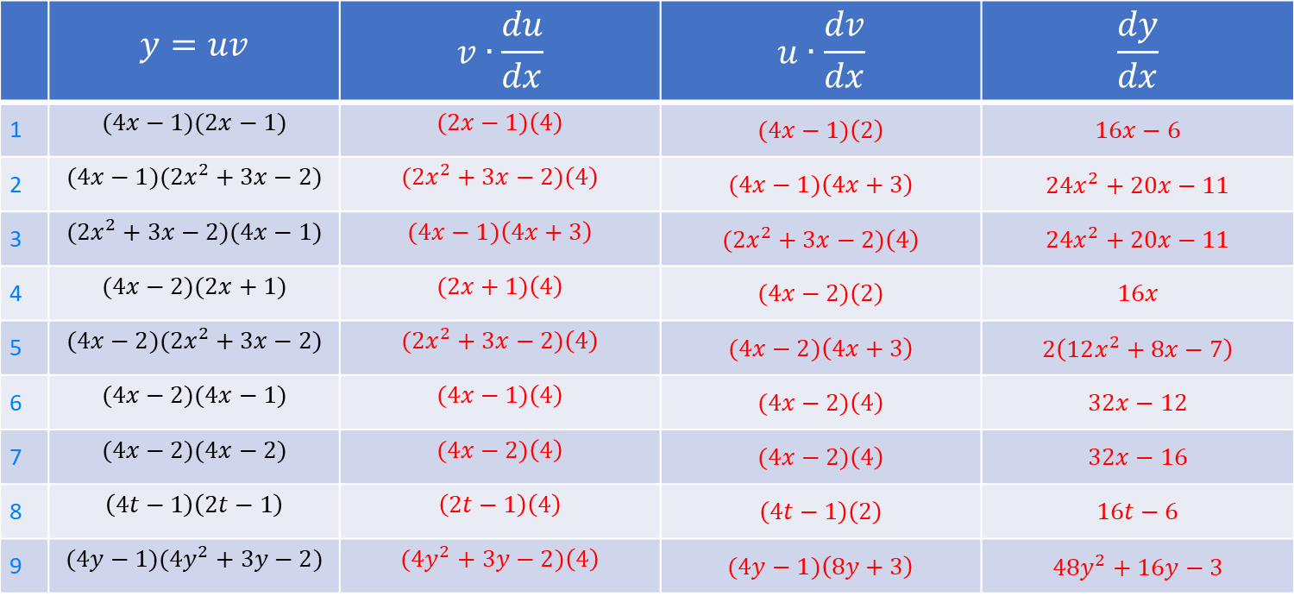
 | $$y=uv$$ | $$v∙\frac{du}{dx}$$ | $$u∙\frac{dv}{dx}$$ | $$\frac{dy}{dx}$$
1 | $$(4x−1)(2x−1)$$ | $$(2x−1)\left(4\right)$$ | $$(4x−1)\left(2\right)$$ | $$16x−6$$
2 | $$(4x−1)(2x^{2}+3x−2)$$ | $$(2x^{2}+3x−2)\left(4\right)$$ | $$(4x−1)\left(4x+3\right)$$ | $$24x^{2}+20x−11$$
3 | $$(2x^{2}+3x−2)(4x−1)$$ | $$(4x−1)\left(4x+3\right)$$ | $$(2x^{2}+3x−2)\left(4\right)$$ | $$24x^{2}+20x−11$$
4 | $$(4x−2)(2x+1)$$ | $$(2x+1)\left(4\right)$$ | $$(4x−2)\left(2\right)$$ | $$16x$$
5 | $$(4x−2)(2x^{2}+3x−2)$$ | $$(2x^{2}+3x−2)\left(4\right)$$ | $$(4x−2)\left(4x+3\right)$$ | $$2\left(12x^{2}+8x−7\right)$$
6 | $$(4x−2)(4x−1)$$ | $$(4x−1)\left(4\right)$$ | $$(4x−2)\left(4\right)$$ | $$32x−12$$
7 | $$(4x−2)(4x−2)$$ | $$(4x−2)\left(4\right)$$ | $$(4x−2)\left(4\right)$$ | $$32x−16$$
8 | $$\left(4t−1\right)\left(2t−1\right)$$ | $$\left(2t−1\right)\left(4\right)$$ | $$\left(4t−1\right)\left(2\right)$$ | $$16t−6$$
9 | $$(4y−1)(4y^{2}+3y−2)$$ | $$(4y^{2}+3y−2)\left(4\right)$$ | $$(4y−1)\left(8y+3\right)$$ | $$48y^{2}+16y−3$$

Slide 8
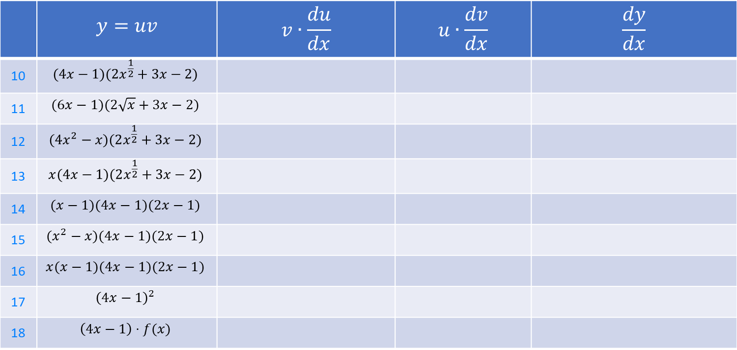
 | $$y=uv$$ | $$v∙\frac{du}{dx}$$ | $$u∙\frac{dv}{dx}$$ | $$\frac{dy}{dx}$$
10 | $$(4x−1)(2x^{\frac{1}{2}}+3x−2)$$
11 | $$(6x−1)(2\sqrt{x}+3x−2)$$
12 | $$(4x^{2}−x)(2x^{\frac{1}{2}}+3x−2)$$
13 | $$x(4x−1)(2x^{\frac{1}{2}}+3x−2)$$
14 | $$(x−1)(4x−1)(2x−1)$$
15 | $$(x^{2}−x)(4x−1)(2x−1)$$
16 | $$x(x−1)(4x−1)(2x−1)$$
17 | $${\left(4x−1\right)}^{2}$$
18 | $$\left(4x−1\right)⋅f(x)$$

Slide 9
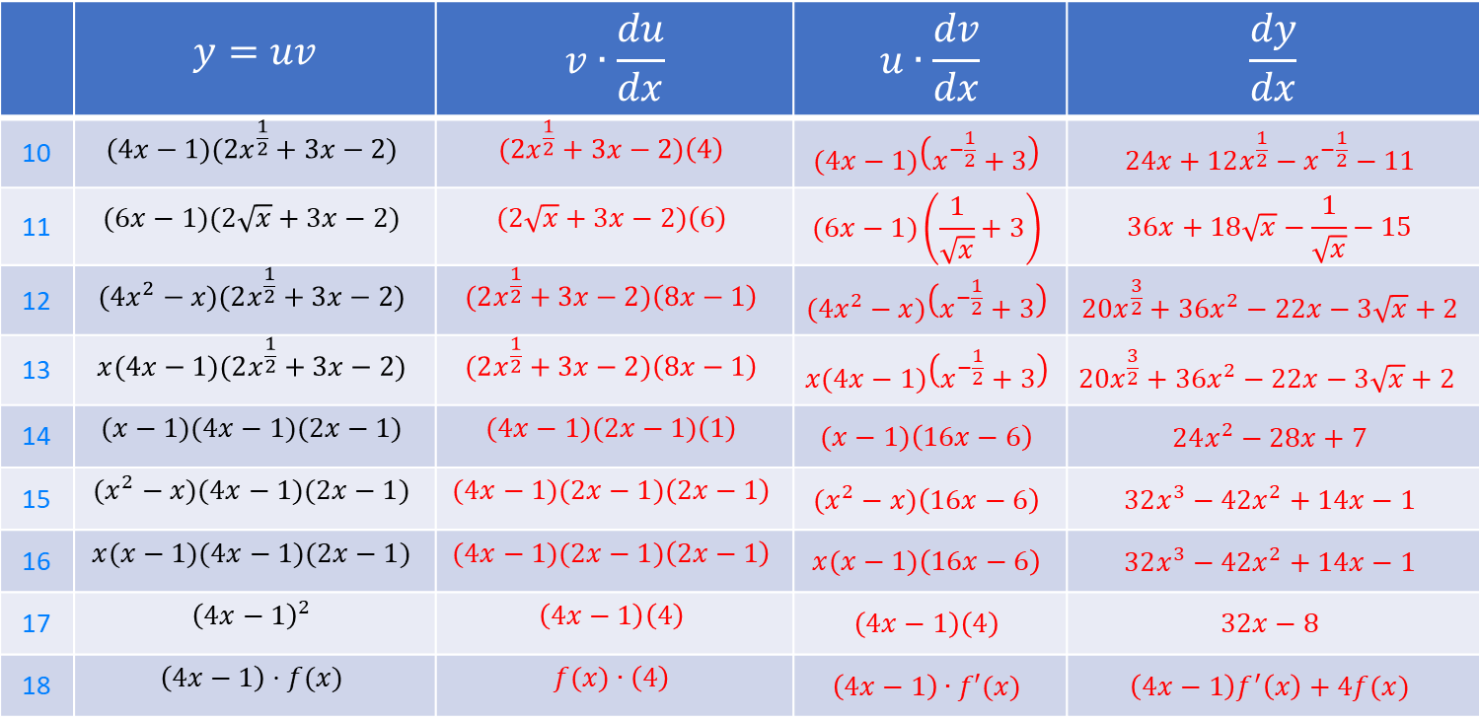
 | $$y=uv$$ | $$v∙\frac{du}{dx}$$ | $$u∙\frac{dv}{dx}$$ | $$\frac{dy}{dx}$$
10 | $$(4x−1)(2x^{\frac{1}{2}}+3x−2)$$ | $$(2x^{\frac{1}{2}}+3x−2)\left(4\right)$$ | $$(4x−1)\left(x^{−\frac{1}{2}}+3\right)$$ | $$24x+12x^{\frac{1}{2}}−x^{−\frac{1}{2}}−11$$
11 | $$(6x−1)(2\sqrt{x}+3x−2)$$ | $$(2\sqrt{x}+3x−2)\left(6\right)$$ | $$(6x−1)\left(\frac{1}{\sqrt{x}}+3\right)$$ | $$36x+18\sqrt{x}−\frac{1}{\sqrt{x}}−15$$
12 | $$(4x^{2}−x)(2x^{\frac{1}{2}}+3x−2)$$ | $$(2x^{\frac{1}{2}}+3x−2)\left(8x−1\right)$$ | $$(4x^{2}−x)\left(x^{−\frac{1}{2}}+3\right)$$ | $$20x^{\frac{3}{2}}+36x^{2}−22x−3\sqrt{x}+2$$
13 | $$x(4x−1)(2x^{\frac{1}{2}}+3x−2)$$ | $$(2x^{\frac{1}{2}}+3x−2)\left(8x−1\right)$$ | $$x(4x−1)\left(x^{−\frac{1}{2}}+3\right)$$ | $$20x^{\frac{3}{2}}+36x^{2}−22x−3\sqrt{x}+2$$
14 | $$(x−1)(4x−1)(2x−1)$$ | $$(4x−1)(2x−1)\left(1\right)$$ | $$(x−1)\left(16x−6\right)$$ | $$24x^{2}−28x+7$$
15 | $$(x^{2}−x)(4x−1)(2x−1)$$ | $$(4x−1)(2x−1)\left(2x−1\right)$$ | $$(x^{2}−x)\left(16x−6\right)$$ | $$32x^{3}−42x^{2}+14x−1$$
16 | $$x(x−1)(4x−1)(2x−1)$$ | $$(4x−1)(2x−1)\left(2x−1\right)$$ | $$x(x−1)\left(16x−6\right)$$ | $$32x^{3}−42x^{2}+14x−1$$
17 | $${\left(4x−1\right)}^{2}$$ | $$\left(4x−1\right)\left(4\right)$$ | $$\left(4x−1\right)\left(4\right)$$ | $$32x−8$$
18 | $$\left(4x−1\right)⋅f(x)$$ | $$f(x)∙\left(4\right)$$ | $$\left(4x−1\right)∙f′(x)$$ | $\left(4x−1\right)f^{′}\left(x\right)+4f(x)$

