Slide 1
Product Rule Polynomial
Silent
Teacher
Intelligent Practice
Narration
Your Turn
$$\frac{d}{dx}(2x+1)(3x^{2}−x+1)$$
$$\frac{d}{dx}\left(3x^{3}−2x\right)\left(x^{5}+\sqrt{x}\right)$$
Practice

Slide 2
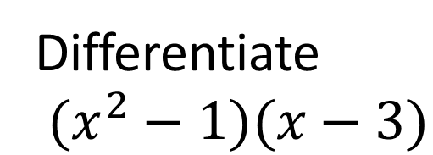
Worked Example
Your Turn
Find $\frac{dy}{dx}$ of $(x−1)(x−2)$
Find $\frac{dy}{dx}$ of $(x−2)(x−3)$
Differentiate
$(x^{2}−1)(x−3)$
Differentiate
$(x^{4}−2x)(x^{2}−1)$
@DrChris_Baker

Slide 3
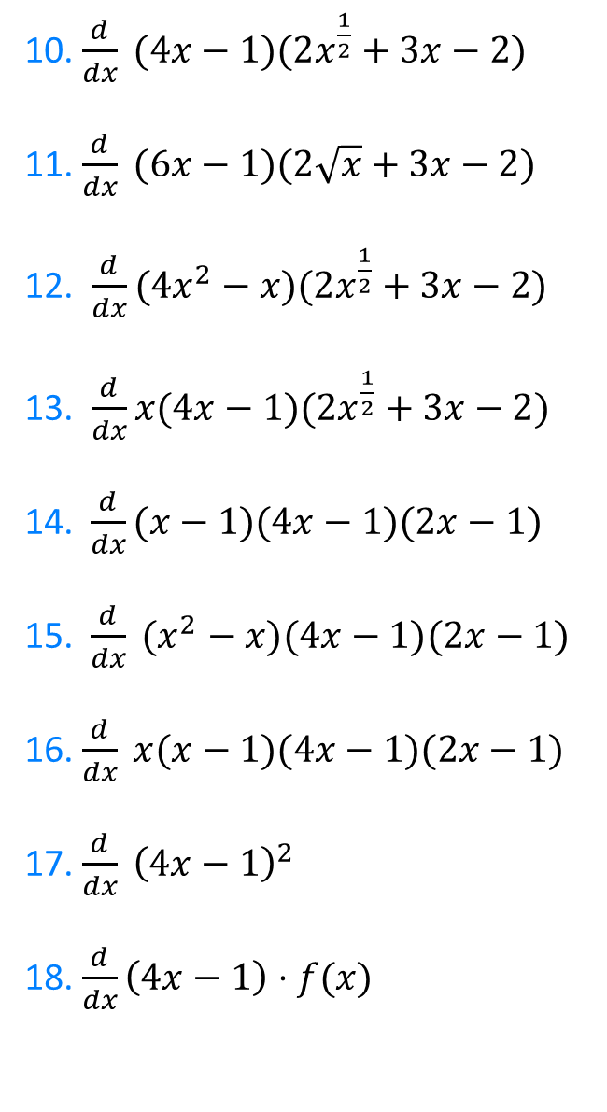
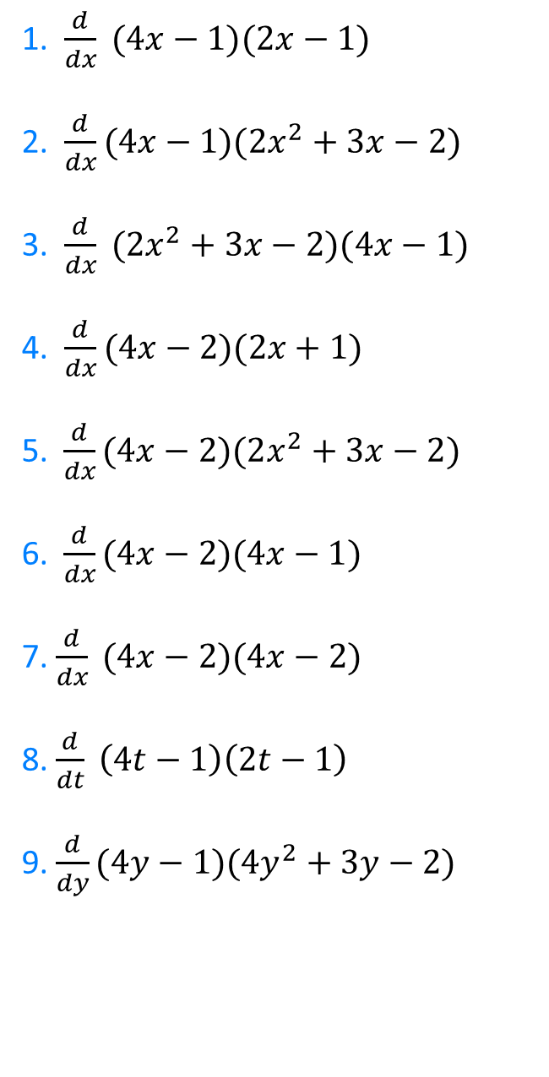
1. $\frac{d}{dx} (4x−1)(2x−1)$
2. $\frac{d}{dx}(4x−1)(2x^{2}+3x−2)$
3. $\frac{d}{dx} (2x^{2}+3x−2)(4x−1)$
4. $\frac{d}{dx}(4x−2)(2x+1)$
5. $\frac{d}{dx}(4x−2)(2x^{2}+3x−2)$
6.$\frac{d}{dx}(4x−2)(4x−1)$
7. $\frac{d}{dx} (4x−2)(4x−2)$
8. $\frac{d}{dt} \left(4t−1\right)\left(2t−1\right)$
9. $\frac{d}{dy}(4y−1)(4y^{2}+3y−2)$
10. $\frac{d}{dx} (4x−1)(2x^{\frac{1}{2}}+3x−2)$
11. $\frac{d}{dx} (6x−1)(2\sqrt{x}+3x−2)$
12. $\frac{d}{dx}(4x^{2}−x)(2x^{\frac{1}{2}}+3x−2)$
13. $\frac{d}{dx}x(4x−1)(2x^{\frac{1}{2}}+3x−2)$
14. $\frac{d}{dx}(x−1)(4x−1)(2x−1)$
15.$\frac{d}{dx} (x^{2}−x)(4x−1)(2x−1)$
16. $\frac{d}{dx} x(x−1)(4x−1)(2x−1)$
17. $\frac{d}{dx} {\left(4x−1\right)}^{2}$
18. $\frac{d}{dx}\left(4x−1\right)⋅f(x)$
@DrChris_Baker

Slide 4
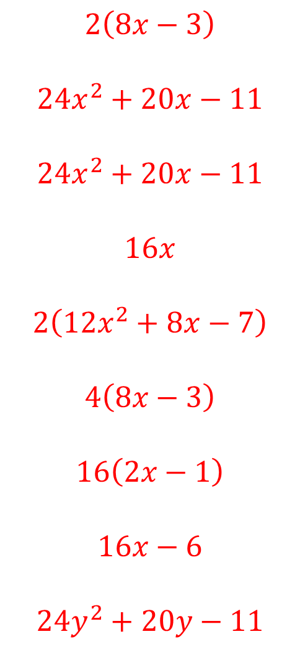
1. $\frac{d}{dx} (4x−1)(2x−1)$
2. $\frac{d}{dx}(4x−1)(2x^{2}+3x−2)$
3. $\frac{d}{dx} (2x^{2}+3x−2)(4x−1)$
4. $\frac{d}{dx}(4x−2)(2x+1)$
5. $\frac{d}{dx}(4x−2)(2x^{2}+3x−2)$
6.$\frac{d}{dx}(4x−2)(4x−1)$
7. $\frac{d}{dx} (4x−2)(4x−2)$
8. $\frac{d}{dt} \left(4t−1\right)\left(2t−1\right)$
9. $\frac{d}{dy}(4y−1)(4y^{2}+3y−2)$
$$2\left(8x−3\right)$$
$$24x^{2}+20x−11$$
$$24x^{2}+20x−11$$
$$16x$$
$$2\left(12x^{2}+8x−7\right)$$
$$4\left(8x−3\right)$$
$$16\left(2x−1\right)$$
$$16x−6$$
$$24y^{2}+20y−11$$
@DrChris_Baker

Slide 5
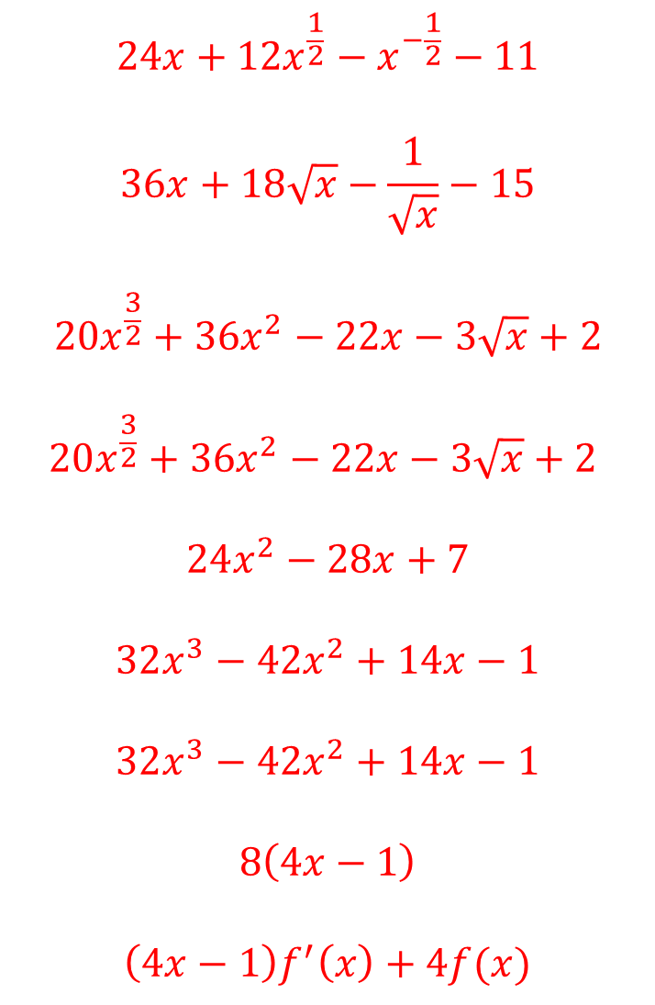
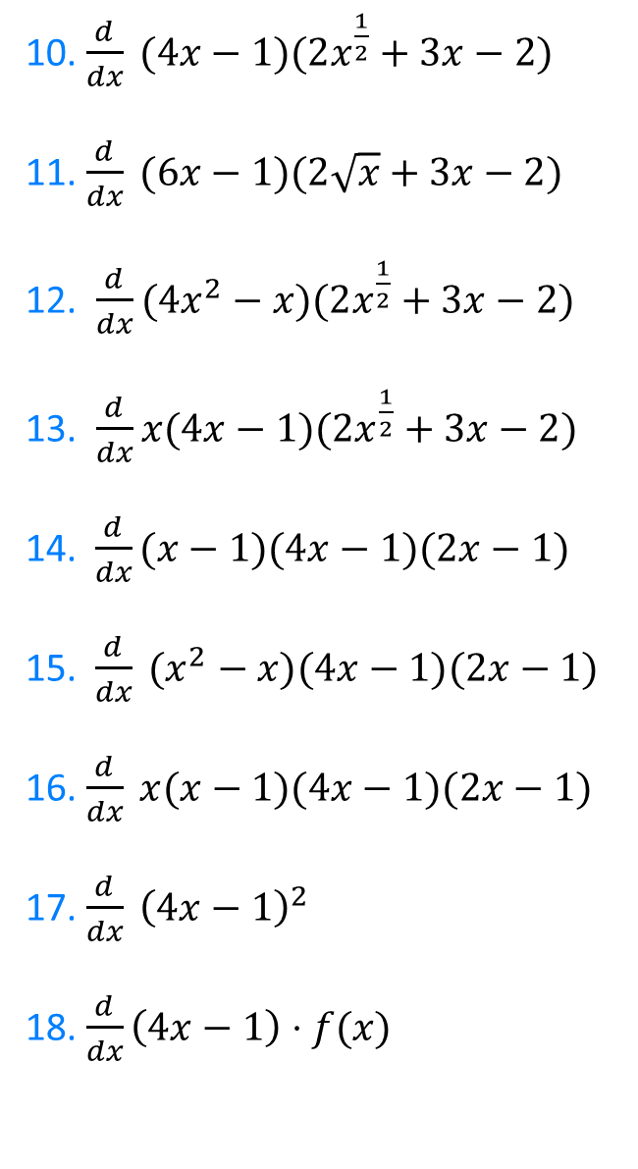
10. $\frac{d}{dx} (4x−1)(2x^{\frac{1}{2}}+3x−2)$
11. $\frac{d}{dx} (6x−1)(2\sqrt{x}+3x−2)$
12. $\frac{d}{dx}(4x^{2}−x)(2x^{\frac{1}{2}}+3x−2)$
13. $\frac{d}{dx}x(4x−1)(2x^{\frac{1}{2}}+3x−2)$
14. $\frac{d}{dx}(x−1)(4x−1)(2x−1)$
15.$\frac{d}{dx} (x^{2}−x)(4x−1)(2x−1)$
16. $\frac{d}{dx} x(x−1)(4x−1)(2x−1)$
17. $\frac{d}{dx} {\left(4x−1\right)}^{2}$
18. $\frac{d}{dx}\left(4x−1\right)⋅f(x)$
$$24x+12x^{\frac{1}{2}}−x^{−\frac{1}{2}}−11$$
$$36x+18\sqrt{x}−\frac{1}{\sqrt{x}}−15$$
$$20x^{\frac{3}{2}}+36x^{2}−22x−3\sqrt{x}+2$$
$$20x^{\frac{3}{2}}+36x^{2}−22x−3\sqrt{x}+2$$
$$24x^{2}−28x+7$$
$$32x^{3}−42x^{2}+14x−1$$
$$32x^{3}−42x^{2}+14x−1$$
$$8\left(4x−1\right)$$
$$\left(4x−1\right)f^{′}\left(x\right)+4f(x)$$
@DrChris_Baker

