Slide 1
Quotient Rule Polynomials
Silent
Teacher
Intelligent Practice
Narration
Your Turn
$$\frac{d}{dx}\frac{2x}{ x−1}$$
$$\frac{d}{dx} \frac{x^{2}−x+5}{x^{3}−2x−1}$$
Practice

Slide 2
Worked Example
Your Turn
Find $\frac{dy}{dx}$ of $\frac{9x^{2}−1}{3x}$
Find $\frac{dy}{dx}$ of $\frac{2x^{2}−x}{2x}$
$$\frac{ⅆy}{ⅆx}=\frac{\left(3x\right)\left(18x\right)−\left(9x^{2}−1\right)\left(3\right)}{{\left(3x\right)}^{2}}$$
$$\frac{ⅆy}{ⅆx}=\frac{\left(2x\right)\left(4x−1\right)−\left(2x^{2}−x\right)\left(2\right)}{{\left(2x\right)}^{2}}$$
$$\frac{ⅆy}{ⅆx}=\frac{27x^{2}+3}{9x^{2}}$$
$$=\frac{9x^{2}+1}{3x^{2}}$$
$$\frac{ⅆy}{ⅆx}=\frac{4x^{2}}{4x^{2}}$$
$$=1$$
Differentiate $\frac{2x^{2}−2x+1}{3x−1}$
Differentiate $\frac{3x^{2}+5x−1}{4x+1}$
$$\frac{ⅆy}{ⅆx}=\frac{\left(3x−1\right)\left(4x−2\right)−\left(2x^{2}−2x+1\right)\left(3\right)}{{\left(3x−1\right)}^{2}}$$
$$\frac{ⅆy}{ⅆx}=\frac{\left(4x+1\right)\left(6x+5\right)−\left(3x^{2}+5x−1\right)\left(4\right)}{{\left(4x+1\right)}^{2}}$$
$$\frac{ⅆy}{ⅆx}=\frac{6x^{2}−4x−1}{{\left(3x−1\right)}^{2}}$$
$$\frac{ⅆy}{ⅆx}=\frac{12x^{2}+6x+9}{{\left(4x+1\right)}^{2}}$$
$$=\frac{3(4x^{2}+2x+5)}{{\left(4x+1\right)}^{2}}$$
@DrChris_Baker
Notes:
The teacher can show both ways of doing these too, via simplifying or via the quotient rule and then simplifying.

Slide 3
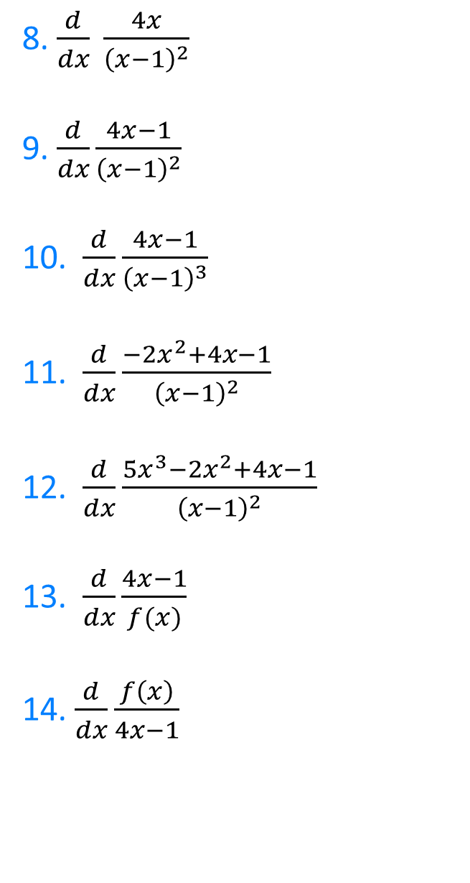

1. $\frac{d}{dx}\frac{4x−1}{x}$
2. $\frac{d}{dx}\frac{x}{4x−1}$
3. $\frac{d}{dx}\frac{x^{2}−4x−1}{x^{2}}$
4. $\frac{d}{dx} \frac{x^{2}}{x^{2}−4x−1}$
5. $\frac{d}{dx} \frac{2x+1}{4x−1}$
6.$\frac{d}{dx}\frac{2x+2}{4x−1}$
7. $\frac{d}{dx}\frac{2x+1}{4x+1}$
8. $\frac{d}{dx} \frac{4x}{{\left(x−1\right)}^{2}}$
9. $\frac{d}{dx}\frac{4x−1}{{\left(x−1\right)}^{2}}$
10. $\frac{d}{dx}\frac{4x−1}{{\left(x−1\right)}^{3}}$
11. $\frac{d}{dx}\frac{−2x^{2}+4x−1}{{\left(x−1\right)}^{2}}$
12. $\frac{d}{dx}\frac{5x^{3}−2x^{2}+4x−1}{{\left(x−1\right)}^{2}}$
13.$\frac{d}{dx}\frac{4x−1}{f(x)}$
14. $\frac{d}{dx}\frac{f\left(x\right)}{4x−1}$
@DrChris_Baker

Slide 4

1. $\frac{d}{dx}\frac{4x−1}{x}$
2. $\frac{d}{dx}\frac{x}{4x−1}$
3. $\frac{d}{dx}\frac{x^{2}−4x−1}{x^{2}}$
4. $\frac{d}{dx} \frac{x^{2}}{x^{2}−4x−1}$
5. $\frac{d}{dx} \frac{2x+1}{4x−1}$
6.$\frac{d}{dx}\frac{2x+2}{4x−1}$
7. $\frac{d}{dx}\frac{2x+1}{4x+1}$
$$=\frac{1}{x^{2}}$$
$$=−\frac{1}{{\left(4x−1\right)}^{2}}$$
$$=\frac{4x+2}{x^{3}}$$
$=−\frac{2x(2x+1)}{{\left(x^{2}−4x−1\right)}^{2}}$
$=−\frac{6}{{\left(4x−1\right)}^{2}}$
$$=−\frac{10}{{\left(4x−1\right)}^{2}}$$
$$=−\frac{2}{{\left(4x+1\right)}^{2}}$$
8. $\frac{d}{dx} \frac{4x}{{\left(x−1\right)}^{2}}$
9. $\frac{d}{dx}\frac{4x−1}{{\left(x−1\right)}^{2}}$
10. $\frac{d}{dx}\frac{4x−1}{{\left(x−1\right)}^{3}}$
11. $\frac{d}{dx}\frac{−2x^{2}+4x−1}{{\left(x−1\right)}^{2}}$
12. $\frac{d}{dx}\frac{5x^{3}−2x^{2}+4x−1}{{\left(x−1\right)}^{2}}$
13.$\frac{d}{dx}\frac{4x−1}{f(x)}$
14. $\frac{d}{dx}\frac{f\left(x\right)}{4x−1}$
$$=−\frac{4(x+1)}{{\left(x−1\right)}^{3}}$$
$$=−\frac{2(2x+1)}{{\left(x−1\right)}^{3}}$$
$$=−\frac{8x+1}{{\left(x−1\right)}^{4}}$$
$$=−\frac{2}{{\left(x−1\right)}^{3}}$$
$$=\frac{5x^{3}−15x^{2}−2}{{\left(x−1\right)}^{3}}$$
$$=\frac{\left(1−4x\right)f^{′}\left(x\right)+4f(x)}{f{\left(x\right)}^{2}}$$
$$=\frac{\left(4x−1\right)f^{′}\left(x\right)−4f(x)}{{\left(4x−1\right)}^{2}}$$
@DrChris_Baker

Slide 5
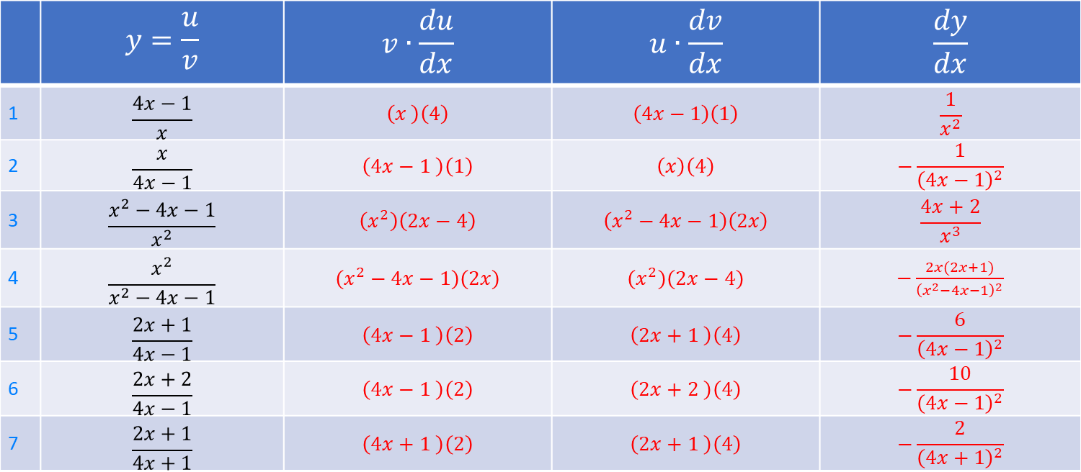
 | $$y=\frac{u}{v}$$ | $$v∙\frac{du}{dx}$$ | $$u∙\frac{dv}{dx}$$ | $$\frac{dy}{dx}$$
1 | $$\frac{4x−1}{x}$$ | $$\left(x \right)\left(4\right)$$ | $$\left(4x−1\right)\left(1\right)$$ | $$\frac{1}{x^{2}}$$
2 | $$\frac{x}{4x−1}$$ | $$\left(4x−1 \right)\left(1\right)$$ | $$\left(x\right)\left(4\right)$$ | $$−\frac{1}{{\left(4x−1\right)}^{2}}$$
3 | $$\frac{x^{2}−4x−1}{x^{2}}$$ | $$\left(x^{2}\right)\left(2x−4\right)$$ | $$\left(x^{2}−4x−1\right)\left(2x\right)$$ | $$\frac{4x+2}{x^{3}}$$
4 | $$\frac{x^{2}}{x^{2}−4x−1}$$ | $$\left(x^{2}−4x−1\right)\left(2x\right)$$ | $$\left(x^{2}\right)\left(2x−4\right)$$ | $−\frac{2x(2x+1)}{{\left(x^{2}−4x−1\right)}^{2}}$
5 | $$\frac{2x+1}{4x−1}$$ | $$\left(4x−1 \right)\left(2\right)$$ | $$\left(2x+1 \right)\left(4\right)$$ | $$−\frac{6}{{\left(4x−1\right)}^{2}}$$
6 | $$\frac{2x+2}{4x−1}$$ | $$\left(4x−1 \right)\left(2\right)$$ | $$\left(2x+2 \right)\left(4\right)$$ | $$−\frac{10}{{\left(4x−1\right)}^{2}}$$
7 | $$\frac{2x+1}{4x+1}$$ | $$\left(4x+1 \right)\left(2\right)$$ | $$\left(2x+1 \right)\left(4\right)$$ | $$−\frac{2}{{\left(4x+1\right)}^{2}}$$

Slide 6
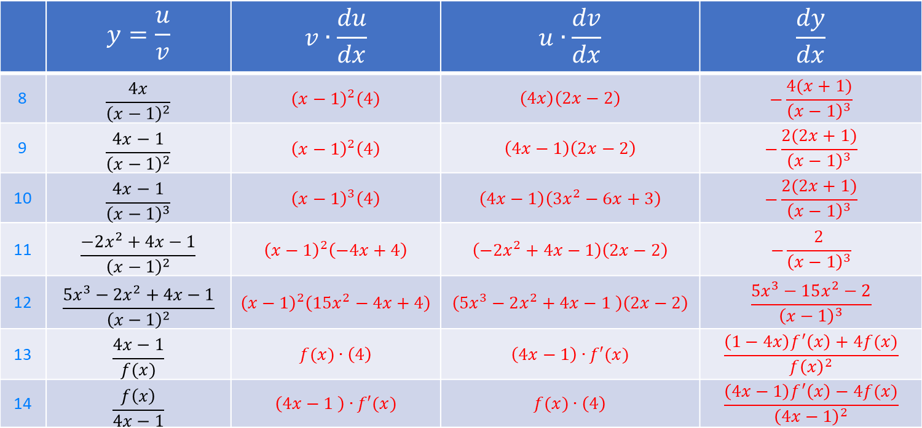
 | $$y=\frac{u}{v}$$ | $$v∙\frac{du}{dx}$$ | $$u∙\frac{dv}{dx}$$ | $$\frac{dy}{dx}$$
8 | $$\frac{4x}{{\left(x−1\right)}^{2}}$$ | $${\left(x−1\right)}^{2}\left(4\right)$$ | $$\left(4x\right)\left(2x−2\right)$$ | $$−\frac{4(x+1)}{{\left(x−1\right)}^{3}}$$
9 | $$\frac{4x−1}{{\left(x−1\right)}^{2}}$$ | $${\left(x−1\right)}^{2}\left(4\right)$$ | $$\left(4x−1\right)\left(2x−2\right)$$ | $$−\frac{2(2x+1)}{{\left(x−1\right)}^{3}}$$
10 | $$\frac{4x−1}{{\left(x−1\right)}^{3}}$$ | $${\left(x−1\right)}^{3}\left(4\right)$$ | $$\left(4x−1\right)\left(3x^{2}−6x+3\right)$$ | $$−\frac{2(2x+1)}{{\left(x−1\right)}^{3}}$$
11 | $$\frac{−2x^{2}+4x−1}{{\left(x−1\right)}^{2}}$$ | $${\left(x−1\right)}^{2}\left(−4x+4\right)$$ | $$\left(−2x^{2}+4x−1\right)\left(2x−2\right)$$ | $$−\frac{2}{{\left(x−1\right)}^{3}}$$
12 | $$\frac{5x^{3}−2x^{2}+4x−1}{{\left(x−1\right)}^{2}}$$ | $${\left(x−1\right)}^{2}\left(15x^{2}−4x+4\right)$$ | $$\left(5x^{3}−2x^{2}+4x−1 \right)\left(2x−2\right)$$ | $$\frac{5x^{3}−15x^{2}−2}{{\left(x−1\right)}^{3}}$$
13 | $$\frac{4x−1}{f(x)}$$ | $$f(x)∙\left(4\right)$$ | $$\left(4x−1\right)∙f′(x)$$ | $$\frac{\left(1−4x\right)f^{′}\left(x\right)+4f(x)}{f{\left(x\right)}^{2}}$$
14 | $$\frac{f\left(x\right)}{4x−1}$$ | $$\left(4x−1 \right)∙f′(x)$$ | $$f(x)∙\left(4\right)$$ | $$\frac{\left(4x−1\right)f^{′}\left(x\right)−4f(x)}{{\left(4x−1\right)}^{2}}$$

