Slide 1
Quotient Rule Polynomials
Silent
Teacher
Intelligent Practice
Narration
Your Turn
$$\frac{d}{dx}\frac{2x}{ x−1}$$
$$\frac{d}{dx} \frac{x^{2}−x+5}{x^{3}−2x−1}$$
Practice

Slide 2
Worked Example
Your Turn
Find $\frac{dy}{dx}$ of $\frac{9x^{2}−1}{3x}$
Find $\frac{dy}{dx}$ of $\frac{2x^{2}−x}{2x}$
Differentiate $\frac{2x^{2}−2x+1}{3x−1}$
Differentiate $\frac{3x^{2}+5x−1}{4x+1}$
@DrChris_Baker
Notes:
The teacher can show both ways of doing these too, via simplifying or via the quotient rule and then simplifying.

Slide 3
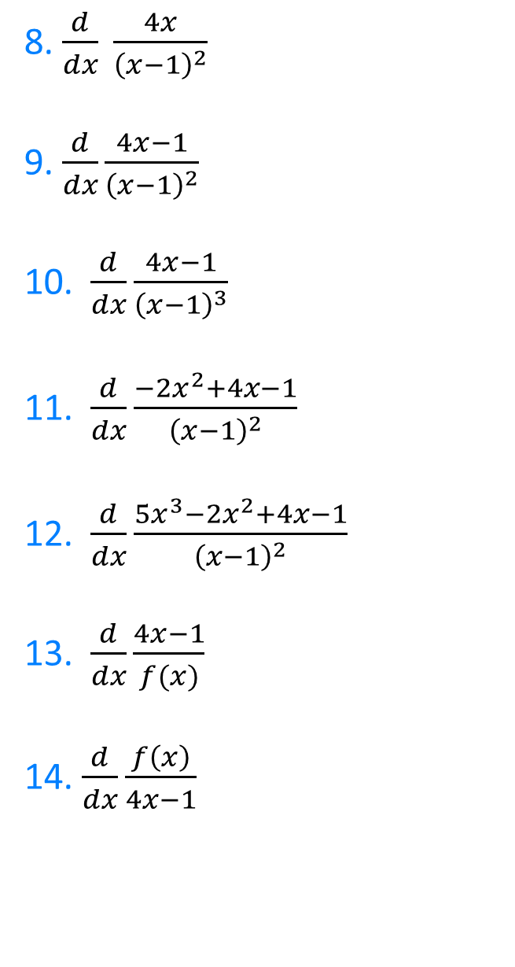

1. $\frac{d}{dx}\frac{4x−1}{x}$
2. $\frac{d}{dx}\frac{x}{4x−1}$
3. $\frac{d}{dx}\frac{x^{2}−4x−1}{x^{2}}$
4. $\frac{d}{dx} \frac{x^{2}}{x^{2}−4x−1}$
5. $\frac{d}{dx} \frac{2x+1}{4x−1}$
6.$\frac{d}{dx}\frac{2x+2}{4x−1}$
7. $\frac{d}{dx}\frac{2x+1}{4x+1}$
8. $\frac{d}{dx} \frac{4x}{{\left(x−1\right)}^{2}}$
9. $\frac{d}{dx}\frac{4x−1}{{\left(x−1\right)}^{2}}$
10. $\frac{d}{dx}\frac{4x−1}{{\left(x−1\right)}^{3}}$
11. $\frac{d}{dx}\frac{−2x^{2}+4x−1}{{\left(x−1\right)}^{2}}$
12. $\frac{d}{dx}\frac{5x^{3}−2x^{2}+4x−1}{{\left(x−1\right)}^{2}}$
13.$\frac{d}{dx}\frac{4x−1}{f(x)}$
14. $\frac{d}{dx}\frac{f\left(x\right)}{4x−1}$
@DrChris_Baker

Slide 4
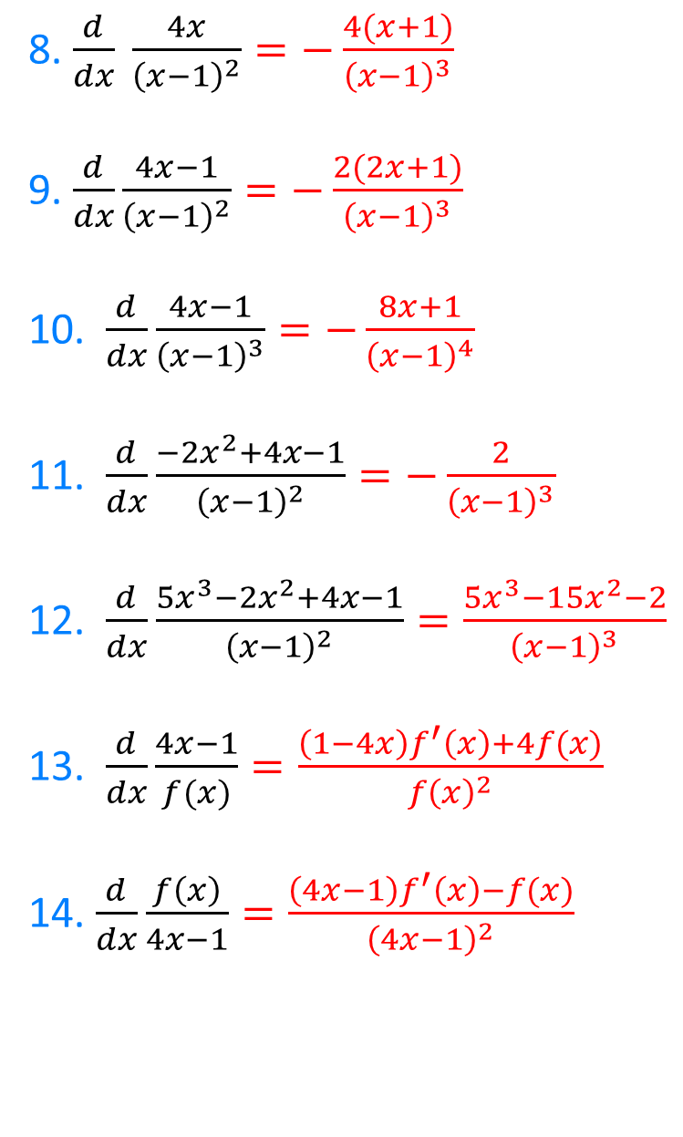
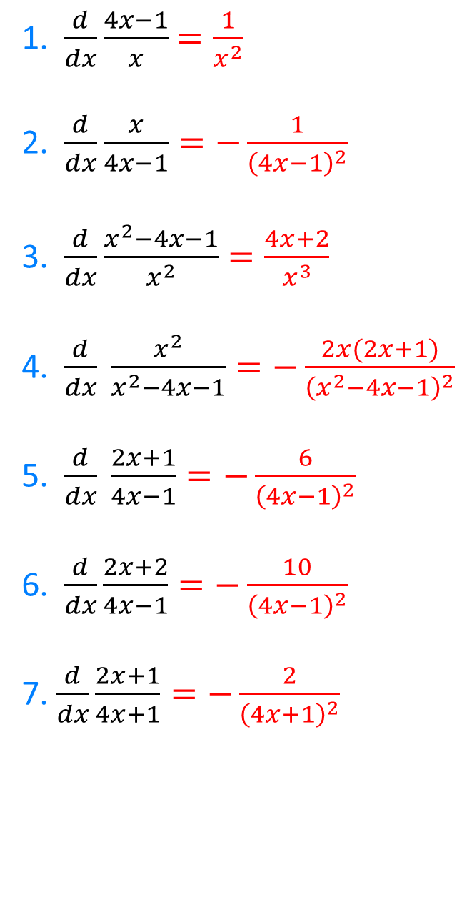
8. $\frac{d}{dx} \frac{4x}{{\left(x−1\right)}^{2}}=−\frac{4(x+1)}{{\left(x−1\right)}^{3}}$
9. $\frac{d}{dx}\frac{4x−1}{{\left(x−1\right)}^{2}}=−\frac{2(2x+1)}{{\left(x−1\right)}^{3}}$
10. $\frac{d}{dx}\frac{4x−1}{{\left(x−1\right)}^{3}}=−\frac{8x+1}{{\left(x−1\right)}^{4}}$
11. $\frac{d}{dx}\frac{−2x^{2}+4x−1}{{\left(x−1\right)}^{2}}=−\frac{2}{{\left(x−1\right)}^{3}}$
12. $\frac{d}{dx}\frac{5x^{3}−2x^{2}+4x−1}{{\left(x−1\right)}^{2}}=\frac{5x^{3}−15x^{2}−2}{{\left(x−1\right)}^{3}}$
13.$\frac{d}{dx}\frac{4x−1}{f(x)}=\frac{\left(1−4x\right)f^{′}\left(x\right)+4f(x)}{f{\left(x\right)}^{2}}$
14. $\frac{d}{dx}\frac{f\left(x\right)}{4x−1}=\frac{\left(4x−1\right)f^{′}\left(x\right)−f(x)}{{\left(4x−1\right)}^{2}}$
1. $\frac{d}{dx}\frac{4x−1}{x}$ $=\frac{1}{x^{2}}$
2. $\frac{d}{dx}\frac{x}{4x−1}=−\frac{1}{{\left(4x−1\right)}^{2}}$
3. $\frac{d}{dx}\frac{x^{2}−4x−1}{x^{2}}=\frac{4x+2}{x^{3}}$
4. $\frac{d}{dx} \frac{x^{2}}{x^{2}−4x−1}=−\frac{2x(2x+1)}{{\left(x^{2}−4x−1\right)}^{2}}$
5. $\frac{d}{dx} \frac{2x+1}{4x−1}=−\frac{6}{{\left(4x−1\right)}^{2}}$
6.$\frac{d}{dx}\frac{2x+2}{4x−1}=−\frac{10}{{\left(4x−1\right)}^{2}}$
7. $\frac{d}{dx}\frac{2x+1}{4x+1}=−\frac{2}{{\left(4x+1\right)}^{2}}$
@DrChris_Baker

