Slide 1
Quadratic Equations:
Solving by factorising when coefficient of $x^{2}$>1
Silent
Teacher
Intelligent Practice
Narration
Your Turn
${2x}^{2}+6x +4$ = 0
${2x}^{2}−2x −4$ = 0
Practice

Slide 2

Worked Example
Your Turn
${2x}^{2}+3x +1$ = 0 ${2x}^{2}−3x +1$ = 0
@mathsmiles_k

Slide 3
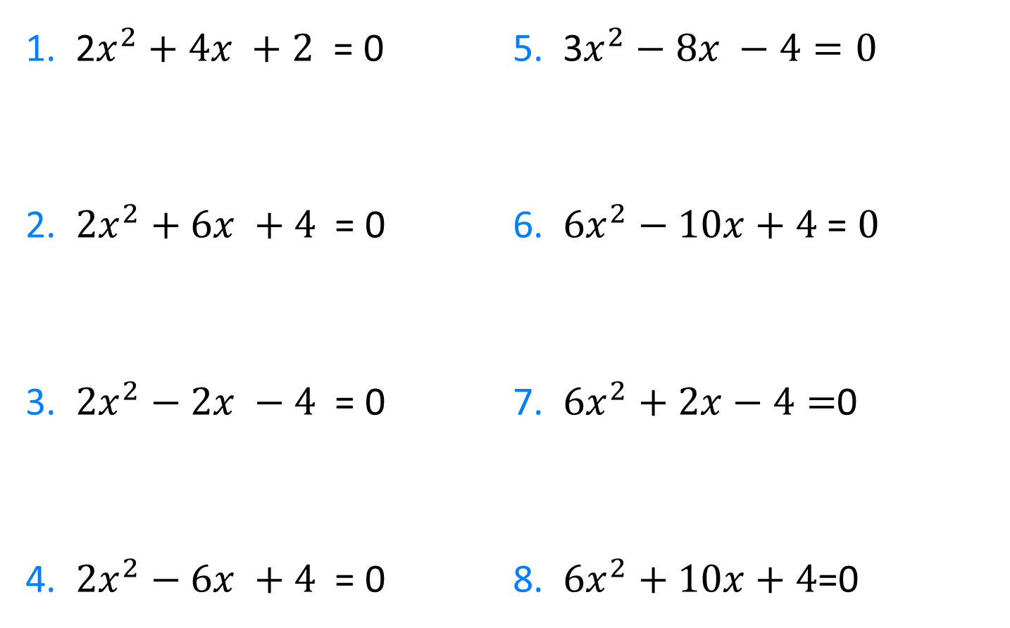
1. 2$x^{2}+4x +2$ = 0
2. ${2x}^{2}+6x +4$ = 0
3. ${2x}^{2}−2x −4$ = 0
4. ${2x}^{2}−6x +4$ = 0
5. 3$x^{2}−8x −4=0$
6. ${6x}^{2}−10x+4$= $0$
7. ${6x}^{2}+2x−4=$0
8. ${6x}^{2}+10x+4$=0
@mathsmiles_k

Slide 4
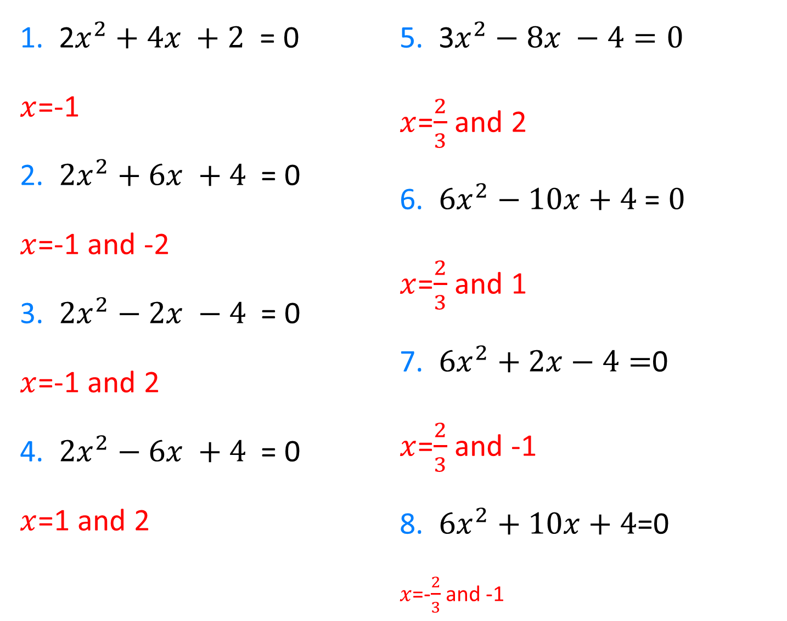
1. 2$x^{2}+4x +2$ = 0
$x$=-1
2. ${2x}^{2}+6x +4$ = 0
$x$=-1 and -2
3. ${2x}^{2}−2x −4$ = 0
$x$=-1 and 2
4. ${2x}^{2}−6x +4$ = 0
$x$=1 and 2
5. 3$x^{2}−8x −4=0$
$x$=$\frac{2}{3}$ and 2
6. ${6x}^{2}−10x+4$= $0$
$x$=$\frac{2}{3}$ and 1
7. ${6x}^{2}+2x−4=$0
$x$=$\frac{2}{3}$ and -1
8. ${6x}^{2}+10x+4$=0
$x$=-$\frac{2}{3}$ and -1
@mathsmiles_k

