Slide 1
Addition in different bases
Silent
Teacher
Intelligent Practice
Narration
Your Turn
$10+11$(base 2)
$14+43$ (base 5)
$2A+34$(base 16)
Practice

Slide 2
Worked Example
Your Turn
$101+111$(base 2)
$110+101$(base 2)
$211+120$(base 3)
$315+403$(base 6)
$1A+41$(base 16)
$39+3C$(base 16)
@DrChris_Baker
Notes:
101+111 (base 2) = 1100 110+101 (base 2) = 1011
211+120 (base 3) = 1101 315+403 (base 6) = 1122
1A+41 (base 16) = 5b 39+3C (base 16) = 75

Slide 3
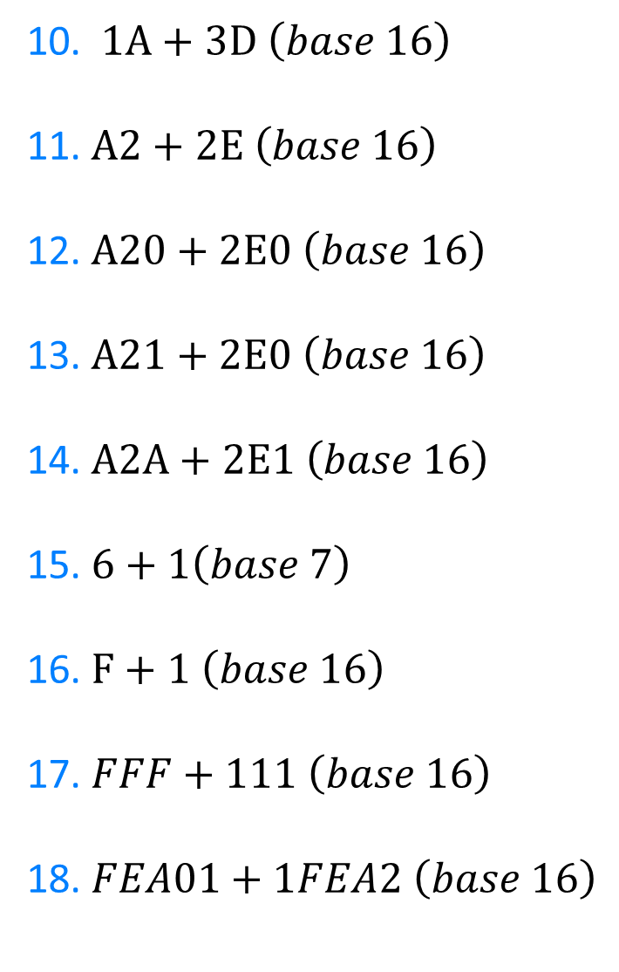
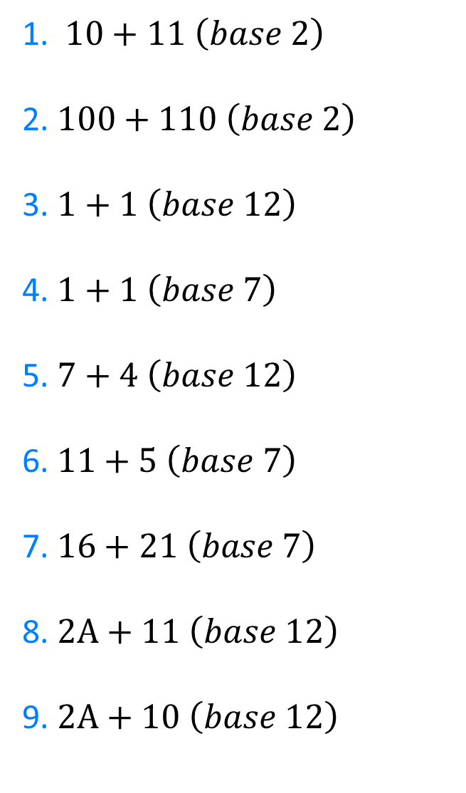
1. $10+11 \left(base 2\right)$
2. $100+110 \left(base 2\right)$
3. $1+1 \left(base 12\right)$
4. $1+1 \left(base 7\right)$
5. $7+4 \left(base 12\right)$
6.$11+5 \left(base 7\right)$
7. $16+21 \left(base 7\right)$
8. $2A+11 \left(base 12\right)$
9. $2A+10 \left(base 12\right)$
10. $1A+3D \left(base 16\right)$
11. $A2+2E \left(base 16\right)$
12. $A20+2E0 \left(base 16\right)$
13. $A21+2E0 \left(base 16\right)$
14. $A2A+2E1 \left(base 16\right)$
15.$6+1\left(base 7\right)$
16. $F+1 \left(base 16\right)$
17. $FFF+111 \left(base 16\right)$
18. $FEA01+1FEA2 \left(base 16\right)$
@DrChris_Baker

Slide 4
10. $1A+3D \left(base 16\right)$
11. $A2+2E \left(base 16\right)$
12. $A20+2E0 \left(base 16\right)$
13. $A21+2E0 \left(base 16\right)$
14. $A2A+2E1 \left(base 16\right)$
15.$6+1\left(base 7\right)$
16. $F+1 \left(base 16\right)$
17. $FFF+111 \left(base 16\right)$
18. $FEA01+1FEA2 \left(base 16\right)$
57
D0
D00
D01
D0B
10
10
1110
11E8A3
1. $10+11 \left(base 2\right)$
2. $100+110 \left(base 2\right)$
3. $1+1 \left(base 12\right)$
4. $1+1 \left(base 7\right)$
5. $7+4 \left(base 12\right)$
6.$11+5 \left(base 7\right)$
7. $16+21 \left(base 7\right)$
8. $2A+11 \left(base 12\right)$
9. $2A+10 \left(base 12\right)$
101
1010
2
2
B
16
40
40
3A
@DrChris_Baker

