Slide 1
Additive Inverse
Silent
Teacher
Intelligent Practice
Narration
Your Turn
$$2+(−2)=0$$
$$−2+2=0$$
$$3−3=0$$
Practice

Slide 2



Worked Example
Your Turn
Find the inverse of:
Find the inverse of:
$$5+\left[\right]=0$$
$$9+\left[\right]=0$$
$$−5+\left[\right]=0$$
$$−9+\left[\right]=0$$
$$−3+\left[\right]=0$$
$$6+\left[\right]=0$$
@DrChris_Baker
Notes:
Can use the notation ^(-1) too if preferred.

Slide 3
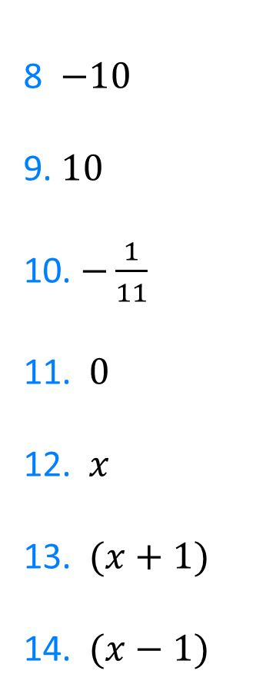

Find the additive inverse of:
1. $3$
2. $2$
3. $1$
4. $\frac{1}{2}$
5. $−1$
6. $−2$
7. $−4$
8 $−10$
9. $10$
10. $−\frac{1}{11}$
11. $0$
12. $x$
13. $(x+1)$
14. $(x−1)$
@DrChris_Baker

Slide 4

Find the additive inverse of:
1. $3$
2. $2$
3. $1$
4. $\frac{1}{2}$
5. $−1$
6. $−2$
7. $−4$
$−3$
$−2$
$−1$
$−\frac{1}{2}$
$1$
$2$
$4$
8 $−10$
9. $10$
10. $−\frac{1}{11}$
11. $0$
12. $x$
13. $(x+1)$
14. $(x−1)$
$10$
$−10$
$\frac{1}{11}$
$0$
$−x$
$−\left(x+1\right)≡−x−1$
$−\left(x−1\right)≡−x+1$
$≡1−x$
@DrChris_Baker

