Slide 1
Modulo arithmetic Addition
Silent
Teacher
Intelligent Practice
Narration
Your Turn
$$1+1 (mod 2)$$
$3+4$ (mod 5)
$11+15$(mod 16)
Practice

Slide 2
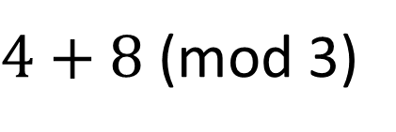
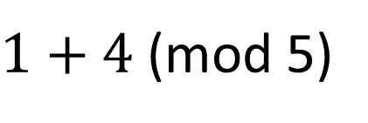
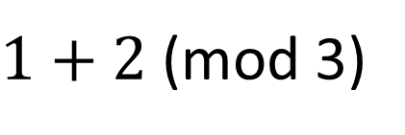
Worked Example
Your Turn
$1+2$(mod 3)
$1+4$(mod 5)
$4+8$(mod 3)
$11+24$(mod 5)
$12+8$(mod 16)
$3+11$(mod 12)
@DrChris_Baker
Notes:
1+2 (mod 3) = 0 1+4 (mod 5) = 0
4+8 (mod 3) = 0 11+24 (mod 5) = 0
12+8 (mod 16) = 4 3+12 (mod 12) = 2

Slide 3
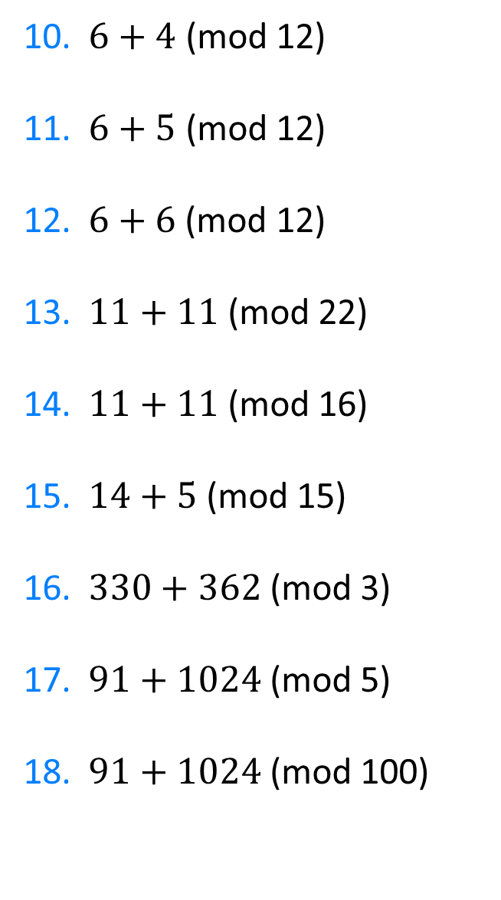
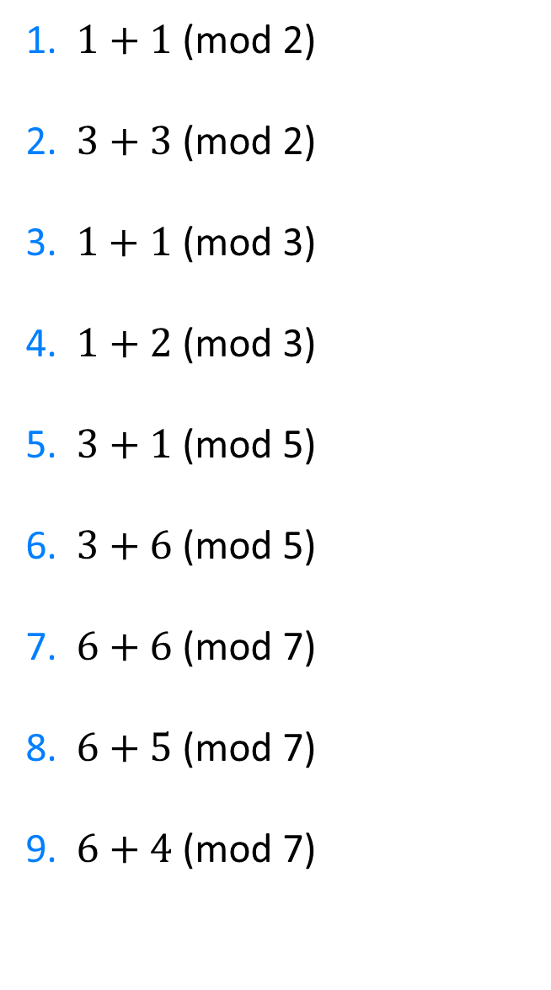
1. $1+1$ (mod 2)
2. $3+3$ (mod 2)
3.$1+1$ (mod 3)
4. $1+2$ (mod 3)
5. $3+1$ (mod 5)
6. $3+6\text{ (}\text{mod}\text{ 5)}$
7. $6+6$ (mod 7)
8. $6+5$ (mod 7)
9. $6+4$ (mod 7)
10. $6+4$ (mod 12)
11. $6+5$ (mod 12)
12.$6+6$ (mod 12)
13. $11+11$ (mod 22)
14. $11+11$ (mod 16)
15. $\text{14 + 5}\text{ (}\text{mod}\text{ 15)}$
16. $330+362$ (mod 3)
17. $91+1024$ (mod 5)
18. $91+1024$ (mod 100)
@DrChris_Baker

Slide 4
1. $1+1$ (mod 2)
2. $3+3$ (mod 2)
3.$1+1$ (mod 3)
4. $1+2$ (mod 3)
5. $3+1$ (mod 5)
6. $3+6\text{ (}\text{mod}\text{ 5)}$
7. $6+6$ (mod 7)
8. $6+5$ (mod 7)
9. $6+4$ (mod 7)
0
0
2
0
4
4
5
4
3
10. $6+4$ (mod 12)
11. $6+5$ (mod 12)
12.$6+6$ (mod 12)
13. $11+11$ (mod 22)
14. $11+11$ (mod 16)
15. $\text{14 + 5}\text{ (}\text{mod}\text{ 15)}$
16. $330+362$ (mod 3)
17. $91+1024$ (mod 5)
18. $91+1024$ (mod 100)
10
11
0
0
6
4
2
0
15
@DrChris_Baker

