Slide 1
Modulo arithmetic Equivalence
Silent
Teacher
Intelligent Practice
Narration
Your Turn
$$14 (mod 2)$$
$412$ (mod 5)
$−10$(mod 16)
Practice

Slide 2
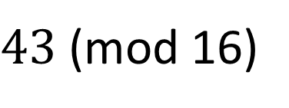
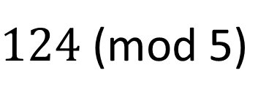
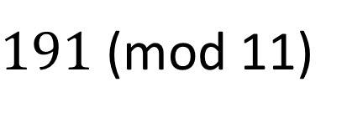
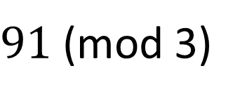
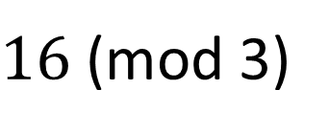
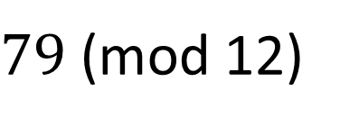
Worked Example
Your Turn
$16$(mod 3)
$91$(mod 3)
$191$(mod 11)
$124$(mod 5)
$43$(mod 16)
$79$(mod 12)
@DrChris_Baker
Notes:
16 (mod 3) = 1 91 (mod 3) = 1
191 (mod 11) = 4 124 (mod 5) = 4
43 (mod 16) = 11 79 (mod 12) = 7

Slide 3
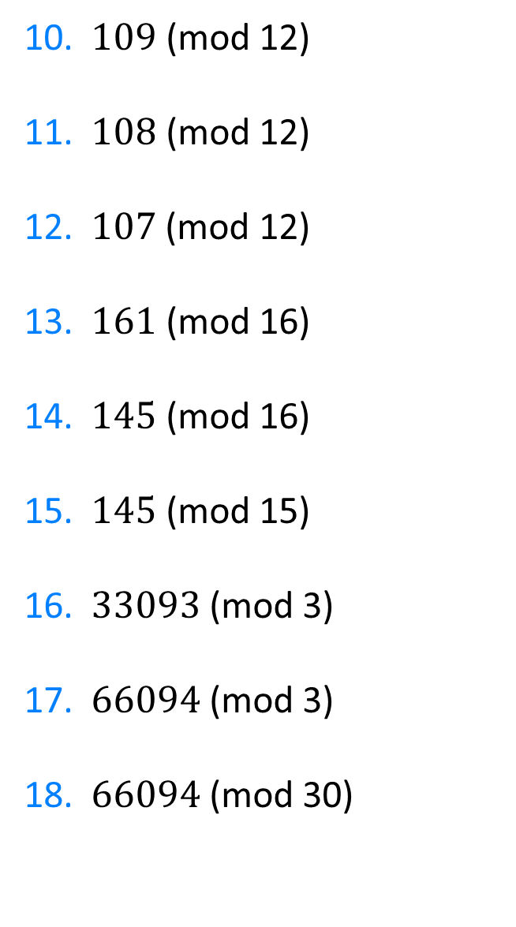
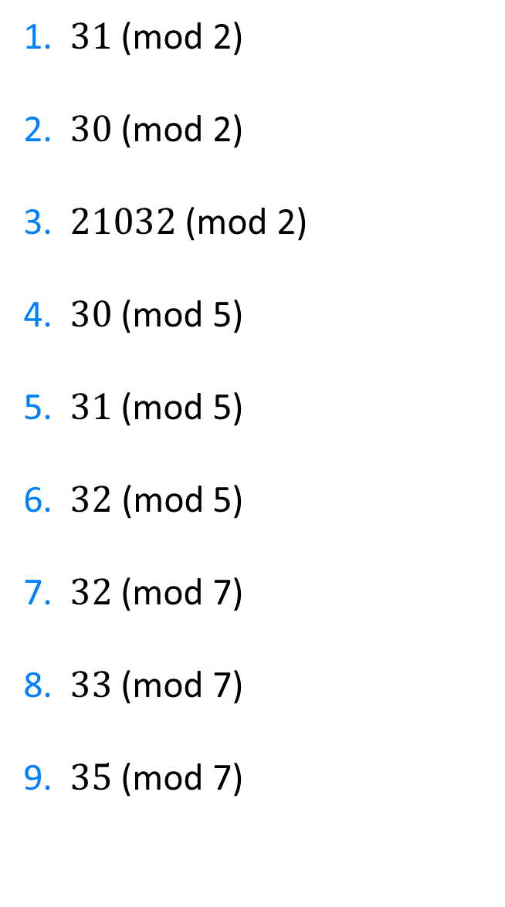
1. $31$ (mod 2)
2. $30$ (mod 2)
3.$21032$ (mod 2)
4. $30$ (mod 5)
5. $31$ (mod 5)
6. $32\text{ (}\text{mod}\text{ 5)}$
7. $32$ (mod 7)
8. $33$ (mod 7)
9. $35$ (mod 7)
10. $109$ (mod 12)
11. $108$ (mod 12)
12.$107$ (mod 12)
13. $161$ (mod 16)
14. $145$ (mod 16)
15. $\text{145}\text{ (}\text{mod}\text{ 15)}$
16. $33093$ (mod 3)
17. $66094$ (mod 3)
18. $66094$ (mod 30)
@DrChris_Baker

Slide 4
1. $31$ (mod 2)
2. $30$ (mod 2)
3.$21032$ (mod 2)
4. $30$ (mod 5)
5. $31$ (mod 5)
6. $32\text{ (}\text{mod}\text{ 5)}$
7. $32$ (mod 7)
8. $33$ (mod 7)
9. $35$ (mod 7)
1
0
1
0
1
2
4
5
0
10. $109$ (mod 12)
11. $108$ (mod 12)
12.$107$ (mod 12)
13. $161$ (mod 16)
14. $145$ (mod 16)
15. $\text{145}\text{ (}\text{mod}\text{ 15)}$
16. $33093$ (mod 3)
17. $66094$ (mod 3)
18. $66094$ (mod 30)
1
0
11
1
1
10
0
1
4
@DrChris_Baker

