Slide 1
Modulo arithmetic Multiplicative Inverse
Silent
Teacher
Intelligent Practice
Narration
Your Turn
$$1^{−1} (mod 2)$$
$3^{−1}$ (mod 5)
$4^{−1}$(mod 16)
Practice

Slide 2
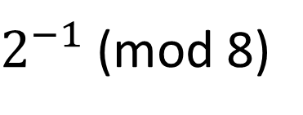
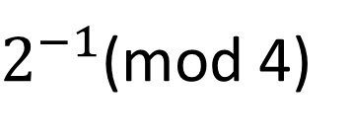
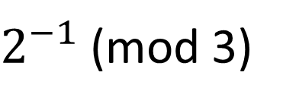
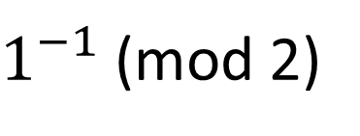
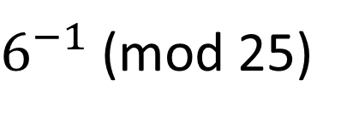
Worked Example
Your Turn
$1^{−1}$ (mod 2)
$2^{−1}$(mod 3)
$2^{−1}$(mod 4)
$2^{−1}$(mod 8)
${13}^{−1}$(mod 16)
$6^{−1}$(mod 25)
@DrChris_Baker
Notes:
1^-1 (mod 2) = 1 2^-1 (mod 3) = 2 Emphasis that if they are not coprime, as in the GCD/HCF is not 1
2^-1mod 6) = Not invertible 11+24 (mod 5) = 0 then there is no inverse.
13^-1 (mod 16) = 5 6^-1 (mod 25) = 21

Slide 3
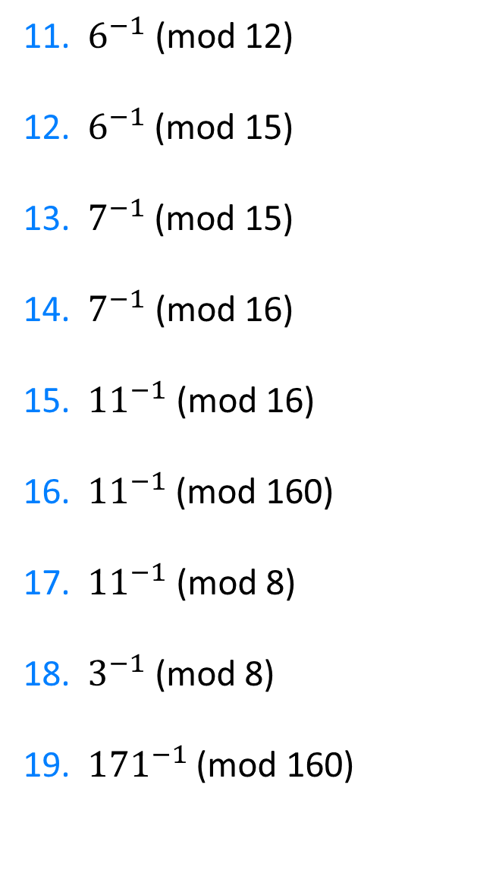
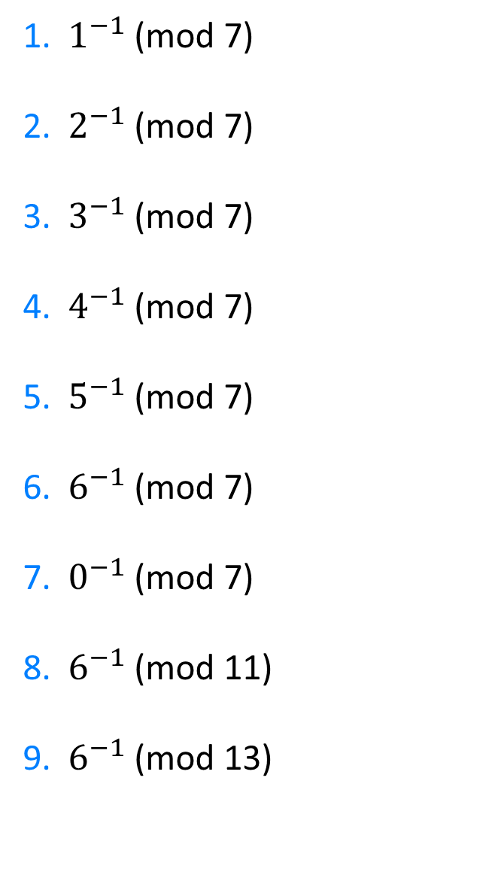
1. $1^{−1}$ (mod 7)
2. ${ 2}^{−1}$ (mod 7)
3.${ 3}^{−1}$ (mod 7)
4. $4^{−1}$ (mod 7)
5. $5^{−1}$ (mod 7)
6.${ 6}^{−1}$ (mod 7)
7. $0^{−1}$ (mod 7)
8. $6^{−1}$ (mod 11)
9. ${ 6}^{−1}$ (mod 13)
11. $6^{−1}$ (mod 12)
12. ${ 6}^{−1}$ (mod 15)
13.${ 7}^{−1}$ (mod 15)
14. $7^{−1}$ (mod 16)
15. ${11}^{−1}$ (mod 16)
16.${ 11}^{−1}$ (mod 160)
17. ${11}^{−1}$ (mod 8)
18. $3^{−1}$ (mod 8)
19. ${ 171}^{−1}$ (mod 160)
@DrChris_Baker

Slide 4
1. $1^{−1}$ (mod 7)
2. ${ 2}^{−1}$ (mod 7)
3.${ 3}^{−1}$ (mod 7)
4. $4^{−1}$ (mod 7)
5. $5^{−1}$ (mod 7)
6.${ 6}^{−1}$ (mod 7)
7. $0^{−1}$ (mod 7)
8. $6^{−1}$ (mod 11)
9. ${ 6}^{−1}$ (mod 13)
None
None
13
7
3
131
3
3
131
1
4
5
2
3
6
Not invertible
2
11
11. $6^{−1}$ (mod 12)
12. ${ 6}^{−1}$ (mod 15)
13.${ 7}^{−1}$ (mod 15)
14. $7^{−1}$ (mod 16)
15. ${11}^{−1}$ (mod 16)
16.${ 11}^{−1}$ (mod 160)
17. ${11}^{−1}$ (mod 8)
18. $3^{−1}$ (mod 8)
19. ${ 171}^{−1}$ (mod 160)
@DrChris_Baker

