Slide 1
Modulo arithmetic Multiplication
Silent
Teacher
Intelligent Practice
Narration
Your Turn
$$1×0 (mod 2)$$
$4×3$ (mod 5)
$11×15$(mod 16)
Practice

Slide 2
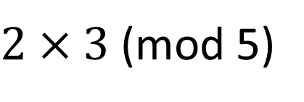
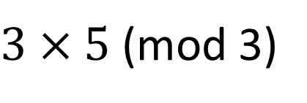
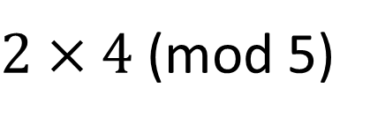
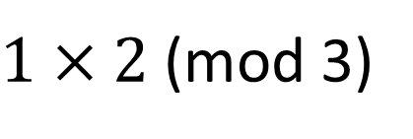
Worked Example
Your Turn
$1×2$(mod 3)
$2×4$(mod 5)
$3×5$(mod 3)
$2×3$(mod 5)
$12×8$(mod 16)
$3×11$(mod 12)
@DrChris_Baker
Notes:
1x2 (mod 3) = 2 1x4 (mod 5) = 4
3x5 (mod 3) = 0 2x3 (mod 5) = 1
12x8 (mod 16) = 0 3x11(mod 12) = 9

Slide 3
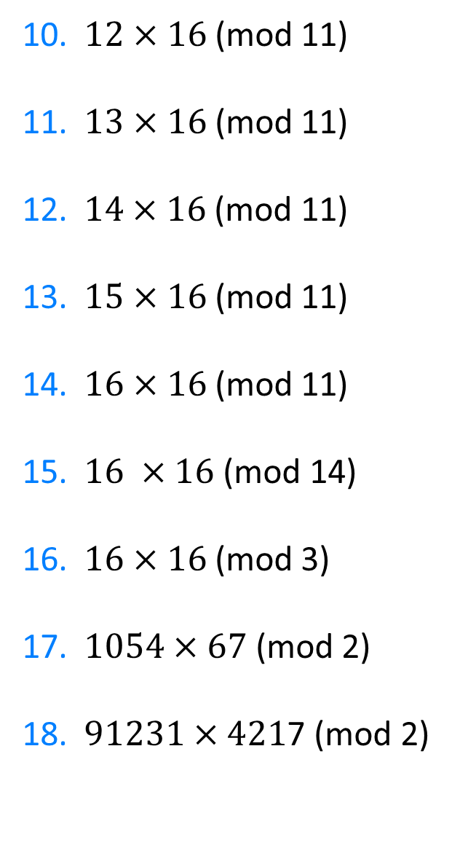
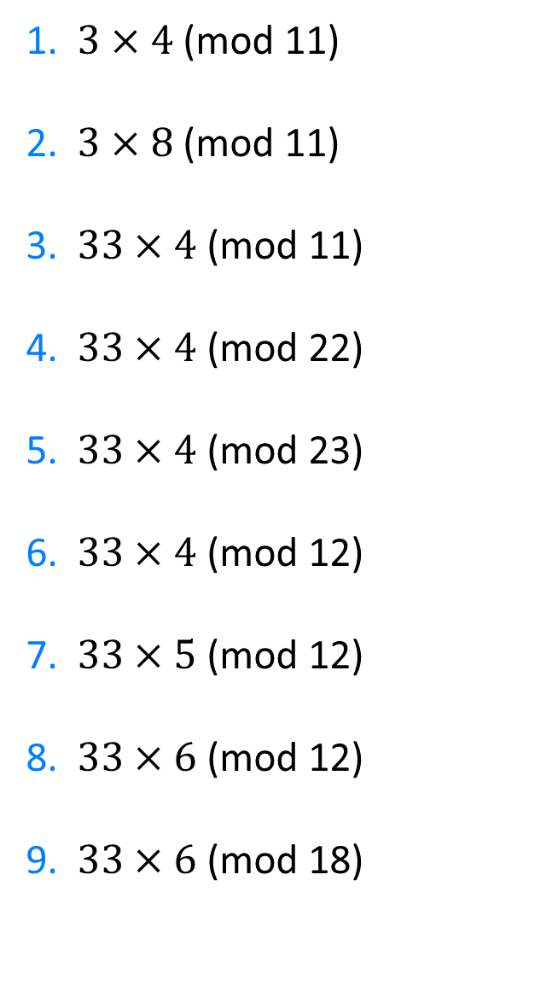
1. $3×4$ (mod 11)
2. $3×8$ (mod 11)
3.$33×4$ (mod 11)
4. $33×4$ (mod 22)
5. $33×4$ (mod 23)
6. $33×4\text{ (}\text{mod}\text{ 12}\text{)}$
7. $33×5$ (mod 12)
8. $33×6$ (mod 12)
9. $33×6$ (mod 18)
10. $12×16$ (mod 11)
11. $13×16$ (mod 11)
12.$14×16$ (mod 11)
13. $15×16$ (mod 11)
14. $16×16$ (mod 11)
15. $\text{16 }×\text{16}\text{ (}\text{mod}\text{ 14)}$
16. $16×16$ (mod 3)
17. $1054×67$ (mod 2)
18. $91231×421$7 (mod 2)
@DrChris_Baker

Slide 4
1. $3×4$ (mod 11)
2. $3×8$ (mod 11)
3.$33×4$ (mod 11)
4. $33×4$ (mod 22)
5. $33×4$ (mod 23)
6. $33×4\text{ (}\text{mod}\text{ 12}\text{)}$
7. $33×5$ (mod 12)
8. $33×6$ (mod 12)
9. $33×6$ (mod 18)
1
2
0
0
17
0
9
6
0
10. $12×16$ (mod 11)
11. $13×16$ (mod 11)
12.$14×16$ (mod 11)
13. $15×16$ (mod 11)
14. $16×16$ (mod 11)
15. $\text{16 }×\text{16}\text{ (}\text{mod}\text{ 14)}$
16. $16×16$ (mod 3)
17. $1054×67$ (mod 2)
18. $91231×421$7 (mod 2)
5
10
4
9
3
4
1
0
1
@DrChris_Baker

