Slide 1
Multiplication in different bases
Silent
Teacher
Intelligent Practice
Narration
Your Turn
$1011×1101$(base 2)
$132×140$ (base 5)
$210×3F1$(base 16)
Practice

Slide 2
Worked Example
Your Turn
$101×111$(base 2)
$110×101$(base 2)
$211×120$(base 3)
$315×403$(base 6)
$1B×41$(base 16)
$39×3C$(base 16)
@DrChris_Baker
Notes:
101x111 (base 2) = 100011 110+101 (base 2) = 10100
211x120 (base 3) = 110020 315x403 (base 6) = 212553
1Bx41 (base 16) = 6DB 39x3C (base 16) = D5C

Slide 3
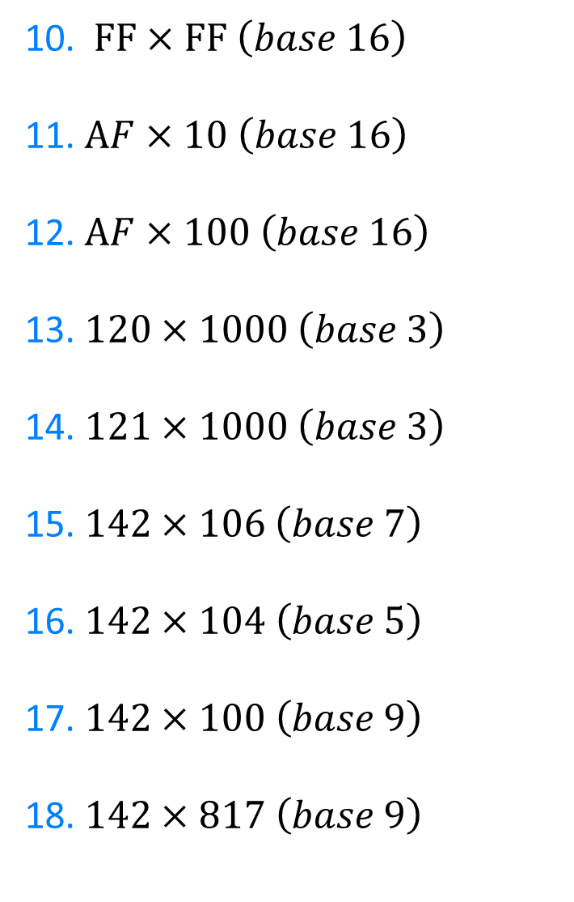
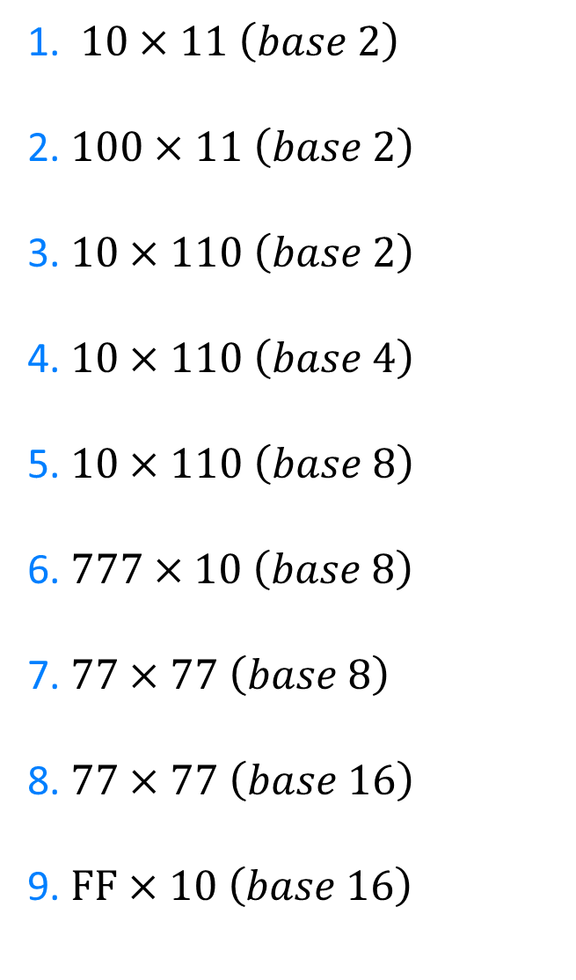
1. $10×11 \left(base 2\right)$
2. $100×11 \left(base 2\right)$
3. $10×110 \left(base 2\right)$
4. $10×110 \left(base 4\right)$
5. $10×110 \left(base 8\right)$
6.$777×10 \left(base 8\right)$
7. $77×77 \left(base 8\right)$
8. $77×77 \left(base 16\right)$
9. $FF×10 \left(base 16\right)$
10. $FF×FF \left(base 16\right)$
11. $AF×10 \left(base 16\right)$
12. $AF×100 \left(base 16\right)$
13. $120×1000 \left(base 3\right)$
14. $121×1000 \left(base 3\right)$
15.$142×106 \left(base 7\right)$
16. $142×104 \left(base 5\right)$
17. $142×100 \left(base 9\right)$
18. $142×817 \left(base 9\right)$
@DrChris_Baker

Slide 4
10. $FF×FF \left(base 16\right)$
11. $AF×10 \left(base 16\right)$
12. $AF×100 \left(base 16\right)$
13. $120×1000 \left(base 3\right)$
14. $121×1000 \left(base 3\right)$
15.$142×106 \left(base 7\right)$
16. $142×104 \left(base 5\right)$
17. $142×100 \left(base 9\right)$
18. $142×817 \left(base 9\right)$
FE01
AF0
AF00
120000
121000
15445
20423
14200
130345
1. $10×11 \left(base 2\right)$
2. $100×11 \left(base 2\right)$
3. $10×110 \left(base 2\right)$
4. $10×110 \left(base 4\right)$
5. $10×110 \left(base 8\right)$
6.$777×10 \left(base 8\right)$
7. $77×77 \left(base 8\right)$
8. $77×77 \left(base 16\right)$
9. $FF×10 \left(base 16\right)$
110
1100
1100
1100
1100
7770
7601
3751
FF0
@DrChris_Baker
Notes:
In Wolfram alpha, use 142_6*106_7 to get answers. You can also use this to the denary representation

