Slide 1
Units of length: Fill in the gaps
Silent
Teacher
Intelligent Practice
Narration
Your Turn
$$km, m, cm, mm$$
Practice

Slide 2
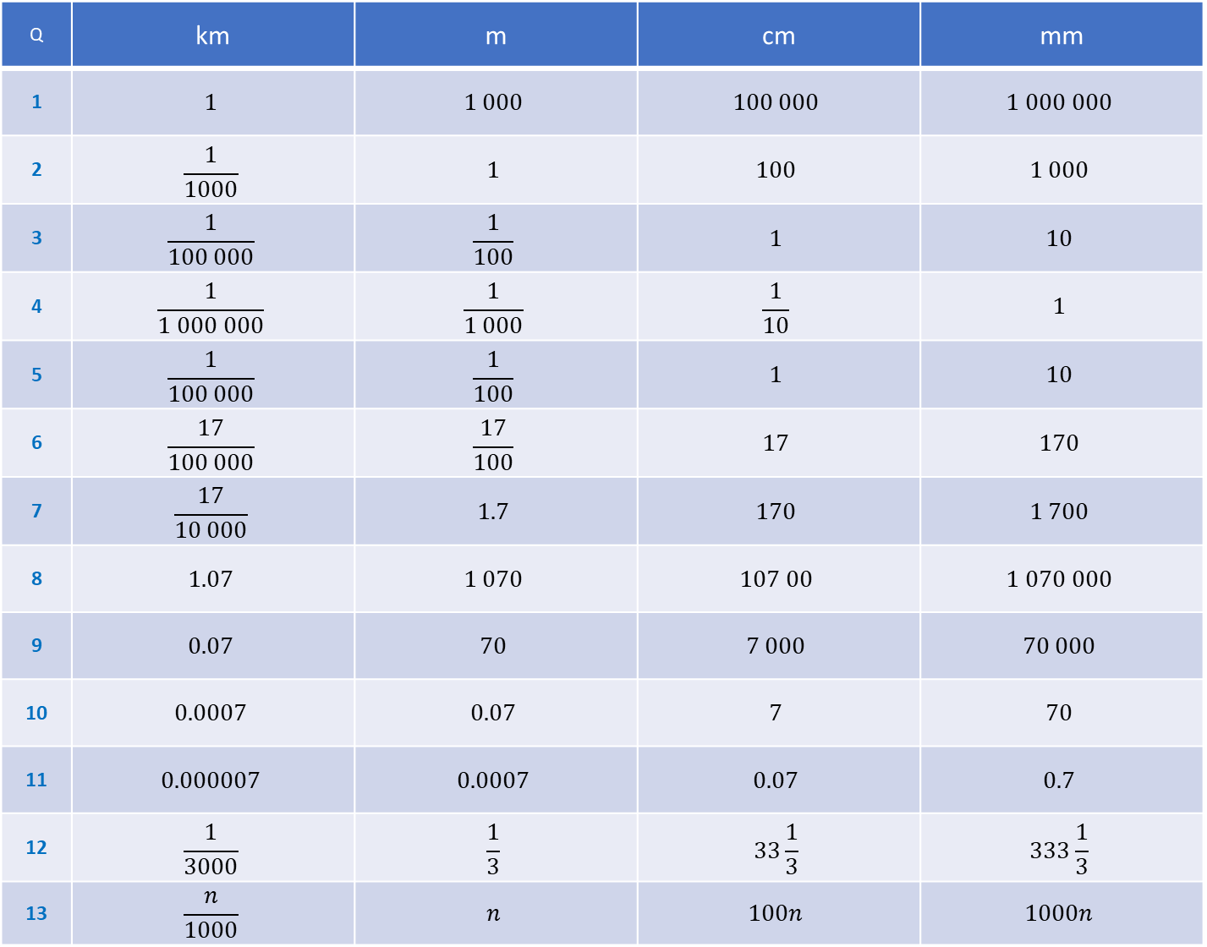
Q | km | m | cm | mm
1 | $$1$$ | $$1 000$$ | $$100 000$$ | $$1 000 000$$
2 | $$\frac{1}{1000}$$ | $$1$$ | $$100$$ | $$1 000$$
3 | $$\frac{1}{100 000}$$ | $$\frac{1}{100}$$ | $$1$$ | $$10$$
4 | $$\frac{1}{1 000 000}$$ | $$\frac{1}{1 000}$$ | $$\frac{1}{10}$$ | $$1$$
5 | $$\frac{1}{100 000}$$ | $$\frac{1}{100}$$ | $$1$$ | $$10$$
6 | $$\frac{17}{100 000}$$ | $$\frac{17}{100}$$ | $$17$$ | $$170$$
7 | $$\frac{17}{10 000}$$ | $$1.7$$ | $$170$$ | $$1 700$$
8 | $$1.07$$ | $$1 070$$ | $$107 00$$ | $$1 070 000$$
9 | $$0.07$$ | $$70$$ | $$7 000$$ | $$70 000$$
10 | $$0.0007$$ | $$0.07$$ | $$7$$ | $$70$$
11 | $$0.000007$$ | $$0.0007$$ | $$0.07$$ | $$0.7$$
12 | $$\frac{1}{3000}$$ | $$\frac{1}{3}$$ | $$33\frac{1}{3}$$ | $$333\frac{1}{3}$$
13 | $$\frac{n}{1000}$$ | $$n$$ | $$100n$$ | $$1000n$$

Slide 3
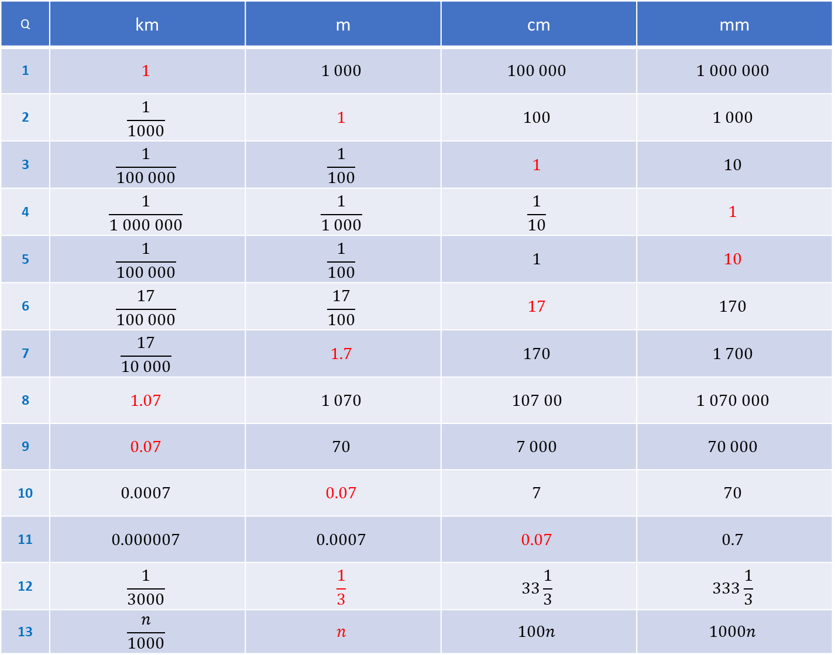
Q | km | m | cm | mm
1 | $$1$$ | $$1 000$$ | $$100 000$$ | $$1 000 000$$
2 | $$\frac{1}{1000}$$ | $$1$$ | $$100$$ | $$1 000$$
3 | $$\frac{1}{100 000}$$ | $$\frac{1}{100}$$ | $$1$$ | $$10$$
4 | $$\frac{1}{1 000 000}$$ | $$\frac{1}{1 000}$$ | $$\frac{1}{10}$$ | $$1$$
5 | $$\frac{1}{100 000}$$ | $$\frac{1}{100}$$ | $$1$$ | $$10$$
6 | $$\frac{17}{100 000}$$ | $$\frac{17}{100}$$ | $$17$$ | $$170$$
7 | $$\frac{17}{10 000}$$ | $$1.7$$ | $$170$$ | $$1 700$$
8 | $$1.07$$ | $$1 070$$ | $$107 00$$ | $$1 070 000$$
9 | $$0.07$$ | $$70$$ | $$7 000$$ | $$70 000$$
10 | $$0.0007$$ | $$0.07$$ | $$7$$ | $$70$$
11 | $$0.000007$$ | $$0.0007$$ | $$0.07$$ | $$0.7$$
12 | $$\frac{1}{3000}$$ | $$\frac{1}{3}$$ | $$33\frac{1}{3}$$ | $$333\frac{1}{3}$$
13 | $$\frac{n}{1000}$$ | $$n$$ | $$100n$$ | $$1000n$$

