Slide 1
Normal distribution: Fill in the gaps
Silent
Teacher
Intelligent Practice
Narration
Your Turn
Practice

Slide 2
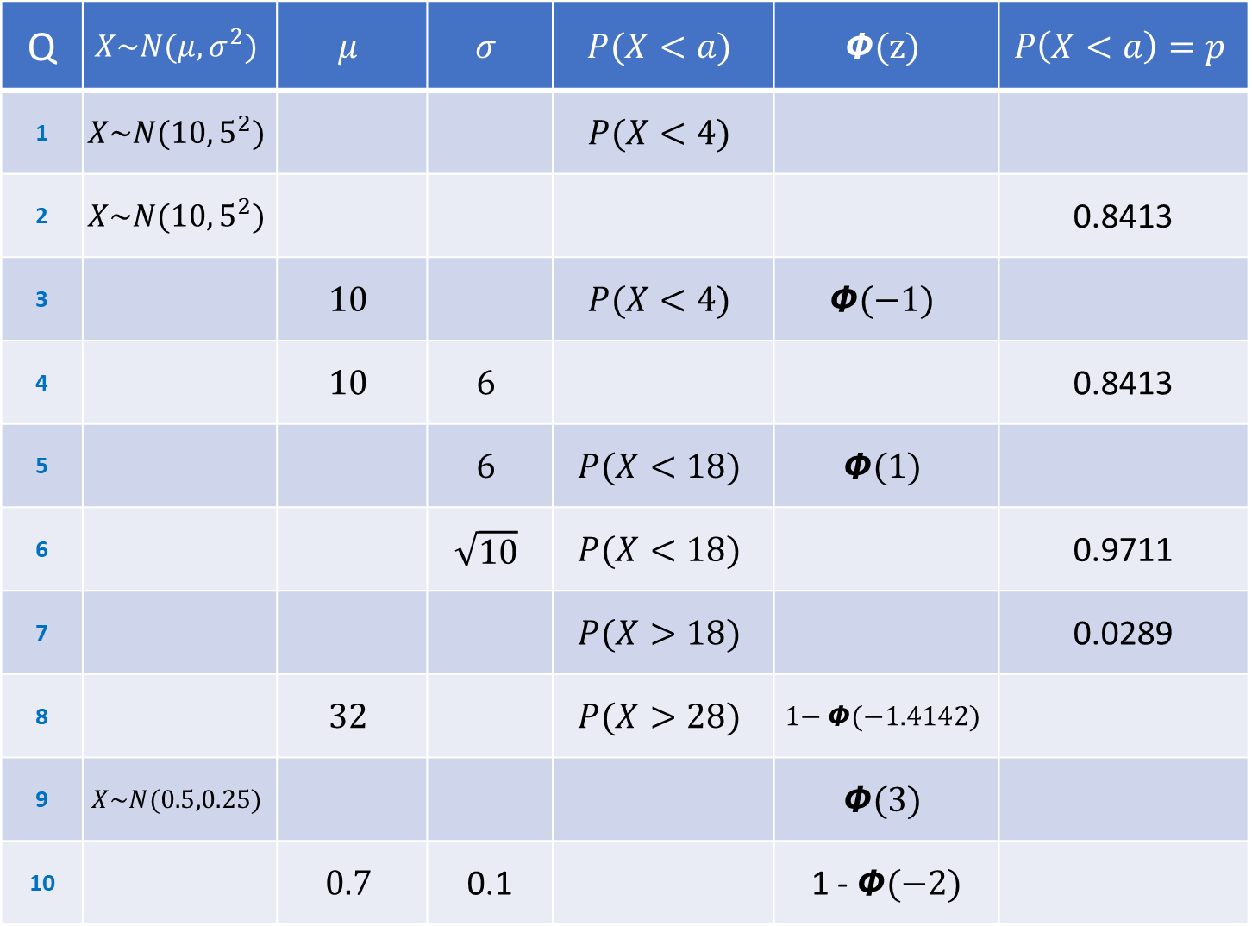
Q | $$X\sim N(μ,σ^{2})$$ | $$μ$$ | $$σ$$ | $$P(X<a)$$ | $$\text{Φ}\text{(}\text{z}\text{)}$$ | $$P\left(X<a\right)=p$$
1 | $$X\sim N(10,5^{2})$$ |  |  | $$P(X<4)$$
2 | $$X\sim N(10,5^{2})$$ |  |  |  |  | 0.8413
3 |  | $$10$$ |  | $$P(X<4)$$ | $$\text{Φ}\text{(−1)}$$
4 |  | $$10$$ | $$6$$ |  |  | 0.8413
5 |  |  | $$6$$ | $$P(X<18)$$ | $$\text{Φ}\text{(1)}$$
6 |  |  | $$\sqrt{10}$$ | $$P(X<18)$$ |  | 0.9711
7 |  |  |  | $$P(X>18)$$ |  | 0.0289
8 |  | $$32$$ |  | $$P(X>28)$$ | $$\text{1− }\text{Φ}\text{(−1.4142)}$$
9 | $$X\sim N(0.5,0.25)$$ |  |  |  | $$\text{Φ}\text{(3)}$$
10 |  | $$0.7$$ | 0.1 |  | 1 - $\text{Φ}\text{(−2)}$

Slide 3
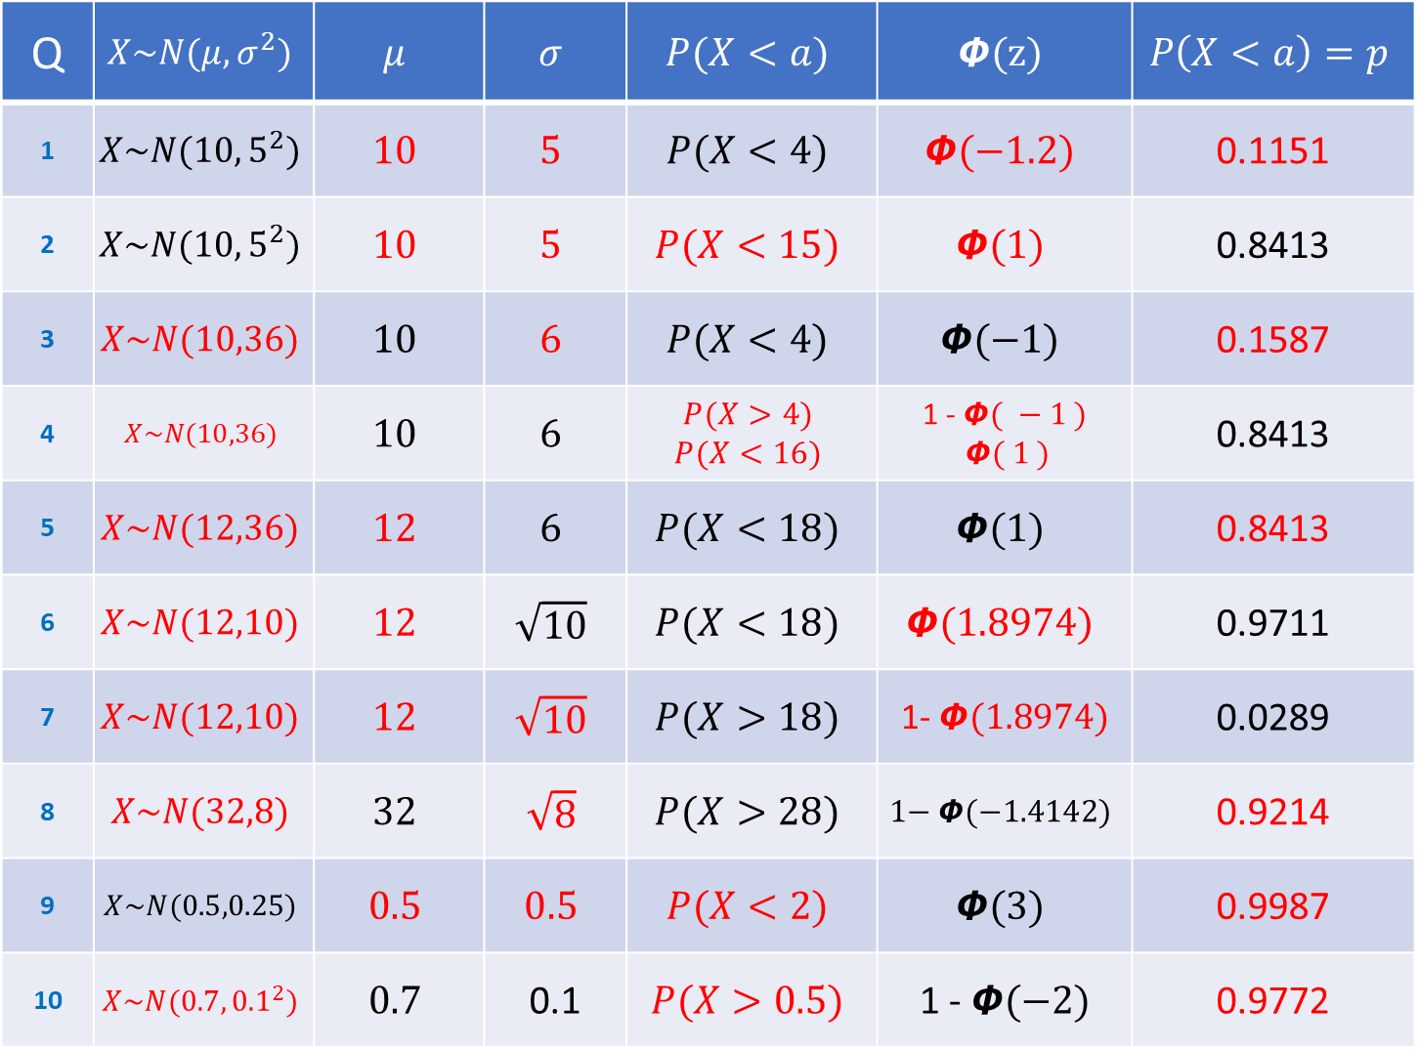
Q | $$X\sim N(μ,σ^{2})$$ | $$μ$$ | $$σ$$ | $$P(X<a)$$ | $$\text{Φ}\text{(}\text{z}\text{)}$$ | $$P\left(X<a\right)=p$$
1 | $$X\sim N(10,5^{2})$$ | $$10$$ | $$5$$ | $$P(X<4)$$ | $$\text{Φ}\text{(−1.2)}$$ | 0.1151
2 | $$X\sim N(10,5^{2})$$ | $$10$$ | $$5$$ | $$P(X<15)$$ | $$\text{Φ}\text{(1)}$$ | 0.8413
3 | $$X\sim N(10,36)$$ | $$10$$ | $$6$$ | $$P(X<4)$$ | $$\text{Φ}\text{(−1)}$$ | 0.1587
4 | $$X\sim N(10,36)$$ | $$10$$ | $$6$$ | $$P(X>4)$$ $$P(X<16)$$ | 1 - $\text{Φ}\text{( }−1\text{ )}$ $\text{Φ}\text{( }1\text{ )}$ | 0.8413
5 | $$X\sim N(12,36)$$ | $$12$$ | $$6$$ | $$P(X<18)$$ | $$\text{Φ}\text{(1)}$$ | 0.8413
6 | $$X\sim N(12,10)$$ | $$12$$ | $$\sqrt{10}$$ | $$P(X<18)$$ | $$\text{Φ}\text{(1.8974)}$$ | 0.9711
7 | $$X\sim N(12,10)$$ | $$12$$ | $$\sqrt{10}$$ | $$P(X>18)$$ | 1- $\text{Φ}\text{(1.8974)}$ | 0.0289
8 | $$X\sim N(32,8)$$ | $$32$$ | $$\sqrt{8}$$ | $$P(X>28)$$ | $$\text{1− }\text{Φ}\text{(−1.4142)}$$ | 0.9214
9 | $$X\sim N(0.5,0.25)$$ | $$0.5$$ | $$0.5$$ | $$P(X<2)$$ | $$\text{Φ}\text{(3)}$$ | 0.9987
10 | $$X\sim N(0.7,{0.1}^{2})$$ | $$0.7$$ | 0.1 | $$P(X>0.5)$$ | 1 - $\text{Φ}\text{(−2)}$ | 0.9772

Slide 4
Q | $$X\sim N(μ,σ^{2})$$ | $$μ$$ | $$σ$$ | $$P(X<a)$$ | $$\text{Φ}\text{(}\text{z}\text{)}$$ | $$P\left(X<a\right)=p$$
1 | $$X\sim N(10,5^{2})$$ | $$10$$ | $$5$$ | $$P(X<4)$$ | $$\text{Φ}\text{(−1.2)}$$ | 0.1151
2 | $$X\sim N(10,5^{2})$$ | $$10$$ | $$5$$ | $$P(X<15)$$ | $$\text{Φ}\text{(1)}$$ | 0.8413
3 | $$X\sim N(10,36)$$ | $$10$$ | $$6$$ | $$P(X<4)$$ | $$\text{Φ}\text{(−1)}$$ | 0.1587
4 | $$X\sim N(10,36)$$ | $$10$$ | $$6$$ | $$P(X>4)$$ $$P(X<16)$$ | 1 - $\text{Φ}\text{( }−1\text{ )}$ $\text{Φ}\text{( }1\text{ )}$ | 0.8413
5 | $$X\sim N(12,36)$$ | $$12$$ | $$6$$ | $$P(X<18)$$ | $$\text{Φ}\text{(1)}$$ | 0.8413
6 | $$X\sim N(12,10)$$ | $$12$$ | $$\sqrt{10}$$ | $$P(X<18)$$ | $$\text{Φ}\text{(1.8974)}$$ | 0.9711
7 | $$X\sim N(12,10)$$ | $$12$$ | $$\sqrt{10}$$ | $$P(X>18)$$ | 1- $\text{Φ}\text{(1.8974)}$ | 0.0289
8 | $$X\sim N(32,8)$$ | $$32$$ | $$\sqrt{8}$$ | $$P(X>28)$$ | $$\text{1− }\text{Φ}\text{(−1.4142)}$$ | 0.9214
9 | $$X\sim N(0.5,0.25)$$ | $$0.5$$ | $$0.5$$ | $$P(X<2)$$ | $$\text{Φ}\text{(3)}$$ | 0.9987
10 | $$X\sim N(0.7,{0.1}^{2})$$ | $$0.7$$ | 0.1 | $$P(X>0.5)$$ | 1 - $\text{Φ}\text{(−2)}$ | 0.9772

