Slide 1
Division with the bus stop method
Silent
Teacher
Intelligent Practice
Narration
Your Turn
$$\left(x+5\right)\left(x+3\right)=$$
$$\left(x+3\right)\left(x+5\right)=$$
$$\left(x−3\right)\left(x+5\right)=$$
Practice

Slide 2
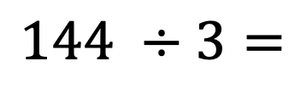
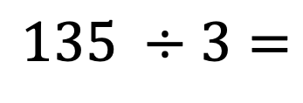
Worked Example
Your Turn
$$135 ÷3=$$
$$144 ÷3=$$
Mrs Beecham

Slide 3


1. $222 ÷3=$
2. $225÷3=$
3. $228÷3=$
4. $528÷3=$
5. $528÷4=$
6. $524÷4 =$
7. $124÷4=$
8. $164÷4=$
9. $160÷4=$
10. $160÷5 =$
11. $190÷5 =$
12.$195÷5 =$
13.$200÷5 =$
14.$240÷5 =$
15.$240÷6 =$
16. $480÷6 =$
17. $480÷3=$
18. $180 ÷3=$
19. $1800 ÷3=$
20. $1803 ÷3=$
21. $1830 ÷3=$
Mrs Beecham

Slide 4
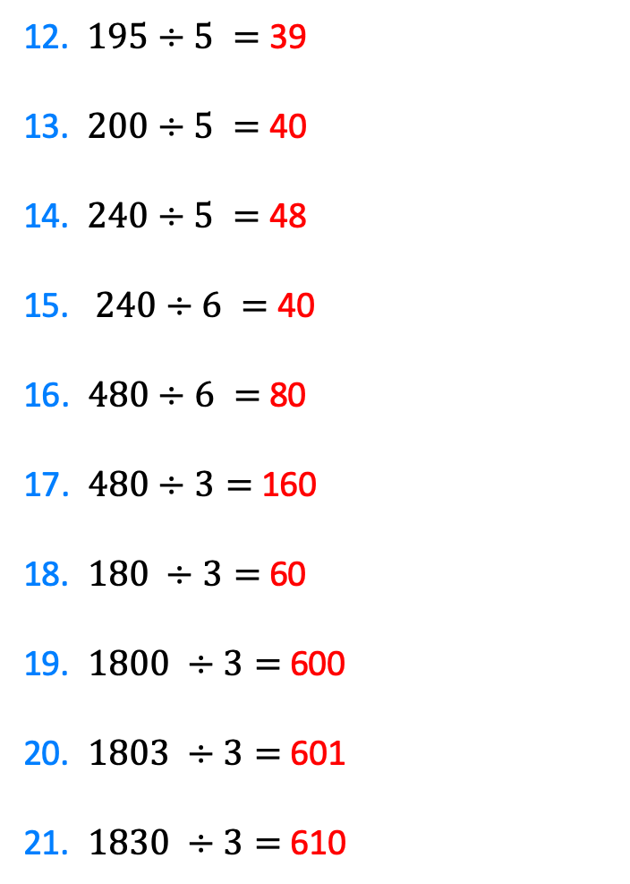
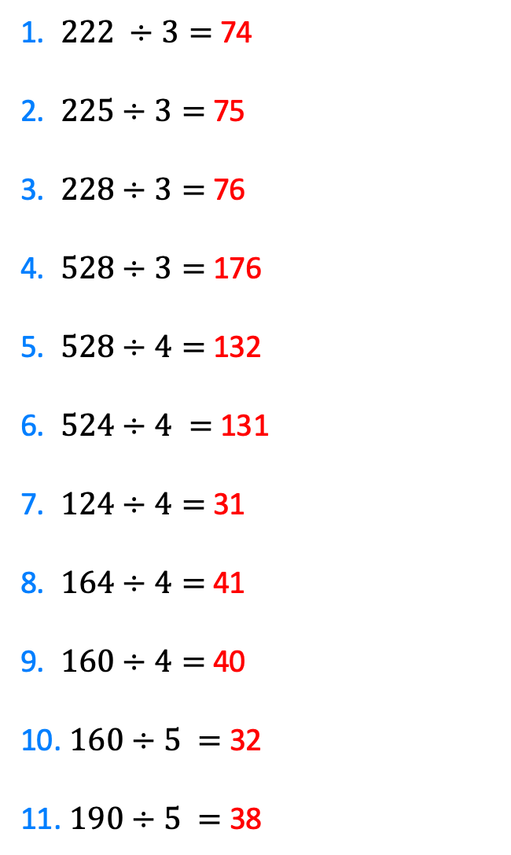
1. $222 ÷3=$ 74
2. $225÷3=$ 75
3. $228÷3=$ 76
4. $528÷3=$ 176
5. $528÷4=$ 132
6. $524÷4 =$ 131
7. $124÷4=$ 31
8. $164÷4=$41
9. $160÷4=$ 40
10. $160÷5 =$ 32
11. $190÷5 =$ 38
12.$195÷5 =$ 39
13.$200÷5 =$ 40
14.$240÷5 =$ 48
15.$240÷6 =$ 40
16. $480÷6 =$ 80
17. $480÷3=$ 160
18. $180 ÷3=$ 60
19. $1800 ÷3=$600
20. $1803 ÷3=$ 601
21. $1830 ÷3=$ 610
Mrs Beecham

