Slide 1
Rearranging Formulae: With powers and roots – Part 2
Silent
Teacher
Intelligent Practice
Narration
Your Turn
$$2a^{2}=c$$
$${4a}^{2}−b=c$$
$$\frac{\sqrt{a}}{2}=c$$
Practice

Slide 2
Worked Example
Your Turn
$${(a+b)}^{2}=c$$
$$\sqrt{a−b}=c$$

Slide 3
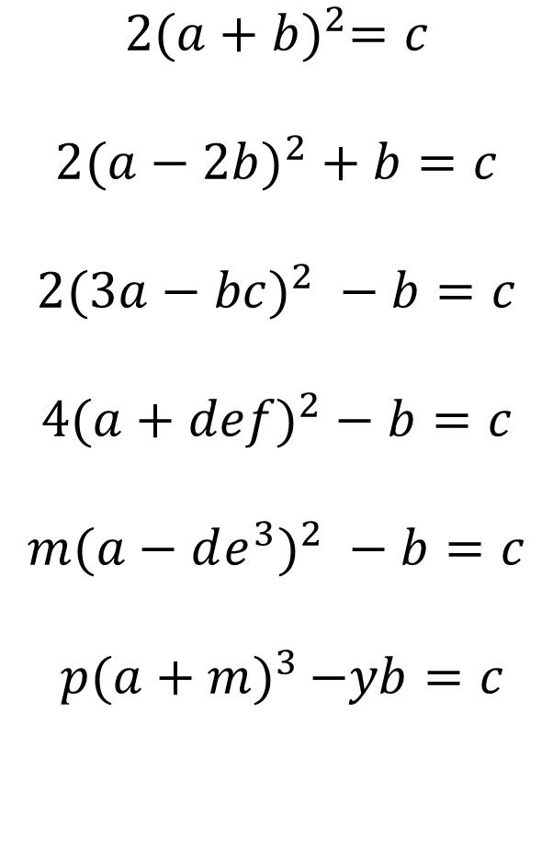
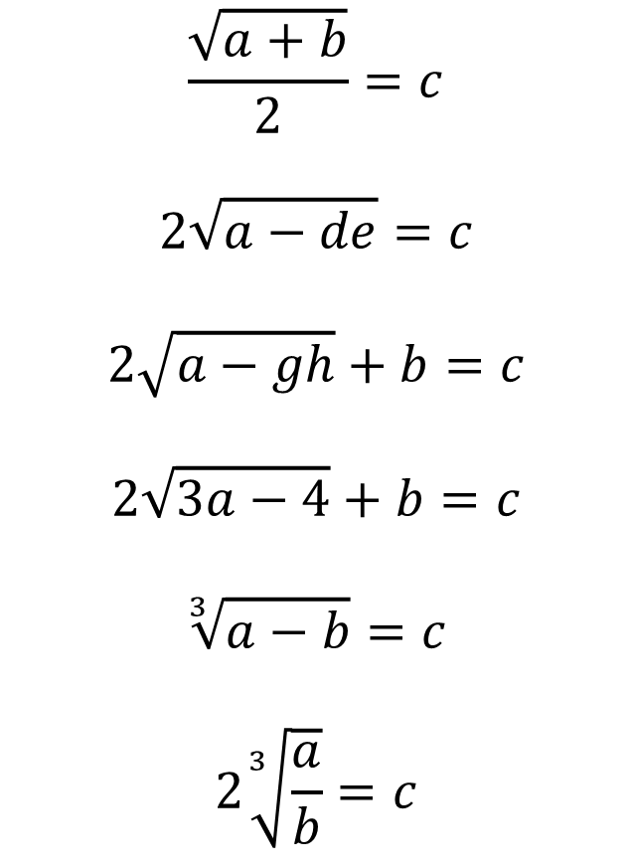
$$2{(a+b)}^{2}=c$$
$${2(a−2b)}^{2}+b=c$$
$${2(3a−bc)}^{2} −b=c$$
$${4(a+def)}^{2}−b=c$$
$${m(a−de^{3})}^{2} −b=c$$
$p{(a+m)}^{3 }−yb=c$
$$\frac{\sqrt{a+b}}{2}=c$$
$$2\sqrt{a−de}=c$$
$$2\sqrt{a−gh}+b=c$$
$$2\sqrt{3a−4}+b=c$$
$$\sqrt[3]{a−b}=c$$
$$2\sqrt[3]{\frac{a}{b}}=c$$

Slide 4


$$2{(a+b)}^{2}=c$$
$${2(a−2b)}^{2}+b=c$$
$${2(3a−bc)}^{2} −b=c$$
$$a=∓\sqrt{\frac{c}{2}} −b$$
$$a=∓\sqrt{\frac{c−b}{2}}+2b$$
$$a=\frac{∓\sqrt{\frac{c+b}{2}}+bc}{3}$$

Slide 5
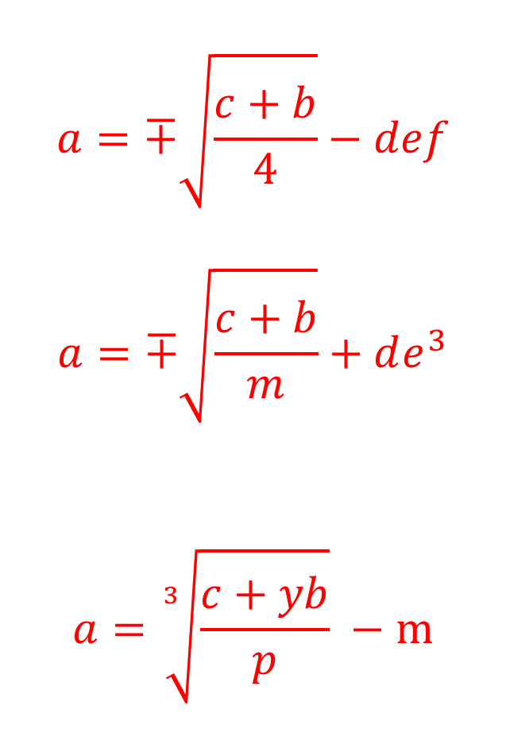

$${4(a+def)}^{2}−b=c$$
$${m(a−de^{3})}^{2} −b=c$$
$p{(a+m)}^{3 }−yb=c$
$$a=∓\sqrt{\frac{c+b}{4}}−def$$
$$a=∓\sqrt{\frac{c+b}{m}}+de^{3}$$
$$a=\sqrt[3]{\frac{c+yb}{p}} −m$$

Slide 6


$$\frac{\sqrt{a+b}}{2}=c$$
$$2\sqrt{a−de}=c$$
$$2\sqrt{a−gh}+b=c$$
$$a=4c^{2}−b$$
$$a=\frac{c^{2}}{4}+de$$
$$a={\left(\frac{c−b}{2}\right)}^{2}+gh$$

Slide 7


$$2\sqrt{3a−4}+b=c$$
$$\sqrt[3]{a−b}=c$$
$$2\sqrt[3]{\frac{a}{b}}=c$$
$$a=\frac{{\left(\frac{c−b}{2}\right)}^{2}+4}{3}$$
$$a=c^{3}+b$$
$$a=\frac{bc^{3}}{8}$$

