Slide 1
Expanding and factorising quadratics: Fill in the gaps
Silent
Teacher
Intelligent Practice
Narration
Your Turn
$$(x −3)(x −7)$$
Practice

Slide 2
Worked Example
Your Turn
$$(x+5)(x+6)=$$
$$(x+3)(x+10)=$$
$=x$² -11$x$ +30
$=x$² -13$x$ +30
thedarklordofalgebra

Slide 3
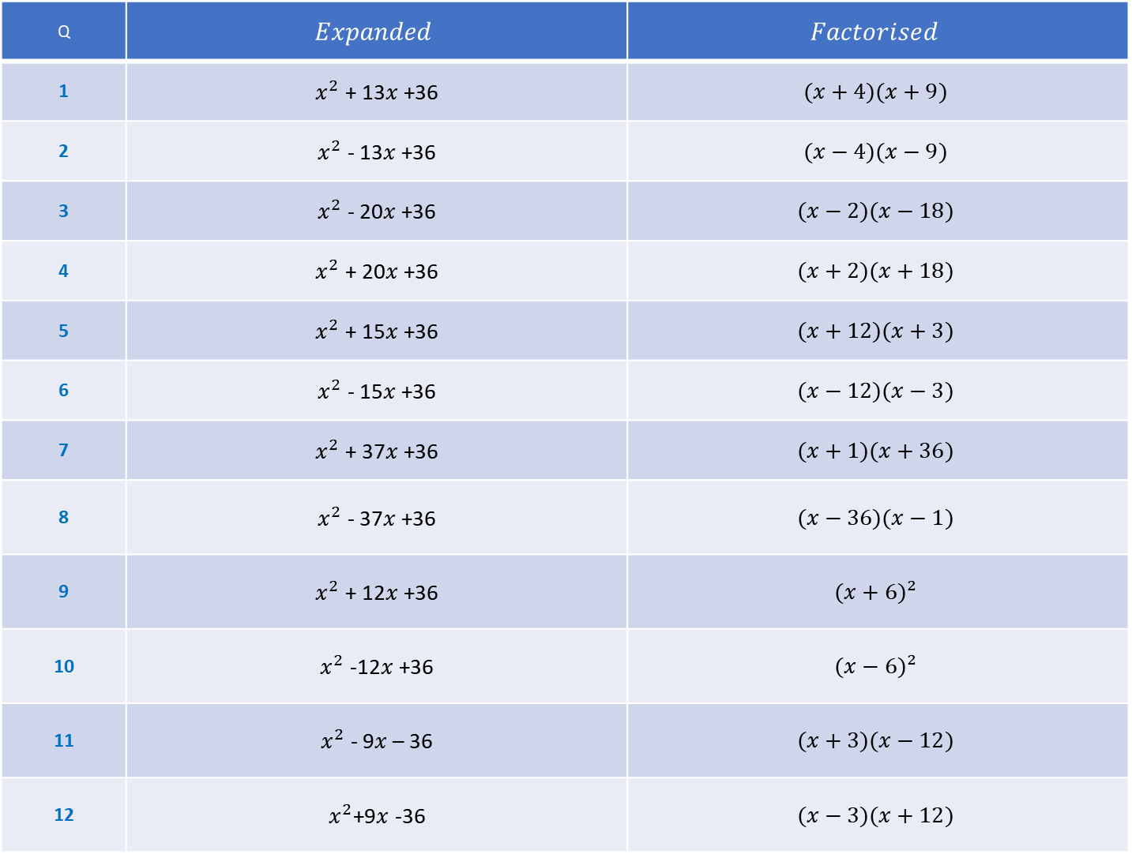
Q | $$Expanded$$ | $$Factorised$$
1 | $x^{2}$ + 13$x$ +36 | $$(x+4)(x+9)$$
2 | $x^{2}$ - 13$x$ +36 | $$(x−4)(x−9)$$
3 | $x^{2}$ - 20$x$ +36 | $$(x−2)(x−18)$$
4 | $x^{2}$ + 20$x$ +36 | $$(x+2)(x+18)$$
5 | $x^{2}$ + 15$x$ +36 | $$(x+12)(x+3)$$
6 | $x^{2}$ - 15$x$ +36 | $$(x−12)(x−3)$$
7 | $x^{2}$ + 37$x$ +36 | $$(x+1)(x+36)$$
8 | $x^{2}$ - 37$x$ +36 | $$(x−36)(x−1)$$
9 | $x^{2}$ + 12$x$ +36 | $$(x+6)²$$
10 | $x^{2}$ -12$x$ +36 | $$(x−6)²$$
11 | $x^{2}$ - 9$x$ – 36 | $$(x+3)(x−12)$$
12 | $x^{2}$+9$x$ -36 | $$(x−3)(x+12)$$

Slide 4
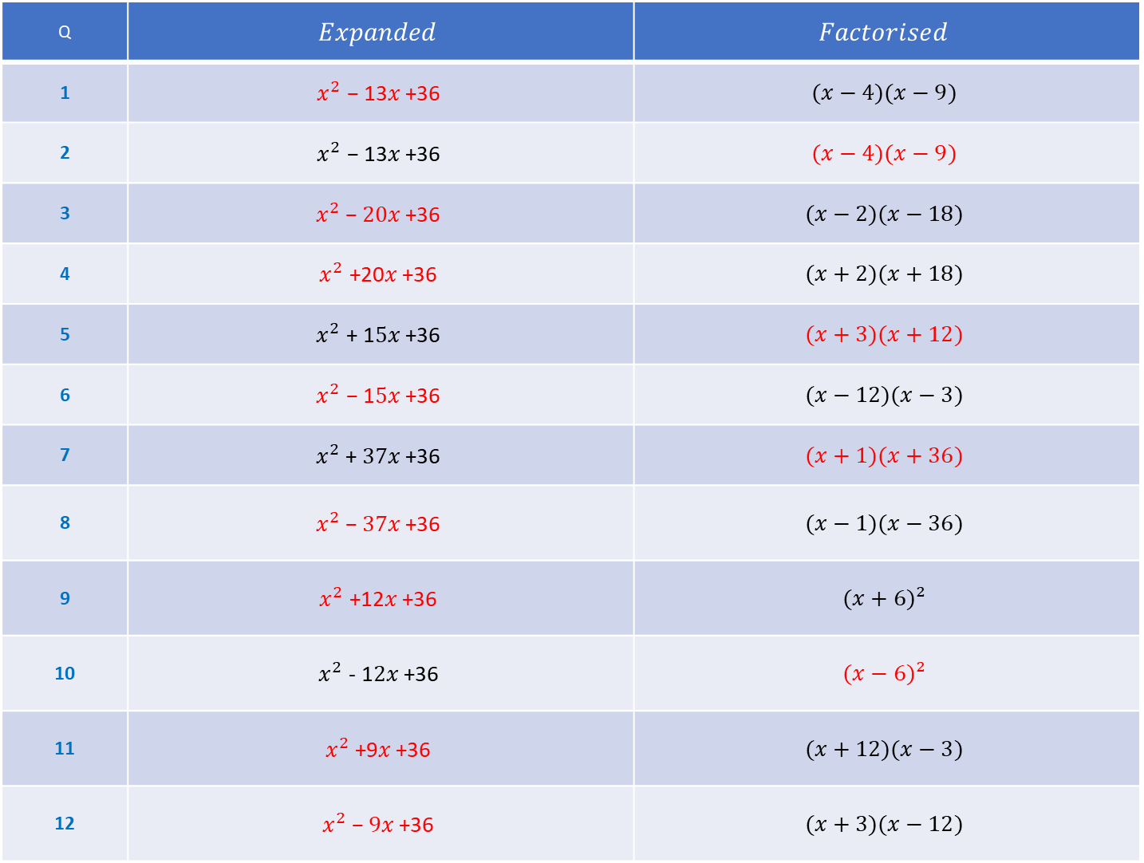
Q | $$Expanded$$ | $$Factorised$$
1 | $$x^{2} \text{−}\text{ 13}x\text{ +36}$$ | $$(x−4)(x−9)$$
2 | $$x^{2} \text{−}\text{ 13}x\text{ +36}$$ | $$(x−4)(x−9)$$
3 | $$x^{2} \text{−} 20x\text{ +36}$$ | $$(x−2)(x−18)$$
4 | $$x^{2} \text{+20}x\text{ +36}$$ | $$(x+2)(x+18)$$
5 | $$x^{2}\text{ + 1}5x\text{ +36}$$ | $$(x+3)(x+12)$$
6 | $$x^{2} \text{−}\text{ 1}5x\text{ +36}$$ | $$(x−12)(x−3)$$
7 | $$x^{2}\text{ + }37x\text{ +36}$$ | $$(x+1)(x+36)$$
8 | $$x^{2} \text{−} 37x\text{ +36}$$ | $$(x−1)(x−36)$$
9 | $$x^{2} \text{+12}x\text{ +36}$$ | $$(x+6)²$$
10 | $$x^{2} \text{−}\text{ 1}2x\text{ +36}$$ | $$(x−6)²$$
11 | $$x^{2} \text{+9}x\text{ +36}$$ | $$(x+12)(x−3)$$
12 | $$x^{2} \text{−} 9x\text{ +36}$$ | $$(x+3)(x−12)$$

