Slide 1
Powers and indices: Converting powers to a different base (V2)
Silent
Teacher
Intelligent Practice
Narration
Your Turn
$$Express 9^{2}as a product of 3$$
$$Express {25}^{3}as a product of 5$$
$$Express {16}^{3}as a product of 2$$
Practice

Slide 2
Worked Example
Your Turn
$$Express 4^{3}as a product of 2$$
$$Express 9^{4}as a product of 3$$

Slide 3
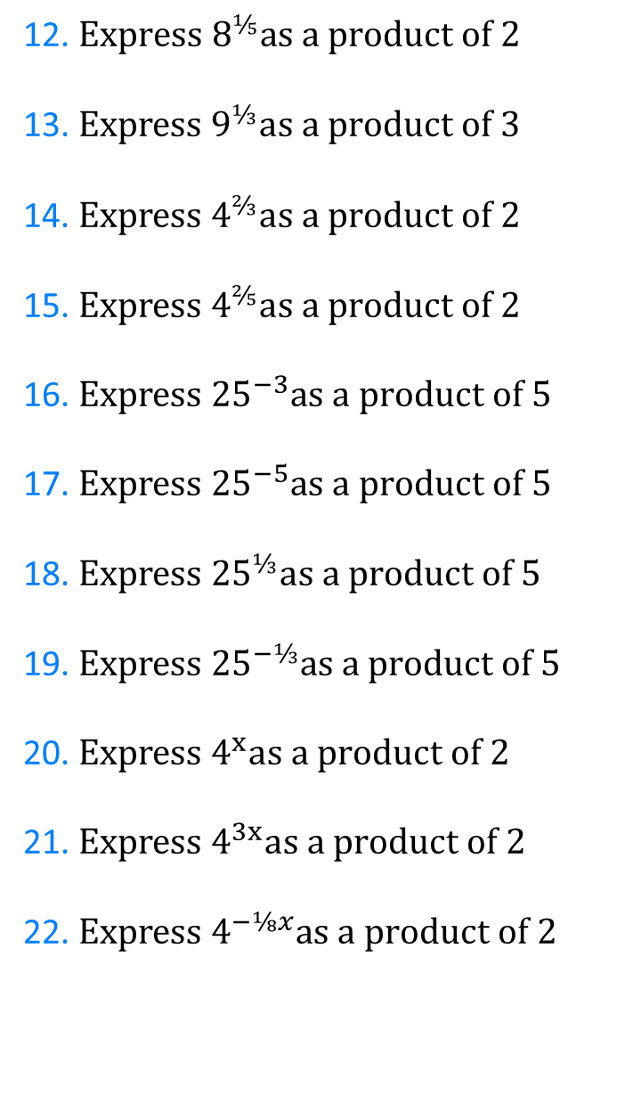
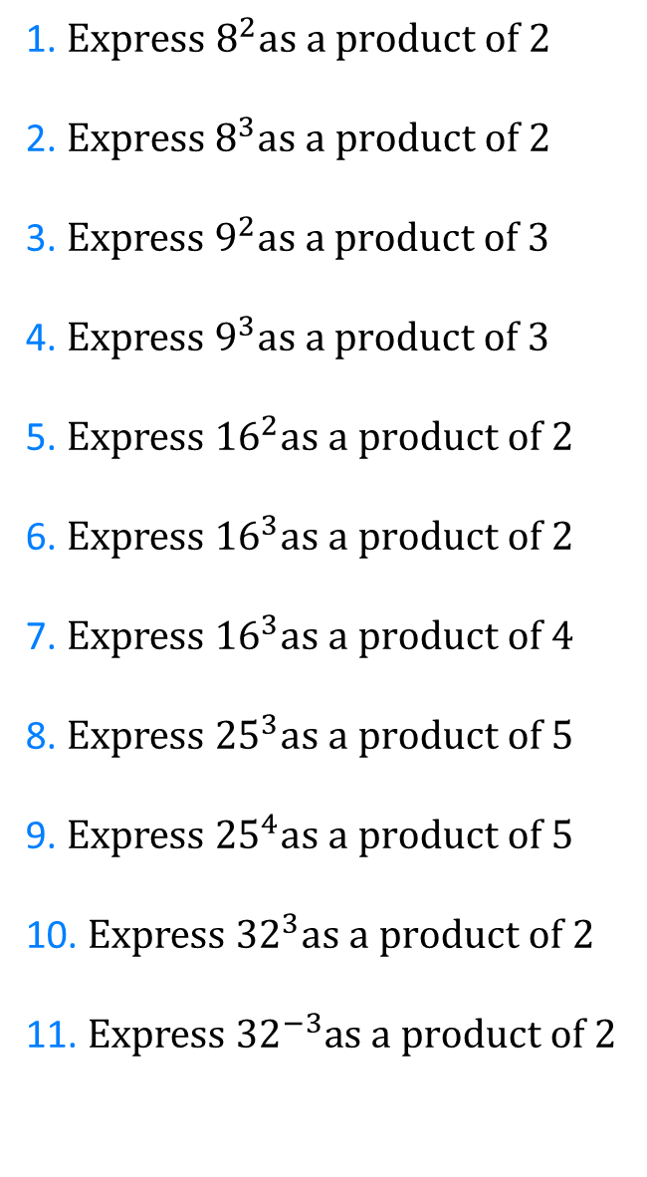
1. $Express 8^{2}as a product of 2$
2.$Express 8^{3}as a product of 2$
3. $Express 9^{2}as a product of 3$
4. $Express 9^{3}as a product of 3$
5. $Express {16}^{2}as a product of 2$
6. $Express {16}^{3}as a product of 2$
7. $Express {16}^{3}as a product of 4$
8. $Express {25}^{3}as a product of 5$
9. $Express {25}^{4}as a product of 5$
10. $Express {32}^{3}as a product of 2$
11. $Express {32}^{−3}as a product of 2$
12. $Express 8^{⅕}as a product of 2$
13. $Express 9^{⅓}as a product of 3$
14. $Express 4^{⅔}as a product of 2$
15. $Express 4^{⅖}as a product of 2$
16. $Express {25}^{−3}as a product of 5$
17. $Express {25}^{−5}as a product of 5$
18. $Express {25}^{⅓}as a product of 5$
19. $Express {25}^{−⅓}as a product of 5$
20. $Express 4^{x}as a product of 2$
21. $Express 4^{3x}as a product of 2$
22. $Express 4^{−⅛x}as a product of 2$

Slide 4
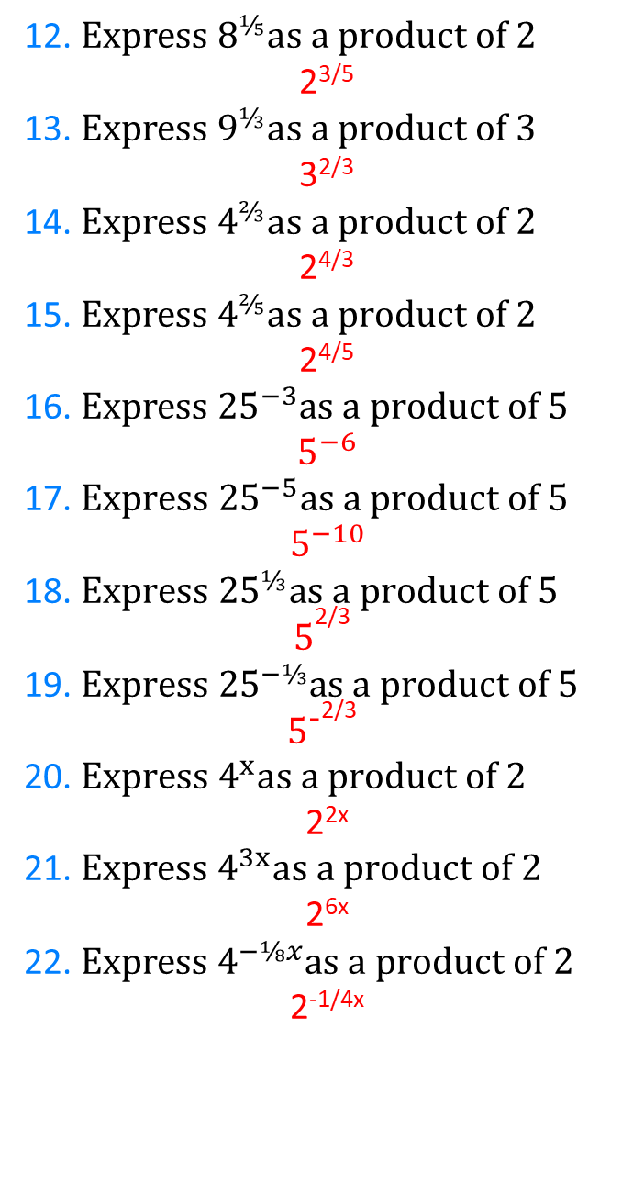
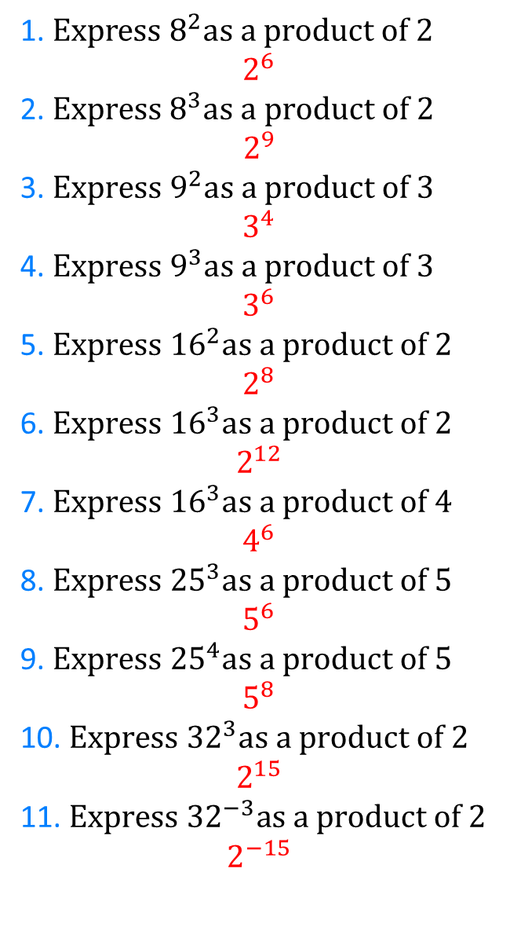
1. $Express 8^{2}as a product of 2$
$$2^{6}$$
2.$Express 8^{3}as a product of 2$
$$2^{9}$$
3. $Express 9^{2}as a product of 3$
$$3^{4}$$
4. $Express 9^{3}as a product of 3$
$$3^{6}$$
5. $Express {16}^{2}as a product of 2$
$$2^{8}$$
6. $Express {16}^{3}as a product of 2$
$$2^{12}$$
7. $Express {16}^{3}as a product of 4$
$$4^{6}$$
8. $Express {25}^{3}as a product of 5$
$$5^{6}$$
9. $Express {25}^{4}as a product of 5$
$$5^{8}$$
10. $Express {32}^{3}as a product of 2$
$$2^{15}$$
11. $Express {32}^{−3}as a product of 2$
$$2^{−15}$$
12. $Express 8^{⅕}as a product of 2$
2^{3/5}
13. $Express 9^{⅓}as a product of 3$
3^{2/3}
14. $Express 4^{⅔}as a product of 2$
2^{4/3}
15. $Express 4^{⅖}as a product of 2$
2^{4/5}
16. $Express {25}^{−3}as a product of 5$
$$5^{−6}$$
17. $Express {25}^{−5}as a product of 5$
$$5^{−10}$$
18. $Express {25}^{⅓}as a product of 5$
$$5^{\text{2/3} }$$
19. $Express {25}^{−⅓}as a product of 5$
$$5^{\text{−}\text{2/3} }$$
20. $Express 4^{x}as a product of 2$
2^{2x}
21. $Express 4^{3x}as a product of 2$
2^{6x}
22. $Express 4^{−⅛x}as a product of 2$
2^{-1/4x}

