Slide 1
Product of prime factors: Generalise
Silent
Teacher
Intelligent Practice
Narration
Your Turn
$$A=2^{p}×3^{q}$$
$$B=2^{m}×5^{n}$$
Example

Slide 2
Worked Example
Your Turn
$$C = 3^{a}×5^{b}$$
$$D = 3^{e}×7^{f}$$
$$3C =$$
$$3D =$$
$$5C =$$
$$7D =$$
$$25C =$$
$$27D =$$
@mrbartonmaths

Slide 3
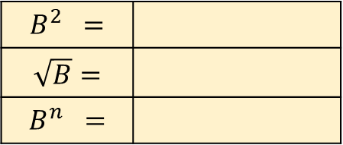
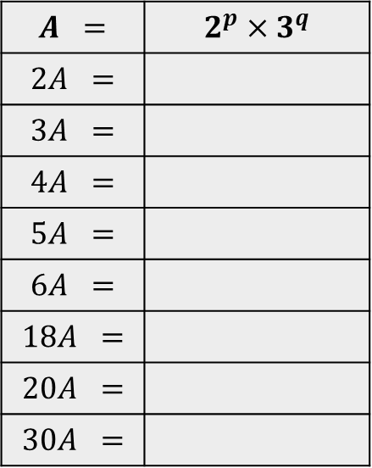
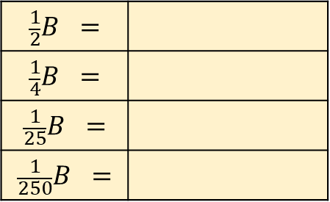
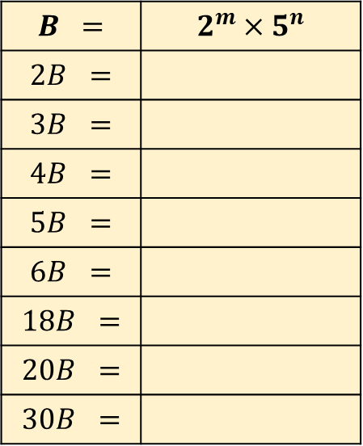
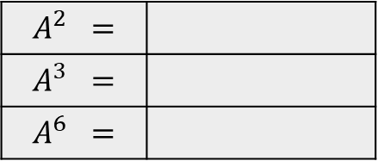
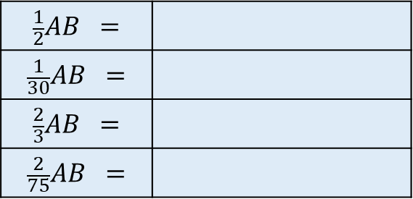
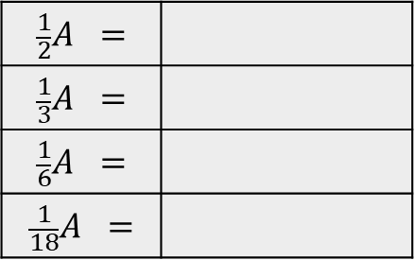
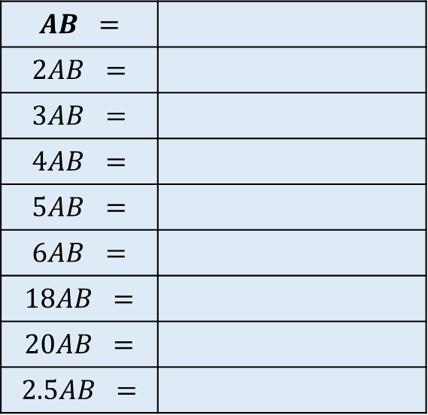
$$A =$$ | $$2^{p}×3^{q}$$
$$2A =$$
$$3A =$$
$$4A =$$
$$5A =$$
$$6A =$$
$$18A =$$
$$20A =$$
$$30A =$$
$$B =$$ | $$2^{m}×5^{n}$$
$$2B =$$
$$3B =$$
$$4B =$$
$$5B =$$
$$6B =$$
$$18B =$$
$$20B =$$
$$30B =$$
$$AB =$$
$$2AB =$$
$$3AB =$$
$$4AB =$$
$$5AB =$$
$$6AB =$$
$$18AB =$$
$$20AB =$$
$$2.5AB =$$
$$\frac{1}{2}A =$$
$$\frac{1}{3}A =$$
$$\frac{1}{6}A =$$
$$\frac{1}{18}A =$$
$$\frac{1}{2}B =$$
$$\frac{1}{4}B =$$
$$\frac{1}{25}B =$$
$$\frac{1}{250}B =$$
$$\frac{1}{2}AB =$$
$$\frac{1}{30}AB =$$
$$\frac{2}{3}AB =$$
$$\frac{2}{75}AB =$$
$$A^{2} =$$
$$A^{3} =$$
$$A^{6} =$$
$$B^{2} =$$
$$\sqrt{B}=$$
$$B^{n} =$$
$${(AB)}^{2} =$$
$${AB}^{2} =$$
$$A+B =$$

Slide 4
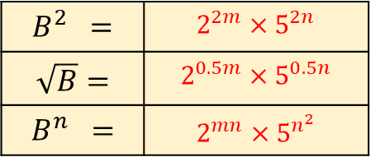
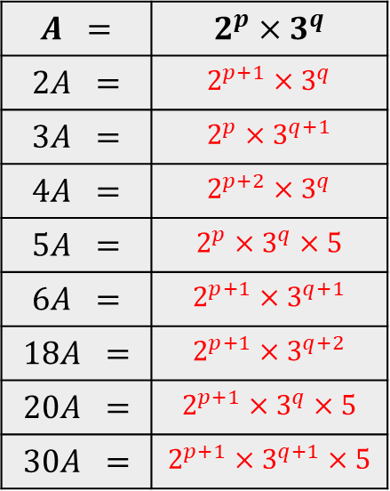
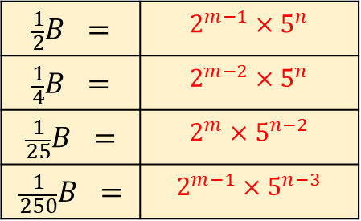
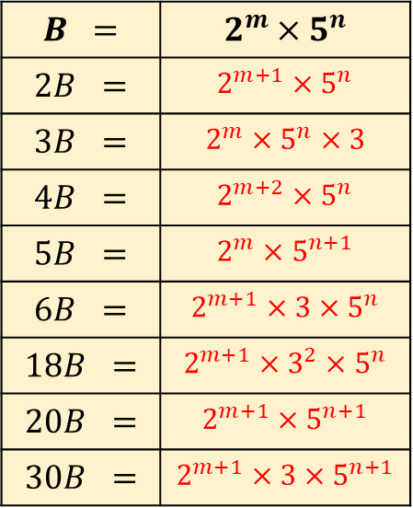
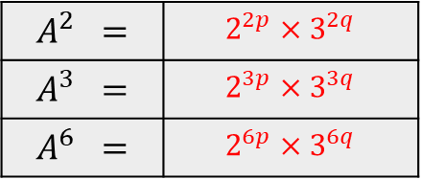
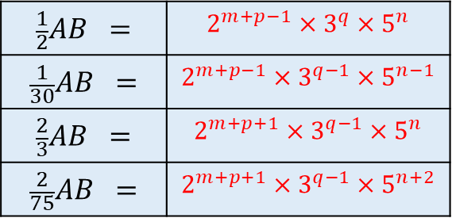
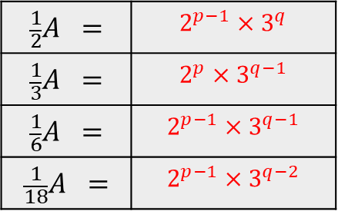
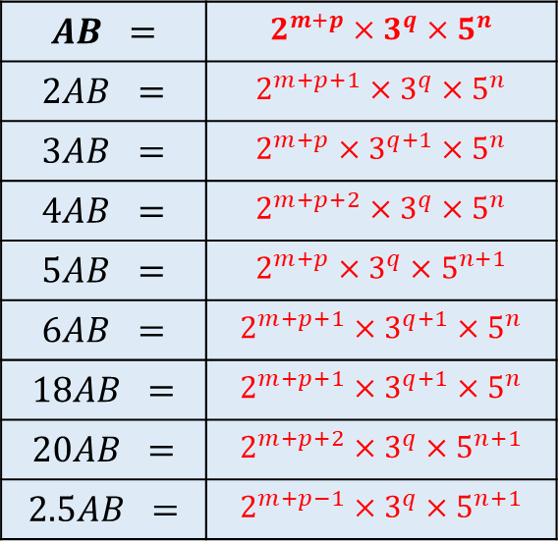
$$A =$$ | $$2^{p}×3^{q}$$
$$2A =$$ | $$2^{p+1}×3^{q}$$
$$3A =$$ | $$2^{p}×3^{q+1}$$
$$4A =$$ | $$2^{p+2}×3^{q}$$
$$5A =$$ | $$2^{p}×3^{q}×5$$
$$6A =$$ | $$2^{p+1}×3^{q+1}$$
$$18A =$$ | $$2^{p+1}×3^{q+2}$$
$$20A =$$ | $$2^{p+1}×3^{q}×5$$
$$30A =$$ | $$2^{p+1}×3^{q+1}×5$$
$$B =$$ | $$2^{m}×5^{n}$$
$$2B =$$ | $$2^{m+1}×5^{n}$$
$$3B =$$ | $$2^{m}×5^{n}×3$$
$$4B =$$ | $$2^{m+2}×5^{n}$$
$$5B =$$ | $$2^{m}×5^{n+1}$$
$$6B =$$ | $$2^{m+1}×3×5^{n}$$
$$18B =$$ | $$2^{m+1}×3^{2}×5^{n}$$
$$20B =$$ | $$2^{m+1}×5^{n+1}$$
$$30B =$$ | $$2^{m+1}×3×5^{n+1}$$
$$AB =$$ | $$2^{m+p}×3^{q}×5^{n}$$
$$2AB =$$ | $$2^{m+p+1}×3^{q}×5^{n}$$
$$3AB =$$ | $$2^{m+p}×3^{q+1}×5^{n}$$
$$4AB =$$ | $$2^{m+p+2}×3^{q}×5^{n}$$
$$5AB =$$ | $$2^{m+p}×3^{q}×5^{n+1}$$
$$6AB =$$ | $$2^{m+p+1}×3^{q+1}×5^{n}$$
$$18AB =$$ | $$2^{m+p+1}×3^{q+1}×5^{n}$$
$$20AB =$$ | $$2^{m+p+2}×3^{q}×5^{n+1}$$
$$2.5AB =$$ | $$2^{m+p−1}×3^{q}×5^{n+1}$$
$$\frac{1}{2}A =$$ | $$2^{p−1}×3^{q}$$
$$\frac{1}{3}A =$$ | $$2^{p}×3^{q−1}$$
$$\frac{1}{6}A =$$ | $$2^{p−1}×3^{q−1}$$
$$\frac{1}{18}A =$$ | $$2^{p−1}×3^{q−2}$$
$$\frac{1}{2}B =$$ | $$2^{m−1}×5^{n}$$
$$\frac{1}{4}B =$$ | $$2^{m−2}×5^{n}$$
$$\frac{1}{25}B =$$ | $$2^{m}×5^{n−2}$$
$$\frac{1}{250}B =$$ | $$2^{m−1}×5^{n−3}$$
$$\frac{1}{2}AB =$$ | $$2^{m+p−1}×3^{q}×5^{n}$$
$$\frac{1}{30}AB =$$ | $$2^{m+p−1}×3^{q−1}×5^{n−1}$$
$$\frac{2}{3}AB =$$ | $$2^{m+p+1}×3^{q−1}×5^{n}$$
$$\frac{2}{75}AB =$$ | $$2^{m+p+1}×3^{q−1}×5^{n+2}$$
$$A^{2} =$$ | $$2^{2p}×3^{2q}$$
$$A^{3} =$$ | $$2^{3p}×3^{3q}$$
$$A^{6} =$$ | $$2^{6p}×3^{6q}$$
$$B^{2} =$$ | $$2^{2m}×5^{2n}$$
$$\sqrt{B}=$$ | $$2^{0.5m}×5^{0.5n}$$
$$B^{n} =$$ | $$2^{mn}×5^{n^{2}}$$
$${(AB)}^{2} =$$ | $$2^{2m+2p}×3^{2q}×5^{2n}$$
$${AB}^{2} =$$ | $$2^{2m+p}×3^{q}×5^{2n}$$
$$A+B =$$ | $$2^{p}×3^{q}+2^{m}×5^{n}$$

Slide 5
$$A =$$ | $$2^{p}×3^{q}$$
$$2A =$$ | $$2^{p+1}×3^{q}$$
$$3A =$$ | $$2^{p}×3^{q+1}$$
$$4A =$$ | $$2^{p+2}×3^{q}$$
$$5A =$$ | $$2^{p}×3^{q}×5$$
$$6A =$$ | $$2^{p+1}×3^{q+1}$$
$$18A =$$ | $$2^{p+1}×3^{q+2}$$
$$20A =$$ | $$2^{p+1}×3^{q}×5$$
$$30A =$$ | $$2^{p+1}×3^{q+1}×5$$
$$B =$$ | $$2^{m}×5^{n}$$
$$2B =$$ | $$2^{m+1}×5^{n}$$
$$3B =$$ | $$2^{m}×5^{n}×3$$
$$4B =$$ | $$2^{m+2}×5^{n}$$
$$5B =$$ | $$2^{m}×5^{n+1}$$
$$6B =$$ | $$2^{m+1}×3×5^{n}$$
$$18B =$$ | $$2^{m+1}×3^{2}×5^{n}$$
$$20B =$$ | $$2^{m+1}×5^{n+1}$$
$$30B =$$ | $$2^{m+1}×3×5^{n+1}$$
$$AB =$$ | $$2^{m+p}×3^{q}×5^{n}$$
$$2AB =$$ | $$2^{m+p+1}×3^{q}×5^{n}$$
$$3AB =$$ | $$2^{m+p}×3^{q+1}×5^{n}$$
$$4AB =$$ | $$2^{m+p+2}×3^{q}×5^{n}$$
$$5AB =$$ | $$2^{m+p}×3^{q}×5^{n+1}$$
$$6AB =$$ | $$2^{m+p+1}×3^{q+1}×5^{n}$$
$$18AB =$$ | $$2^{m+p+1}×3^{q+1}×5^{n}$$
$$20AB =$$ | $$2^{m+p+2}×3^{q}×5^{n+1}$$
$$2.5AB =$$ | $$2^{m+p−1}×3^{q}×5^{n+1}$$
$$\frac{1}{2}A =$$ | $$2^{p−1}×3^{q}$$
$$\frac{1}{3}A =$$ | $$2^{p}×3^{q−1}$$
$$\frac{1}{6}A =$$ | $$2^{p−1}×3^{q−1}$$
$$\frac{1}{18}A =$$ | $$2^{p−1}×3^{q−2}$$
$$\frac{1}{2}B =$$ | $$2^{m−1}×5^{n}$$
$$\frac{1}{4}B =$$ | $$2^{m−2}×5^{n}$$
$$\frac{1}{25}B =$$ | $$2^{m}×5^{n−2}$$
$$\frac{1}{250}B =$$ | $$2^{m−1}×5^{n−3}$$
$$\frac{1}{2}AB =$$ | $$2^{m+p−1}×3^{q}×5^{n}$$
$$\frac{1}{30}AB =$$ | $$2^{m+p−1}×3^{q−1}×5^{n−1}$$
$$\frac{2}{3}AB =$$ | $$2^{m+p+1}×3^{q−1}×5^{n}$$
$$\frac{2}{75}AB =$$ | $$2^{m+p+1}×3^{q−1}×5^{n+2}$$
$$A^{2} =$$ | $$2^{2p}×3^{2q}$$
$$A^{3} =$$ | $$2^{3p}×3^{3q}$$
$$A^{6} =$$ | $$2^{6p}×3^{6q}$$
$$B^{2} =$$ | $$2^{2m}×5^{2n}$$
$$\sqrt{B}=$$ | $$2^{0.5m}×5^{0.5n}$$
$$B^{n} =$$ | $$2^{mn}×5^{n^{2}}$$
$${(AB)}^{2} =$$ | $$2^{2m+2p}×3^{2q}×5^{2n}$$
$${AB}^{2} =$$ | $$2^{2m+p}×3^{q}×5^{2n}$$
$$A+B =$$ | $$2^{p}×3^{q}+2^{m}×5^{n}$$

Slide 6
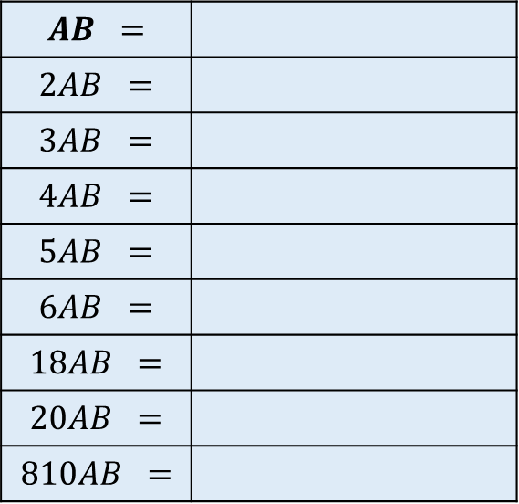
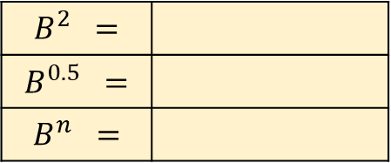
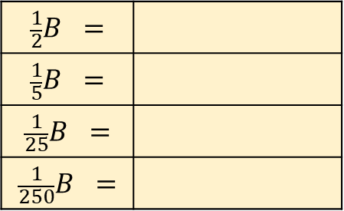
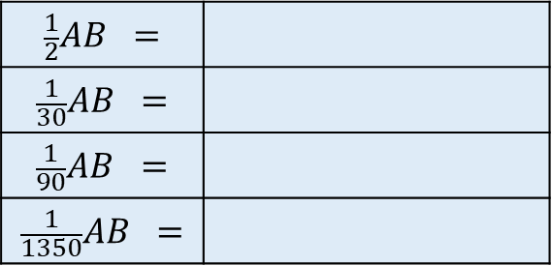
$$A =$$ | $$2^{p}×3^{q}$$
$$2A =$$
$$3A =$$
$$4A =$$
$$5A =$$
$$6A =$$
$$18A =$$
$$20A =$$
$$30A =$$
$$B =$$ | $$2^{m}×5^{n}$$
$$2B =$$
$$3B =$$
$$4B =$$
$$5B =$$
$$6B =$$
$$18B =$$
$$20B =$$
$$30B =$$
$$AB =$$
$$2AB =$$
$$3AB =$$
$$4AB =$$
$$5AB =$$
$$6AB =$$
$$18AB =$$
$$20AB =$$
$$810AB =$$
$$\frac{1}{2}A =$$
$$\frac{1}{3}A =$$
$$\frac{1}{6}A =$$
$$\frac{1}{18}A =$$
$$\frac{1}{2}B =$$
$$\frac{1}{5}B =$$
$$\frac{1}{25}B =$$
$$\frac{1}{250}B =$$
$$\frac{1}{2}AB =$$
$$\frac{1}{30}AB =$$
$$\frac{1}{90}AB =$$
$$\frac{1}{1350}AB =$$
$$A^{2} =$$
$$A^{3} =$$
$$A^{6} =$$
$$B^{2} =$$
$$B^{0.5} =$$
$$B^{n} =$$
$${(AB)}^{2} =$$
$${AB}^{2} =$$
$$A+B =$$

Slide 7
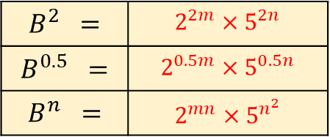
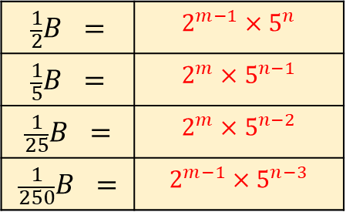
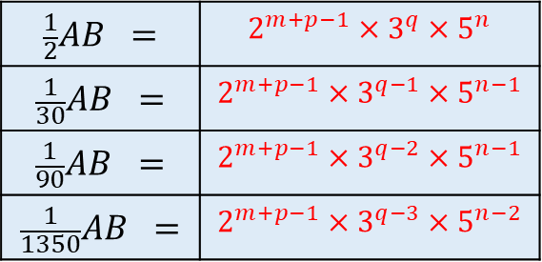
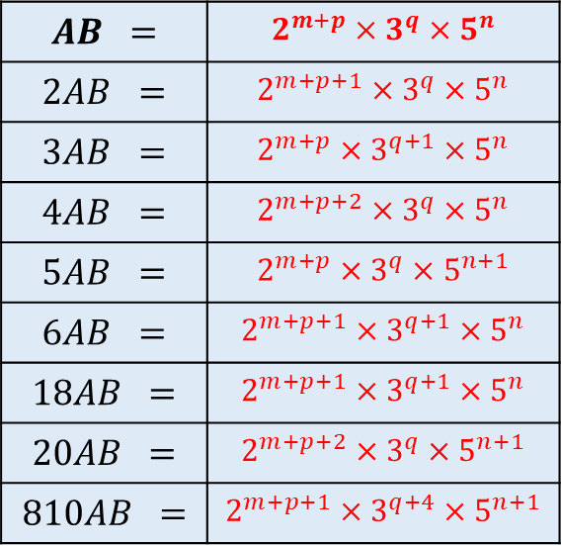
$$A =$$ | $$2^{p}×3^{q}$$
$$2A =$$ | $$2^{p+1}×3^{q}$$
$$3A =$$ | $$2^{p}×3^{q+1}$$
$$4A =$$ | $$2^{p+2}×3^{q}$$
$$5A =$$ | $$2^{p}×3^{q}×5$$
$$6A =$$ | $$2^{p+1}×3^{q+1}$$
$$18A =$$ | $$2^{p+1}×3^{q+2}$$
$$20A =$$ | $$2^{p+1}×3^{q}×5$$
$$30A =$$ | $$2^{p+1}×3^{q+1}×5$$
$$B =$$ | $$2^{m}×5^{n}$$
$$2B =$$ | $$2^{m+1}×5^{n}$$
$$3B =$$ | $$2^{m}×5^{n}×3$$
$$4B =$$ | $$2^{m+2}×5^{n}$$
$$5B =$$ | $$2^{m}×5^{n+1}$$
$$6B =$$ | $$2^{m+1}×3×5^{n}$$
$$18B =$$ | $$2^{m+1}×3^{2}×5^{n}$$
$$20B =$$ | $$2^{m+1}×5^{n+1}$$
$$30B =$$ | $$2^{m+1}×3×5^{n+1}$$
$$AB =$$ | $$2^{m+p}×3^{q}×5^{n}$$
$$2AB =$$ | $$2^{m+p+1}×3^{q}×5^{n}$$
$$3AB =$$ | $$2^{m+p}×3^{q+1}×5^{n}$$
$$4AB =$$ | $$2^{m+p+2}×3^{q}×5^{n}$$
$$5AB =$$ | $$2^{m+p}×3^{q}×5^{n+1}$$
$$6AB =$$ | $$2^{m+p+1}×3^{q+1}×5^{n}$$
$$18AB =$$ | $$2^{m+p+1}×3^{q+1}×5^{n}$$
$$20AB =$$ | $$2^{m+p+2}×3^{q}×5^{n+1}$$
$$810AB =$$ | $$2^{m+p+1}×3^{q+4}×5^{n+1}$$
$$\frac{1}{2}A =$$ | $$2^{p−1}×3^{q}$$
$$\frac{1}{3}A =$$ | $$2^{p}×3^{q−1}$$
$$\frac{1}{6}A =$$ | $$2^{p−1}×3^{q−1}$$
$$\frac{1}{18}A =$$ | $$2^{p−1}×3^{q−2}$$
$$\frac{1}{2}B =$$ | $$2^{m−1}×5^{n}$$
$$\frac{1}{5}B =$$ | $$2^{m}×5^{n−1}$$
$$\frac{1}{25}B =$$ | $$2^{m}×5^{n−2}$$
$$\frac{1}{250}B =$$ | $$2^{m−1}×5^{n−3}$$
$$\frac{1}{2}AB =$$ | $$2^{m+p−1}×3^{q}×5^{n}$$
$$\frac{1}{30}AB =$$ | $$2^{m+p−1}×3^{q−1}×5^{n−1}$$
$$\frac{1}{90}AB =$$ | $$2^{m+p−1}×3^{q−2}×5^{n−1}$$
$$\frac{1}{1350}AB =$$ | $$2^{m+p−1}×3^{q−3}×5^{n−2}$$
$$A^{2} =$$ | $$2^{2p}×3^{2q}$$
$$A^{3} =$$ | $$2^{3p}×3^{3q}$$
$$A^{6} =$$ | $$2^{6p}×3^{6q}$$
$$B^{2} =$$ | $$2^{2m}×5^{2n}$$
$$B^{0.5} =$$ | $$2^{0.5m}×5^{0.5n}$$
$$B^{n} =$$ | $$2^{mn}×5^{n^{2}}$$
$${(AB)}^{2} =$$ | $$2^{2m+2p}×3^{2q}×5^{2n}$$
$${AB}^{2} =$$ | $$2^{2m+p}×3^{q}×5^{2n}$$
$$A+B =$$ | $$2^{p}×3^{q}+2^{m}×5^{n}$$

Slide 8
$$A =$$ | $$2^{p}×3^{q}$$
$$2A =$$ | $$2^{p+1}×3^{q}$$
$$3A =$$ | $$2^{p}×3^{q+1}$$
$$4A =$$ | $$2^{p+2}×3^{q}$$
$$5A =$$ | $$2^{p}×3^{q}×5$$
$$6A =$$ | $$2^{p+1}×3^{q+1}$$
$$18A =$$ | $$2^{p+1}×3^{q+2}$$
$$20A =$$ | $$2^{p+1}×3^{q}×5$$
$$30A =$$ | $$2^{p+1}×3^{q+1}×5$$
$$B =$$ | $$2^{m}×5^{n}$$
$$2B =$$ | $$2^{m+1}×5^{n}$$
$$3B =$$ | $$2^{m}×5^{n}×3$$
$$4B =$$ | $$2^{m+2}×5^{n}$$
$$5B =$$ | $$2^{m}×5^{n+1}$$
$$6B =$$ | $$2^{m+1}×3×5^{n}$$
$$18B =$$ | $$2^{m+1}×3^{2}×5^{n}$$
$$20B =$$ | $$2^{m+1}×5^{n+1}$$
$$30B =$$ | $$2^{m+1}×3×5^{n+1}$$
$$AB =$$ | $$2^{m+p}×3^{q}×5^{n}$$
$$2AB =$$ | $$2^{m+p+1}×3^{q}×5^{n}$$
$$3AB =$$ | $$2^{m+p}×3^{q+1}×5^{n}$$
$$4AB =$$ | $$2^{m+p+2}×3^{q}×5^{n}$$
$$5AB =$$ | $$2^{m+p}×3^{q}×5^{n+1}$$
$$6AB =$$ | $$2^{m+p+1}×3^{q+1}×5^{n}$$
$$18AB =$$ | $$2^{m+p+1}×3^{q+1}×5^{n}$$
$$20AB =$$ | $$2^{m+p+2}×3^{q}×5^{n+1}$$
$$810AB =$$ | $$2^{m+p+1}×3^{q+4}×5^{n+1}$$
$$\frac{1}{2}A =$$ | $$2^{p−1}×3^{q}$$
$$\frac{1}{3}A =$$ | $$2^{p}×3^{q−1}$$
$$\frac{1}{6}A =$$ | $$2^{p−1}×3^{q−1}$$
$$\frac{1}{18}A =$$ | $$2^{p−1}×3^{q−2}$$
$$\frac{1}{2}B =$$ | $$2^{m−1}×5^{n}$$
$$\frac{1}{5}B =$$ | $$2^{m}×5^{n−1}$$
$$\frac{1}{25}B =$$ | $$2^{m}×5^{n−2}$$
$$\frac{1}{250}B =$$ | $$2^{m−1}×5^{n−3}$$
$$\frac{1}{2}AB =$$ | $$2^{m+p−1}×3^{q}×5^{n}$$
$$\frac{1}{30}AB =$$ | $$2^{m+p−1}×3^{q−1}×5^{n−1}$$
$$\frac{1}{90}AB =$$ | $$2^{m+p−1}×3^{q−2}×5^{n−1}$$
$$\frac{1}{1350}AB =$$ | $$2^{m+p−1}×3^{q−3}×5^{n−2}$$
$$A^{2} =$$ | $$2^{2p}×3^{2q}$$
$$A^{3} =$$ | $$2^{3p}×3^{3q}$$
$$A^{6} =$$ | $$2^{6p}×3^{6q}$$
$$B^{2} =$$ | $$2^{2m}×5^{2n}$$
$$B^{0.5} =$$ | $$2^{0.5m}×5^{0.5n}$$
$$B^{n} =$$ | $$2^{mn}×5^{n^{2}}$$
$${(AB)}^{2} =$$ | $$2^{2m+2p}×3^{2q}×5^{2n}$$
$${AB}^{2} =$$ | $$2^{2m+p}×3^{q}×5^{2n}$$
$$A+B =$$ | $$2^{p}×3^{q}+2^{m}×5^{n}$$

