Slide 1
Proof involving inequalities
Silent
Teacher
Intelligent Practice
Narration
Your Turn
$x^{2}+12x+36≥0$
$x^{2}−12x+36≥0$
$$x^{2}−12x+36>−13$$
Practice

Slide 2

This is how we do it…
If you have an inequality where it is not showing it is always > or < 0
Pick a starting side
Subtract and immediately add back on whatever is on the other side.
Manipulate, leaving the part that is identical to your other side alone
Prove
$$x^{2}+2x+3≥10x−13$$
Consider LHS:
$$x^{2}+2x+3$$
$${=(x}^{2}+2x+3)−\left(10x−13\right)+(10x−13)$$
$${=x}^{2}−8x+16+\left(10x−13\right)$$
$${=(x−4)}^{2}+ (10x−13)$$
As ${(x−4)}^{2}≥0$
$${(x−4)}^{2}+ \left(10x−13\right)≥\left(10x−13\right)$$
$$∴x^{2}+2x+3≥10x−13$$
1
Pick a side to manipulate
2
Subtract then add other side
Manipulate, leaving ‘other side’ untouched
3
4
Introduce Inequality
Fin

Slide 3

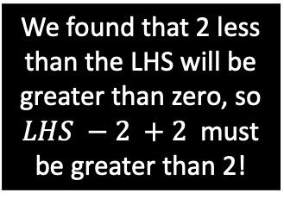

One more of those tricky ‘only work with one side’ questions:
Prove
LHS:
$$\frac{x}{y}+\frac{y}{x}$$
$$=\frac{x}{y}+\frac{y}{x}−2+2$$
$$=\frac{x^{2}+y^{2}}{xy}−2+2$$
$$=\frac{x^{2}+y^{2}−2xy}{xy}+2$$
$$=\frac{{(x−y)}^{2}}{xy}+2≥2$$
As numerator at least 0 and denominator is positive, so quotient $≥0$
So, from above
$$\frac{x}{y}+\frac{y}{x}−2+2≥2$$
$$\frac{x}{y}+\frac{y}{x}≥2$$
Prove for all positive $x$ and $y$
$$\frac{x}{y}+\frac{y}{x}≥2$$
Proof
Plan
$$\frac{x}{y}+\frac{y}{x}−2+2≥2$$
Meet in the middle jottings if needed
Notes:
$$\frac{x}{y}+\frac{y}{x}≥2$$
$$→\frac{x^{2}+y^{2}}{xy}≥2$$
$$\frac{x^{2}+y^{2}}{xy}−2≥0$$
$$\frac{x^{2}+y^{2}−2xy}{xy}≥0$$
$$\frac{{(x−y)}^{2}}{xy}≥0$$
We found that 2 less than the LHS will be greater than zero, so
$LHS −2 +2$ must be greater than 2!

Slide 4
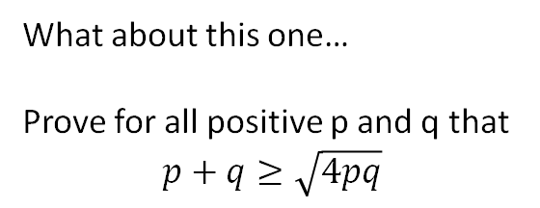

A super hard one…
What about this one…
Prove for all positive p and q that
$$p+q≥\sqrt{4pq}$$
Key starting point
In this question we need to spot that there are things that have been squared:$\sqrt{p}$ and $\sqrt{q}$
a
$$p+q$$
$$={(\sqrt{p})}^{2}+{(\sqrt{q})}^{2}$$
$$={(\sqrt{p})}^{2}+{(\sqrt{q})}^{2} −\sqrt{4pq}+\sqrt{4pq}$$
$$={(\sqrt{p})}^{2}+{(\sqrt{q})}^{2} −2\sqrt{pq}+\sqrt{4pq}$$
$$={(\sqrt{p}−\sqrt{q})}^{2}+\sqrt{4pq}$$
$$As {(\sqrt{p}−\sqrt{q})}^{2}≥0$$
${(\sqrt{p}−\sqrt{q})}^{2}+\sqrt{4pq}$ $≥\sqrt{4pq}$
$$p+q≥\sqrt{4pq}$$
LHS
b
Reflection
Thoughts:
Proof isn’t an exact science, there isn’t always a method that works each time.
I think this is VERY hard to spot, so it’s important to have a toolkit of methods to use.
c
d
e
f
g
h

Slide 5




Test your understanding
a
LHS:
$${=x}^{2}+6x$$
$${=x}^{2}+6x+9−9$$
$$={(x+3)}^{2}−9$$
As ${(x+3)}^{2}≥0$
$${(x+3)}^{2}−9≥−9$$
$$x^{2}+6x≥−9$$
a) Prove $x^{2}+6x≥−9$
b
b) Prove $x^{2}−4x+30≥6x+5$
LHS:
$$=x^{2}−4x+30$$
$${=(x}^{2}−4x+30)−(6x+5)+(6x+5)$$
$$={(x}^{2}−10x+25)+(6x+5)$$
$$={(x−5)}^{2}+(6x+5)$$
As ${(x−5)}^{2}≥0$
$${(x−5)}^{2}+\left(6x+5\right)≥6x+5$$
$$x^{2}−4x+30≥6x+5$$
$$=\frac{{(x−4)}^{2}}{2x}+4$$
As ${(x−4)}^{2}≥0$ and $2x<0$
$\frac{{(x−4)}^{2}}{2x}≤0$
So $\frac{{(x−4)}^{2}}{2x}+4≤4$
$$\frac{x}{2}+\frac{8}{x}≤4$$
c) If $x<0$
c
LHS: $\frac{x}{2}+\frac{8}{x}$
$$=\frac{x}{2}+\frac{8}{x}−4+4$$
$$=\frac{x^{2}}{2x}+\frac{16}{2x}−\frac{8x}{2x}+4$$
$$=\frac{x^{2}−8x+16}{2x}+4$$
Prove $\frac{x}{2}+\frac{8}{x}≤4$

Slide 6
Creating LHS > RHS proof questions
E.g. Prove $x^{2}+2x+3≥10x−13$
What are the key things to this working?
When you rearrange (or -/+) you get a perfect square
How could they make it harder?
Not make it a perfect square, it could then be a > question instead of a $≥$ question
e.g. $x^{2}+2x+4>10x−13$ would still be true.
The left hand side is just one more
$${=(x}^{2}+2x+4)−\left(10x−13\right)+(10x−13)$$
$${=x}^{2}−8x+17+\left(10x−13\right)$$
$${=x}^{2}−8x+16+1+\left(10x−13\right)$$
$${=(x−4)}^{2}+1+ (10x−13)$$
As ${(x−4)}^{2}≥0$
$${(x−4)}^{2}+ \left(10x−13\right)≥\left(10x−13\right)$$
$$∴x^{2}+2x+4>10x−13$$
Complete the square for the first part

Slide 7
Minimally different questions
There is no set method that you can apply to all proof questions.
You need to have a tool kit of skills and techniques you can use, and have an eye for when to use them.
Usually, the key to unlocking the proof is completing the square.
In a moment you will be given a dauntingly large set of questions to try and prove.
But each one is just the same as the last, with a minor change or addition.
As you work through each one, see if you can use the previous one to help you.
Some are impossible, so if they are, find a counter example for these.

Slide 8

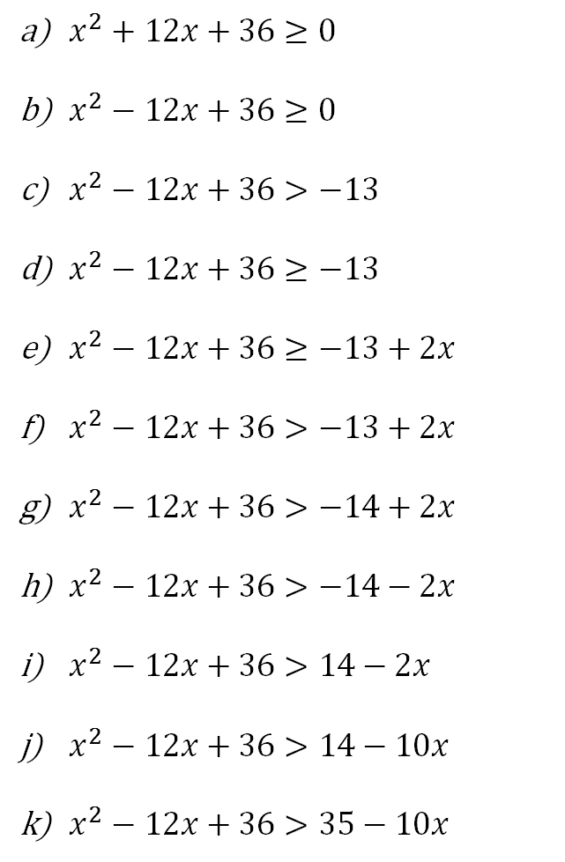
Prove if possible, otherwise, find a counter example.
$x^{2}+12x+36≥0$
$x^{2}−12x+36≥0$
$x^{2}−12x+36>−13$
$x^{2}−12x+36≥−13$
$x^{2}−12x+36≥−13+2x$
$x^{2}−12x+36>−13+2x$
$x^{2}−12x+36>−14+2x$
$x^{2}−12x+36>−14−2x$
$x^{2}−12x+36>14−2x$
$x^{2}−12x+36>14−10x$
$x^{2}−12x+36>35−10x$
$x^{2}+12x−36≥0$
$x^{2}+12x−36≥−72$
$2x^{2}+24x−72≥−144$
${\frac{1}{2}x}^{2}+6x−18≥−36$
$x^{2}+6x−18≥−36$
$x^{2}+6x+18≥−36$
$x^{2}+6x+18≥36$
$x^{2}+x+3≥6$
$x^{2}+x+3≥6+x$
$x^{2}+x+9≥6+x$
$x+\frac{9}{x}≥6$

Slide 9
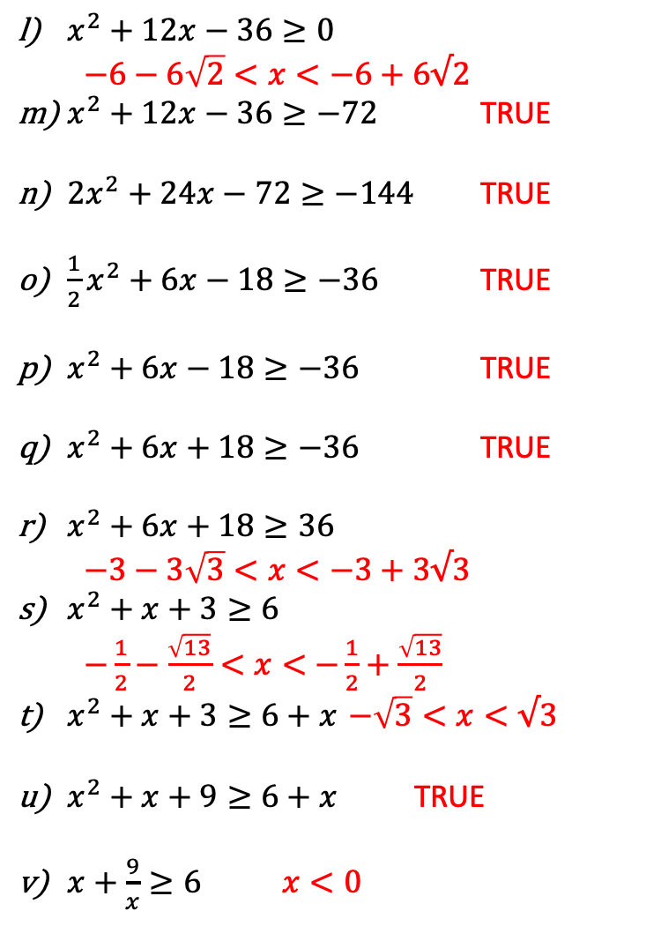
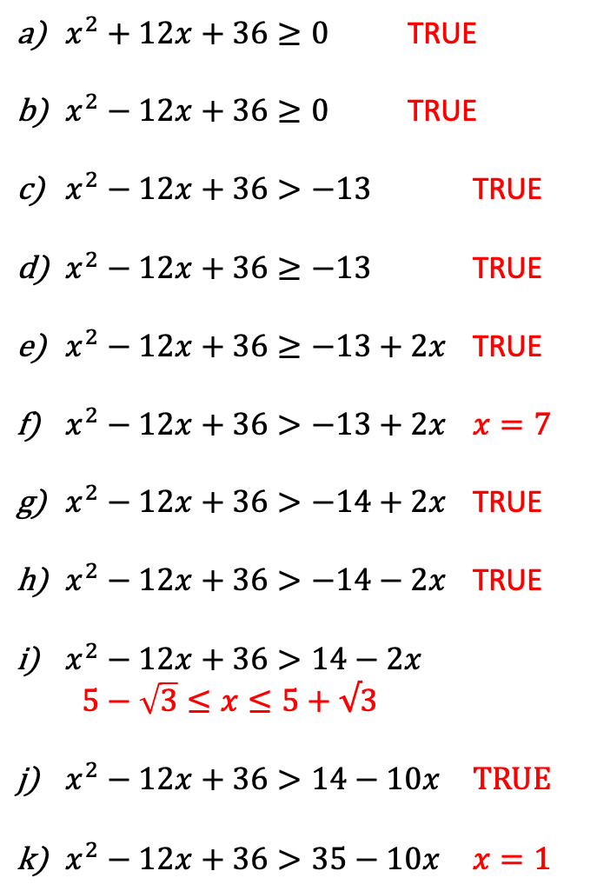
Prove if possible, otherwise, find a counter example.
$x^{2}+12x+36≥0$ TRUE
$x^{2}−12x+36≥0$ TRUE
$x^{2}−12x+36>−13$ TRUE
$x^{2}−12x+36≥−13$ TRUE
$x^{2}−12x+36≥−13+2x$ TRUE
$x^{2}−12x+36>−13+2x$ $x=7$
$x^{2}−12x+36>−14+2x$ TRUE
$x^{2}−12x+36>−14−2x$ TRUE
$x^{2}−12x+36>14−2x$ $5−\sqrt{3}≤x≤5+√3$
$x^{2}−12x+36>14−10x$ TRUE
$x^{2}−12x+36>35−10x$ $x=1$
$x^{2}+12x−36≥0$ $−6−6\sqrt{2}<x<−6+6√2$
$x^{2}+12x−36≥−72$ TRUE
$2x^{2}+24x−72≥−144$ TRUE
${\frac{1}{2}x}^{2}+6x−18≥−36$ TRUE
$x^{2}+6x−18≥−36$ TRUE
$x^{2}+6x+18≥−36$ TRUE
$x^{2}+6x+18≥36$ $−3−3\sqrt{3}<x<−3+3√3$
$x^{2}+x+3≥6$ $−\frac{1}{2}−\frac{\sqrt{13}}{2}<x<$ $−\frac{1}{2}+\frac{\sqrt{13}}{2}$
$x^{2}+x+3≥6+x$ $−\sqrt{3}<x<√3$
$x^{2}+x+9≥6+x$ TRUE
$x+\frac{9}{x}≥6$ $x<0$

