Slide 1
Sum & Product: Fill in the gaps
Silent
Teacher
Intelligent Practice
Narration
Your Turn
$$9+\left(−3\right)=$$
9 x (-3) =
Practice

Slide 2
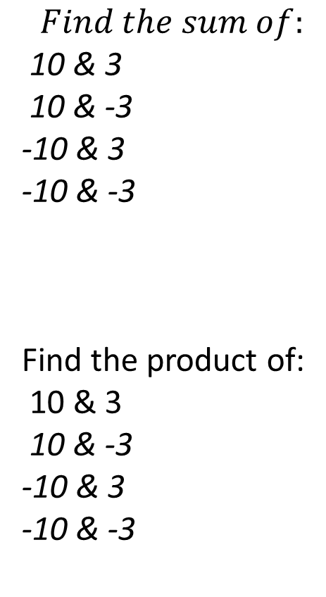
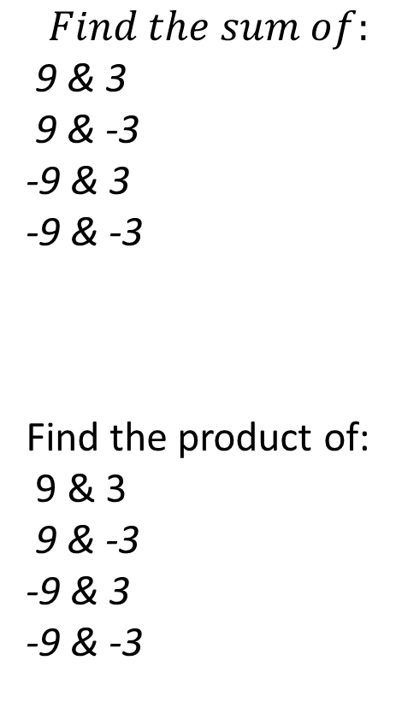
Worked Example
Your Turn
$$Find the sum of:$$
9 & 3
9 & -3
-9 & 3
-9 & -3
Find the product of:
9 & 3
9 & -3
-9 & 3
-9 & -3
$$Find the sum of:$$
10 & 3
10 & -3
-10 & 3
-10 & -3
Find the product of:
10 & 3
10 & -3
-10 & 3
-10 & -3
thedarklordofalgebra

Slide 3
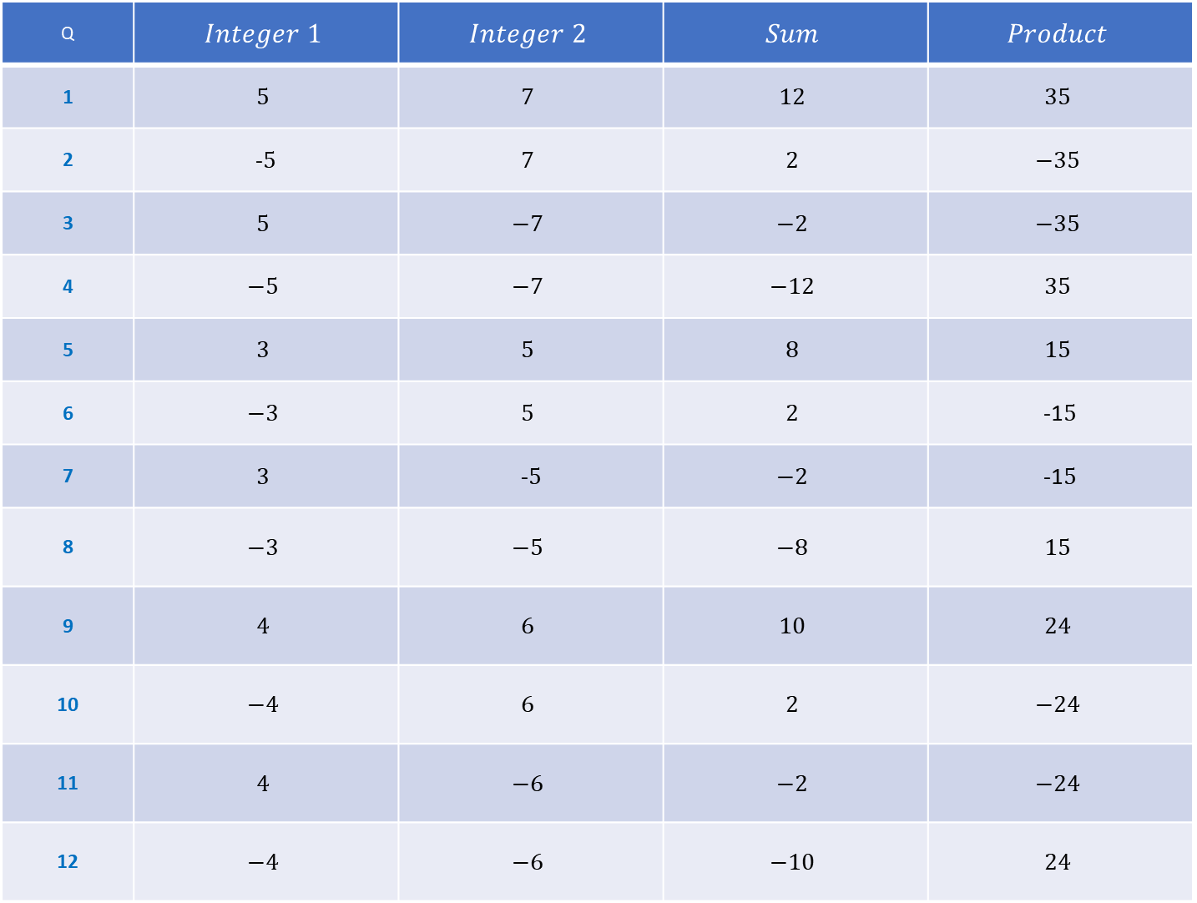
Q | $$Integer 1$$ | $$Integer 2$$ | $$Sum$$ | $$Product$$
1 | $$5$$ | $$7$$ | $$12$$ | $$35$$
2 | -$5$ | $$7$$ | $$2$$ | $$−35$$
3 | $$5$$ | $$−7$$ | $$−2$$ | $$−35$$
4 | $$−5$$ | $$−7$$ | $$−12$$ | $$35$$
5 | $$3$$ | $$5$$ | $$8$$ | $$15$$
6 | $$−3$$ | $$5$$ | $$2$$ | -1$5$
7 | $$3$$ | -$5$ | $$−2$$ | -1$5$
8 | $$−3$$ | $$−5$$ | $$−8$$ | $$15$$
9 | $$4$$ | $$6$$ | $$10$$ | $$24$$
10 | $$−4$$ | $$6$$ | $$2$$ | $$−24$$
11 | $$4$$ | $$−6$$ | $$−2$$ | $$−24$$
12 | $$−4$$ | $$−6$$ | $$−10$$ | $$24$$

Slide 4
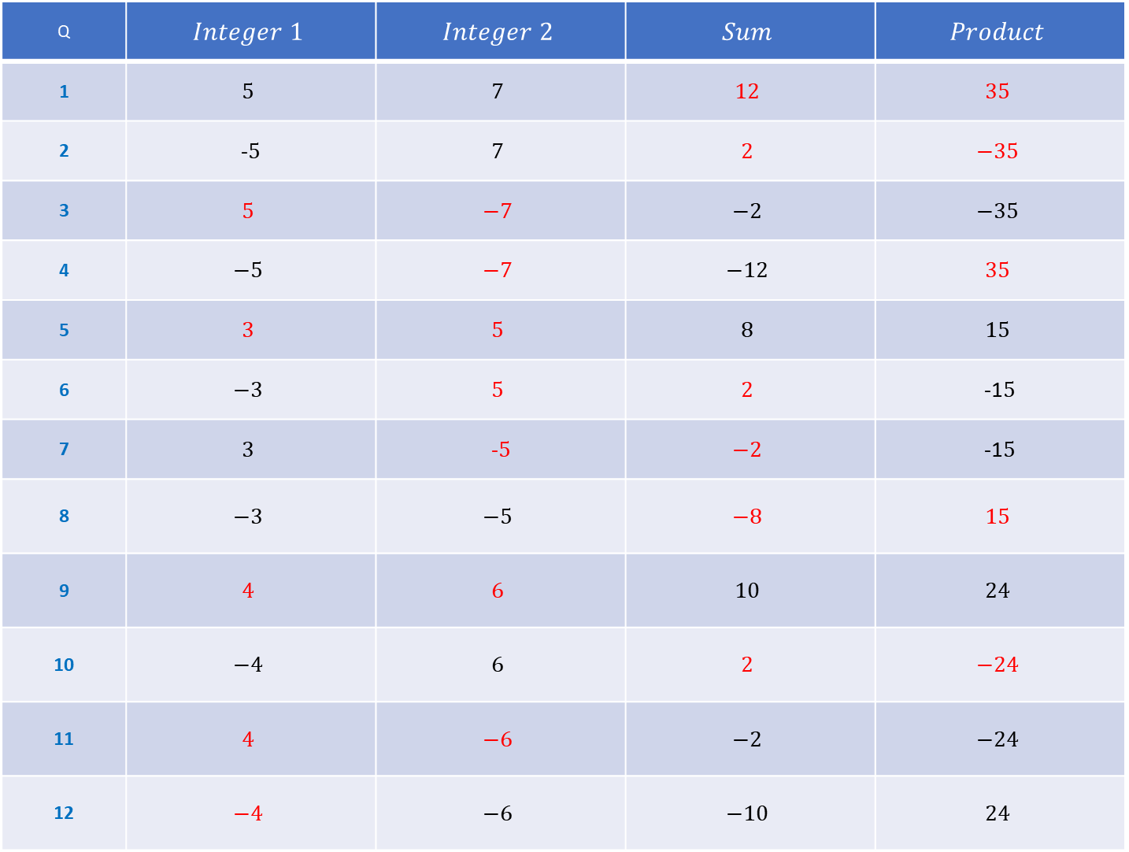
Q | $$Integer 1$$ | $$Integer 2$$ | $$Sum$$ | $$Product$$
1 | $$5$$ | $$7$$ | $$12$$ | $$35$$
2 | -$5$ | $$7$$ | $$2$$ | $$−35$$
3 | $$5$$ | $$−7$$ | $$−2$$ | $$−35$$
4 | $$−5$$ | $$−7$$ | $$−12$$ | $$35$$
5 | $$3$$ | $$5$$ | $$8$$ | $$15$$
6 | $$−3$$ | $$5$$ | $$2$$ | -1$5$
7 | $$3$$ | -$5$ | $$−2$$ | -1$5$
8 | $$−3$$ | $$−5$$ | $$−8$$ | $$15$$
9 | $$4$$ | $$6$$ | $$10$$ | $$24$$
10 | $$−4$$ | $$6$$ | $$2$$ | $$−24$$
11 | $$4$$ | $$−6$$ | $$−2$$ | $$−24$$
12 | $$−4$$ | $$−6$$ | $$−10$$ | $$24$$

