Slide 1
Equations of parallel lines
Silent
Teacher
Intelligent Practice
Narration
Your Turn
Practice

Slide 2
Equations of parallel lines
Example | Thoughts? | Your turn
Write down the equation parallel to y = 4x+1 which passes through (2,17) |  | Write down the equation parallel to y = 8x+5 which passes through (2,26)
?

Slide 3
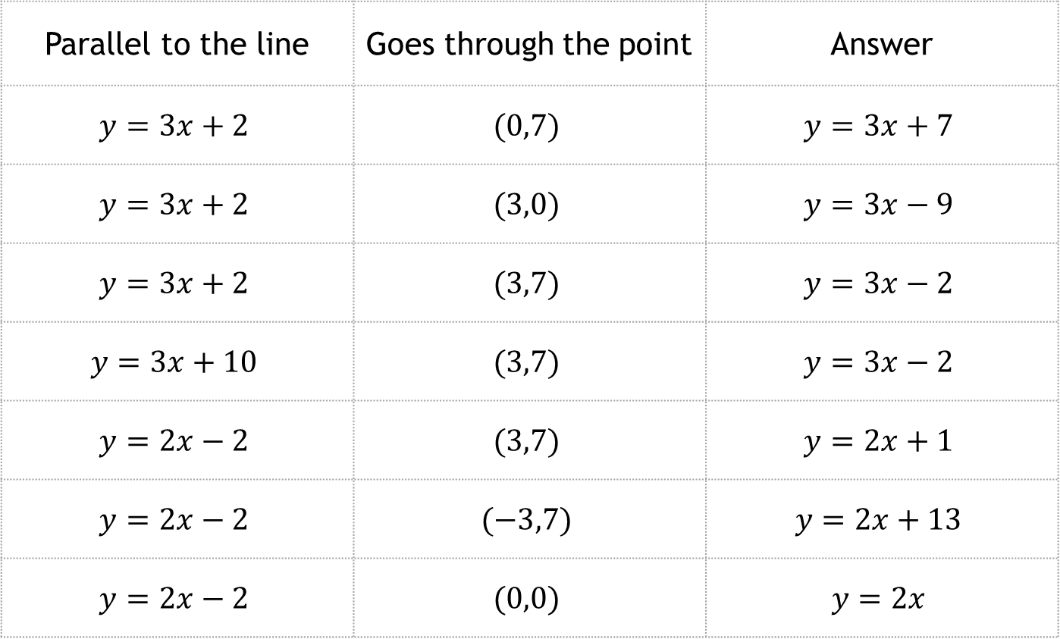
Equations of parallel lines
Write down the equation…
Parallel to the line | Goes through the point | Answer
$$y=3x+2$$ | $$(0,7)$$ | $$y=3x+7$$
$$y=3x+2$$ | $$(3,0)$$ | $$y=3x−9$$
$$y=3x+2$$ | $$(3,7)$$ | $$y=3x−2$$
$$y=3x+10$$ | $$(3,7)$$ | $$y=3x−2$$
$$y=2x−2$$ | $$(3,7)$$ | $$y=2x+1$$
$$y=2x−2$$ | $$(−3,7)$$ | $$y=2x+13$$
$$y=2x−2$$ | $$(0,0)$$ | $$y=2x$$
?
?
?
?
?
?
?
Reveal all

Slide 4
Equations of parallel lines
Write down the equation…
Parallel to the line | Goes through the point | Answer
$$y=3x+2$$ | $$(0,7)$$ | $$y=3x+7$$
$$y=3x+2$$ | $$(3,0)$$ | $$y=3x−9$$
$$y=3x+2$$ | $$(3,7)$$ | $$y=3x−2$$
$$y=3x+10$$ | $$(3,7)$$ | $$y=3x−2$$
$$y=2x−2$$ | $$(3,7)$$ | $$y=2x+1$$
$$y=2x−2$$ | $$(−3,7)$$ | $$y=2x+13$$
$$y=2x−2$$ | $$(0,0)$$ | $$y=2x$$
Reveal all

