Slide 1
Equations of perpendicular lines
Silent
Teacher
Intelligent Practice
Narration
Your Turn
Practice

Slide 2
Equations of perpendicular lines
Example | Thoughts? | Your turn
Write down the equation perpendicular to y = 4x+1 which passes through (8,17) |  | Write down the equation perpendicular to y = 8x+5 which passes through (16,26)
?

Slide 3
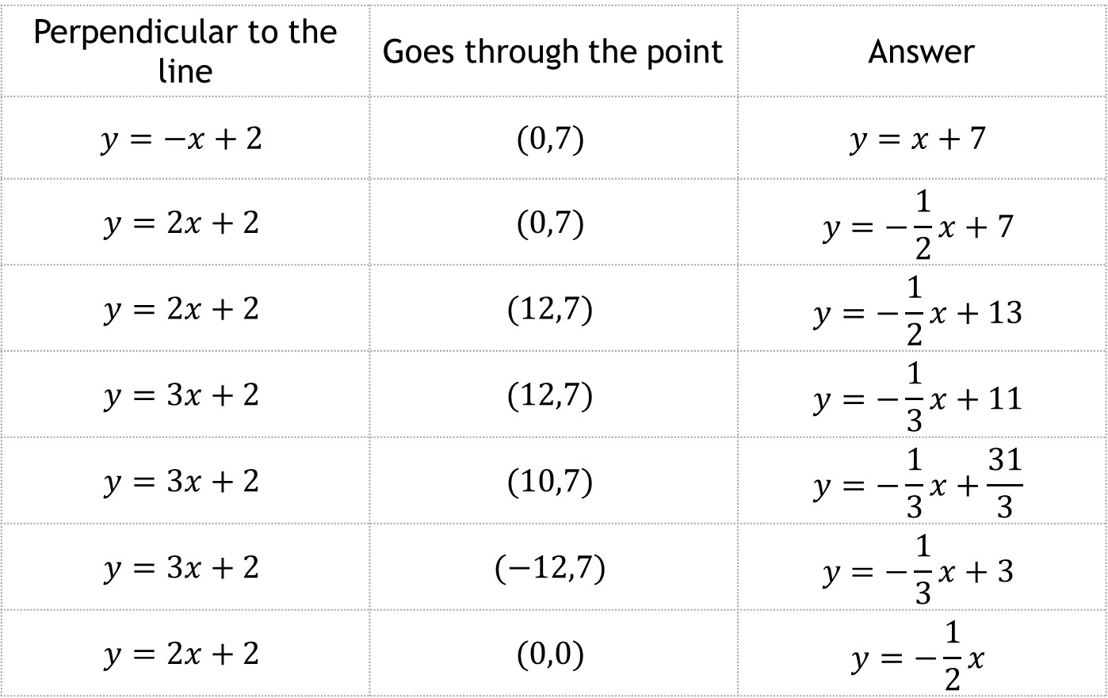
Equations of perpendicular lines
Write down the equation…
Perpendicular to the line | Goes through the point | Answer
$$y=−x+2$$ | $$(0,7)$$ | $$y=x+7$$
$$y=2x+2$$ | $$(0,7)$$ | $$y=−\frac{1}{2}x+7$$
$$y=2x+2$$ | $$(12,7)$$ | $$y=−\frac{1}{2}x+13$$
$$y=3x+2$$ | $$(12,7)$$ | $$y=−\frac{1}{3}x+11$$
$$y=3x+2$$ | $$(10,7)$$ | $$y=−\frac{1}{3}x+\frac{31}{3}$$
$$y=3x+2$$ | $$(−12,7)$$ | $$y=−\frac{1}{3}x+3$$
$$y=2x+2$$ | $$(0,0)$$ | $$y=−\frac{1}{2}x$$
?
?
?
?
?
?
?
Reveal all

Slide 4
Equations of perpendicular lines
Write down the equation…
Perpendicular to the line | Goes through the point | Answer
$$y=−x+2$$ | $$(0,7)$$ | $$y=x+7$$
$$y=2x+2$$ | $$(0,7)$$ | $$y=−\frac{1}{2}x+7$$
$$y=2x+2$$ | $$(12,7)$$ | $$y=−\frac{1}{2}x+13$$
$$y=3x+2$$ | $$(12,7)$$ | $$y=−\frac{1}{3}x+11$$
$$y=3x+2$$ | $$(10,7)$$ | $$y=−\frac{1}{3}x+\frac{31}{3}$$
$$y=3x+2$$ | $$(−12,7)$$ | $$y=−\frac{1}{3}x+3$$
$$y=2x+2$$ | $$(0,0)$$ | $$y=−\frac{1}{2}x$$
Reveal all

