Slide 1
Factorising by Grouping
Silent
Teacher
Intelligent Practice
Narration
Your Turn
$$\left(2x+1\right){\left(2x−5\right)}^{2}−\left(3x+1\right){\left(2x−5\right)}^{3}$$
$$\left(5x−3\right)(x−5){\left(2−x\right)}^{3}+{\left(x−5\right)}^{2}(x−2)$$
Practice

Slide 2
Worked Example
Your Turn
$${3x\left(5x+2\right)}^{2}−2{\left(5x+2\right)}^{3}$$
$${5x\left(7x−1\right)}^{2}+3{\left(7x−1\right)}^{3}$$
$${3x\left(5x−2\right)}^{2}−2(2−5x)$$
$${3x\left(7x−1\right)}^{2}−2(1−7x)$$
@DrChris_Baker

Slide 3
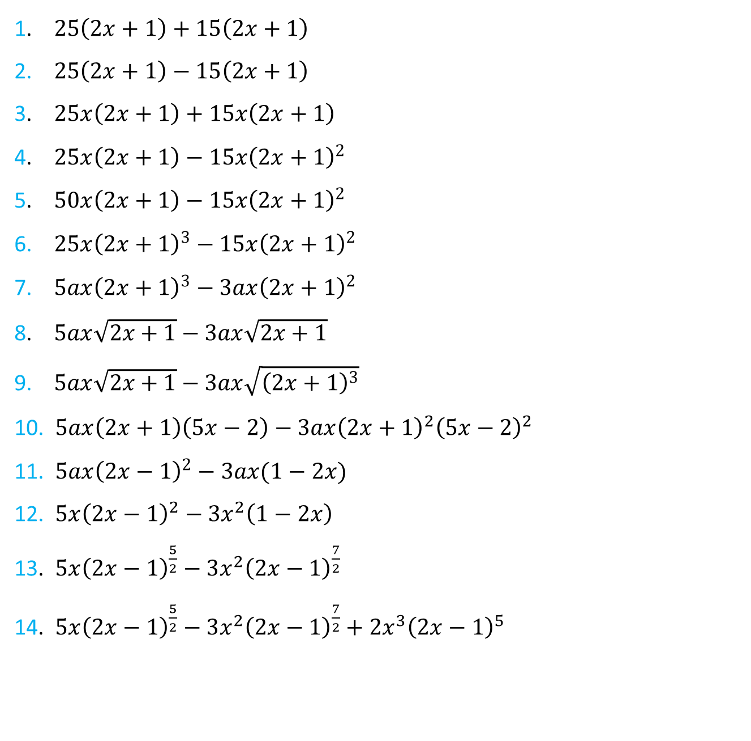
1. $25\left(2x+1\right)+15\left(2x+1\right)$
2. $25\left(2x+1\right)−15\left(2x+1\right)$
3. $25x\left(2x+1\right)+15x\left(2x+1\right)$
4. $25x\left(2x+1\right)−15x{\left(2x+1\right)}^{2}$
5. $50x\left(2x+1\right)−15x{\left(2x+1\right)}^{2}$
6. $25x{\left(2x+1\right)}^{3}−15x{\left(2x+1\right)}^{2}$
7. $5ax{\left(2x+1\right)}^{3}−3ax{\left(2x+1\right)}^{2}$
8. $5ax\sqrt{2x+1}−3ax\sqrt{2x+1}$
9. $5ax\sqrt{2x+1}−3ax\sqrt{{\left(2x+1\right)}^{3}}$
10. $5ax\left(2x+1\right)\left(5x−2\right)−3ax{\left(2x+1\right)}^{2}{\left(5x−2\right)}^{2}$
11. $5ax{\left(2x−1\right)}^{2}−3ax(1−2x)$
12. $5x{\left(2x−1\right)}^{2}−3x^{2}\left(1−2x\right)$
13. $5x{\left(2x−1\right)}^{\frac{5}{2}}−3x^{2}{\left(2x−1\right)}^{\frac{7}{2}}$
14. $5x{\left(2x−1\right)}^{\frac{5}{2}}−3x^{2}{\left(2x−1\right)}^{\frac{7}{2}}+2x^{3}{\left(2x−1\right)}^{5}$
@DrChris_Baker

Slide 4
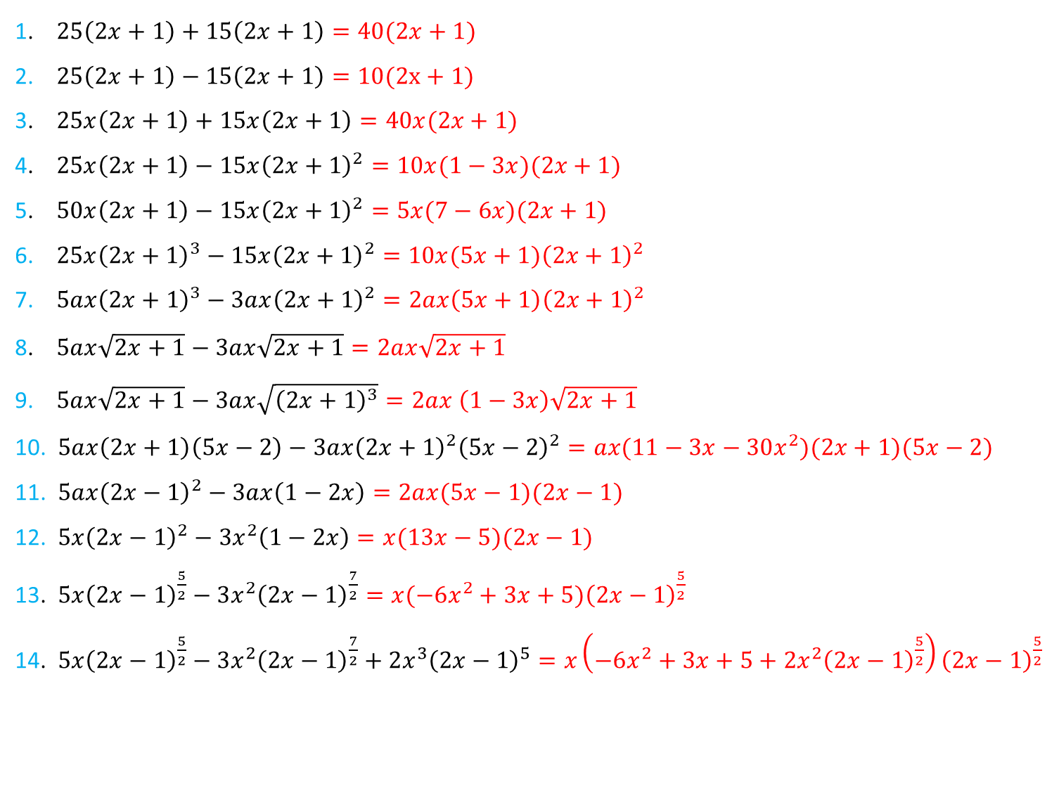
1. $25\left(2x+1\right)+15\left(2x+1\right)=40(2x+1)$
2. $25\left(2x+1\right)−15\left(2x+1\right)=10(2x+1)$
3. $25x\left(2x+1\right)+15x\left(2x+1\right)=40x(2x+1)$
4. $25x\left(2x+1\right)−15x{\left(2x+1\right)}^{2}=10x(1−3x)(2x+1)$
5. $50x\left(2x+1\right)−15x{\left(2x+1\right)}^{2}=5x(7−6x)(2x+1)$
6. $25x{\left(2x+1\right)}^{3}−15x{\left(2x+1\right)}^{2}={10x(5x+1)\left(2x+1\right)}^{2}$
7. $5ax{\left(2x+1\right)}^{3}−3ax{\left(2x+1\right)}^{2}=2ax\left(5x+1\right){\left(2x+1\right)}^{2}$
8. $5ax\sqrt{2x+1}−3ax\sqrt{2x+1}=2ax\sqrt{2x+1}$
9. $5ax\sqrt{2x+1}−3ax\sqrt{{\left(2x+1\right)}^{3}}=2ax \left(1−3x\right)\sqrt{2x+1}$
10. $5ax\left(2x+1\right)\left(5x−2\right)−3ax{\left(2x+1\right)}^{2}{\left(5x−2\right)}^{2}=ax(11−3x−30x^{2})(2x+1)(5x−2)$
11. $5ax{\left(2x−1\right)}^{2}−3ax\left(1−2x\right)=2ax(5x−1)(2x−1)$
12. $5x{\left(2x−1\right)}^{2}−3x^{2}\left(1−2x\right)=x(13x−5)(2x−1)$
13. $5x{\left(2x−1\right)}^{\frac{5}{2}}−3x^{2}{\left(2x−1\right)}^{\frac{7}{2}}=x(−6x^{2}+3x+5){\left(2x−1\right)}^{\frac{5}{2}}$
14. $5x{\left(2x−1\right)}^{\frac{5}{2}}−3x^{2}{\left(2x−1\right)}^{\frac{7}{2}}+2x^{3}{\left(2x−1\right)}^{5}=x{\left(−6x^{2}+3x+5+2x^{2}{\left(2x−1\right)}^{\frac{5}{2}}\right)\left(2x−1\right)}^{\frac{5}{2}}$
@DrChris_Baker

