Slide 1
Product of prime factors: Yes / no ?
True/false
Reflect
Your Turn
$$4×7$$
$$3×7$$
$$2×7$$
Rule

Slide 2
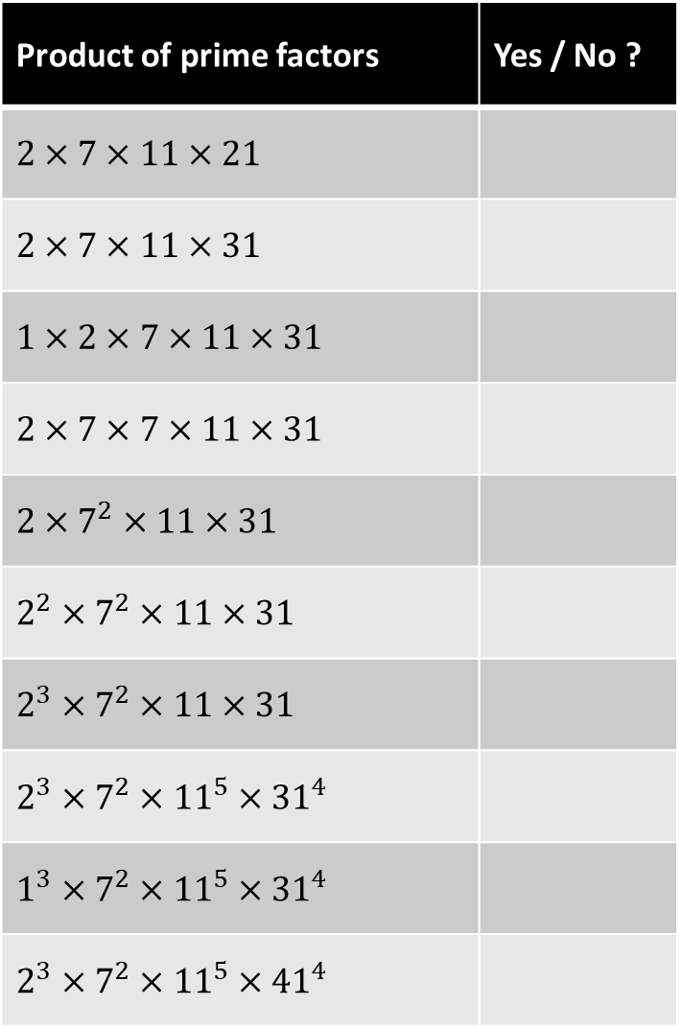
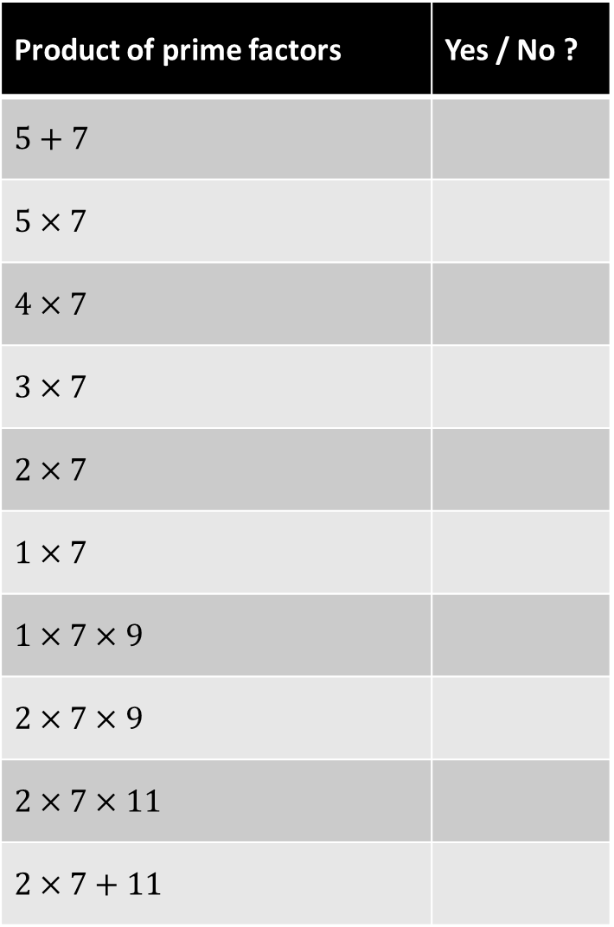
Product of prime factors | Yes / No ?
$$5+7$$
$$5×7$$
$$4×7$$
$$3×7$$
$$2×7$$
$$1×7$$
$$1×7×9$$
$$2×7×9$$
$$2×7×11$$
$$2×7+11$$
Product of prime factors | Yes / No ?
$$2×7×11×21$$
$$2×7×11×31$$
$$1×2×7×11×31$$
$$2×7×7×11×31$$
$$2×7^{2}×11×31$$
$$2^{2}×7^{2}×11×31$$
$$2^{3}×7^{2}×11×31$$
$$2^{3}×7^{2}×{11}^{5}×{31}^{4}$$
$$1^{3}×7^{2}×{11}^{5}×{31}^{4}$$
$$2^{3}×7^{2}×{11}^{5}×{41}^{4}$$

Slide 3
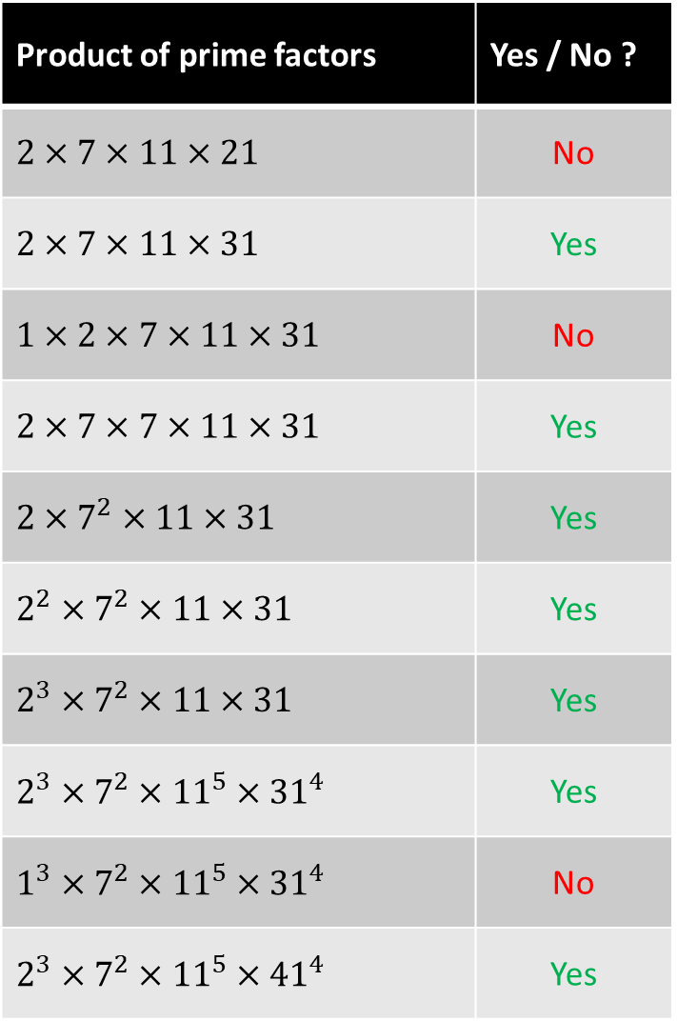
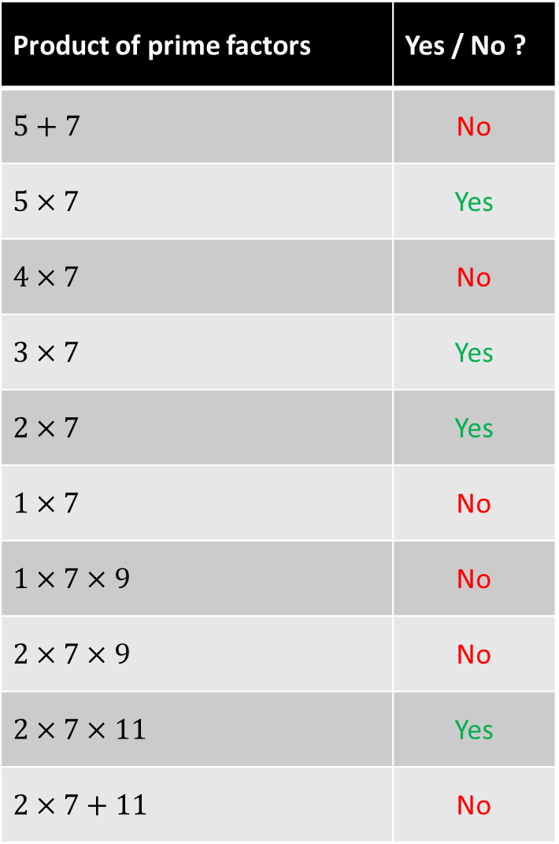
Product of prime factors | Yes / No ?
$$5+7$$ | No
$$5×7$$ | Yes
$$4×7$$ | No
$$3×7$$ | Yes
$$2×7$$ | Yes
$$1×7$$ | No
$$1×7×9$$ | No
$$2×7×9$$ | No
$$2×7×11$$ | Yes
$$2×7+11$$ | No
Product of prime factors | Yes / No ?
$$2×7×11×21$$ | No
$$2×7×11×31$$ | Yes
$$1×2×7×11×31$$ | No
$$2×7×7×11×31$$ | Yes
$$2×7^{2}×11×31$$ | Yes
$$2^{2}×7^{2}×11×31$$ | Yes
$$2^{3}×7^{2}×11×31$$ | Yes
$$2^{3}×7^{2}×{11}^{5}×{31}^{4}$$ | Yes
$$1^{3}×7^{2}×{11}^{5}×{31}^{4}$$ | No
$$2^{3}×7^{2}×{11}^{5}×{41}^{4}$$ | Yes

Slide 4
Product of prime factors | Yes / No ?
$$5+7$$ | No
$$5×7$$ | Yes
$$4×7$$ | No
$$3×7$$ | Yes
$$2×7$$ | Yes
$$1×7$$ | No
$$1×7×9$$ | No
$$2×7×9$$ | No
$$2×7×11$$ | Yes
$$2×7+11$$ | No
Product of prime factors | Yes / No ?
$$2×7×11×21$$ | No
$$2×7×11×31$$ | Yes
$$1×2×7×11×31$$ | No
$$2×7×7×11×31$$ | Yes
$$2×7^{2}×11×31$$ | Yes
$$2^{2}×7^{2}×11×31$$ | Yes
$$2^{3}×7^{2}×11×31$$ | Yes
$$2^{3}×7^{2}×{11}^{5}×{31}^{4}$$ | Yes
$$1^{3}×7^{2}×{11}^{5}×{31}^{4}$$ | No
$$2^{3}×7^{2}×{11}^{5}×{41}^{4}$$ | Yes

Slide 5
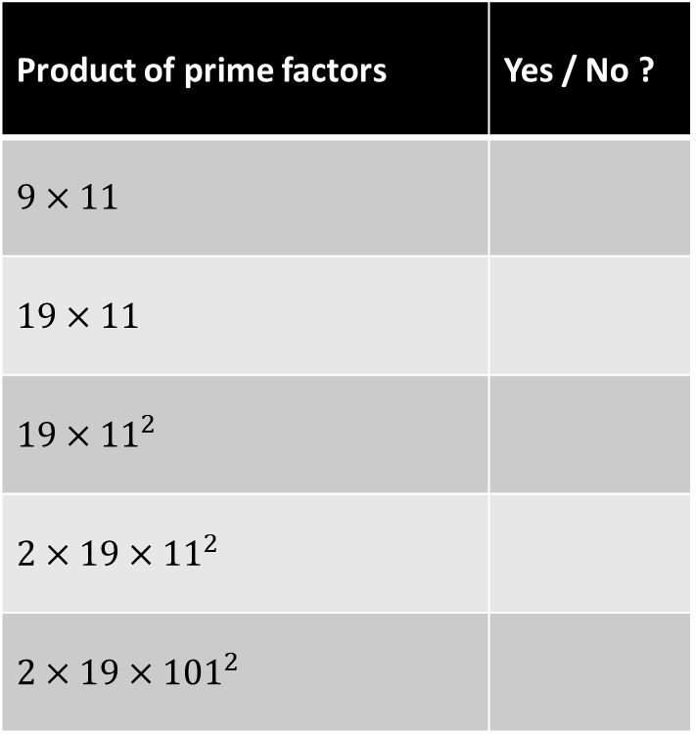
Your Turn
Product of prime factors | Yes / No ?
$$9×11$$
$$19×11$$
$$19×{11}^{2}$$
$$2×19×{11}^{2}$$
$$2×19×{101}^{2}$$
@mrbartonmaths

Slide 6
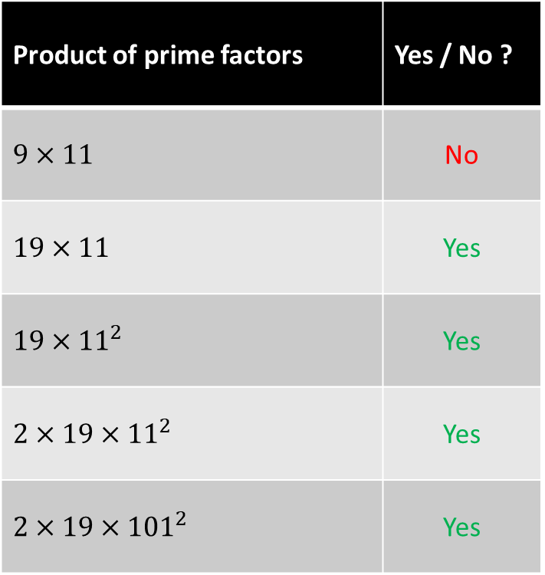
Your Turn - answers
Product of prime factors | Yes / No ?
$$9×11$$ | No
$$19×11$$ | Yes
$$19×{11}^{2}$$ | Yes
$$2×19×{11}^{2}$$ | Yes
$$2×19×{101}^{2}$$ | Yes
@mrbartonmaths

