Slide 1
Estimated Mean from a Grouped Frequency Table (Version 2)
Silent
Teacher
Intelligent Practice
Narration
Your Turn
Mass, $x$ (kg) | Frequency
$$0<x≤10$$ | $$2$$
$$10<x≤20$$ | $$4$$
$$20<x≤30$$ | $$8$$
$$30<x≤40$$ | $$6$$
Practice

Slide 2
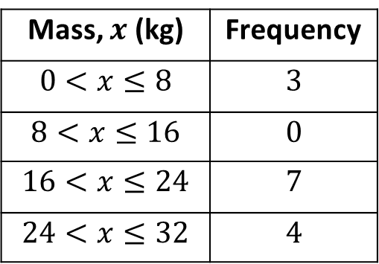
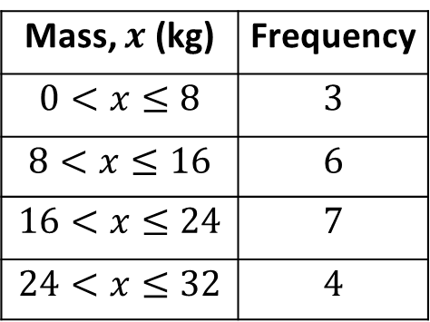
Worked Example
Your Turn
Calculate an estimate for the mean:
Calculate an estimate for the mean:
Mass, $x$ (kg) | Frequency
$$0<x≤8$$ | $$3$$
$$8<x≤16$$ | $$6$$
$$16<x≤24$$ | $$7$$
$$24<x≤32$$ | $$4$$
Mass, $x$ (kg) | Frequency
$$0<x≤8$$ | $$3$$
$$8<x≤16$$ | $$0$$
$$16<x≤24$$ | $$7$$
$$24<x≤32$$ | $$4$$

Slide 3
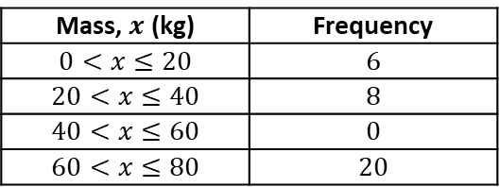
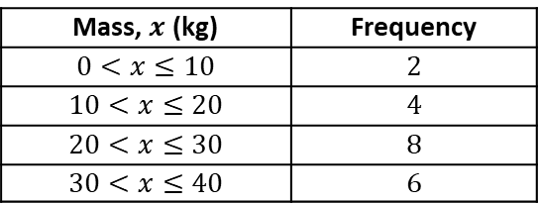
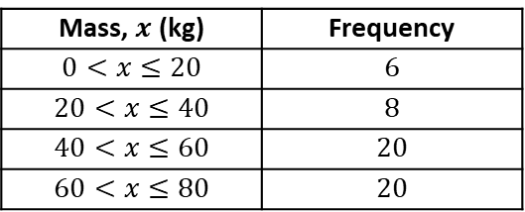
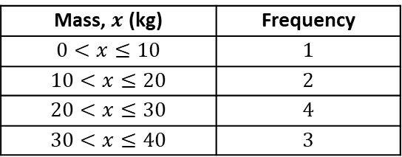
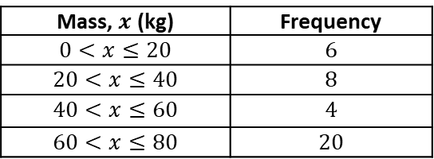
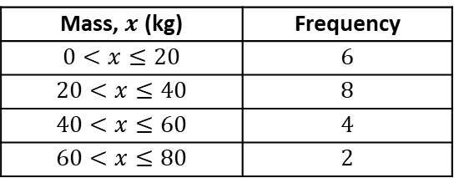
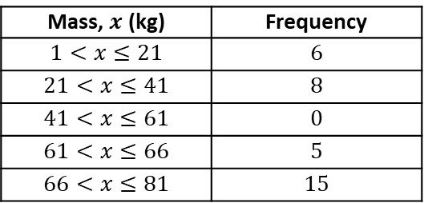
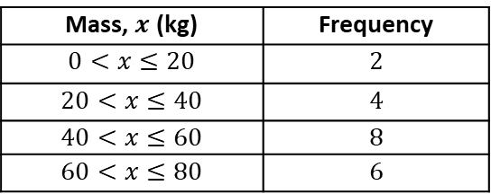
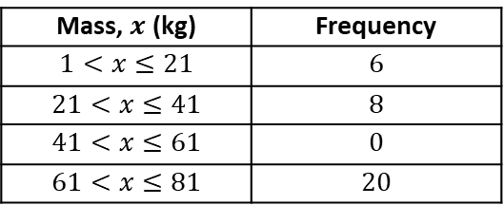
Mass, $x$ (kg) | Frequency
$$0<x≤10$$ | $$1$$
$$10<x≤20$$ | $$2$$
$$20<x≤30$$ | $$4$$
$$30<x≤40$$ | $$3$$
Mass, $x$ (kg) | Frequency
$$0<x≤20$$ | $$6$$
$$20<x≤40$$ | $$8$$
$$40<x≤60$$ | $$20$$
$$60<x≤80$$ | $$20$$
1.
6.
Mass, $x$ (kg) | Frequency
$$0<x≤10$$ | $$2$$
$$10<x≤20$$ | $$4$$
$$20<x≤30$$ | $$8$$
$$30<x≤40$$ | $$6$$
Mass, $x$ (kg) | Frequency
$$0<x≤20$$ | $$6$$
$$20<x≤40$$ | $$8$$
$$40<x≤60$$ | $$0$$
$$60<x≤80$$ | $$20$$
2.
7.
Mass, $x$ (kg) | Frequency
$$0<x≤20$$ | $$2$$
$$20<x≤40$$ | $$4$$
$$40<x≤60$$ | $$8$$
$$60<x≤80$$ | $$6$$
Mass, $x$ (kg) | Frequency
$$1<x≤21$$ | $$6$$
$$21<x≤41$$ | $$8$$
$$41<x≤61$$ | $$0$$
$$61<x≤81$$ | $$20$$
3.
8.
Mass, $x$ (kg) | Frequency
$$0<x≤20$$ | $$6$$
$$20<x≤40$$ | $$8$$
$$40<x≤60$$ | $$4$$
$$60<x≤80$$ | $$2$$
Mass, $x$ (kg) | Frequency
$$1<x≤21$$ | $$6$$
$$21<x≤41$$ | $$8$$
$$41<x≤61$$ | $$0$$
$$61<x≤66$$ | $$5$$
$$66<x≤81$$ | $$15$$
4.
9.
Mass, $x$ (kg) | Frequency
$$0<x≤20$$ | $$6$$
$$20<x≤40$$ | $$8$$
$$40<x≤60$$ | $$4$$
$$60<x≤80$$ | $$20$$
Mass, $x$ (kg) | Frequency
$$1<x≤21$$ | $$6$$
$$21<x≤41$$ | $$8$$
$$41<x≤81$$ | $$20$$
5.
10.

Slide 4
Mass, $x$ (kg) | Frequency
$$0<x≤10$$ | $$1$$
$$10<x≤20$$ | $$2$$
$$20<x≤30$$ | $$4$$
$$30<x≤40$$ | $$3$$
Mass, $x$ (kg) | Frequency
$$0<x≤20$$ | $$6$$
$$20<x≤40$$ | $$8$$
$$40<x≤60$$ | $$20$$
$$60<x≤80$$ | $$20$$
1.
6.
24kg
50kg
Mass, $x$ (kg) | Frequency
$$0<x≤10$$ | $$2$$
$$10<x≤20$$ | $$4$$
$$20<x≤30$$ | $$8$$
$$30<x≤40$$ | $$6$$
Mass, $x$ (kg) | Frequency
$$0<x≤20$$ | $$6$$
$$20<x≤40$$ | $$8$$
$$40<x≤60$$ | $$0$$
$$60<x≤80$$ | $$20$$
2.
7.
24kg
50kg
Mass, $x$ (kg) | Frequency
$$0<x≤20$$ | $$2$$
$$20<x≤40$$ | $$4$$
$$40<x≤60$$ | $$8$$
$$60<x≤80$$ | $$6$$
Mass, $x$ (kg) | Frequency
$$1<x≤21$$ | $$6$$
$$21<x≤41$$ | $$8$$
$$41<x≤61$$ | $$0$$
$$61<x≤81$$ | $$20$$
3.
8.
48kg
51kg
Mass, $x$ (kg) | Frequency
$$0<x≤20$$ | $$6$$
$$20<x≤40$$ | $$8$$
$$40<x≤60$$ | $$4$$
$$60<x≤80$$ | $$2$$
Mass, $x$ (kg) | Frequency
$$1<x≤21$$ | $$6$$
$$21<x≤41$$ | $$8$$
$$41<x≤61$$ | $$0$$
$$61<x≤66$$ | $$5$$
$$66<x≤81$$ | $$15$$
4.
9.
32kg
51kg
Mass, $x$ (kg) | Frequency
$$0<x≤20$$ | $$6$$
$$20<x≤40$$ | $$8$$
$$40<x≤60$$ | $$4$$
$$60<x≤80$$ | $$20$$
Mass, $x$ (kg) | Frequency
$$1<x≤21$$ | $$6$$
$$21<x≤41$$ | $$8$$
$$41<x≤81$$ | $$20$$
5.
10.
50kg
45.11…kg

