Slide 1
Dividing mixed fractions by whole numbers
Silent
Teacher
Intelligent Practice
Narration
Your Turn
$$3\frac{1}{3}÷3$$
$$3\frac{2}{3}÷3$$
$$3\frac{2}{3}÷6$$
Practice

Slide 2
Worked Example
Your Turn
$$2\frac{1}{3}÷2$$
$$4\frac{2}{3}÷2$$
@fortyninecubed
@mathsmrgordon

Slide 3
$$3\frac{1}{3}÷3$$
$$3\frac{2}{3}÷3$$
$$3\frac{2}{3}÷6$$
$$3\frac{2}{3}÷2$$
$$2\frac{1}{3}÷2$$
$$2\frac{1}{3}÷10$$
$$4\frac{2}{3}÷10$$
$$40\frac{2}{3}÷10$$
@mathsmrgordon

Slide 4
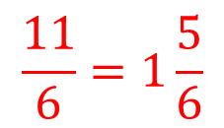
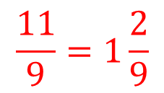
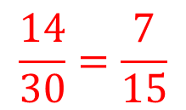
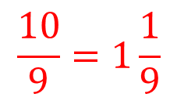
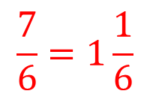
$$3\frac{1}{3}÷3$$
$$3\frac{2}{3}÷3$$
$$3\frac{2}{3}÷6$$
$$3\frac{2}{3}÷2$$
$$\frac{10}{9}=1\frac{1}{9}$$
$$2\frac{1}{3}÷2$$
$$2\frac{1}{3}÷10$$
$$4\frac{2}{3}÷10$$
$$40\frac{2}{3}÷10$$
$$\frac{7}{6}=1\frac{1}{6}$$
$$\frac{11}{9}=1\frac{2}{9}$$
$$\frac{7}{30}$$
$$\frac{11}{18}$$
$$\frac{14}{30}=\frac{7}{15}$$
$$\frac{11}{6}=1\frac{5}{6}$$
$$\frac{122}{30}=4\frac{2}{30}=4\frac{1}{15}$$
@mathsmrgordon

