Slide 1
Order of operations: First step
True/false
Reflect
Your Turn
$$3+4×5$$
$$\left(3+4\right)×5$$
$$(3+4×5)$$
Rule

Slide 2
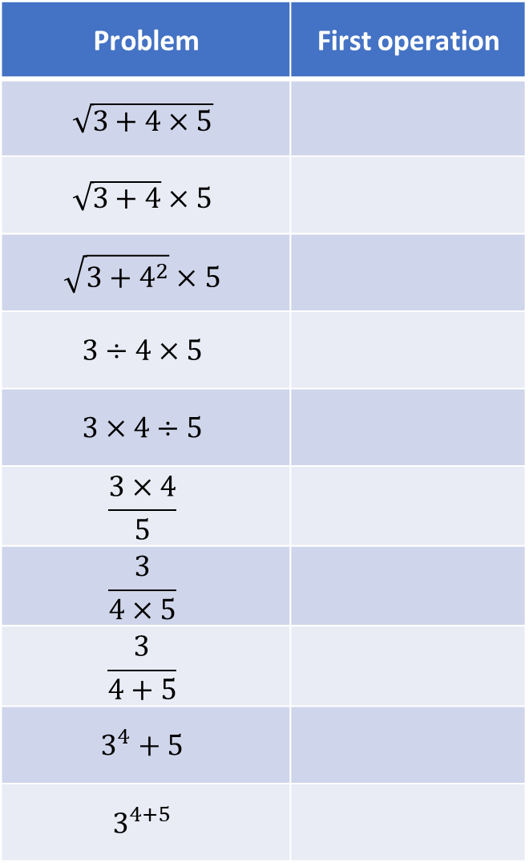
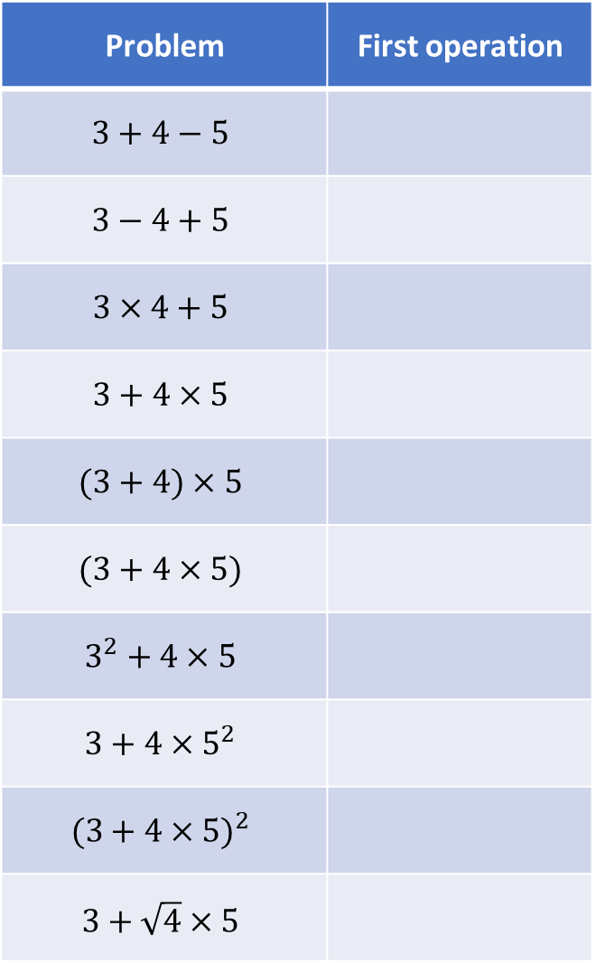
Problem | First operation
$$3+4−5$$
$$3−4+5$$
$$3×4+5$$
$$3+4×5$$
$$(3+4)×5$$
$$(3+4×5)$$
$$3^{2}+4×5$$
$$3+4×5^{2}$$
$$(3+4×{5)}^{2}$$
$$3+\sqrt{4}×5$$
Problem | First operation
$$\sqrt{3+4×5}$$
$$\sqrt{3+4}×5$$
$$\sqrt{3+4^{2}}×5$$
$$3÷4×5$$
$$3×4÷5$$
$$\frac{3×4}{5}$$
$$\frac{3}{4×5}$$
$$\frac{3}{4+5}$$
$$3^{4}+5$$
$$3^{4+5}$$

Slide 3
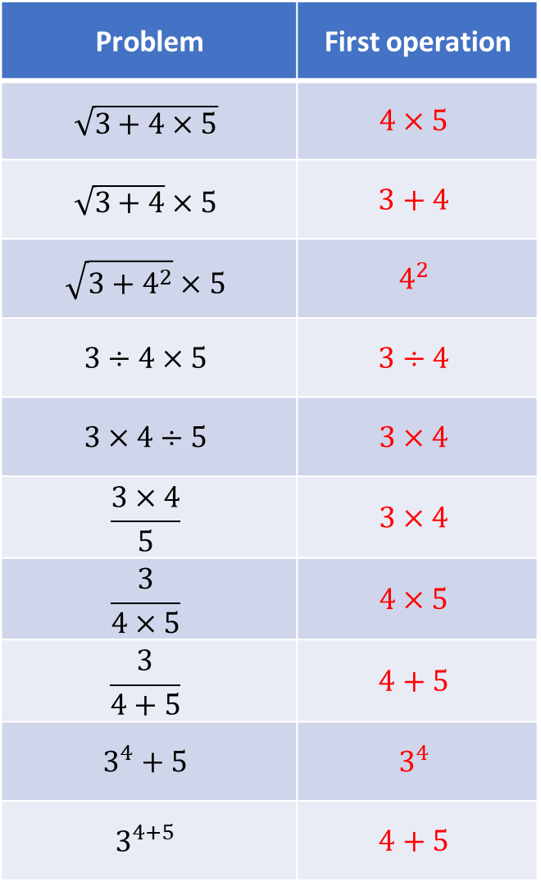
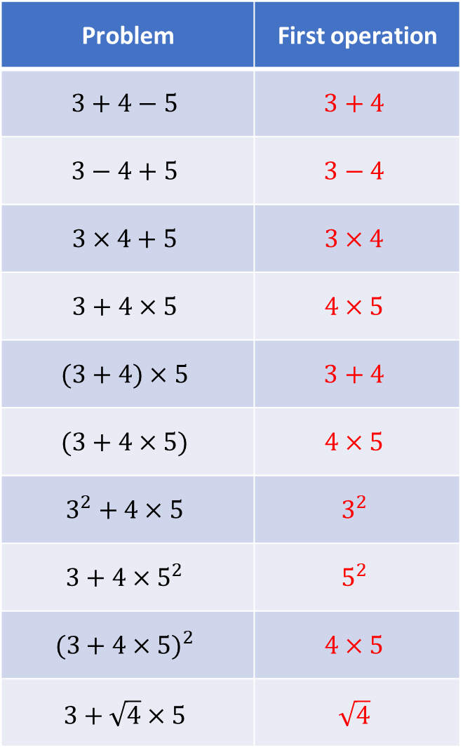
Problem | First operation
$$3+4−5$$ | $$3+4$$
$$3−4+5$$ | $$3−4$$
$$3×4+5$$ | $$3×4$$
$$3+4×5$$ | $$4×5$$
$$(3+4)×5$$ | $$3+4$$
$$(3+4×5)$$ | $$4×5$$
$$3^{2}+4×5$$ | $$3^{2}$$
$$3+4×5^{2}$$ | $$5^{2}$$
$$(3+4×{5)}^{2}$$ | $$4×5$$
$$3+\sqrt{4}×5$$ | $$\sqrt{4}$$
Problem | First operation
$$\sqrt{3+4×5}$$ | $$4×5$$
$$\sqrt{3+4}×5$$ | $$3+4$$
$$\sqrt{3+4^{2}}×5$$ | $$4^{2}$$
$$3÷4×5$$ | $$3÷4$$
$$3×4÷5$$ | $$3×4$$
$$\frac{3×4}{5}$$ | $$3×4$$
$$\frac{3}{4×5}$$ | $$4×5$$
$$\frac{3}{4+5}$$ | $$4+5$$
$$3^{4}+5$$ | $$3^{4}$$
$$3^{4+5}$$ | $$4+5$$

Slide 4
Problem | First operation
$$3+4−5$$ | $$3+4$$
$$3−4+5$$ | $$3−4$$
$$3×4+5$$ | $$3×4$$
$$3+4×5$$ | $$4×5$$
$$(3+4)×5$$ | $$3+4$$
$$(3+4×5)$$ | $$4×5$$
$$3^{2}+4×5$$ | $$3^{2}$$
$$3+4×5^{2}$$ | $$5^{2}$$
$$(3+4×{5)}^{2}$$ | $$4×5$$
$$3+\sqrt{4}×5$$ | $$\sqrt{4}$$
Problem | First operation
$$\sqrt{3+4×5}$$ | $$4×5$$
$$\sqrt{3+4}×5$$ | $$3+4$$
$$\sqrt{3+4^{2}}×5$$ | $$4^{2}$$
$$3÷4×5$$ | $$3÷4$$
$$3×4÷5$$ | $$3×4$$
$$\frac{3×4}{5}$$ | $$3×4$$
$$\frac{3}{4×5}$$ | $$4×5$$
$$\frac{3}{4+5}$$ | $$4+5$$
$$3^{4}+5$$ | $$3^{4}$$
$$3^{4+5}$$ | $$4+5$$

Slide 5
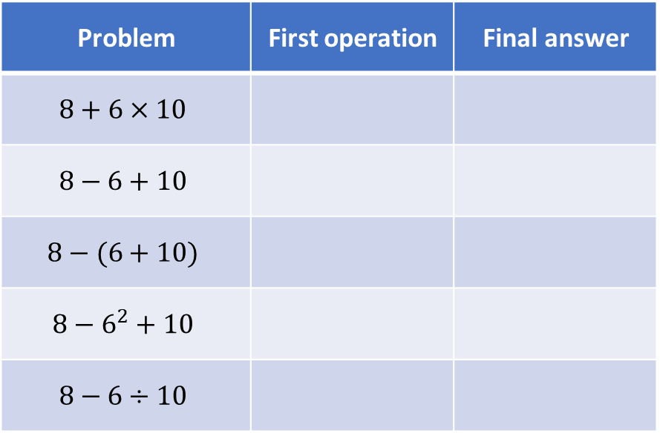
Your Turn
Problem | First operation | Final answer
$$8+6×10$$
$$8−6+10$$
$$8−(6+10)$$
$$8−6^{2}+10$$
$$8−6÷10$$
@mrbartonmaths

Slide 6
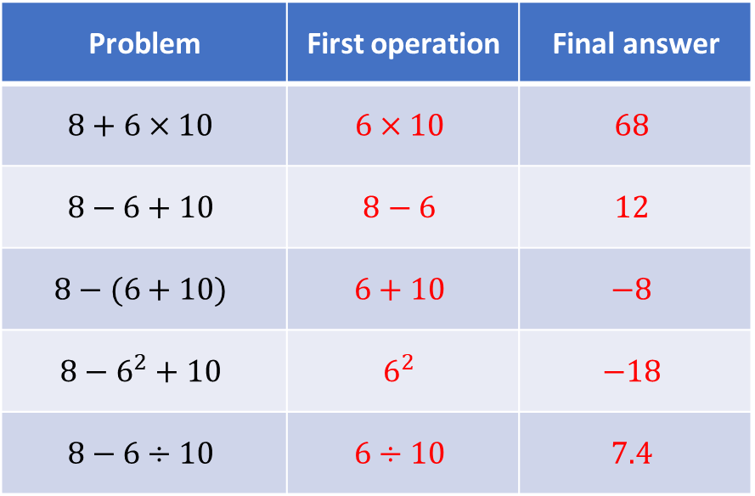
Your Turn - answers
Problem | First operation | Final answer
$$8+6×10$$ | $$6×10$$ | $$68$$
$$8−6+10$$ | $$8−6$$ | $$12$$
$$8−(6+10)$$ | $$6+10$$ | $$−8$$
$$8−6^{2}+10$$ | $$6^{2}$$ | $$−18$$
$$8−6÷10$$ | $$6÷10$$ | $$7.4$$
@mrbartonmaths

