Slide 1
Combined percentage change: Fill in the gaps
Silent
Teacher
Intelligent Practice
Narration
Your Turn
$$£50, 20\%, 40\%$$
Practice

Slide 2
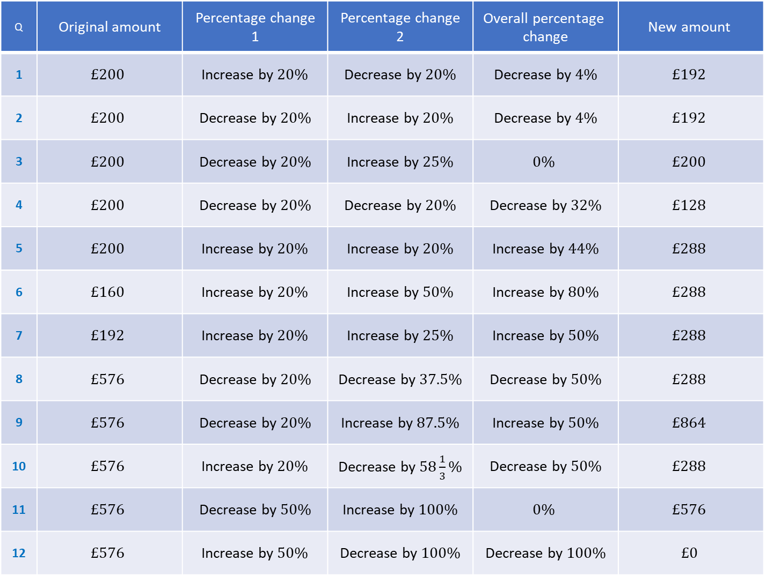
Q | Original amount | Percentage change 1 | Percentage change 2 | $$\text{Overall} \text{percentage} \text{change}$$ | $$\text{New} \text{amount}$$
1 | $$£200$$ | Increase by $20\%$ | Decrease by $20\%$ | Decrease by $4\%$ | $$£192$$
2 | $$£200$$ | Decrease by $20\%$ | Increase by $20\%$ | Decrease by $4\%$ | $$£192$$
3 | $$£200$$ | Decrease by $20\%$ | Increase by $25\%$ | $$0\%$$ | $$£200$$
4 | $$£200$$ | Decrease by $20\%$ | Decrease by $20\%$ | Decrease by $32\%$ | $$£128$$
5 | $$£200$$ | Increase by $20\%$ | Increase by $20\%$ | Increase by $44\%$ | $$£288$$
6 | $$£160$$ | Increase by $20\%$ | Increase by $50\%$ | Increase by $80\%$ | $$£288$$
7 | $$£192$$ | Increase by $20\%$ | Increase by $25\%$ | Increase by $50\%$ | $$£288$$
8 | $$£576$$ | Decrease by $20\%$ | Decrease by $37.5\%$ | Decrease by $50\%$ | $$£288$$
9 | $$£576$$ | Decrease by $20\%$ | Increase by $87.5\%$ | Increase by $50\%$ | $$£864$$
10 | $$£576$$ | Increase by $20\%$ | Decrease by $58\frac{1}{3}\%$ | Decrease by $50\%$ | $$£288$$
11 | $$£576$$ | Decrease by $50\%$ | Increase by $100\%$ | $$0\%$$ | $$£576$$
12 | $$£576$$ | Increase by $50\%$ | Decrease by $100\%$ | Decrease by $100\%$ | $$£0$$

Slide 3
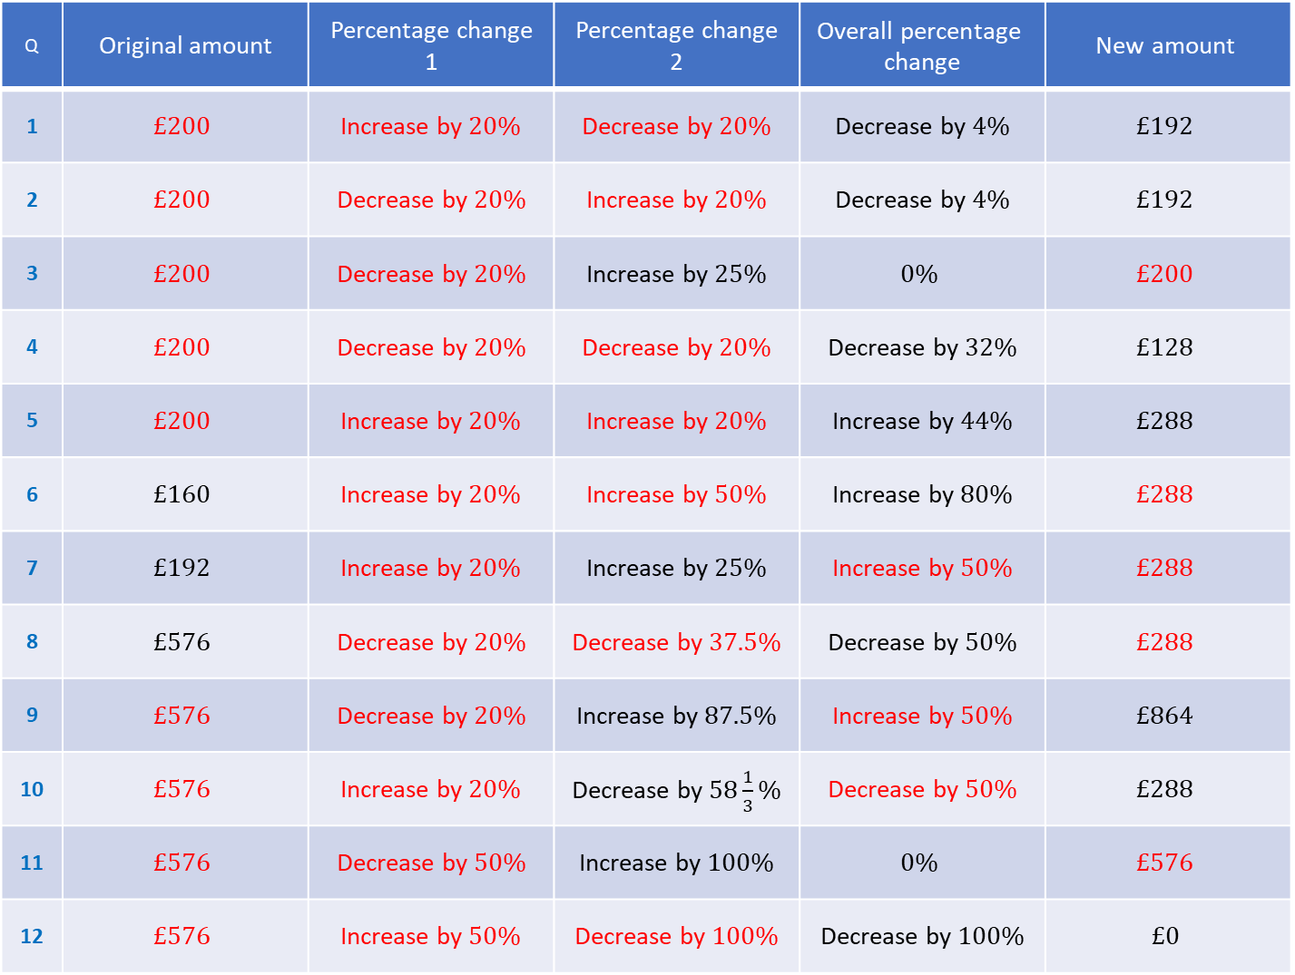
Q | Original amount | Percentage change 1 | Percentage change 2 | $$\text{Overall} \text{percentage} \text{change}$$ | $$\text{New} \text{amount}$$
1 | $$£200$$ | Increase by $20\%$ | Decrease by $20\%$ | Decrease by $4\%$ | $$£192$$
2 | $$£200$$ | Decrease by $20\%$ | Increase by $20\%$ | Decrease by $4\%$ | $$£192$$
3 | $$£200$$ | Decrease by $20\%$ | Increase by $25\%$ | $$0\%$$ | $$£200$$
4 | $$£200$$ | Decrease by $20\%$ | Decrease by $20\%$ | Decrease by $32\%$ | $$£128$$
5 | $$£200$$ | Increase by $20\%$ | Increase by $20\%$ | Increase by $44\%$ | $$£288$$
6 | $$£160$$ | Increase by $20\%$ | Increase by $50\%$ | Increase by $80\%$ | $$£288$$
7 | $$£192$$ | Increase by $20\%$ | Increase by $25\%$ | Increase by $50\%$ | $$£288$$
8 | $$£576$$ | Decrease by $20\%$ | Decrease by $37.5\%$ | Decrease by $50\%$ | $$£288$$
9 | $$£576$$ | Decrease by $20\%$ | Increase by $87.5\%$ | Increase by $50\%$ | $$£864$$
10 | $$£576$$ | Increase by $20\%$ | Decrease by $58\frac{1}{3}\%$ | Decrease by $50\%$ | $$£288$$
11 | $$£576$$ | Decrease by $50\%$ | Increase by $100\%$ | $$0\%$$ | $$£576$$
12 | $$£576$$ | Increase by $50\%$ | Decrease by $100\%$ | Decrease by $100\%$ | $$£0$$

