Slide 1
Coordinates and ratio: Fill in the gaps
Silent
Teacher
Intelligent Practice
Narration
Your Turn
$$(1, 5)$$
Practice

Slide 2
b
m
a

Slide 3
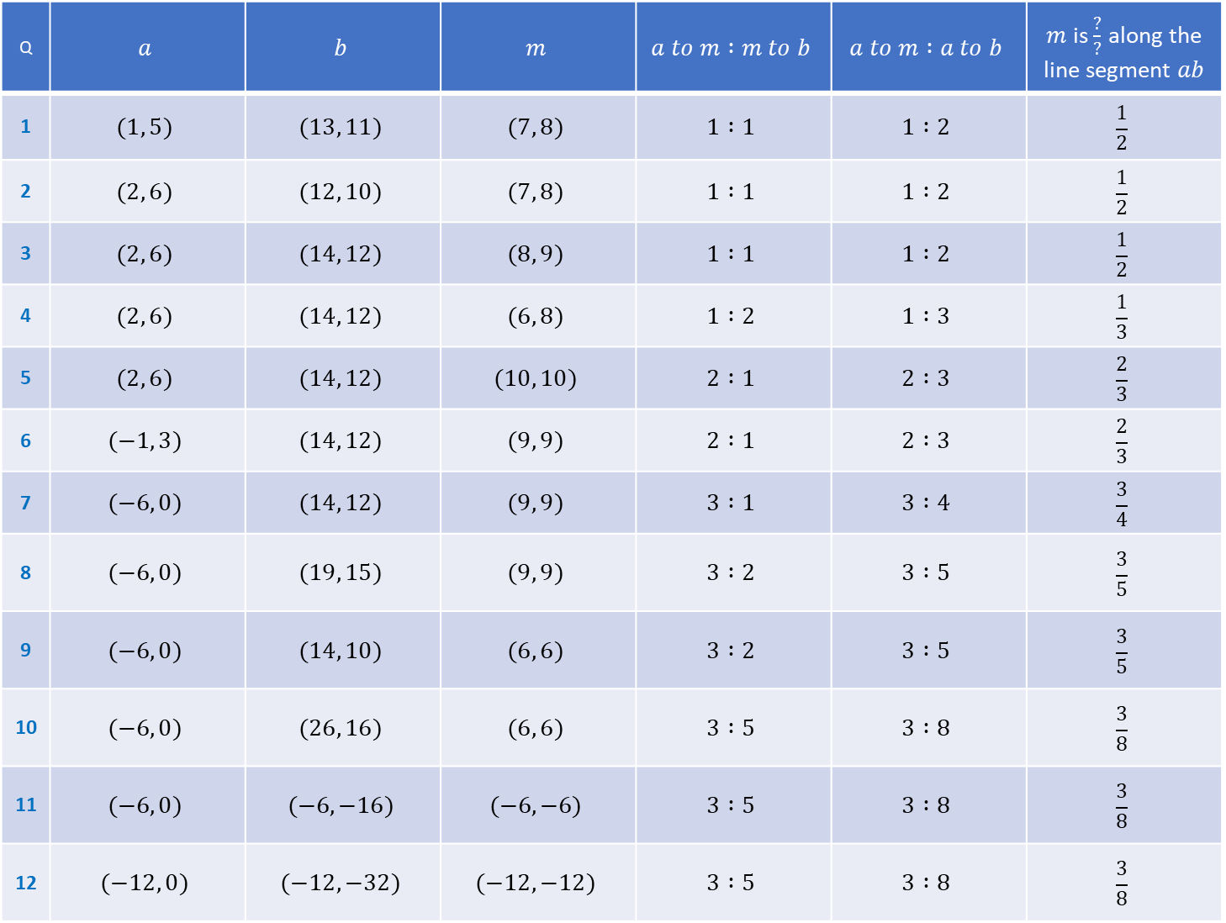
Q | $$a$$ | $$b$$ | $$m$$ | $$a to m :m to b$$ | $$a to m :a to b$$ | $m$ is $\frac{?}{?}$ along the line segment $ab$
1 | $$(1, 5)$$ | $$(13, 11)$$ | $$(7, 8)$$ | $$1 :1$$ | $$1 :2$$ | $$\frac{1}{2}$$
2 | $$(2, 6)$$ | $$(12, 10)$$ | $$(7, 8)$$ | $$1 :1$$ | $$1 :2$$ | $$\frac{1}{2}$$
3 | $$(2, 6)$$ | $$(14, 12)$$ | $$(8, 9)$$ | $$1 :1$$ | $$1 :2$$ | $$\frac{1}{2}$$
4 | $$(2, 6)$$ | $$(14, 12)$$ | $$(6, 8)$$ | $$1 :2$$ | $$1 :3$$ | $$\frac{1}{3}$$
5 | $$(2, 6)$$ | $$(14, 12)$$ | $$(10, 10)$$ | $$2 :1$$ | $$2 :3$$ | $$\frac{2}{3}$$
6 | $$(−1, 3)$$ | $$(14, 12)$$ | $$(9, 9)$$ | $$2 :1$$ | $$2 :3$$ | $$\frac{2}{3}$$
7 | $$(−6, 0)$$ | $$(14, 12)$$ | $$(9, 9)$$ | $$3 :1$$ | $$3 :4$$ | $$\frac{3}{4}$$
8 | $$(−6, 0)$$ | $$(19, 15)$$ | $$(9, 9)$$ | $$3 :2$$ | $$3 :5$$ | $$\frac{3}{5}$$
9 | $$(−6, 0)$$ | $$(14, 10)$$ | $$(6, 6)$$ | $$3 :2$$ | $$3 :5$$ | $$\frac{3}{5}$$
10 | $$(−6, 0)$$ | $$(26, 16)$$ | $$(6, 6)$$ | $$3 :5$$ | $$3 :8$$ | $$\frac{3}{8}$$
11 | $$(−6, 0)$$ | $$(−6, −16)$$ | $$(−6, −6)$$ | $$3 :5$$ | $$3 :8$$ | $$\frac{3}{8}$$
12 | $$(−12, 0)$$ | $$(−12, −32)$$ | $$(−12, −12)$$ | $$3 :5$$ | $$3 :8$$ | $$\frac{3}{8}$$

Slide 4
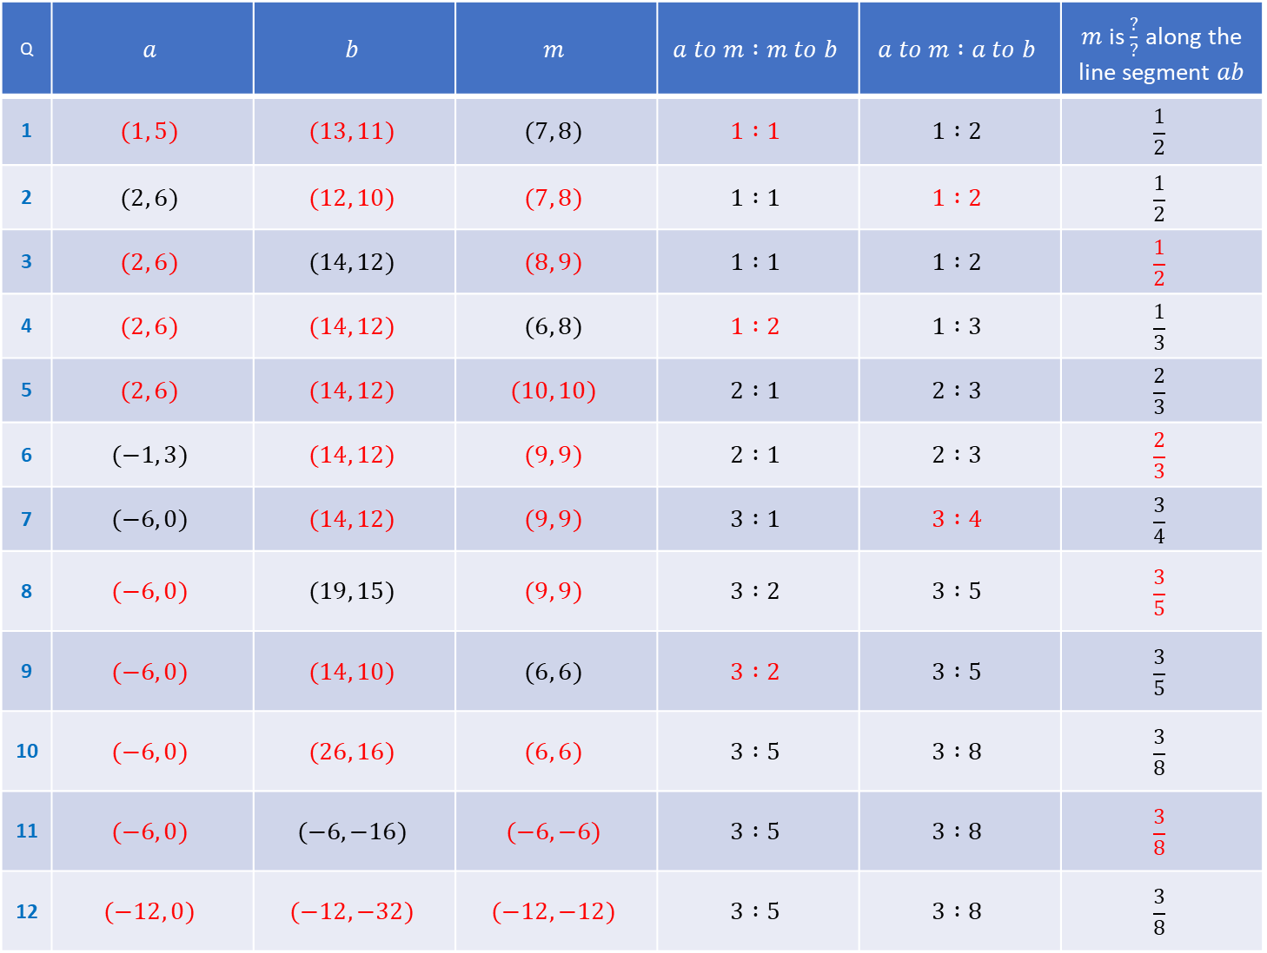
Q | $$a$$ | $$b$$ | $$m$$ | $$a to m :m to b$$ | $$a to m :a to b$$ | $m$ is $\frac{?}{?}$ along the line segment $ab$
1 | $$(1, 5)$$ | $$(13, 11)$$ | $$(7, 8)$$ | $$1 :1$$ | $$1 :2$$ | $$\frac{1}{2}$$
2 | $$(2, 6)$$ | $$(12, 10)$$ | $$(7, 8)$$ | $$1 :1$$ | $$1 :2$$ | $$\frac{1}{2}$$
3 | $$(2, 6)$$ | $$(14, 12)$$ | $$(8, 9)$$ | $$1 :1$$ | $$1 :2$$ | $$\frac{1}{2}$$
4 | $$(2, 6)$$ | $$(14, 12)$$ | $$(6, 8)$$ | $$1 :2$$ | $$1 :3$$ | $$\frac{1}{3}$$
5 | $$(2, 6)$$ | $$(14, 12)$$ | $$(10, 10)$$ | $$2 :1$$ | $$2 :3$$ | $$\frac{2}{3}$$
6 | $$(−1, 3)$$ | $$(14, 12)$$ | $$(9, 9)$$ | $$2 :1$$ | $$2 :3$$ | $$\frac{2}{3}$$
7 | $$(−6, 0)$$ | $$(14, 12)$$ | $$(9, 9)$$ | $$3 :1$$ | $$3 :4$$ | $$\frac{3}{4}$$
8 | $$(−6, 0)$$ | $$(19, 15)$$ | $$(9, 9)$$ | $$3 :2$$ | $$3 :5$$ | $$\frac{3}{5}$$
9 | $$(−6, 0)$$ | $$(14, 10)$$ | $$(6, 6)$$ | $$3 :2$$ | $$3 :5$$ | $$\frac{3}{5}$$
10 | $$(−6, 0)$$ | $$(26, 16)$$ | $$(6, 6)$$ | $$3 :5$$ | $$3 :8$$ | $$\frac{3}{8}$$
11 | $$(−6, 0)$$ | $$(−6, −16)$$ | $$(−6, −6)$$ | $$3 :5$$ | $$3 :8$$ | $$\frac{3}{8}$$
12 | $$(−12, 0)$$ | $$(−12, −32)$$ | $$(−12, −12)$$ | $$3 :5$$ | $$3 :8$$ | $$\frac{3}{8}$$

