Slide 1
Division with fractions
Silent
Teacher
Intelligent Practice
Narration
Your Turn
$$\frac{4}{6}÷\frac{4}{5}$$
$$\frac{4}{3}÷\frac{4}{5}$$
Practice

Slide 2
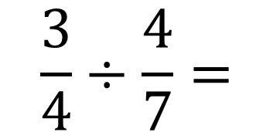
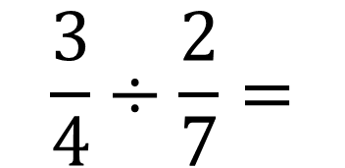
Worked Example
Your Turn
$$\frac{3}{4}÷\frac{2}{7}=$$
$$\frac{3}{4}÷\frac{4}{7}=$$

Slide 3
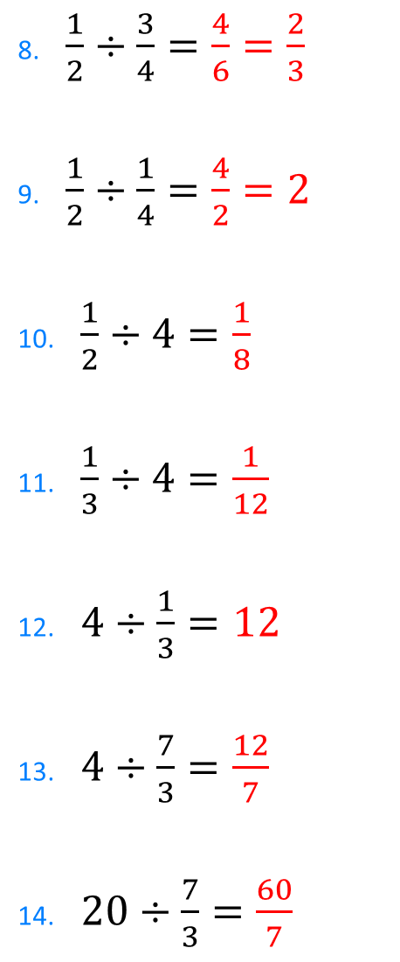
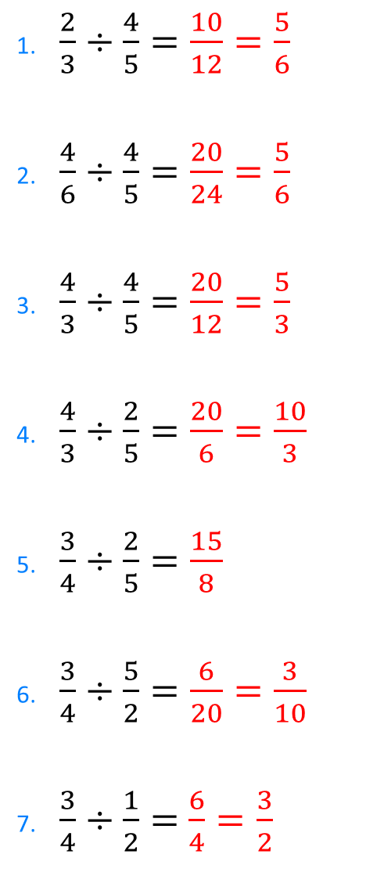
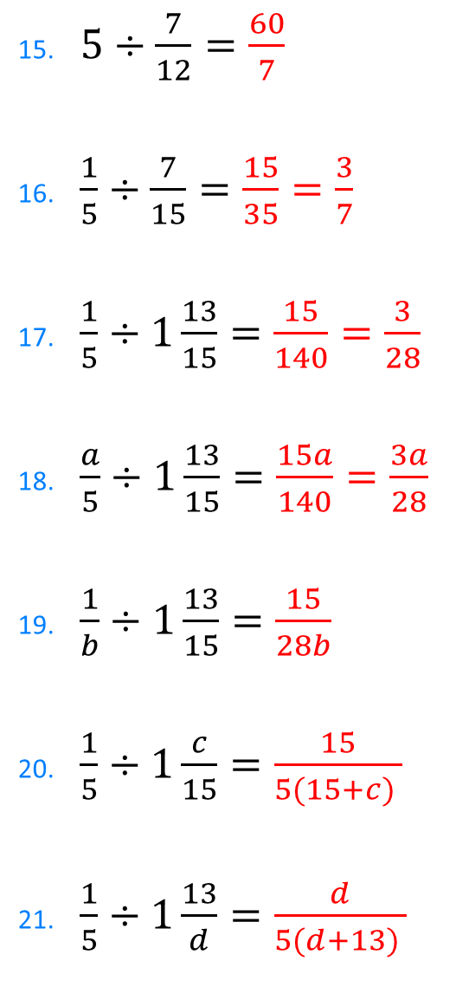
1. $\frac{2}{3}÷\frac{4}{5}=\frac{10}{12}=\frac{5}{6}$
2. $\frac{4}{6}÷\frac{4}{5}=\frac{20}{24}=\frac{5}{6}$
3. $\frac{4}{3}÷\frac{4}{5}=\frac{20}{12}=\frac{5}{3}$
4. $\frac{4}{3}÷\frac{2}{5}=\frac{20}{6}=\frac{10}{3}$
5. $\frac{3}{4}÷\frac{2}{5}=\frac{15}{8}$
6. $\frac{3}{4}÷\frac{5}{2}=\frac{6}{20}=\frac{3}{10}$
7. $\frac{3}{4}÷\frac{1}{2}=$ $\frac{6}{4}=\frac{3}{2}$
8. $\frac{1}{2}÷\frac{3}{4}=\frac{4}{6}=\frac{2}{3}$
9. $\frac{1}{2}÷\frac{1}{4}=\frac{4}{2}=2$
10. $\frac{1}{2}÷4=\frac{1}{8}$
11. $\frac{1}{3}÷4=\frac{1}{12}$
12. $4÷\frac{1}{3}=12$
13. $4÷\frac{7}{3}=\frac{12}{7}$
14. $20÷\frac{7}{3}=\frac{60}{7}$
15. $5÷\frac{7}{12}=\frac{60}{7}$
16. $\frac{1}{5}÷\frac{7}{15}=\frac{15}{35}=\frac{3}{7}$
17. $\frac{1}{5}÷1\frac{13}{15}=\frac{15}{140}=\frac{3}{28}$
18. $\frac{a}{5}÷1\frac{13}{15}=\frac{15a}{140}=\frac{3a}{28}$
19. $\frac{1}{b}÷1\frac{13}{15}=\frac{15}{28b}$
20. $\frac{1}{5}÷1\frac{c}{15}=\frac{15}{5(15+c) }$
21. $\frac{1}{5}÷1\frac{13}{d}=\frac{d}{5(d+13) }$

Slide 4
1. $\frac{2}{3}÷\frac{4}{5}=\frac{10}{12}=\frac{5}{6}$
2. $\frac{4}{6}÷\frac{4}{5}=\frac{20}{24}=\frac{5}{6}$
3. $\frac{4}{3}÷\frac{4}{5}=\frac{20}{12}=\frac{5}{3}$
4. $\frac{4}{3}÷\frac{2}{5}=\frac{20}{6}=\frac{10}{3}$
5. $\frac{3}{4}÷\frac{2}{5}=\frac{15}{8}$
6. $\frac{3}{4}÷\frac{5}{2}=\frac{6}{20}=\frac{3}{10}$
7. $\frac{3}{4}÷\frac{1}{2}=$ $\frac{6}{4}=\frac{3}{2}$
8. $\frac{1}{2}÷\frac{3}{4}=\frac{4}{6}=\frac{2}{3}$
9. $\frac{1}{2}÷\frac{1}{4}=\frac{4}{2}=2$
10. $\frac{1}{2}÷4=\frac{1}{8}$
11. $\frac{1}{3}÷4=\frac{1}{12}$
12. $4÷\frac{1}{3}=12$
13. $4÷\frac{7}{3}=\frac{12}{7}$
14. $20÷\frac{7}{3}=\frac{60}{7}$
15. $5÷\frac{7}{12}=\frac{60}{7}$
16. $\frac{1}{5}÷\frac{7}{15}=\frac{15}{35}=\frac{3}{7}$
17. $\frac{1}{5}÷1\frac{13}{15}=\frac{15}{140}=\frac{3}{28}$
18. $\frac{a}{5}÷1\frac{13}{15}=\frac{15a}{140}=\frac{3a}{28}$
19. $\frac{1}{b}÷1\frac{13}{15}=\frac{15}{28b}$
20. $\frac{1}{5}÷1\frac{c}{15}=\frac{15}{5(15+c) }$
21. $\frac{1}{5}÷1\frac{13}{d}=\frac{d}{5(d+13) }$

