Slide 1
Coordinates of a square: Fill in the gaps
Silent
Teacher
Intelligent Practice
Narration
Your Turn
Practice

Slide 2
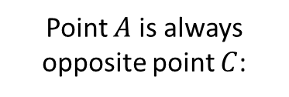
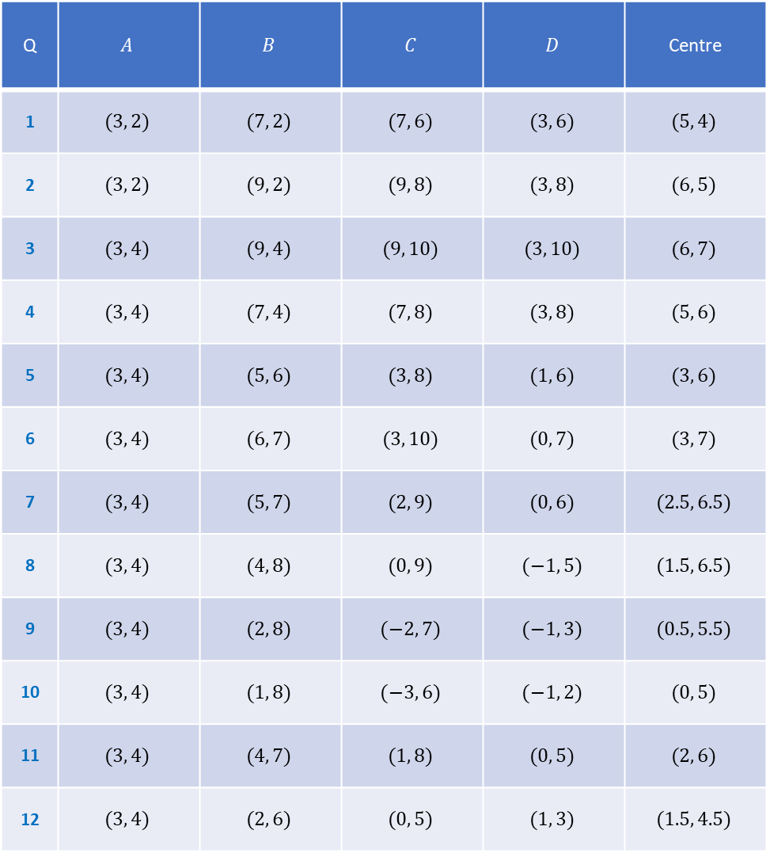
Q | $$A$$ | $$B$$ | $$C$$ | $$D$$ | Centre
1 | $$(3, 2)$$ | $$(7, 2)$$ | $$(7, 6)$$ | $$(3, 6)$$ | $$(5, 4)$$
2 | $$(3, 2)$$ | $$(9, 2)$$ | $$(9, 8)$$ | $$(3, 8)$$ | $$(6, 5)$$
3 | $$(3, 4)$$ | $$(9, 4)$$ | $$(9, 10)$$ | $$(3, 10)$$ | $$(6, 7)$$
4 | $$(3, 4)$$ | $$(7, 4)$$ | $$(7, 8)$$ | $$(3, 8)$$ | $$(5, 6)$$
5 | $$(3, 4)$$ | $$(5, 6)$$ | $$(3, 8)$$ | $$(1, 6)$$ | $$(3, 6)$$
6 | $$(3, 4)$$ | $$(6, 7)$$ | $$(3, 10)$$ | $$(0, 7)$$ | $$(3, 7)$$
7 | $$(3, 4)$$ | $$(5, 7)$$ | $$(2, 9)$$ | $$(0, 6)$$ | $$(2.5, 6.5)$$
8 | $$(3, 4)$$ | $$(4, 8)$$ | $$(0, 9)$$ | $$(−1, 5)$$ | $$(1.5, 6.5)$$
9 | $$(3, 4)$$ | $$(2, 8)$$ | $$(−2, 7)$$ | $$(−1, 3)$$ | $$(0.5, 5.5)$$
10 | $$(3, 4)$$ | $$(1, 8)$$ | $$(−3, 6)$$ | $$(−1, 2)$$ | $$(0, 5)$$
11 | $$(3, 4)$$ | $$(4, 7)$$ | $$(1, 8)$$ | $$(0, 5)$$ | $$(2, 6)$$
12 | $$(3, 4)$$ | $$(2, 6)$$ | $$(0, 5)$$ | $$(1, 3)$$ | $$(1.5, 4.5)$$
Point $A$ is always opposite point $C$:
$$D$$
$$C$$
$$A$$
$$B$$
The points are always read anti-clockwise around the square
But the square could change orientation:
$$C$$
$$D$$
$$B$$
$$A$$

Slide 3
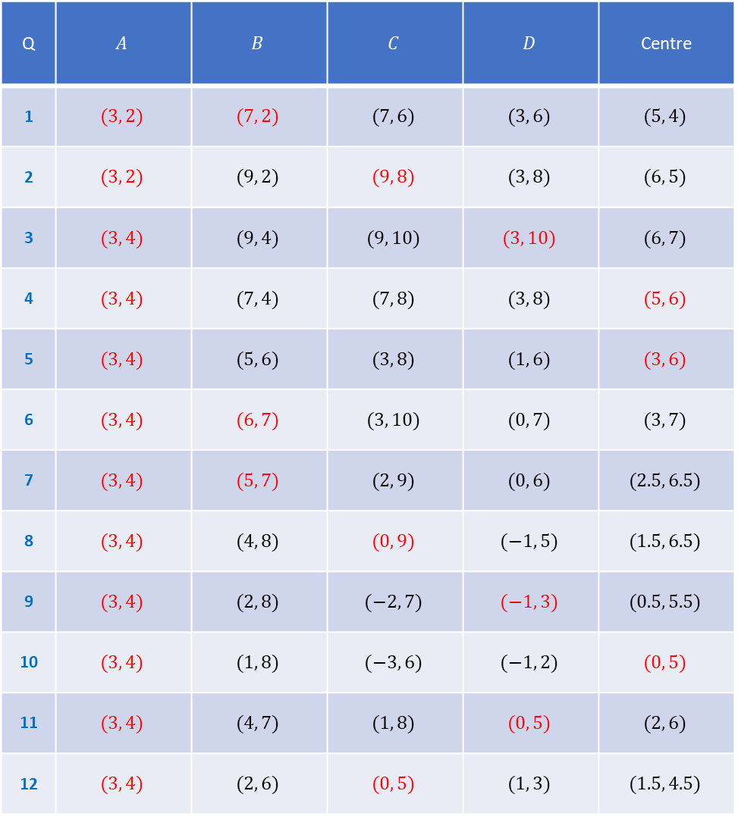
Q | $$A$$ | $$B$$ | $$C$$ | $$D$$ | Centre
1 | $$(3, 2)$$ | $$(7, 2)$$ | $$(7, 6)$$ | $$(3, 6)$$ | $$(5, 4)$$
2 | $$(3, 2)$$ | $$(9, 2)$$ | $$(9, 8)$$ | $$(3, 8)$$ | $$(6, 5)$$
3 | $$(3, 4)$$ | $$(9, 4)$$ | $$(9, 10)$$ | $$(3, 10)$$ | $$(6, 7)$$
4 | $$(3, 4)$$ | $$(7, 4)$$ | $$(7, 8)$$ | $$(3, 8)$$ | $$(5, 6)$$
5 | $$(3, 4)$$ | $$(5, 6)$$ | $$(3, 8)$$ | $$(1, 6)$$ | $$(3, 6)$$
6 | $$(3, 4)$$ | $$(6, 7)$$ | $$(3, 10)$$ | $$(0, 7)$$ | $$(3, 7)$$
7 | $$(3, 4)$$ | $$(5, 7)$$ | $$(2, 9)$$ | $$(0, 6)$$ | $$(2.5, 6.5)$$
8 | $$(3, 4)$$ | $$(4, 8)$$ | $$(0, 9)$$ | $$(−1, 5)$$ | $$(1.5, 6.5)$$
9 | $$(3, 4)$$ | $$(2, 8)$$ | $$(−2, 7)$$ | $$(−1, 3)$$ | $$(0.5, 5.5)$$
10 | $$(3, 4)$$ | $$(1, 8)$$ | $$(−3, 6)$$ | $$(−1, 2)$$ | $$(0, 5)$$
11 | $$(3, 4)$$ | $$(4, 7)$$ | $$(1, 8)$$ | $$(0, 5)$$ | $$(2, 6)$$
12 | $$(3, 4)$$ | $$(2, 6)$$ | $$(0, 5)$$ | $$(1, 3)$$ | $$(1.5, 4.5)$$
Point $A$ is always opposite point $C$:
$$D$$
$$C$$
$$A$$
$$B$$
The points are always read anti-clockwise around the square
But the square could change orientation:
$$C$$
$$D$$
$$B$$
$$A$$

Slide 4
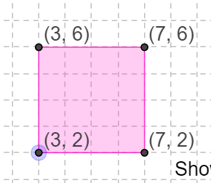
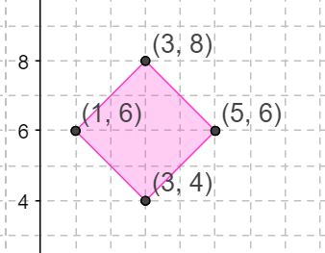
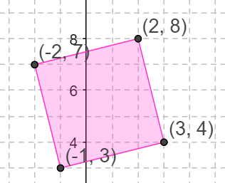
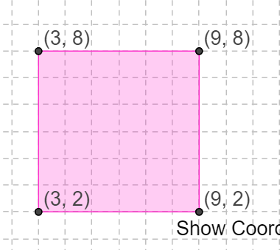
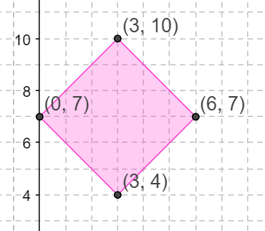
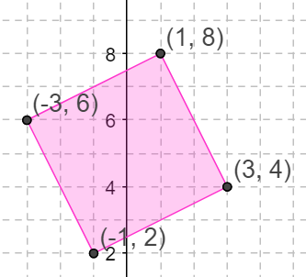
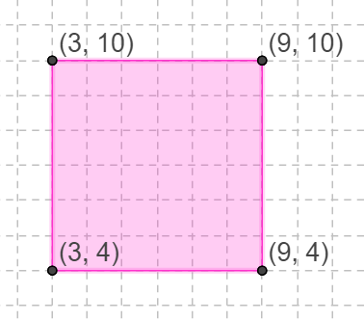
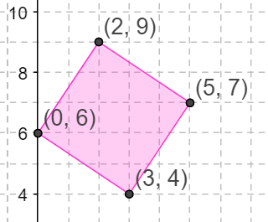
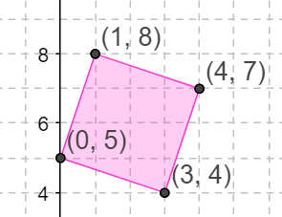
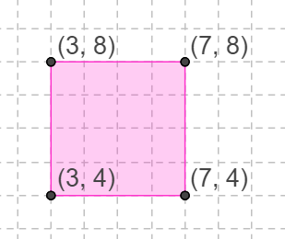
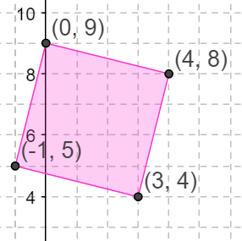
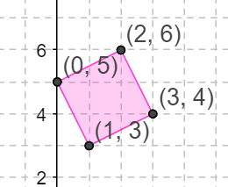
1.
5.
9.
2.
6.
10.
3.
7.
11.
4.
8.
12.

Slide 5
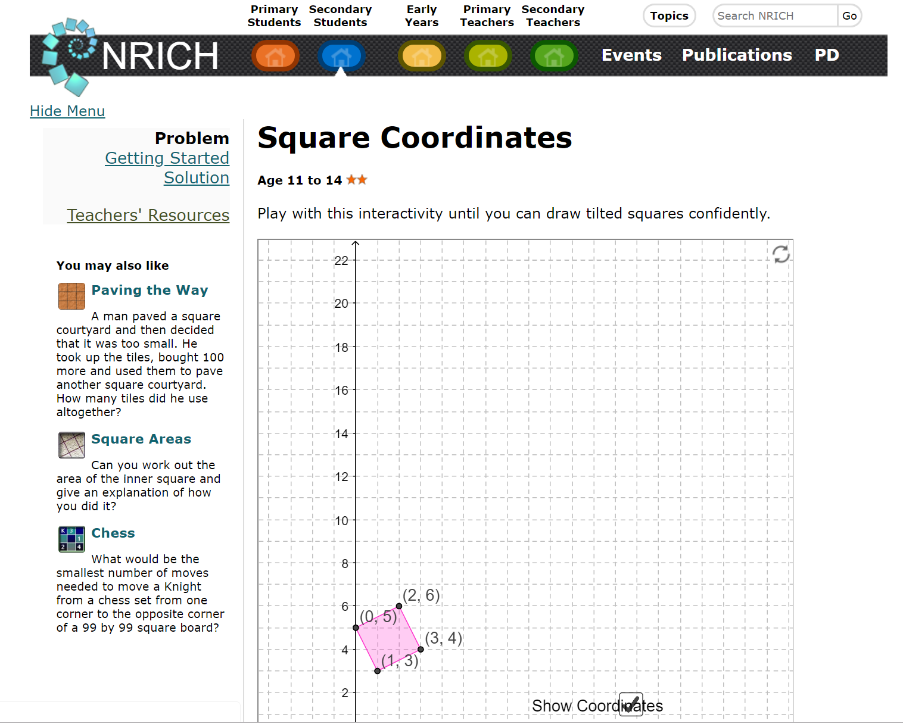
https://nrich.maths.org/squarecoordinates

