Slide 1
Fraction of an amount: Fill in the gaps
Silent
Teacher
Intelligent Practice
Narration
Your Turn
$$\frac{1}{4} of £60=$$
$$\frac{1}{3}of £60 =$$
Practice

Slide 2
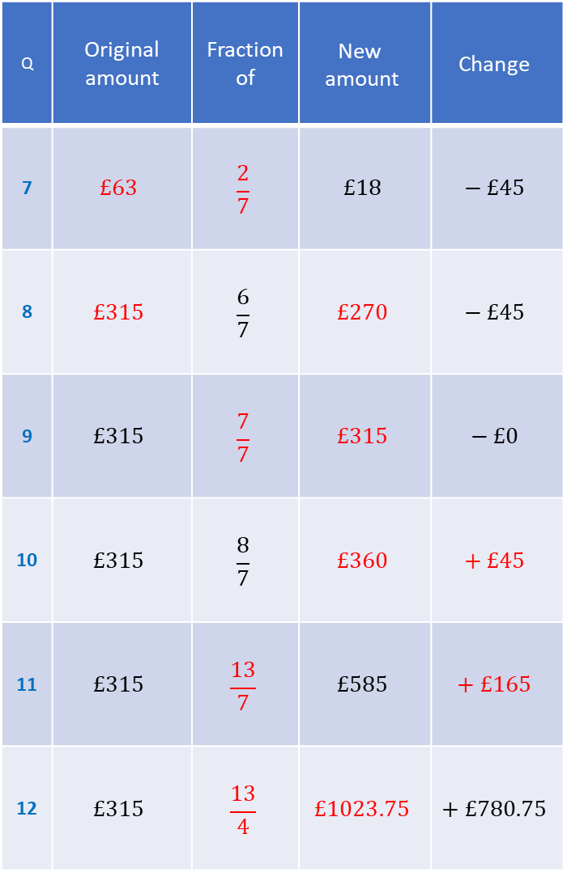
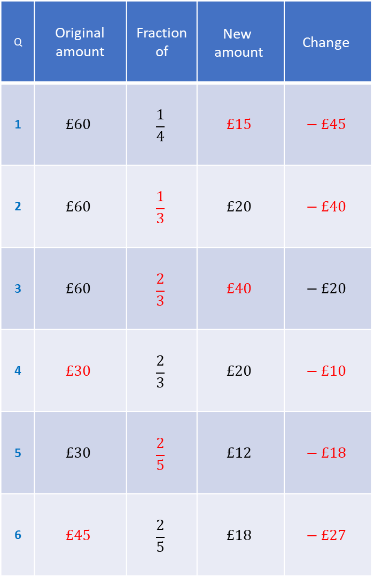
Q | Original amount | Fraction of | $$\text{New} \text{amount}$$ | $$\text{Change}$$
1 | $$£60$$ | $$\frac{1}{4}$$ | $$£15$$ | $$− £45$$
2 | $$£60$$ | $$\frac{1}{3}$$ | $$£20$$ | $$− £40$$
3 | $$£60$$ | $$\frac{2}{3}$$ | $$£40$$ | $$− £20$$
4 | $$£30$$ | $$\frac{2}{3}$$ | $$£20$$ | $$− £10$$
5 | $$£30$$ | $$\frac{2}{5}$$ | $$£12$$ | $$− £18$$
6 | $$£45$$ | $$\frac{2}{5}$$ | $$£18$$ | $$− £27$$
Q | Original amount | Fraction of | $$\text{New} \text{amount}$$ | $$\text{Change}$$
7 | $$£63$$ | $$\frac{2}{7}$$ | $$£18$$ | $$− £45$$
8 | $$£315$$ | $$\frac{6}{7}$$ | $$£270$$ | $$− £45$$
9 | $$£315$$ | $$\frac{7}{7}$$ | $$£315$$ | $$− £0$$
10 | $$£315$$ | $$\frac{8}{7}$$ | $$£360$$ | $$+ £45$$
11 | $$£315$$ | $$\frac{13}{7}$$ | $$£585$$ | $$+ £165$$
12 | $$£315$$ | $$\frac{13}{4}$$ | $$£1023.75$$ | $$+ £780.75$$

Slide 3
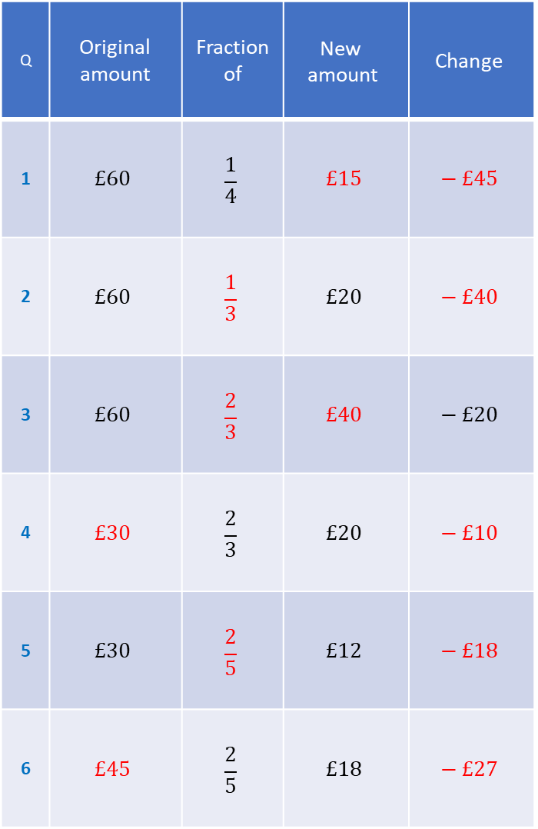
Q | Original amount | Fraction of | $$\text{New} \text{amount}$$ | $$\text{Change}$$
1 | $$£60$$ | $$\frac{1}{4}$$ | $$£15$$ | $$− £45$$
2 | $$£60$$ | $$\frac{1}{3}$$ | $$£20$$ | $$− £40$$
3 | $$£60$$ | $$\frac{2}{3}$$ | $$£40$$ | $$− £20$$
4 | $$£30$$ | $$\frac{2}{3}$$ | $$£20$$ | $$− £10$$
5 | $$£30$$ | $$\frac{2}{5}$$ | $$£12$$ | $$− £18$$
6 | $$£45$$ | $$\frac{2}{5}$$ | $$£18$$ | $$− £27$$
Q | Original amount | Fraction of | $$\text{New} \text{amount}$$ | $$\text{Change}$$
7 | $$£63$$ | $$\frac{2}{7}$$ | $$£18$$ | $$− £45$$
8 | $$£315$$ | $$\frac{6}{7}$$ | $$£270$$ | $$− £45$$
9 | $$£315$$ | $$\frac{7}{7}$$ | $$£315$$ | $$− £0$$
10 | $$£315$$ | $$\frac{8}{7}$$ | $$£360$$ | $$+ £45$$
11 | $$£315$$ | $$\frac{13}{7}$$ | $$£585$$ | $$+ £165$$
12 | $$£315$$ | $$\frac{13}{4}$$ | $$£1023.75$$ | $$+ £780.75$$

