Slide 1
Gradients: Parallel, perpendicular, neither?
True/false
Reflect
Your Turn
$$5 and 6$$
$$5 and 5$$
$$5 and \frac{1}{5}$$
Rule

Slide 2
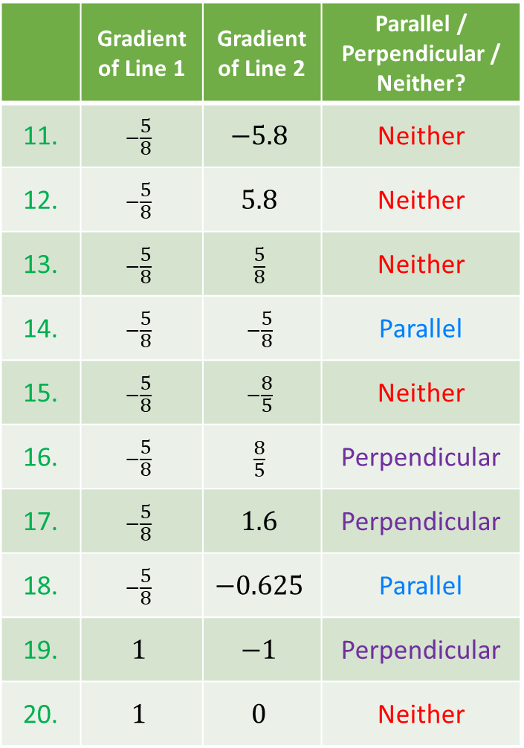
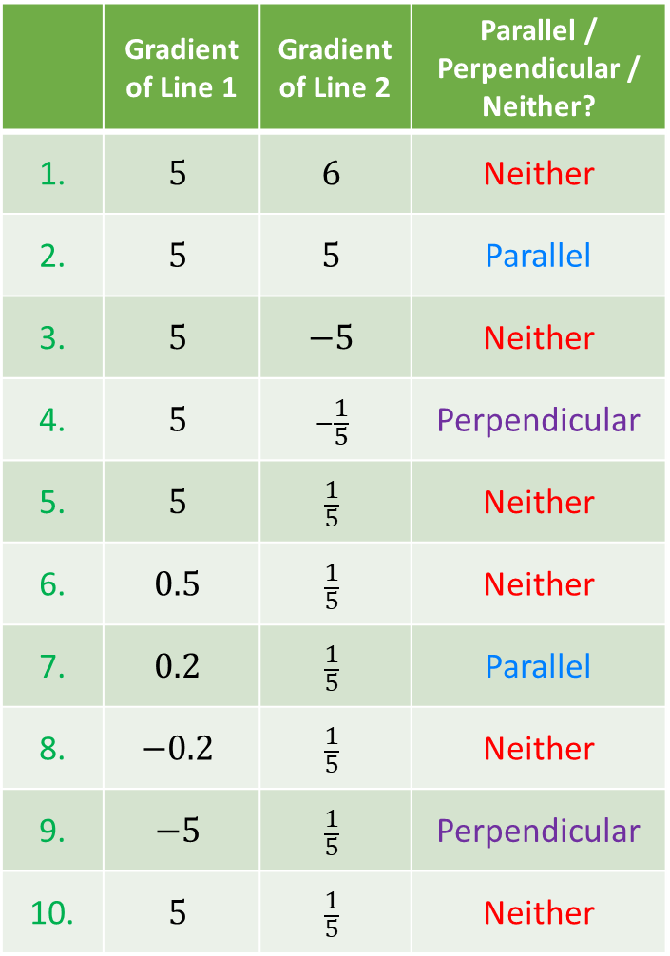
 | Gradient of Line 1 | Gradient of Line 2 | Parallel / Perpendicular / Neither?
1. | $$5$$ | $$6$$ | Neither
2. | $$5$$ | $$5$$ | Parallel
3. | $$5$$ | $$−5$$ | Neither
4. | $$5$$ | $$−\frac{1}{5}$$ | Perpendicular
5. | $$5$$ | $$\frac{1}{5}$$ | Neither
6. | $$0.5$$ | $$\frac{1}{5}$$ | Neither
7. | $$0.2$$ | $$\frac{1}{5}$$ | Parallel
8. | $$−0.2$$ | $$\frac{1}{5}$$ | Neither
9. | $$−5$$ | $$\frac{1}{5}$$ | Perpendicular
10. | $$5$$ | $$\frac{1}{5}$$ | Neither
 | Gradient of Line 1 | Gradient of Line 2 | Parallel / Perpendicular / Neither?
11. | $$−\frac{5}{8}$$ | $$−5.8$$ | Neither
12. | $$−\frac{5}{8}$$ | $$5.8$$ | Neither
13. | $$−\frac{5}{8}$$ | $$\frac{5}{8}$$ | Neither
14. | $$−\frac{5}{8}$$ | $$−\frac{5}{8}$$ | Parallel
15. | $$−\frac{5}{8}$$ | $$−\frac{8}{5}$$ | Neither
16. | $$−\frac{5}{8}$$ | $$\frac{8}{5}$$ | Perpendicular
17. | $$−\frac{5}{8}$$ | $$1.6$$ | Perpendicular
18. | $$−\frac{5}{8}$$ | $$−0.625$$ | Parallel
19. | $$1$$ | $$−1$$ | Perpendicular
20. | $$1$$ | $$0$$ | Neither

Slide 3
 | Gradient of Line 1 | Gradient of Line 2 | Parallel / Perpendicular / Neither?
1. | $$5$$ | $$6$$ | Neither
2. | $$5$$ | $$5$$ | Parallel
3. | $$5$$ | $$−5$$ | Neither
4. | $$5$$ | $$−\frac{1}{5}$$ | Perpendicular
5. | $$5$$ | $$\frac{1}{5}$$ | Neither
6. | $$0.5$$ | $$\frac{1}{5}$$ | Neither
7. | $$0.2$$ | $$\frac{1}{5}$$ | Parallel
8. | $$−0.2$$ | $$\frac{1}{5}$$ | Neither
9. | $$−5$$ | $$\frac{1}{5}$$ | Perpendicular
10. | $$5$$ | $$\frac{1}{5}$$ | Neither
 | Gradient of Line 1 | Gradient of Line 2 | Parallel / Perpendicular / Neither?
11. | $$−\frac{5}{8}$$ | $$−5.8$$ | Neither
12. | $$−\frac{5}{8}$$ | $$5.8$$ | Neither
13. | $$−\frac{5}{8}$$ | $$\frac{5}{8}$$ | Neither
14. | $$−\frac{5}{8}$$ | $$−\frac{5}{8}$$ | Parallel
15. | $$−\frac{5}{8}$$ | $$−\frac{8}{5}$$ | Neither
16. | $$−\frac{5}{8}$$ | $$\frac{8}{5}$$ | Perpendicular
17. | $$−\frac{5}{8}$$ | $$1.6$$ | Perpendicular
18. | $$−\frac{5}{8}$$ | $$−0.625$$ | Parallel
19. | $$1$$ | $$−1$$ | Perpendicular
20. | $$1$$ | $$0$$ | Neither

Slide 4
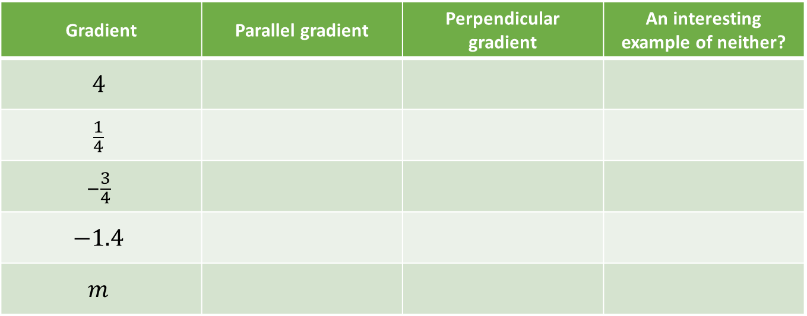
Your Turn
Gradient | Parallel gradient | Perpendicular gradient | An interesting example of neither?
$$4$$
$$\frac{1}{4}$$
$$−\frac{3}{4}$$
$$−1.4$$
$$m$$

Slide 5
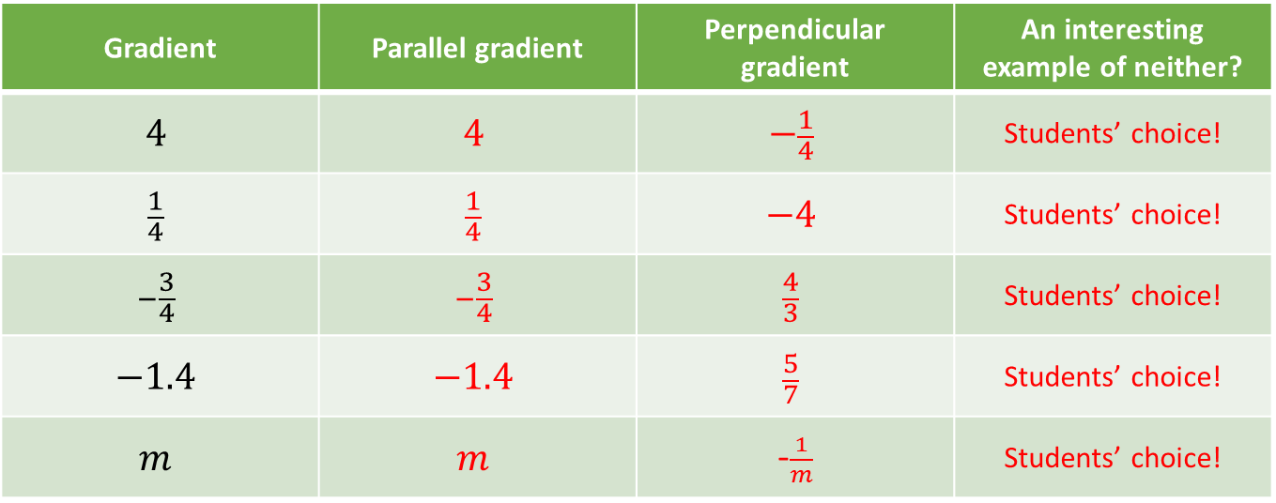
Your Turn - answers
Gradient | Parallel gradient | Perpendicular gradient | An interesting example of neither?
$$4$$ | $$4$$ | $$−\frac{1}{4}$$ | Students’ choice!
$$\frac{1}{4}$$ | $$\frac{1}{4}$$ | $$−4$$ | Students’ choice!
$$−\frac{3}{4}$$ | $$−\frac{3}{4}$$ | $$\frac{4}{3}$$ | Students’ choice!
$$−1.4$$ | $$−1.4$$ | $$\frac{5}{7}$$ | Students’ choice!
$$m$$ | $$m$$ | -$\frac{1}{m}$ | Students’ choice!

