Slide 1
Percentage change: Fill in the gaps
Silent
Teacher
Intelligent Practice
Narration
Your Turn
$$£50, 20\%, Increase$$
Practice

Slide 2
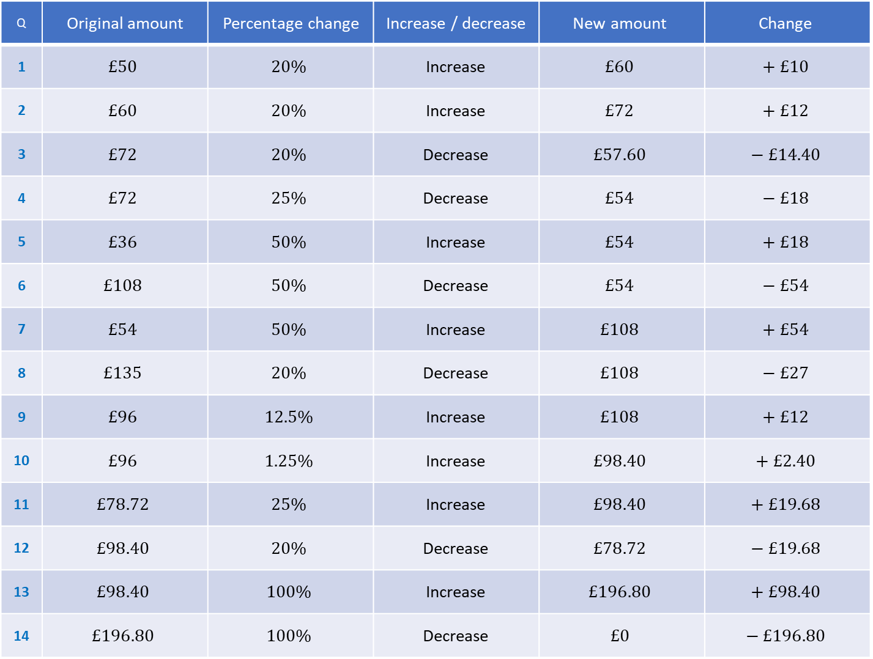
Q | Original amount | Percentage change | Increase / decrease | $$\text{New} \text{amount}$$ | $$\text{Change}$$
1 | $$£50$$ | $$20\%$$ | Increase | $$£60$$ | $$+ £10$$
2 | $$£60$$ | $$20\%$$ | Increase | $$£72$$ | $$+ £12$$
3 | $$£72$$ | $$20\%$$ | Decrease | $$£57.60$$ | $$− £14.40$$
4 | $$£72$$ | $$25\%$$ | Decrease | $$£54$$ | $$− £18$$
5 | $$£36$$ | $$50\%$$ | Increase | $$£54$$ | $$+ £18$$
6 | $$£108$$ | $$50\%$$ | Decrease | $$£54$$ | $$− £54$$
7 | $$£54$$ | $$50\%$$ | Increase | $$£108$$ | $$+ £54$$
8 | $$£135$$ | $$20\%$$ | Decrease | $$£108$$ | $$− £27$$
9 | $$£96$$ | $$12.5\%$$ | Increase | $$£108$$ | $$+ £12$$
10 | $$£96$$ | $$1.25\%$$ | Increase | $$£98.40$$ | $$+ £2.40$$
11 | $$£78.72$$ | $$25\%$$ | Increase | $$£98.40$$ | $$+ £19.68$$
12 | $$£98.40$$ | $$20\%$$ | Decrease | $$£78.72$$ | $$− £19.68$$
13 | $$£98.40$$ | $$100\%$$ | Increase | $$£196.80$$ | $$+ £98.40$$
14 | $$£196.80$$ | $$100\%$$ | Decrease | $$£0$$ | $$− £196.80$$

Slide 3
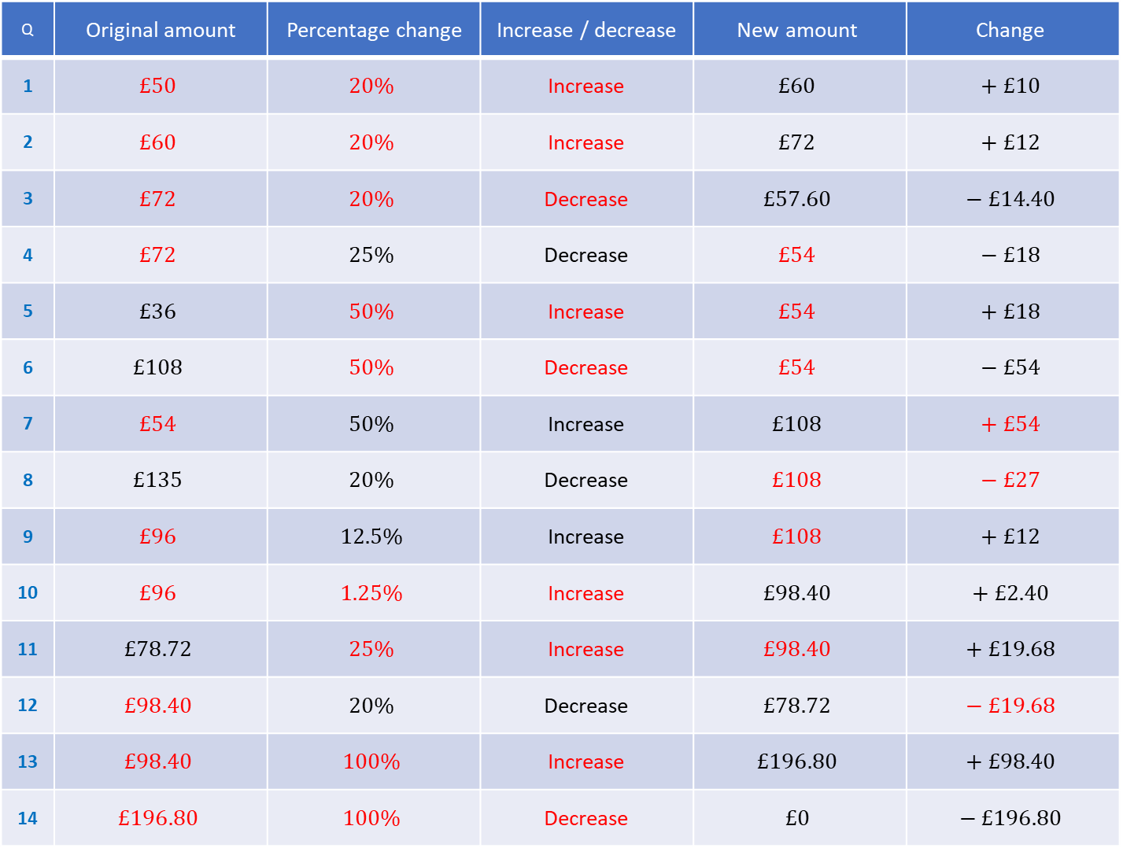
Q | Original amount | Percentage change | Increase / decrease | $$\text{New} \text{amount}$$ | $$\text{Change}$$
1 | $$£50$$ | $$20\%$$ | Increase | $$£60$$ | $$+ £10$$
2 | $$£60$$ | $$20\%$$ | Increase | $$£72$$ | $$+ £12$$
3 | $$£72$$ | $$20\%$$ | Decrease | $$£57.60$$ | $$− £14.40$$
4 | $$£72$$ | $$25\%$$ | Decrease | $$£54$$ | $$− £18$$
5 | $$£36$$ | $$50\%$$ | Increase | $$£54$$ | $$+ £18$$
6 | $$£108$$ | $$50\%$$ | Decrease | $$£54$$ | $$− £54$$
7 | $$£54$$ | $$50\%$$ | Increase | $$£108$$ | $$+ £54$$
8 | $$£135$$ | $$20\%$$ | Decrease | $$£108$$ | $$− £27$$
9 | $$£96$$ | $$12.5\%$$ | Increase | $$£108$$ | $$+ £12$$
10 | $$£96$$ | $$1.25\%$$ | Increase | $$£98.40$$ | $$+ £2.40$$
11 | $$£78.72$$ | $$25\%$$ | Increase | $$£98.40$$ | $$+ £19.68$$
12 | $$£98.40$$ | $$20\%$$ | Decrease | $$£78.72$$ | $$− £19.68$$
13 | $$£98.40$$ | $$100\%$$ | Increase | $$£196.80$$ | $$+ £98.40$$
14 | $$£196.80$$ | $$100\%$$ | Decrease | $$£0$$ | $$− £196.80$$

