Slide 1
Probability of a single event: version 2
Silent
Teacher
Intelligent Practice
Narration
Your Turn
Example

Slide 2
Worked Example
Your Turn
P(yellow) =
P(yellow) =
@mrbartonmaths

Slide 3
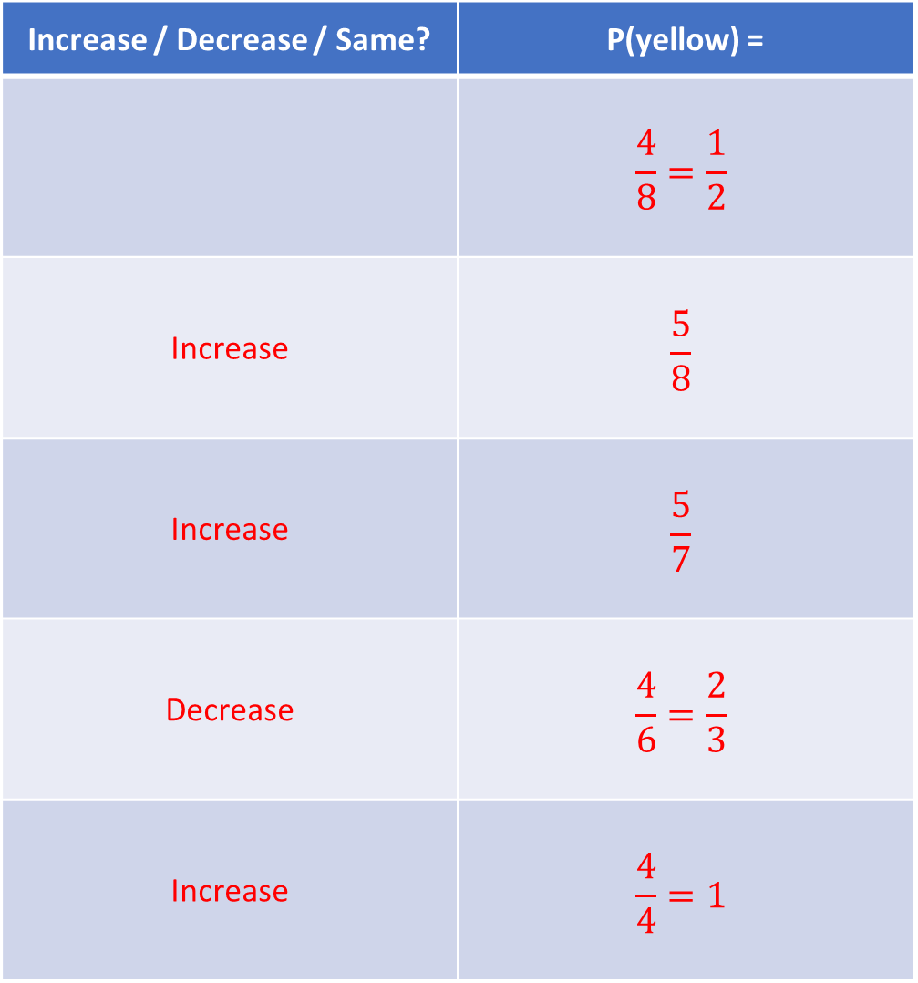
Increase / Decrease / Same? | P(yellow) =
 | $$\frac{4}{8}=\frac{1}{2}$$
Increase | $$\frac{5}{8}$$
Increase | $$\frac{5}{7}$$
Decrease | $$\frac{4}{6}=\frac{2}{3}$$
Increase | $$\frac{4}{4}=1$$
1.
2.
3.
4.
5.

Slide 4
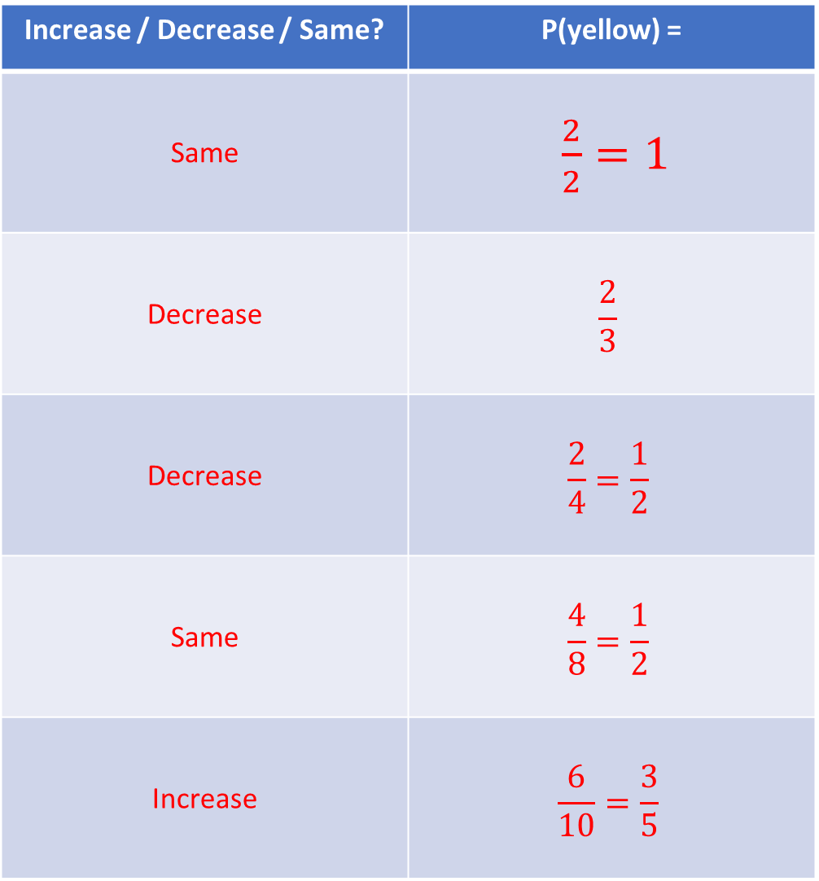
Increase / Decrease / Same? | P(yellow) =
Same | $\frac{2}{2}=1$
Decrease | $$\frac{2}{3}$$
Decrease | $$\frac{2}{4}=\frac{1}{2}$$
Same | $$\frac{4}{8}=\frac{1}{2}$$
Increase | $$\frac{6}{10}=\frac{3}{5}$$
6.
7.
8.
9.
10.

Slide 5
Increase / Decrease / Same? | P(yellow) =
 | $$\frac{4}{8}=\frac{1}{2}$$
Increase | $$\frac{5}{8}$$
Increase | $$\frac{5}{7}$$
Decrease | $$\frac{4}{6}=\frac{2}{3}$$
Increase | $$\frac{4}{4}=1$$
1.
2.
3.
4.
5.

Slide 6
Increase / Decrease / Same? | P(yellow) =
Same | $\frac{2}{2}=1$
Decrease | $$\frac{2}{3}$$
Decrease | $$\frac{2}{4}=\frac{1}{2}$$
Same | $$\frac{4}{8}=\frac{1}{2}$$
Increase | $$\frac{6}{10}=\frac{3}{5}$$
6.
7.
8.
9.
10.

