Slide 1
Product of prime factors: Version 2
Silent
Teacher
Intelligent Practice
Narration
Your Turn
$$18 \text{product} \text{of} \text{prime} \text{factors}=$$
$$90 \text{product} \text{of} \text{prime} \text{factors}=$$
$$180 \text{product} \text{of} \text{prime} \text{factors}=$$
Example

Slide 2
Worked Example
Your Turn
$$\text{Express}\text{ 24 }\text{as} \text{a} \text{product} \text{of} \text{prime} \text{factors}$$
$$\text{Express}\text{ 48 }\text{as} \text{a} \text{product} \text{of} \text{prime} \text{factors}$$
@mrbartonmaths

Slide 3
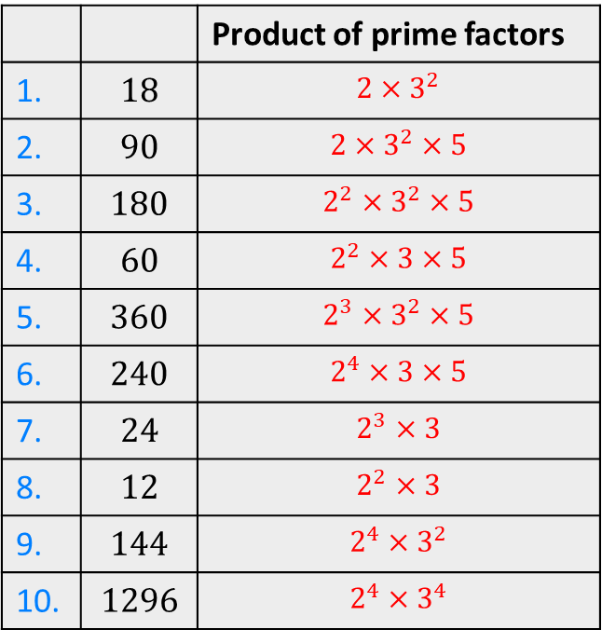
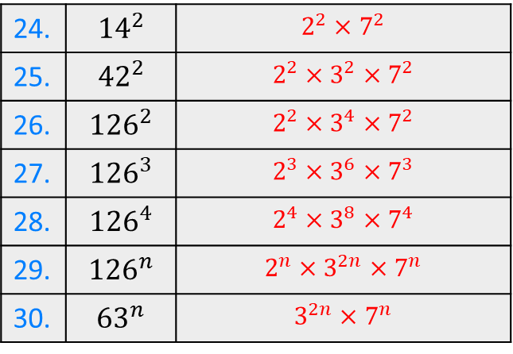
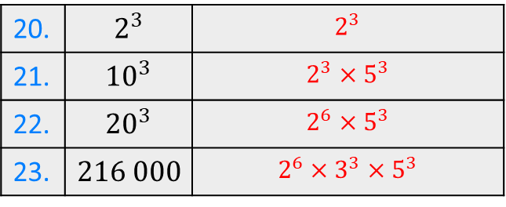
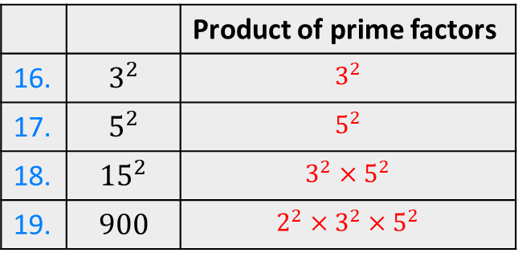
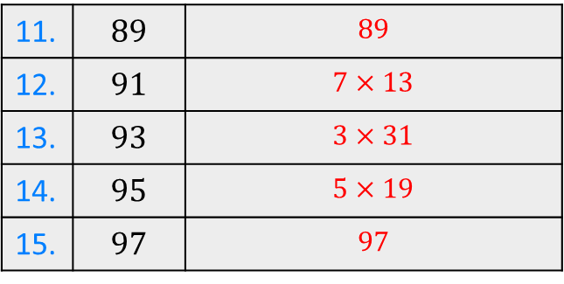
 |  | Product of prime factors
1. | $$18$$ | $$2×3^{2}$$
2. | $$90$$ | $$2×3^{2}×5$$
3. | $$180$$ | $$2^{2}×3^{2}×5$$
4. | $$60$$ | $$2^{2}×3×5$$
5. | $$360$$ | $$2^{3}×3^{2}×5$$
6. | $$240$$ | $$2^{4}×3×5$$
7. | $$24$$ | $$2^{3}×3$$
8. | $$12$$ | $$2^{2}×3$$
9. | $$144$$ | $$2^{4}×3^{2}$$
10. | $$1296$$ | $$2^{4}×3^{4}$$
 |  | Product of prime factors
16. | $$3^{2}$$ | $$3^{2}$$
17. | $$5^{2}$$ | $$5^{2}$$
18. | $${15}^{2}$$ | $$3^{2}×5^{2}$$
19. | $$900$$ | $${2^{2}×3}^{2}×5^{2}$$
20. | $$2^{3}$$ | $$2^{3}$$
21. | $${10}^{3}$$ | $$2^{3}×5^{3}$$
22. | $${20}^{3}$$ | $$2^{6}×5^{3}$$
23. | $$216 000$$ | $$2^{6}×3^{3}×5^{3}$$
24. | $${14}^{2}$$ | $$2^{2}×7^{2}$$
25. | $${42}^{2}$$ | $$2^{2}×3^{2}×7^{2}$$
26. | $${126}^{2}$$ | $$2^{2}×3^{4}×7^{2}$$
27. | $${126}^{3}$$ | $$2^{3}×3^{6}×7^{3}$$
28. | $${126}^{4}$$ | $$2^{4}×3^{8}×7^{4}$$
29. | $${126}^{n}$$ | $$2^{n}×3^{2n}×7^{n}$$
30. | $${63}^{n}$$ | $$3^{2n}×7^{n}$$
11. | $$89$$ | $$89$$
12. | $$91$$ | $$7×13$$
13. | $$93$$ | $$3×31$$
14. | $$95$$ | $$5×19$$
15. | $$97$$ | $$97$$

Slide 4
 |  | Product of prime factors
1. | $$18$$ | $$2×3^{2}$$
2. | $$90$$ | $$2×3^{2}×5$$
3. | $$180$$ | $$2^{2}×3^{2}×5$$
4. | $$60$$ | $$2^{2}×3×5$$
5. | $$360$$ | $$2^{3}×3^{2}×5$$
6. | $$240$$ | $$2^{4}×3×5$$
7. | $$24$$ | $$2^{3}×3$$
8. | $$12$$ | $$2^{2}×3$$
9. | $$144$$ | $$2^{4}×3^{2}$$
10. | $$1296$$ | $$2^{4}×3^{4}$$
 |  | Product of prime factors
16. | $$3^{2}$$ | $$3^{2}$$
17. | $$5^{2}$$ | $$5^{2}$$
18. | $${15}^{2}$$ | $$3^{2}×5^{2}$$
19. | $$900$$ | $${2^{2}×3}^{2}×5^{2}$$
20. | $$2^{3}$$ | $$2^{3}$$
21. | $${10}^{3}$$ | $$2^{3}×5^{3}$$
22. | $${20}^{3}$$ | $$2^{6}×5^{3}$$
23. | $$216 000$$ | $$2^{6}×3^{3}×5^{3}$$
24. | $${14}^{2}$$ | $$2^{2}×7^{2}$$
25. | $${42}^{2}$$ | $$2^{2}×3^{2}×7^{2}$$
26. | $${126}^{2}$$ | $$2^{2}×3^{4}×7^{2}$$
27. | $${126}^{3}$$ | $$2^{3}×3^{6}×7^{3}$$
28. | $${126}^{4}$$ | $$2^{4}×3^{8}×7^{4}$$
29. | $${126}^{n}$$ | $$2^{n}×3^{2n}×7^{n}$$
30. | $${63}^{n}$$ | $$3^{2n}×7^{n}$$
11. | $$89$$ | $$89$$
12. | $$91$$ | $$7×13$$
13. | $$93$$ | $$3×31$$
14. | $$95$$ | $$5×19$$
15. | $$97$$ | $$97$$

