Slide 1
Decimals: Subtracting decimals – carry (alternate version)
Silent
Teacher
Intelligent Practice
Narration
Your Turn
$$2 −0.7=$$
$$0.7 −0.2=$$
$$0.7 − 0.21=$$
Practice

Slide 2
Worked Example
Your Turn
$$0.35−0.21=$$
$$0.25−0.13=$$

Slide 3
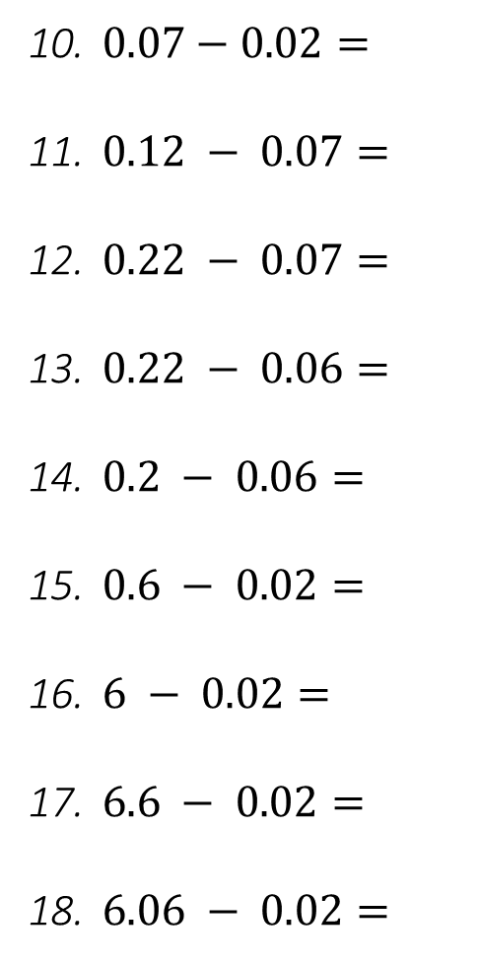
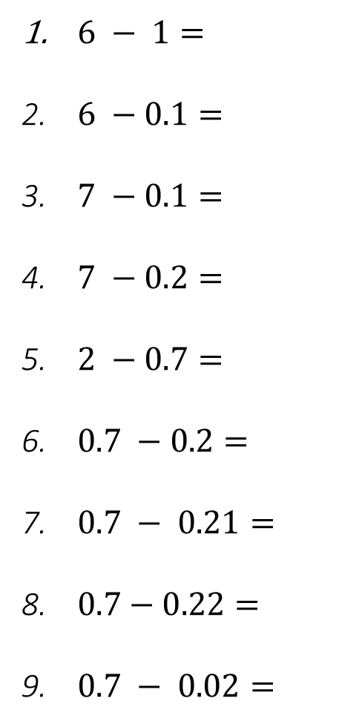
$6 − 1=$
$6 −0.1=$
$7 −0.1=$
$7 −0.2=$
$2 −0.7=$
$0.7 −0.2=$
$0.7 − 0.21=$
$0.7−0.22=$
$0.7 − 0.02=$
$0.07−0.02=$
$0.12 − 0.07=$
$0.22 − 0.07=$
$0.22 − 0.06=$
$0.2 − 0.06=$
$0.6 − 0.02=$
$6 − 0.02=$
$6.6 − 0.02=$
$6.06 − 0.02=$

Slide 4
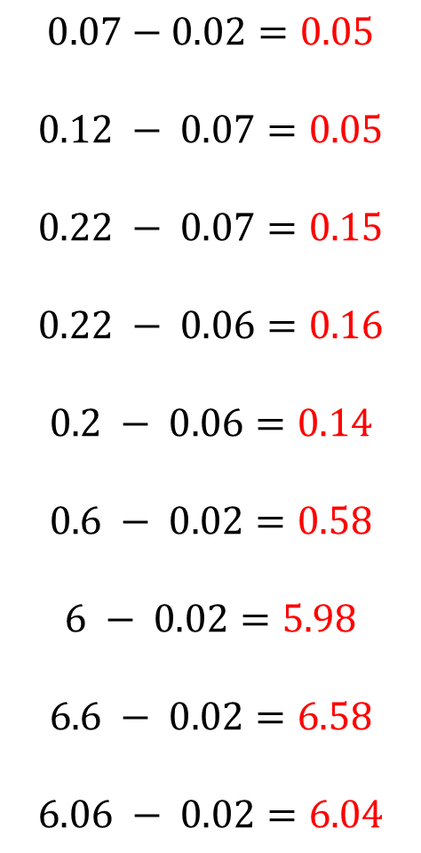
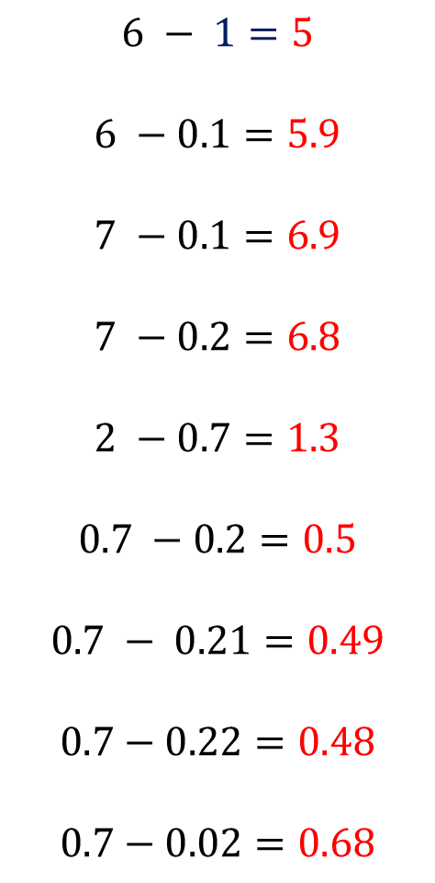
$$6 − 1=5$$
$$6 −0.1=5.9$$
$$7 −0.1=6.9$$
$$7 −0.2=6.8$$
$$2 −0.7=1.3$$
$$0.7 −0.2=0.5$$
$$0.7 − 0.21=0.49$$
$$0.7−0.22=0.48$$
$$0.7−0.02=0.68$$
$$0.07−0.02=0.05$$
$$0.12 − 0.07=0.05$$
$$0.22 − 0.07=0.15$$
$$0.22 − 0.06=0.16$$
$$0.2 − 0.06=0.14$$
$$0.6 − 0.02=0.58$$
$$6 − 0.02=5.98$$
$$6.6 − 0.02=6.58$$
$$6.06 − 0.02=6.04$$

