Slide 1
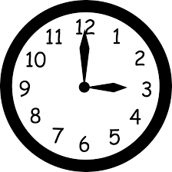
Time: Fill in the gaps
Silent
Teacher
Intelligent Practice
Narration
Your Turn
Practice

Slide 2
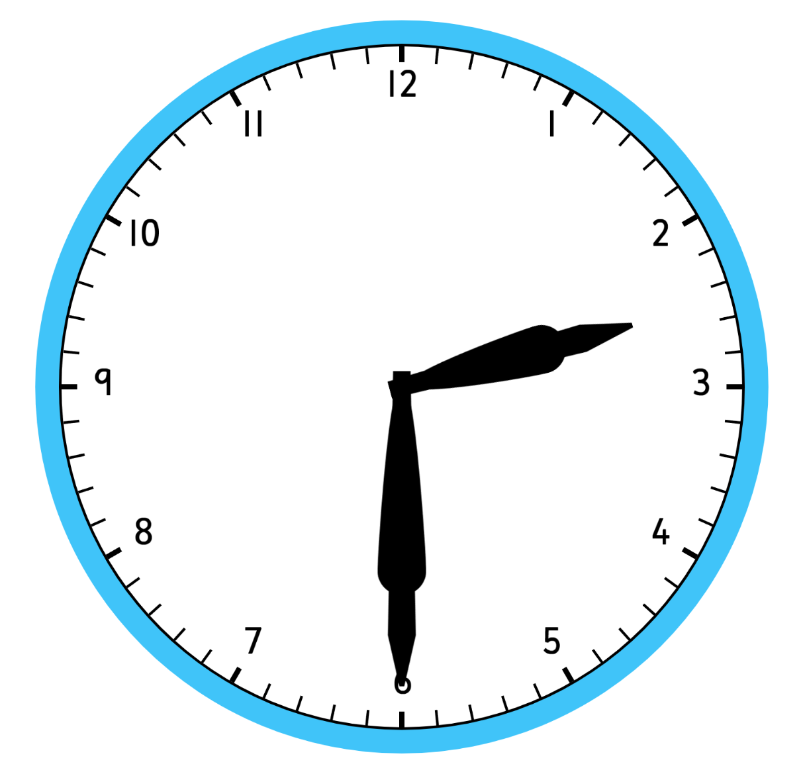
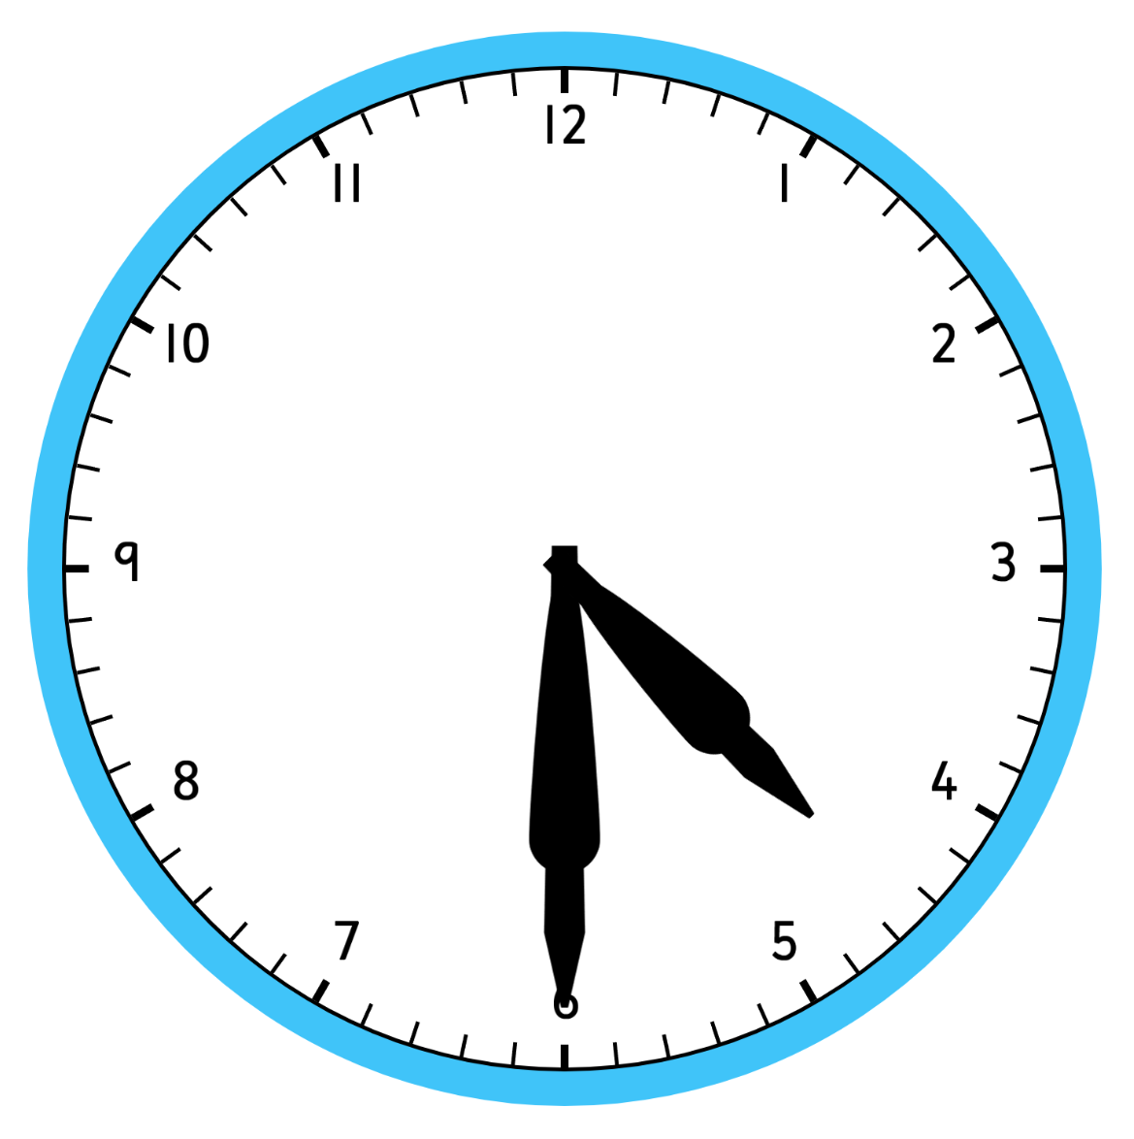
Worked Example
Your Turn
pm
pm
24 hour clock:
One and a half hours earlier (12 hour clock):
Three hours 15 minutes later
(24 hour clock):
Time until 7.30am:
Time since 21:45:
24 hour clock:
One and a half hours earlier (12 hour clock):
Three hours 15 minutes later
(24 hour clock):
Time until 7.30am:
Time since 21:45:

Slide 3
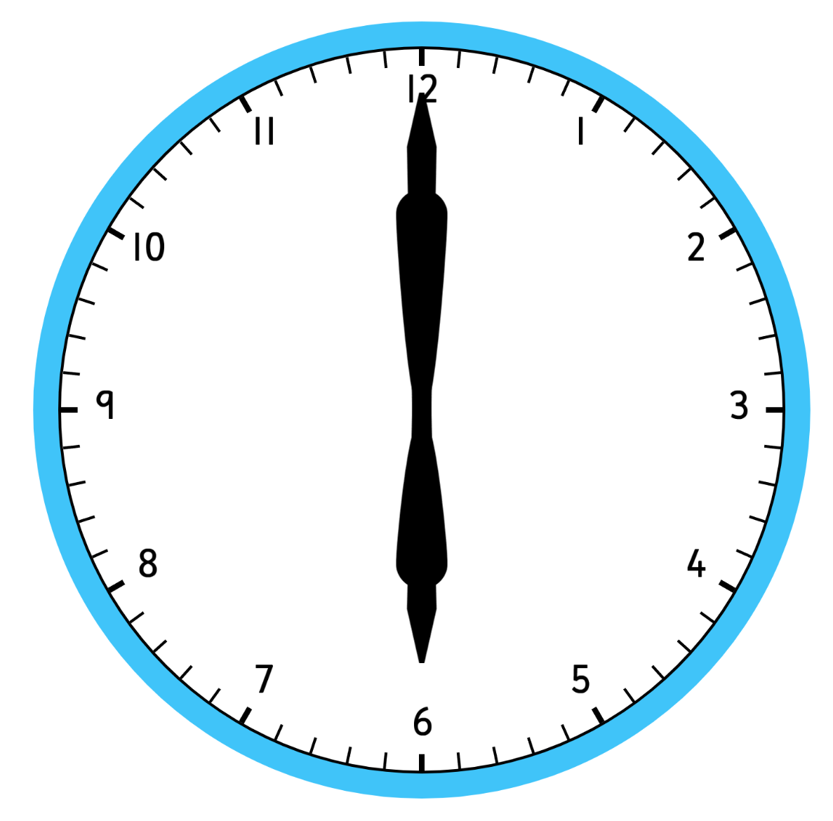
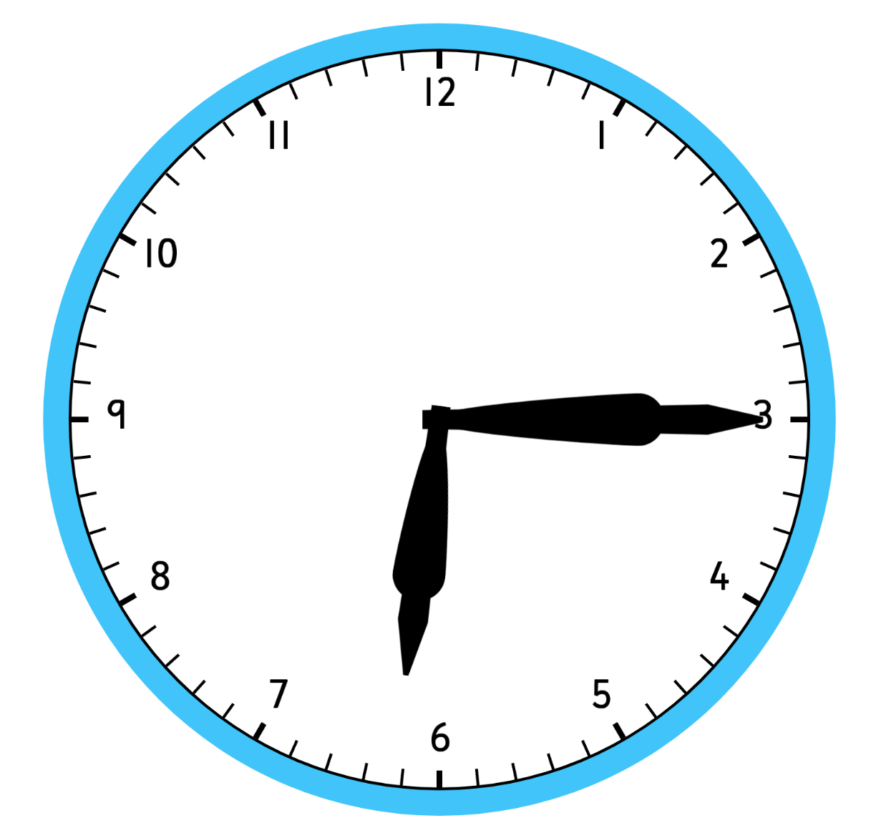
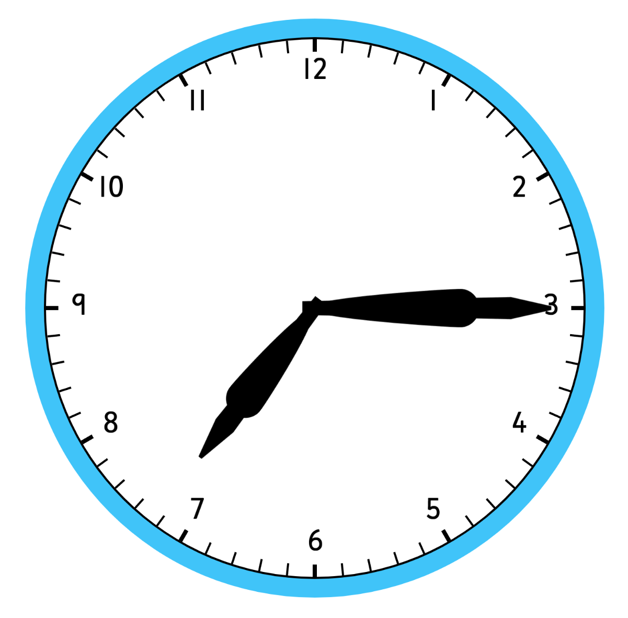
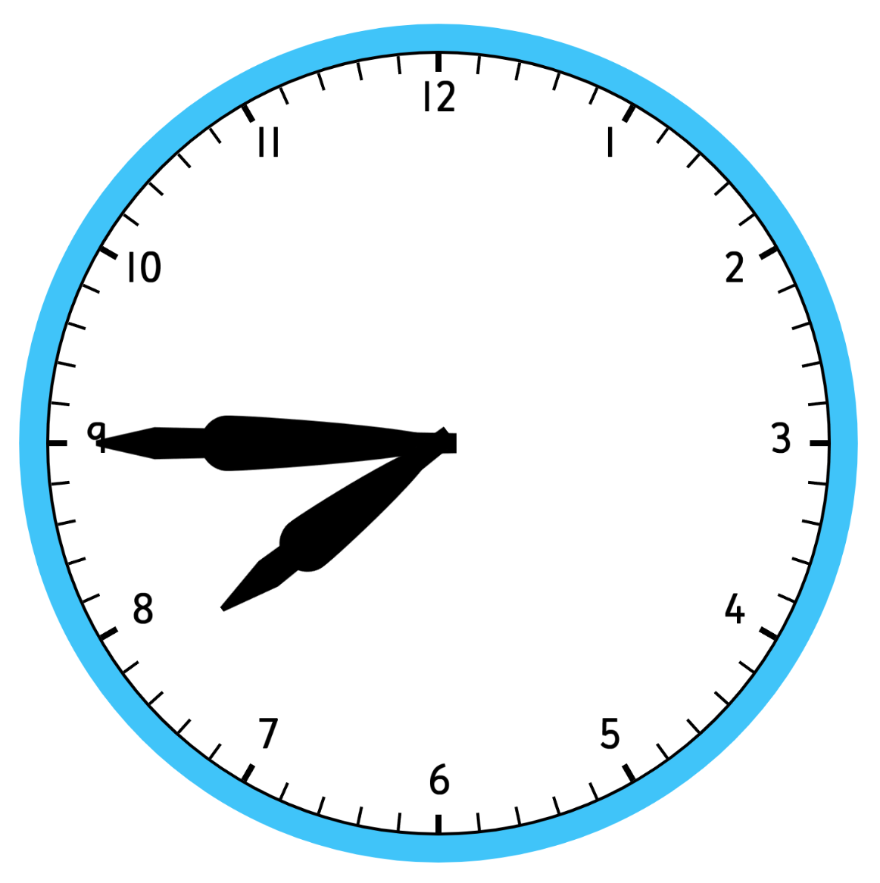
Analogue clock | am / pm | 24 hour clock | One and a half hours earlier (12 hour clock) | Three hours 15 minutes later (24 hour clock) | Time until 7.30am | Time since 21:45
 | am | 06:00 | 4:30am | 09:15 | 1 hour 30 mins | 8 hours 15 mins
 | am | 06:15 | 4:45am | 09:30 | 1 hour 15 mins | 8 hours 30 mins
 | am | 07:15 | 5:45am | 10:30 | 15 mins | 9 hours 30 mins
 | pm | 19:15 | 5:45pm | 22:30 | 12 hours 15 mins | 21 hours 30 mins
 | pm | 19:45 | 6:15pm | 23:00 | 11 hours 45 mins | 22 hours
$$1.$$
$$2.$$
$$3.$$
$$4.$$
$$5.$$

Slide 4
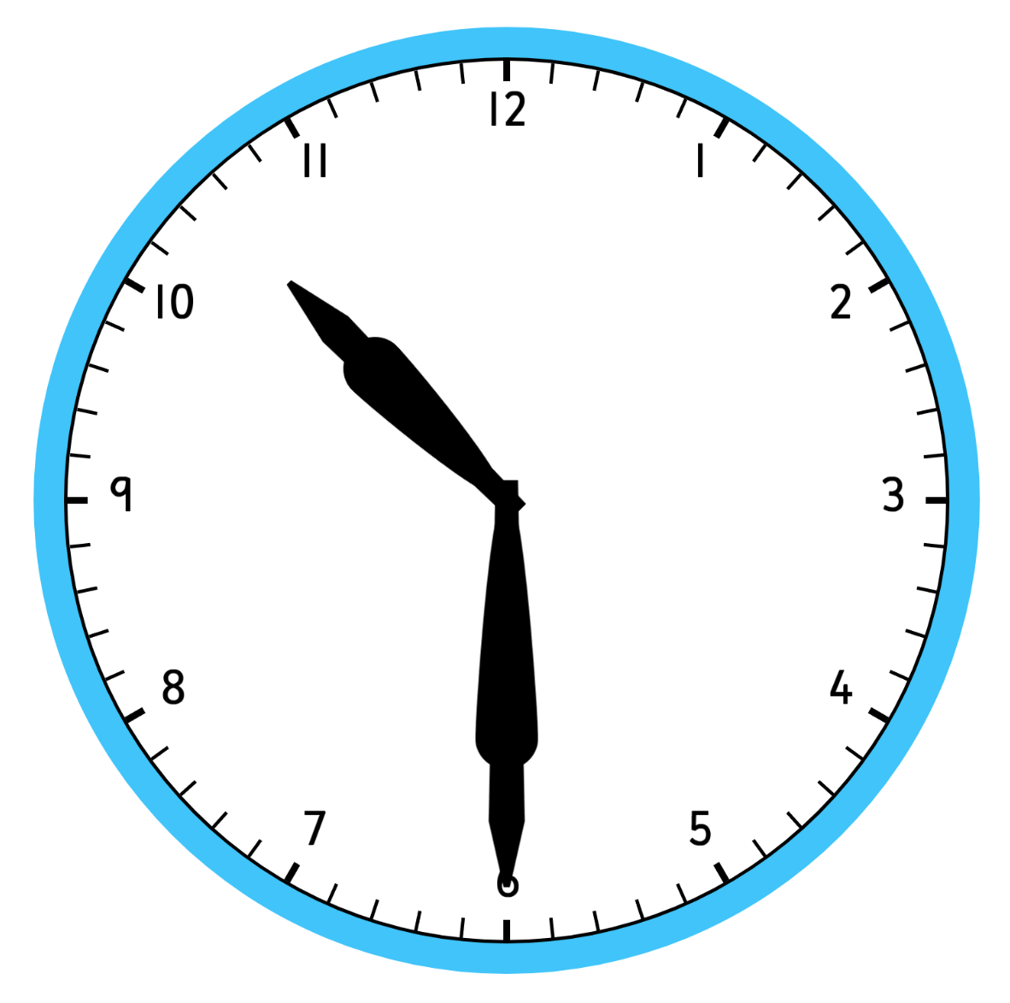
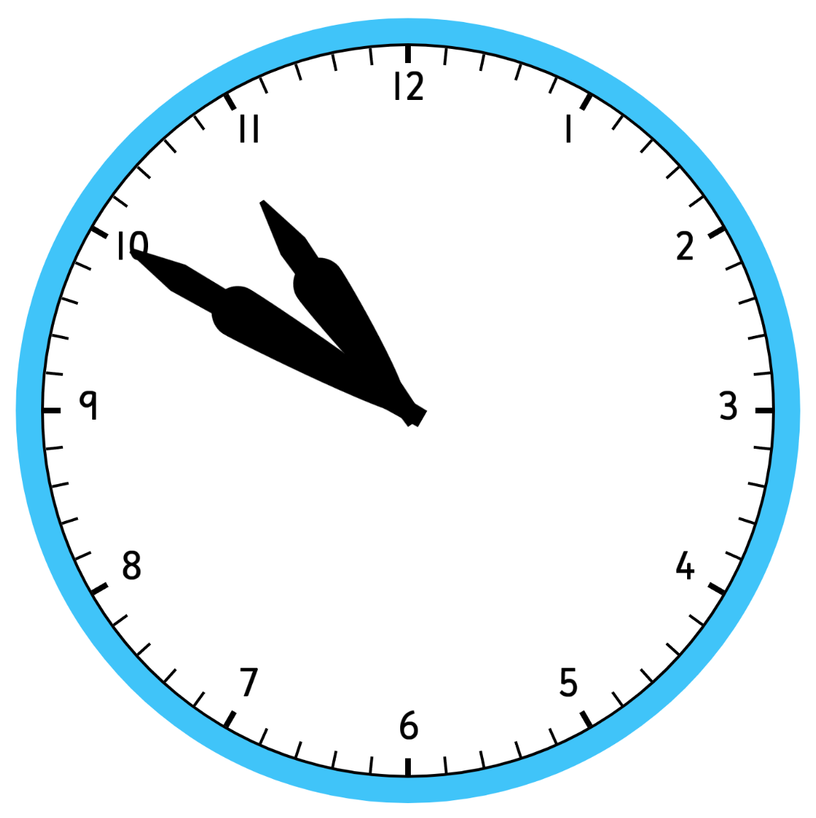
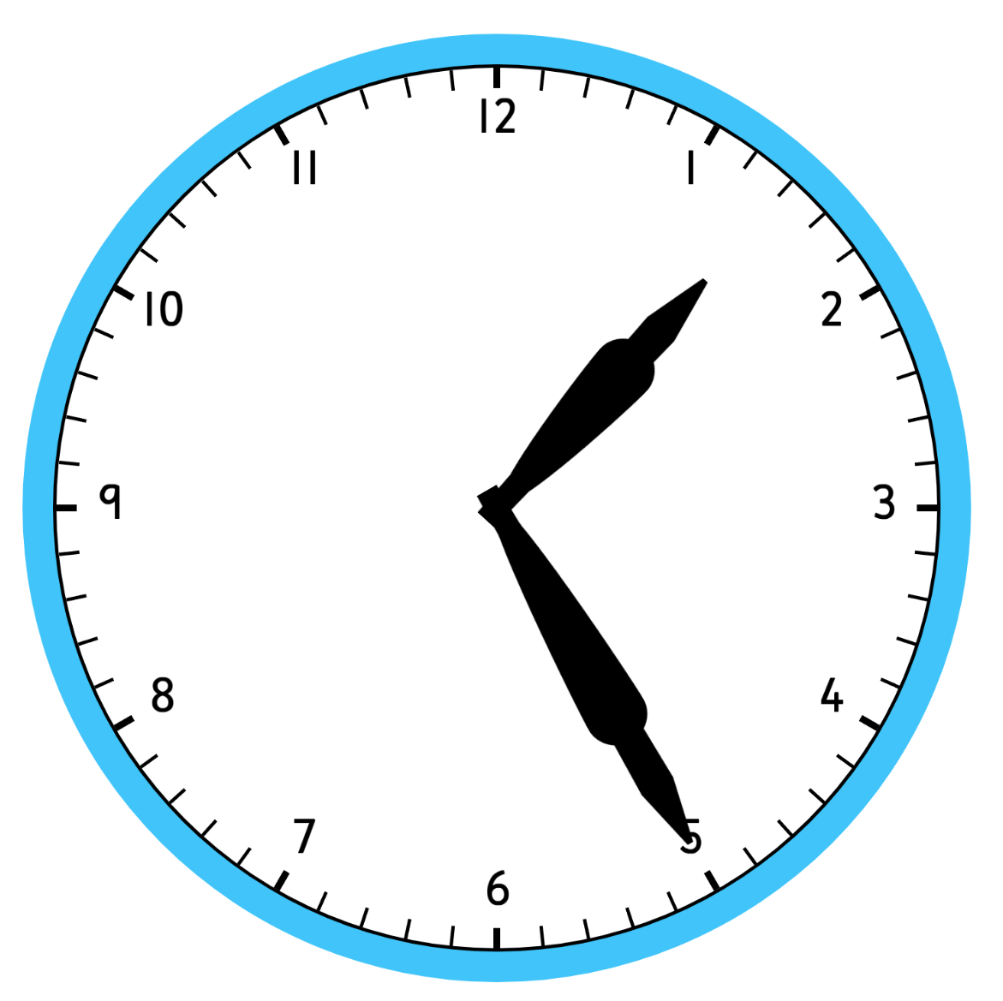
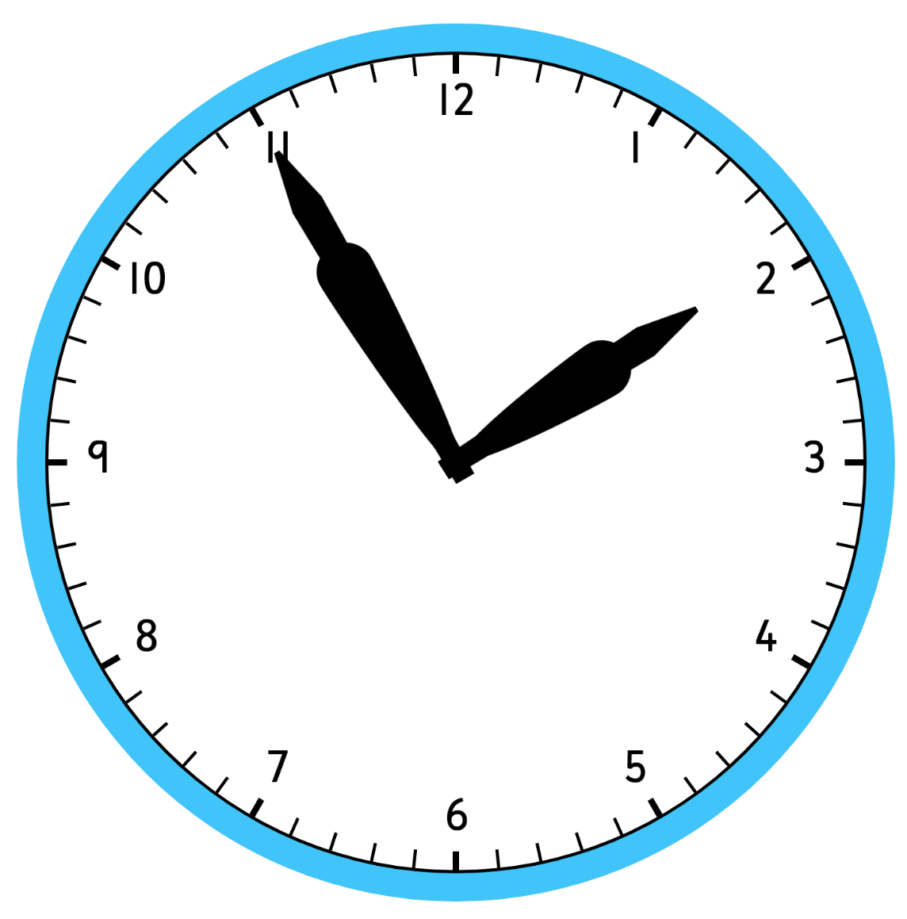
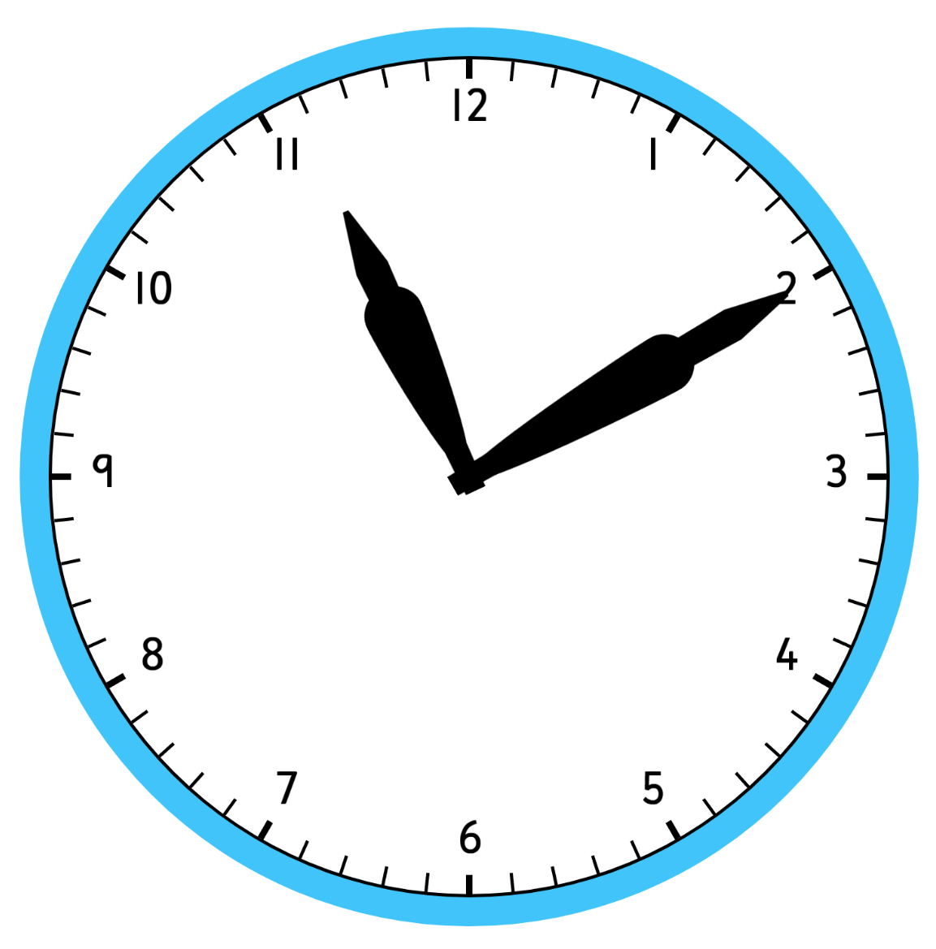
Analogue clock | am / pm | 24 hour clock | One and a half hours earlier (12 hour clock) | Three hours 15 minutes later (24 hour clock) | Time until 7.30am | Time since 21:45
 | pm | 22:30 | 9:00pm | 01:45 | 9 hours | 45 mins
 | pm | 22:50 | 9:20pm | 02:05 | 8 hours 40 mins | 1 hour 5 mins
 | am | 01:25 | 11:55am | 04:40 | 6 hours 5 mins | 3 hours 40 mins
 | pm | 13:55 | 12:25pm | 17:10 | 17 hours 35 mins | 16 hours 10 mins
 | am | 11:10 | 9:40am | 14:25 | 20 hours 20 mins | 13 hours 25 mins
$$6.$$
$$7.$$
$$8.$$
$$9.$$
$$10.$$

Slide 5
Analogue clock | am / pm | 24 hour clock | One and a half hours earlier (12 hour clock) | Three hours 15 minutes later (24 hour clock) | Time until 7.30am | Time since 21:45
 | am | 06:00 | 4:30am | 09:15 | 1 hour 30 mins | 8 hours 15 mins
 | am | 06:15 | 4:45am | 09:30 | 1 hour 15 mins | 8 hours 30 mins
 | am | 07:15 | 5:45am | 10:30 | 15 mins | 9 hours 30 mins
 | pm | 19:15 | 5:45pm | 22:30 | 12 hours 15 mins | 21 hours 30 mins
 | pm | 19:45 | 6:15pm | 23:00 | 11 hours 45 mins | 22 hours
$$1.$$
$$2.$$
$$3.$$
$$4.$$
$$5.$$

Slide 6
Analogue clock | am / pm | 24 hour clock | One and a half hours earlier (12 hour clock) | Three hours 15 minutes later (24 hour clock) | Time until 7.30am | Time since 21:45
 | pm | 22:30 | 9:00pm | 01:45 | 9 hours | 45 mins
 | pm | 22:50 | 9:20pm | 02:05 | 8 hours 40 mins | 1 hour 5 mins
 | am | 01:25 | 11:55am | 04:40 | 6 hours 5 mins | 3 hours 40 mins
 | pm | 13:55 | 12:25pm | 17:10 | 17 hours 35 mins | 16 hours 10 mins
 | am | 11:10 | 9:40am | 14:25 | 20 hours 20 mins | 13 hours 25 mins
$$6.$$
$$7.$$
$$8.$$
$$9.$$
$$10.$$

