Slide 1
Quadratic formula: Values of $a$, $b$, $c$
True/false
Reflect
Your Turn
$$3x^{2}+5x+1=0$$
$$0=3x^{2}+5x+1$$
$$0=3x^{2}+5x+2$$
Rule

Slide 2
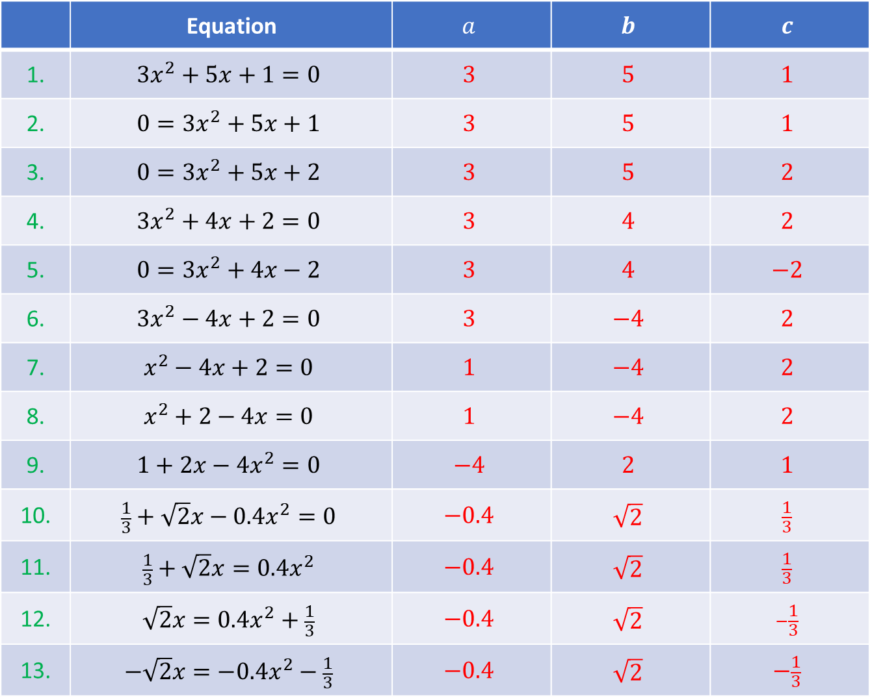
 | Equation | $$a$$ | $$b$$ | $$c$$
1. | $$3x^{2}+5x+1=0$$ | $$3$$ | $$5$$ | $$1$$
2. | $$0=3x^{2}+5x+1$$ | $$3$$ | $$5$$ | $$1$$
3. | $$0=3x^{2}+5x+2$$ | $$3$$ | $$5$$ | $$2$$
4. | $${3x}^{2}+4x+2=0$$ | $$3$$ | $$4$$ | $$2$$
5. | $$0={3x}^{2}+4x−2$$ | $$3$$ | $$4$$ | $$−2$$
6. | $${3x}^{2}−4x+2=0$$ | $$3$$ | $$−4$$ | $$2$$
7. | $$x^{2}−4x+2=0$$ | $$1$$ | $$−4$$ | $$2$$
8. | $$x^{2}+2−4x=0$$ | $$1$$ | $$−4$$ | $$2$$
9. | $$1+2x−4x^{2}=0$$ | $$−4$$ | $$2$$ | $$1$$
10. | $$\frac{1}{3}+\sqrt{2}x−0.4x^{2}=0$$ | $$−0.4$$ | $$\sqrt{2}$$ | $$\frac{1}{3}$$
11. | $$\frac{1}{3}+\sqrt{2}x=0.4x^{2}$$ | $$−0.4$$ | $$\sqrt{2}$$ | $$\frac{1}{3}$$
12. | $$\sqrt{2}x=0.4x^{2}+\frac{1}{3}$$ | $$−0.4$$ | $$\sqrt{2}$$ | $$−\frac{1}{3}$$
13. | $$−\sqrt{2}x=−0.4x^{2}−\frac{1}{3}$$ | $$−0.4$$ | $$\sqrt{2}$$ | $$−\frac{1}{3}$$

Slide 3
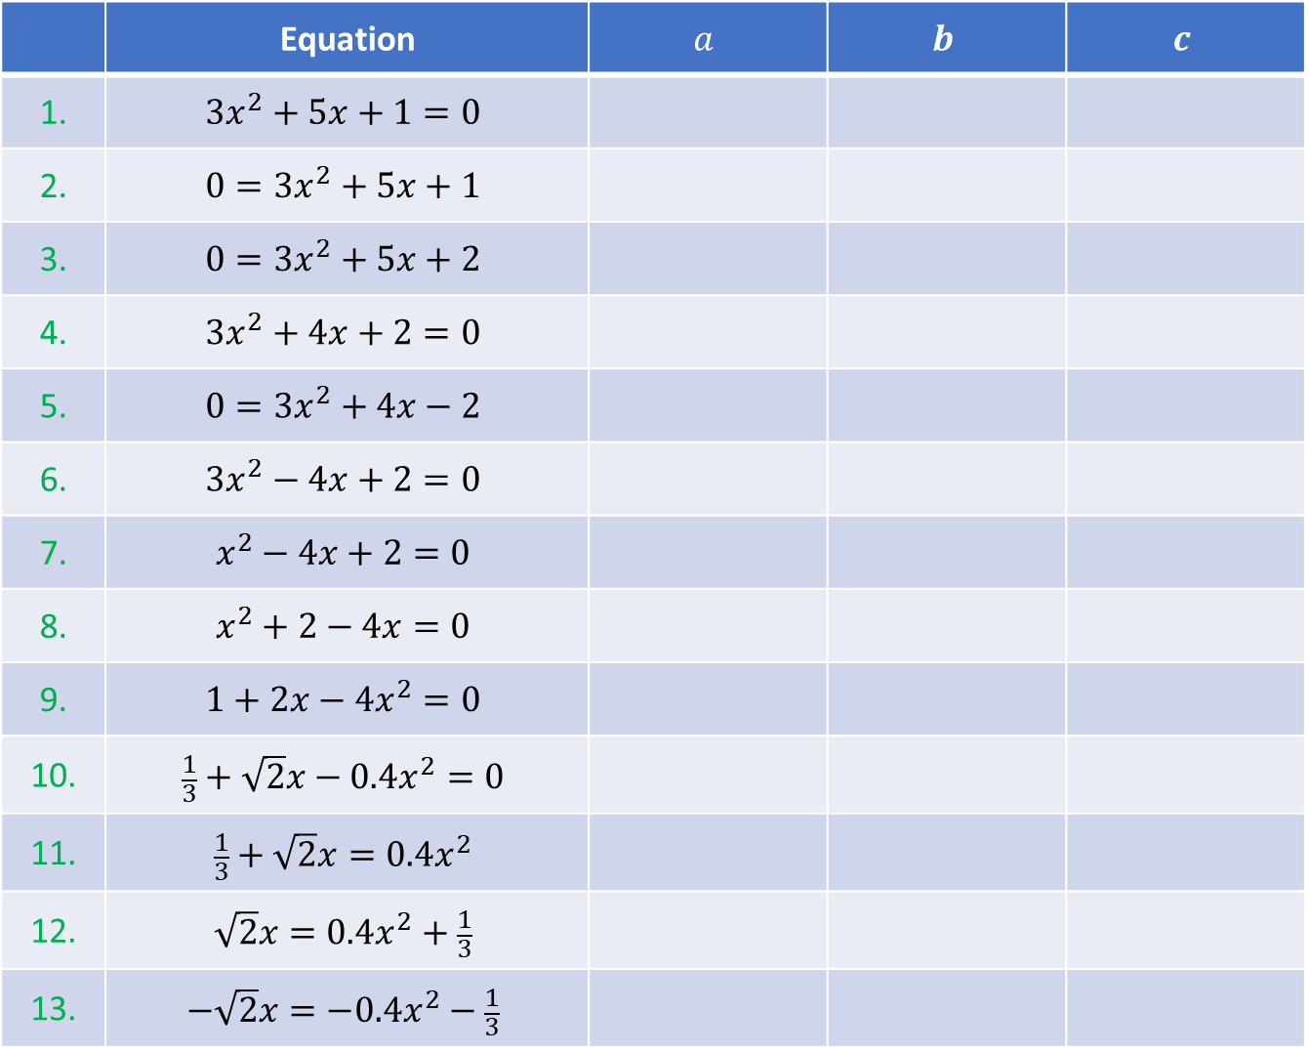
 | Equation | $$a$$ | $$b$$ | $$c$$
1. | $$3x^{2}+5x+1=0$$
2. | $$0=3x^{2}+5x+1$$
3. | $$0=3x^{2}+5x+2$$
4. | $${3x}^{2}+4x+2=0$$
5. | $$0={3x}^{2}+4x−2$$
6. | $${3x}^{2}−4x+2=0$$
7. | $$x^{2}−4x+2=0$$
8. | $$x^{2}+2−4x=0$$
9. | $$1+2x−4x^{2}=0$$
10. | $$\frac{1}{3}+\sqrt{2}x−0.4x^{2}=0$$
11. | $$\frac{1}{3}+\sqrt{2}x=0.4x^{2}$$
12. | $$\sqrt{2}x=0.4x^{2}+\frac{1}{3}$$
13. | $$−\sqrt{2}x=−0.4x^{2}−\frac{1}{3}$$

Slide 4
 | Equation | $$a$$ | $$b$$ | $$c$$
1. | $$3x^{2}+5x+1=0$$ | $$3$$ | $$5$$ | $$1$$
2. | $$0=3x^{2}+5x+1$$ | $$3$$ | $$5$$ | $$1$$
3. | $$0=3x^{2}+5x+2$$ | $$3$$ | $$5$$ | $$2$$
4. | $${3x}^{2}+4x+2=0$$ | $$3$$ | $$4$$ | $$2$$
5. | $$0={3x}^{2}+4x−2$$ | $$3$$ | $$4$$ | $$−2$$
6. | $${3x}^{2}−4x+2=0$$ | $$3$$ | $$−4$$ | $$2$$
7. | $$x^{2}−4x+2=0$$ | $$1$$ | $$−4$$ | $$2$$
8. | $$x^{2}+2−4x=0$$ | $$1$$ | $$−4$$ | $$2$$
9. | $$1+2x−4x^{2}=0$$ | $$−4$$ | $$2$$ | $$1$$
10. | $$\frac{1}{3}+\sqrt{2}x−0.4x^{2}=0$$ | $$−0.4$$ | $$\sqrt{2}$$ | $$\frac{1}{3}$$
11. | $$\frac{1}{3}+\sqrt{2}x=0.4x^{2}$$ | $$−0.4$$ | $$\sqrt{2}$$ | $$\frac{1}{3}$$
12. | $$\sqrt{2}x=0.4x^{2}+\frac{1}{3}$$ | $$−0.4$$ | $$\sqrt{2}$$ | $$−\frac{1}{3}$$
13. | $$−\sqrt{2}x=−0.4x^{2}−\frac{1}{3}$$ | $$−0.4$$ | $$\sqrt{2}$$ | $$−\frac{1}{3}$$

Slide 5
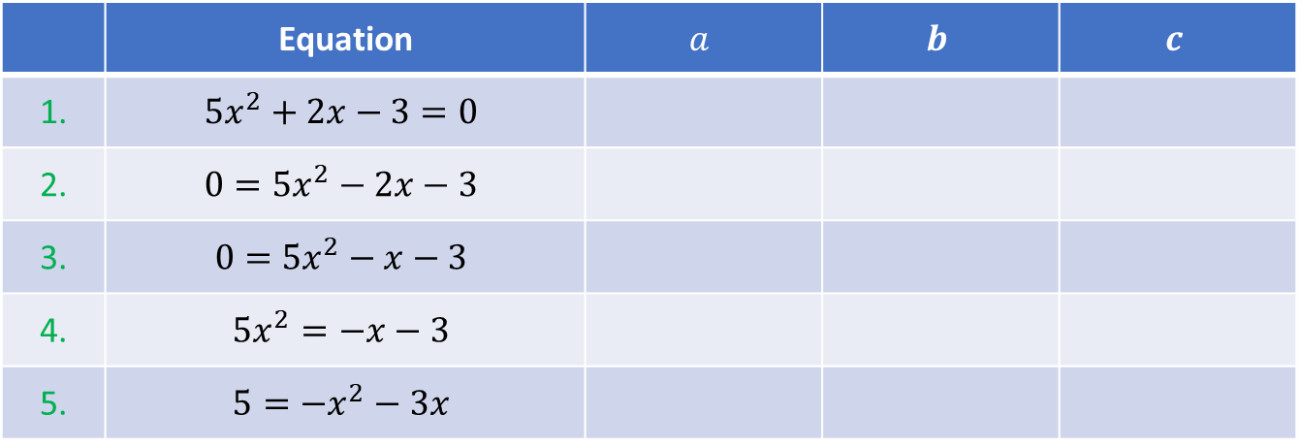
Your Turn
 | Equation | $$a$$ | $$b$$ | $$c$$
1. | $$5x^{2}+2x−3=0$$
2. | $$0=5x^{2}−2x−3$$
3. | $$0=5x^{2}−x−3$$
4. | $$5x^{2}=−x−3$$
5. | $$5=−x^{2}−3x$$
@mrbartonmaths

Slide 6
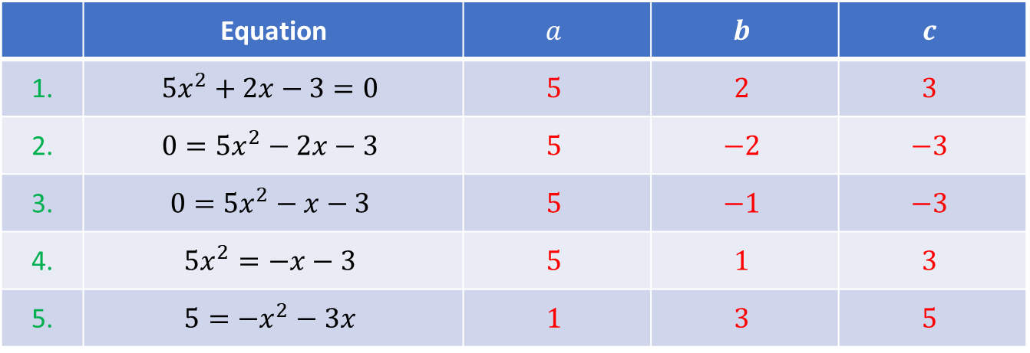
Your Turn - answers
 | Equation | $$a$$ | $$b$$ | $$c$$
1. | $$5x^{2}+2x−3=0$$ | $$5$$ | $$2$$ | $$3$$
2. | $$0=5x^{2}−2x−3$$ | $$5$$ | $$−2$$ | $$−3$$
3. | $$0=5x^{2}−x−3$$ | $$5$$ | $$−1$$ | $$−3$$
4. | $$5x^{2}=−x−3$$ | $$5$$ | $$1$$ | $$3$$
5. | $$5=−x^{2}−3x$$ | $$1$$ | $$3$$ | $$5$$
@mrbartonmaths

