Slide 1
Expanding brackets in the form $$\left(ax+b\right)\left(cx+d\right)$$
Silent
Teacher
Intelligent Practice
Narration
Your Turn
$$\left(3x+7\right)\left(10x+5\right)=$$
$$\left(10x+5\right)\left(3x+7\right)=$$
Practice

Slide 2
Worked Example
Your Turn
$$(3x+4)\left(5x+2\right)=$$
$$(3x+2)(5x+4)=$$

Slide 3
Worked Example
Your Turn
$$(3x−4)\left(5x+2\right)=$$
$$(3x−2)(5x+4)=$$

Slide 4
Worked Example
Your Turn
$$(3x+4)\left(5x−2\right)=$$
$$(3x+2)(5x−4)=$$

Slide 5
Worked Example
Your Turn
$$(3x−4)\left(5x−2\right)=$$
$$(3x−2)(5x−4)=$$

Slide 6
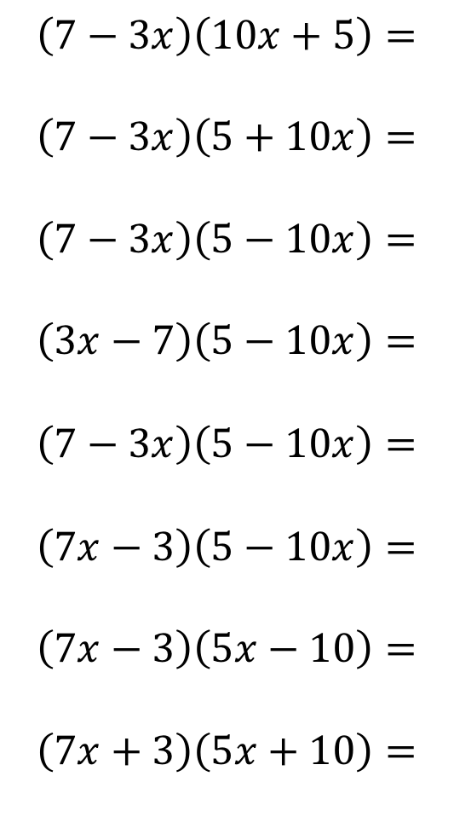
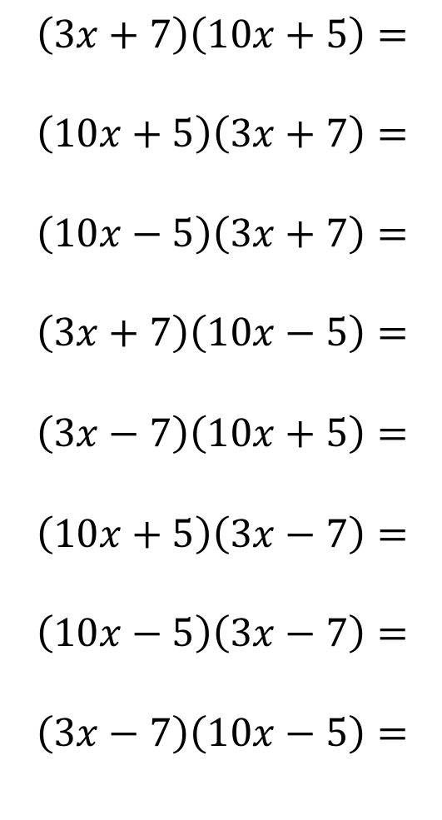
1.
2.
3.
4.
5.
6.
7.
8.
$$\left(3x+7\right)\left(10x+5\right)=$$
$$\left(10x+5\right)\left(3x+7\right)=$$
$$\left(10x−5\right)\left(3x+7\right)=$$
$$\left(3x+7\right)\left(10x−5\right)=$$
$$\left(3x−7\right)\left(10x+5\right)=$$
$$\left(10x+5\right)\left(3x−7\right)=$$
$$\left(10x−5\right)\left(3x−7\right)=$$
$$\left(3x−7\right)\left(10x−5\right)=$$
9.
10.
11.
12.
13.
14.
15.
16.
$$\left(7−3x\right)\left(10x+5\right)=$$
$$\left(7−3x\right)\left(5+10x\right)=$$
$$\left(7−3x\right)\left(5−10x\right)=$$
$$\left(3x−7\right)\left(5−10x\right)=$$
$$\left(7−3x\right)\left(5−10x\right)=$$
$$\left(7x−3\right)\left(5−10x\right)=$$
$$\left(7x−3\right)\left(5x−10\right)=$$
$$\left(7x+3\right)\left(5x+10\right)=$$

Slide 7
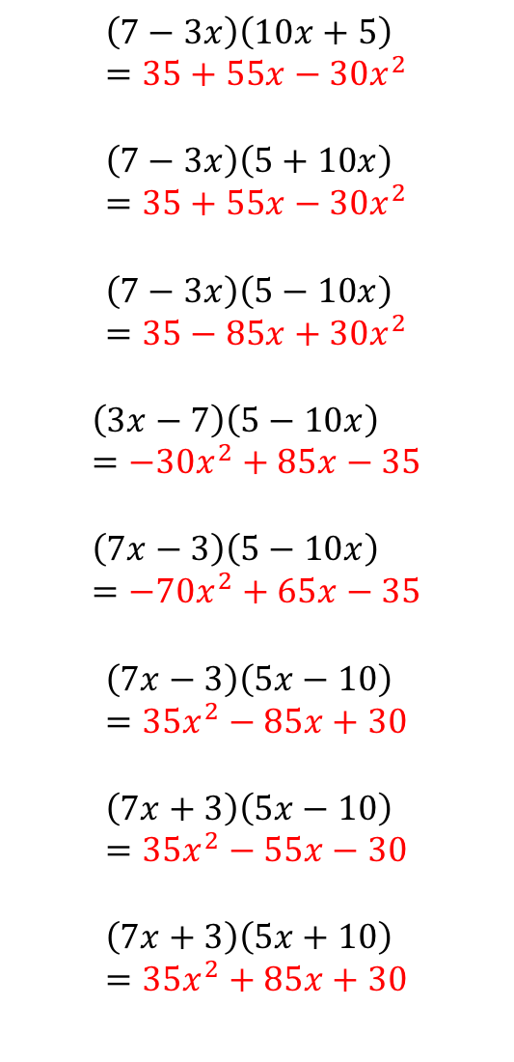
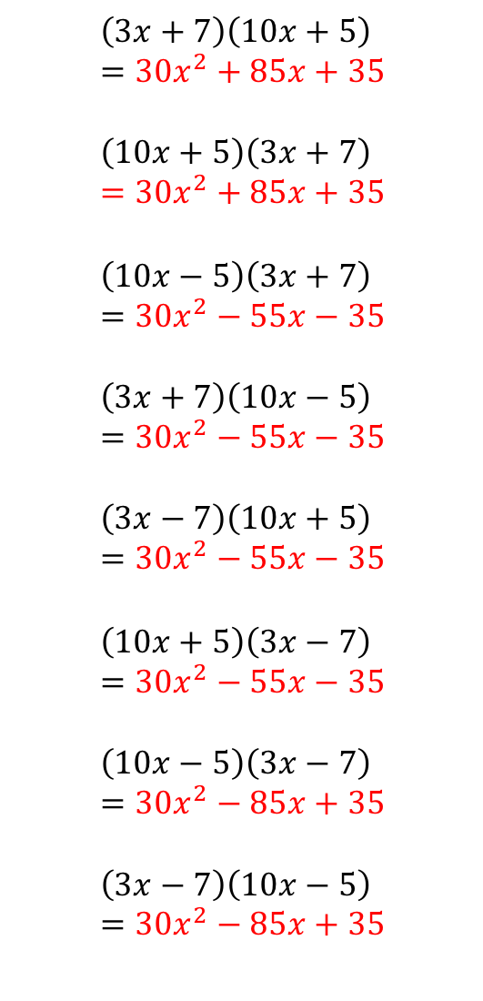
1.
2.
3.
4.
5.
6.
7.
8.
$$\left(3x+7\right)\left(10x+5\right)=30x^{2}+85x+35$$
$$\left(10x+5\right)\left(3x+7\right)=30x^{2}+85x+35$$
$$\left(10x−5\right)\left(3x+7\right)=30x^{2}−55x−35$$
$$\left(3x+7\right)\left(10x−5\right)=30x^{2}−55x−35$$
$$\left(3x−7\right)\left(10x+5\right)=30x^{2}−55x−35$$
$$\left(10x+5\right)\left(3x−7\right)=30x^{2}−55x−35$$
$$\left(10x−5\right)\left(3x−7\right)=30x^{2}−85x+35$$
$$\left(3x−7\right)\left(10x−5\right)=30x^{2}−85x+35$$
9.
10.
11.
12.
13.
14.
15.
16.
$$\left(7−3x\right)\left(10x+5\right)=35+55x−30x^{2}$$
$$\left(7−3x\right)\left(5+10x\right)=35+55x−30x^{2}$$
$$\left(7−3x\right)\left(5−10x\right)=35−85x+30x^{2}$$
$$\left(3x−7\right)\left(5−10x\right)=−30x^{2}+85x−35$$
$$\left(7x−3\right)\left(5−10x\right)=−70x^{2}+65x−35$$
$$\left(7x−3\right)\left(5x−10\right)=35x^{2}−85x+30$$
$$\left(7x+3\right)\left(5x−10\right)=35x^{2}−55x−30$$
$$\left(7x+3\right)\left(5x+10\right)=35x^{2}+85x+30$$

