Slide 1
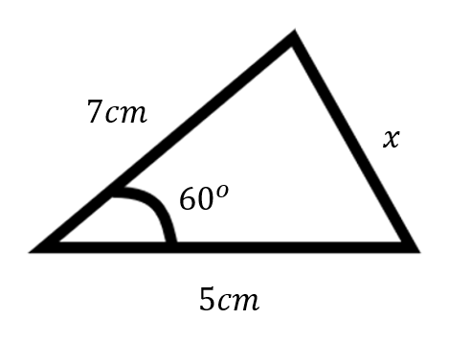
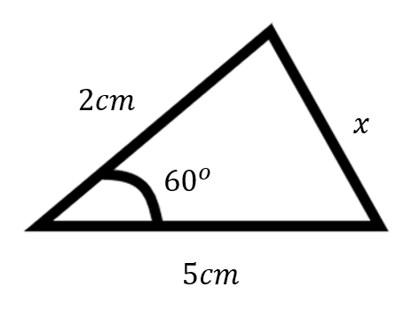
Worked Example
Your Turn
Find $x$
Find $x$

Slide 2
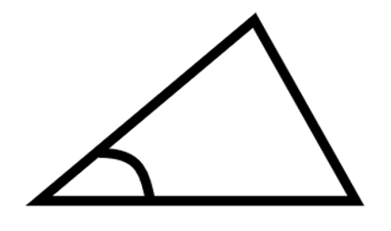
REFLECT, EXPECT, CHECK, EXPLAIN
Find $x$
Find $x$
$$10cm$$
$$x$$
$${40}^{o}$$
$$5cm$$
$$x$$
$$2cm$$
$${40}^{o}$$
Reflect
Expect
Check
Explain
$$4cm$$

Slide 3
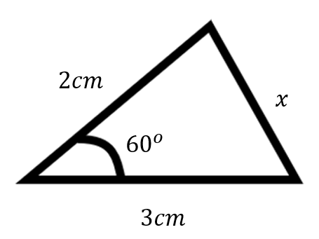
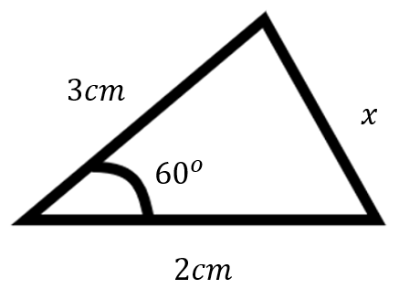
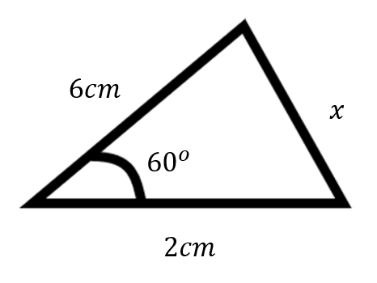
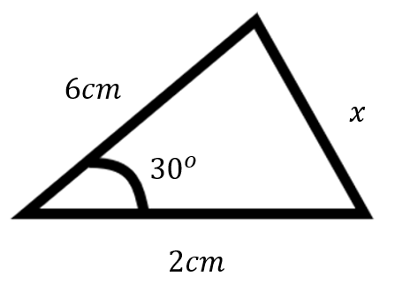
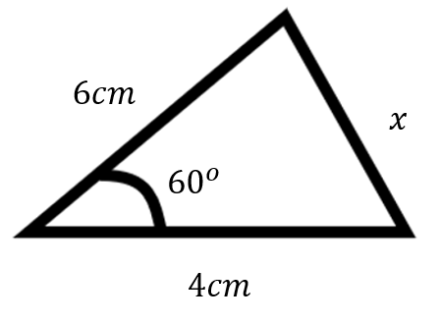
COSINE RULE
For each triangle, find the missing length $x$, giving your answer to 1 decimal place (where appropriate)
1.
2.
3.
4.
5.
6.

Slide 4
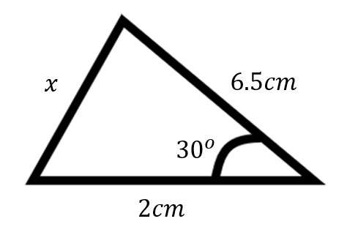
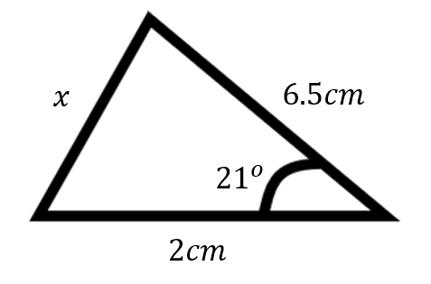
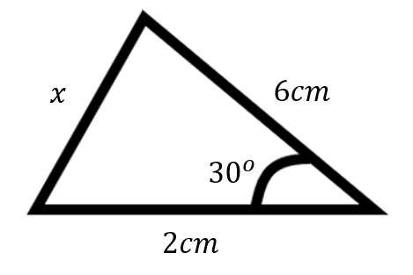
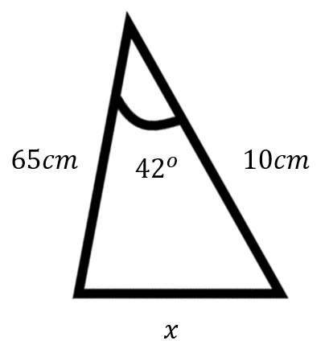
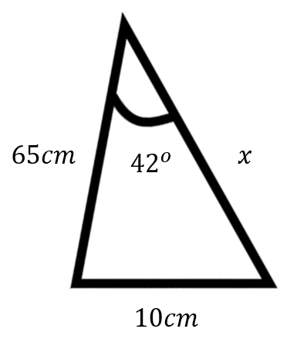
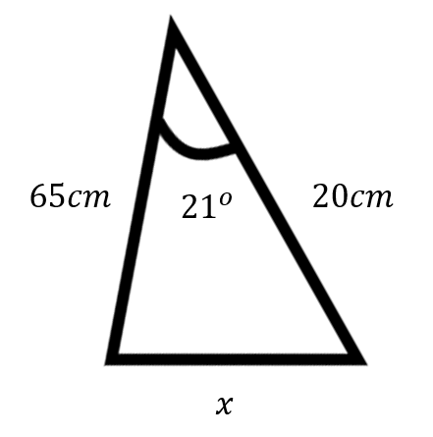
7.
8.
9.
10.
11.
12.

Slide 5
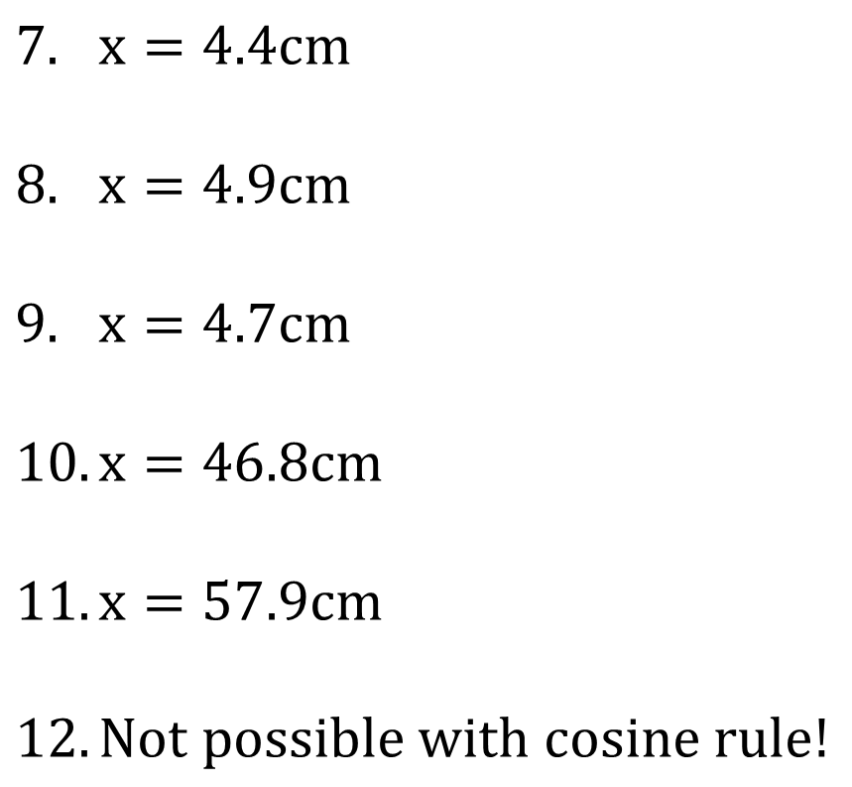
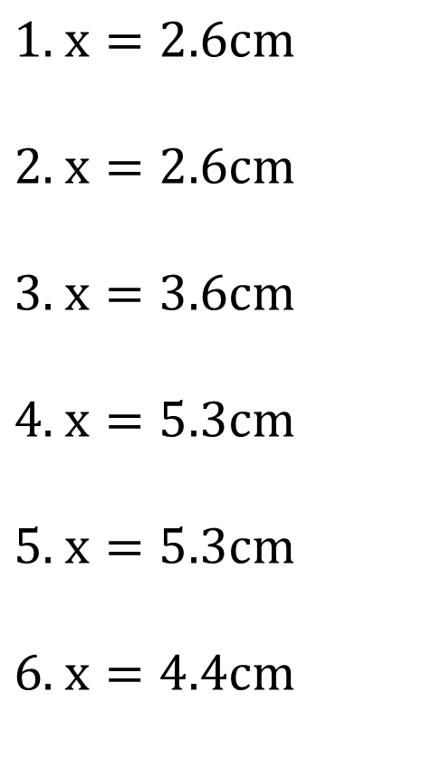
SOLUTIONS
$x=2.6cm$
$x=2.6cm$
$x=3.6cm$
$x=5.3cm$
$x=5.3cm$
$x=4.4cm$
$x=4.4cm$
$x=4.9cm$
$x=4.7cm$
$x=46.8cm$
$x=57.9cm$
$Not possible with cosine rule!$

