Slide 1
Percentage of an amount (alternate version)
Silent
Teacher
Intelligent Practice
Narration
Your Turn
$$10\% \text{of} 80=$$
$$10\% \text{of} 800=$$
$$50\% \text{of} 800 =$$
Practice

Slide 2
Worked Example
Your Turn
$$10\% \text{of} 60=$$
$$10\% \text{of} 20=$$
@katban70

Slide 3
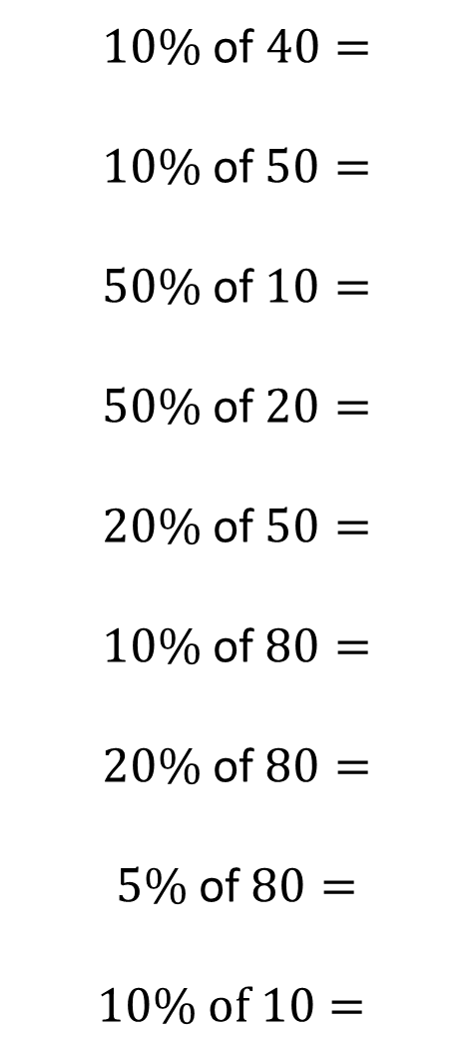
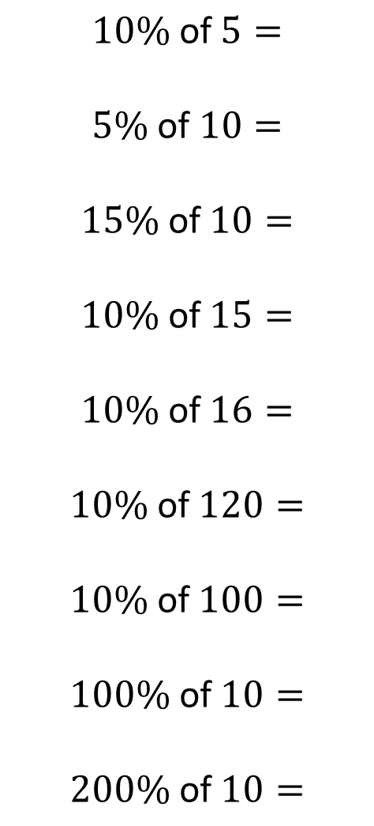
$10\%$ of $40=$
$$10\% \text{of} 50=$$
$$50\% \text{of} 10=$$
$$50\% \text{of} 20=$$
$$20\% \text{of} 50=$$
$$10\% \text{of} 80=$$
$$20\% \text{of} 80=$$
$$5\% \text{of} 80=$$
$$10\% of 10=$$
$$10\% \text{of} 5=$$
$5\%$ of $10=$
$$15\% \text{of} 10=$$
$$10\% \text{of} 15=$$
$$10\% \text{of} 16=$$
$$10\% \text{of} 120=$$
$$10\% \text{of} 100=$$
$$100\% \text{of} 10=$$
$$200\% \text{of} 10=$$
@katban70
Notes:
The exercise aims to highlight three things. The first is within questions 2/3, 4/5, 10/11 and 12/13 – where switching the number and percentage gives the same answer. The second thing is that we can find 10% then use this to find other percentages – this is within question 6/7/8 and 9/11/12. The final thing is that we don’t always find percentages less than 100% - this is within the final two questions.

Slide 4
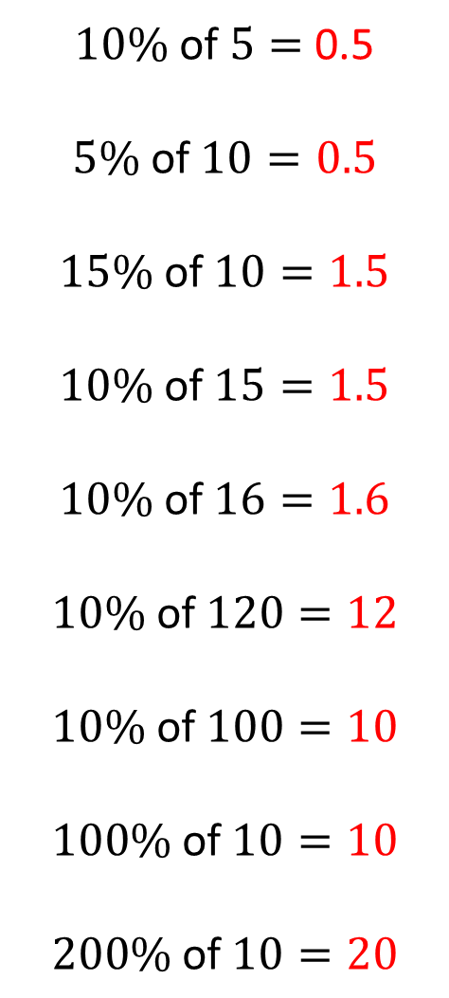
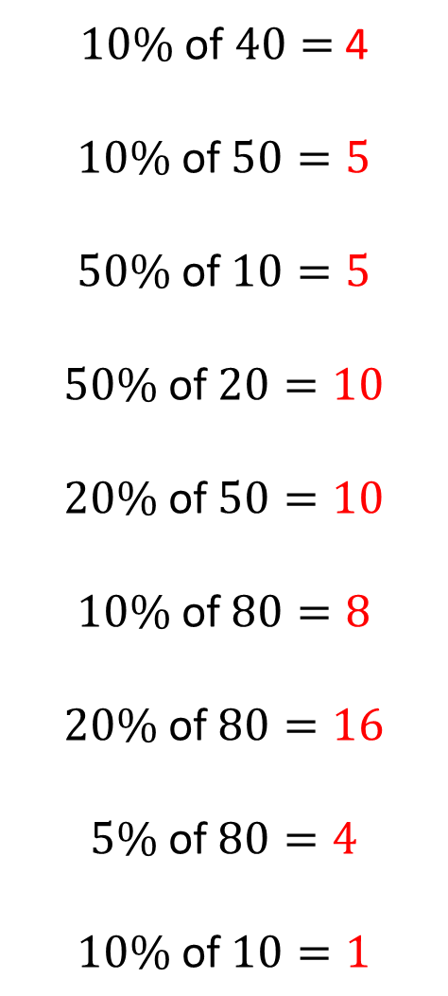
$10\%$ of $40=$ 4
$$10\% \text{of} 50=5$$
$$50\% \text{of} 10=5$$
$$50\% \text{of} 20=10$$
$$20\% \text{of} 50=10$$
$$10\% \text{of} 80=8$$
$$20\% \text{of} 80=16$$
$$5\% \text{of} 80=4$$
$$10\% \text{of} 10=1$$
$10\%$ of $5=$ 0.5
$$5\% \text{of} 10=0.5$$
$$15\% \text{of} 10=1.5$$
$$10\% \text{of} 15=1.5$$
$$10\% \text{of} 16=1.6$$
$$10\% \text{of} 120=12$$
$$10\% \text{of} 100=10$$
$$100\% \text{of} 10=10$$
$$200\% \text{of} 10=20$$
@katban70

Slide 5
Question Write the question out | Reflect Think about how it is similar or different to the question before | Expect How do you expect the answer to change? | Check Do the question!

