Slide 1
How do we make an Equivalent Fraction?
Silent
Teacher
Intelligent Practice
Narration
Your Turn
$$\frac{2}{9}$$
$$×\frac{?}{?}$$
$$\frac{16}{72}$$
Practice

Slide 2
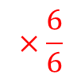
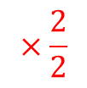
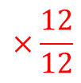
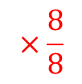
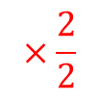
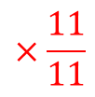
Worked Example
Your Turn
What have we multiplied by to make this equivalent fraction?
What have we multiplied by to make this equivalent fraction
$$\frac{1}{2}$$
$$\frac{2}{4}$$
$$×\frac{2}{2}$$
$$×\frac{2}{2}$$
$$\frac{2}{4}$$
$$\frac{4}{8}$$
$$\frac{2}{4}$$
$$\frac{3}{8}$$
$$×\frac{6}{6}$$
$$×\frac{8}{8}$$
$$\frac{12}{24}$$
$$\frac{24}{64}$$
$$×\frac{11}{11}$$
$$×\frac{12}{12}$$
$$\frac{3}{6}$$
$$\frac{33}{66}$$
$$\frac{4}{7}$$
$$\frac{48}{84}$$
=
=

Slide 3
1)
$$\frac{1}{2}$$
4)
$$\frac{1}{5}$$
$$\frac{2}{8}$$
$$\frac{2}{10}$$
2)
$$\frac{1}{2}$$
5)
$$\frac{1}{5}$$
$$\frac{8}{16}$$
$$\frac{4}{20}$$
3)
$$\frac{1}{2}$$
6)
$$\frac{1}{5}$$
$$\frac{9}{18}$$
$$\frac{10}{50}$$

Slide 4
7)
$$\frac{2}{3}$$
10)
$$\frac{2}{6}$$
$$\frac{16}{24}$$
$$\frac{18}{54}$$
8)
$$\frac{2}{3}$$
11)
$$\frac{6}{7}$$
$$\frac{18}{27}$$
$$\frac{30}{35}$$
9)
$$\frac{2}{6}$$
12)
$$\frac{6}{7}$$
$$\frac{16}{48}$$
$$\frac{48}{56}$$

Slide 5
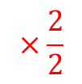
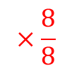
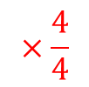
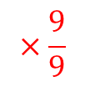
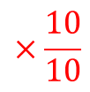
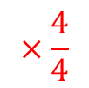
1)
$$\frac{1}{2}$$
4)
$$\frac{1}{5}$$
$$×\frac{4}{4}$$
$$×\frac{2}{2}$$
$$\frac{2}{8}$$
$$\frac{2}{10}$$
2)
$$\frac{1}{2}$$
5)
$$\frac{1}{5}$$
$$×\frac{8}{8}$$
$$×\frac{4}{4}$$
$$\frac{8}{16}$$
$$\frac{4}{20}$$
3)
$$\frac{1}{2}$$
6)
$$\frac{1}{5}$$
$$×\frac{9}{9}$$
$$×\frac{10}{10}$$
$$\frac{9}{18}$$
$$\frac{10}{50}$$

Slide 6
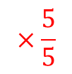
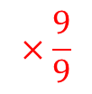
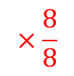
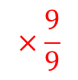
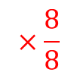
7)
$$\frac{2}{3}$$
10)
$$\frac{2}{6}$$
$$×\frac{8}{8}$$
$$×\frac{9}{9}$$
$$\frac{16}{24}$$
$$\frac{18}{54}$$
8)
$$\frac{2}{3}$$
11)
$$\frac{6}{7}$$
$$×\frac{9}{9}$$
$$×\frac{5}{5}$$
$$\frac{18}{27}$$
$$\frac{30}{35}$$
9)
$$\frac{2}{6}$$
12)
$$\frac{6}{7}$$
$$×\frac{8}{8}$$
$$×\frac{8}{8}$$
$$\frac{16}{48}$$
$$\frac{48}{56}$$

